Slide 1

Cyber Crime & Ethical Hacking makes the Internet Association difficult
Amit Kumar Jaiswal

Slide 2
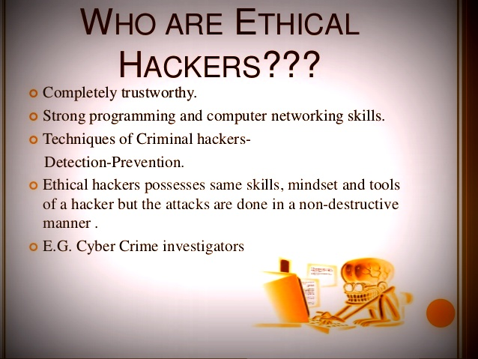

Slide 3
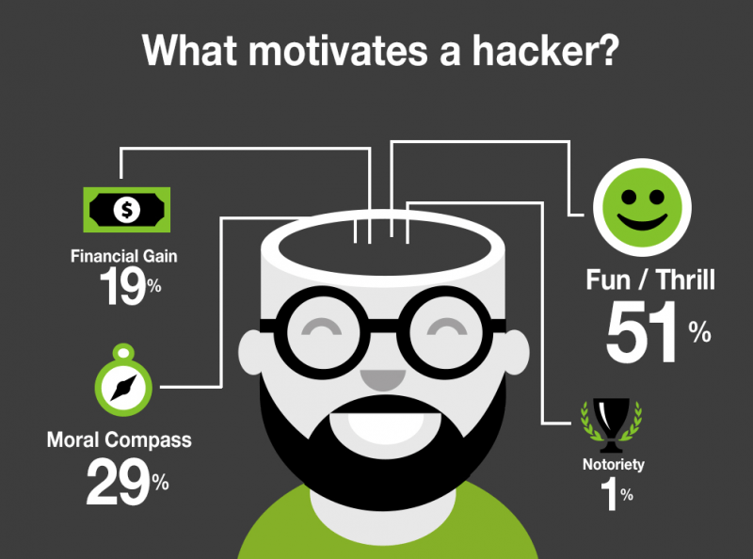

Slide 4
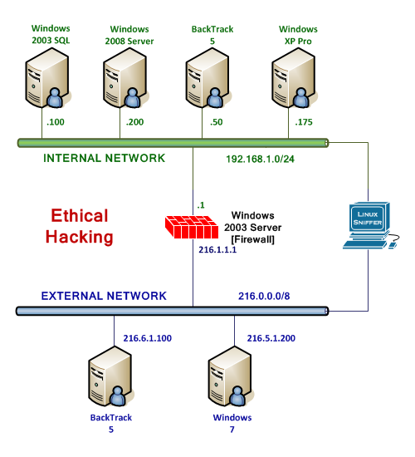

Slide 5
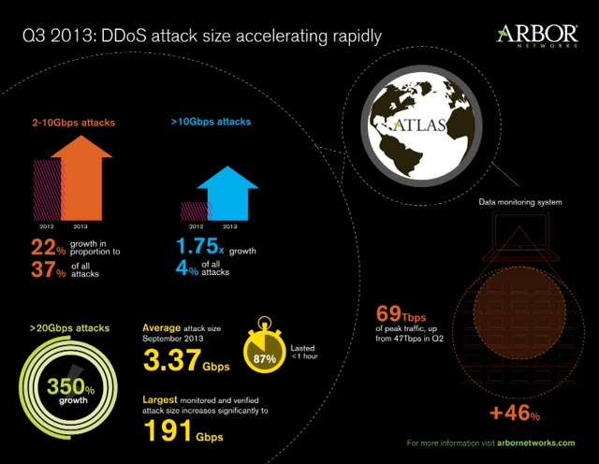

Slide 6
