Slide 1
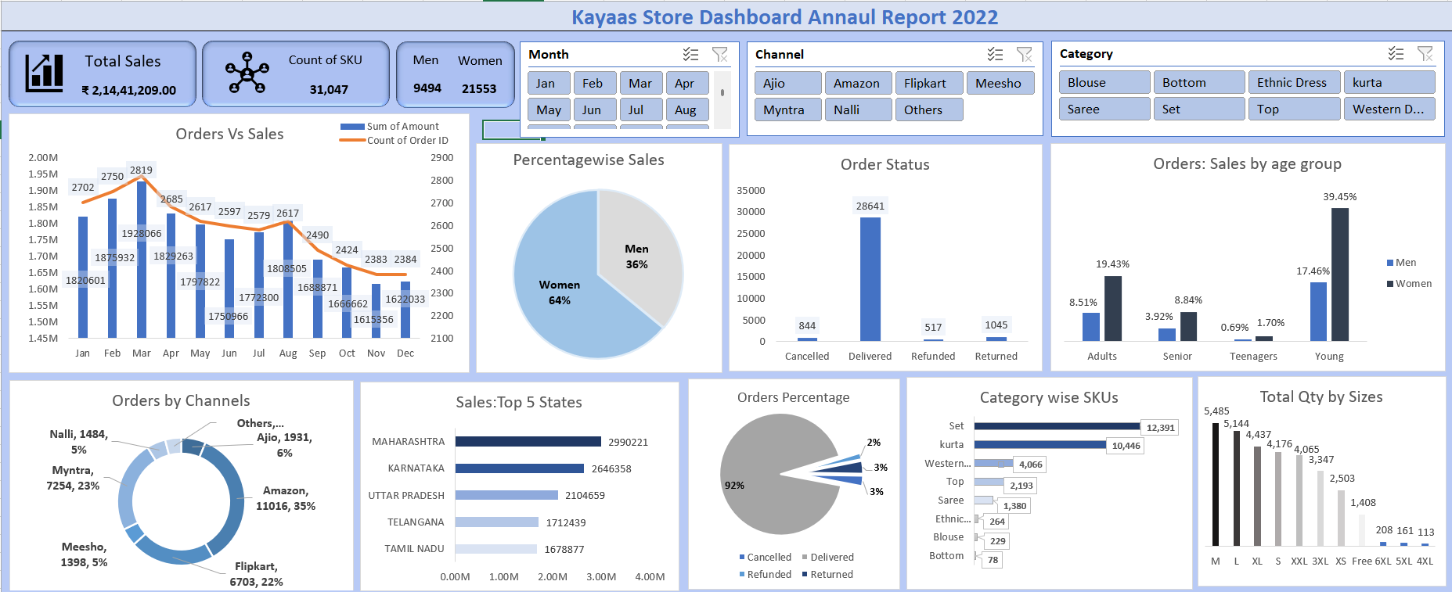
Kayaas Store Dashboard
Annual Report 2022
Sales • Orders • Customers • Channels • Categories • Geography
1

Slide 2
Project Overview
Interactive business-performance dashboard for 2022
• Provides a consolidated view of Kayaas Store sales and order performance.
• Combines KPI cards, trend analysis, customer segmentation, channel analysis and product analysis.
• Interactive slicers allow users to filter the report by Month, Channel and Category.
• Designed to convert transactional data into actionable business insights.
2

Slide 3
Key Performance Indicators
Headline values visible in the supplied dashboard
TOTAL SALES
COUNT OF SKU
MEN
WOMEN
₹2,14,41,209
31,047
9,494
21,553
• Women account for the larger visible customer/order share.
• KPI cards provide an immediate executive-level view before detailed analysis.
3

Slide 4
Sales Trend & Order Status
Monthly performance and fulfillment outcomes
• Orders vs Sales compares monthly sales amount with order count.
• March shows the highest visible order count at approximately 2,819.
• Delivered orders dominate the status view with 28,641 orders.
• Other visible statuses are Cancelled (844), Refunded (517) and Returned (1,045).
5

Slide 5
Customer & Channel Analysis
Who is buying and where orders are coming from
• Percentagewise Sales shows approximately 64% Women and 36% Men.
• Young customers form the largest visible age-group contribution, particularly Women.
• Amazon is the leading visible channel with 11,016 orders (35%).
• Myntra contributes 7,254 orders (23%) and Flipkart 6,703 orders (22%).
6

Slide 6
Geography & Product Analysis
Top states, category depth and size demand
• Maharashtra leads the displayed Top 5 states with approximately ₹2.99M sales.
• Karnataka follows at approximately ₹2.65M, then Uttar Pradesh at ₹2.10M.
• Set has the highest visible SKU count (12,391), followed by Kurta (10,446).
• M size has the highest visible total quantity, followed by L and XL.
7

Slide 7
Interactive Filters
Slice the dashboard for focused analysis
MONTH
Jan • Feb • Mar • Apr • May • Jun • Jul • Aug • Sep • Oct • Nov • Dec
CHANNEL
Ajio • Amazon • Flipkart • Meesho • Myntra • Nalli • Others
CATEGORY
Blouse • Bottom • Ethnic Dress • Kurta • Saree • Set • Top • Western Dress
8

Slide 8
Dashboard at a Glance
Full dashboard view
4

Slide 9
Key Business Insights
Observations from the dashboard snapshot
• Women are the dominant visible customer segment.
• Amazon, Myntra and Flipkart together represent the major visible order channels.
• A very high share of orders is delivered, indicating strong fulfillment performance.
• Young customers are the strongest visible age group.
• Maharashtra is the strongest state among the displayed Top 5.
• Set and Kurta dominate visible SKU counts, while "M“ size is the strongest visible size by quantity.
9

Slide 10
Conclusion
• It connects sales, orders, customers, channels, geography and product demand in one report.
• The insights can support decisions around channel strategy, inventory, customer targeting and operational performance.
Thank You
11

Slide 14
Recommended Next Steps
How the dashboard can be extended
• Add profit and profit-margin KPIs to move beyond sales-only reporting.
• Track return rate, cancellation rate and refund rate as dedicated KPIs.
• Add year-over-year and month-over-month growth measures.
• Create drill-through pages for product, channel and state-level investigation.
• Add customer retention and repeat-purchase analysis.
• Add geographic maps and top/bottom product performance views.
• The dashboard provides a single interactive view of Kayaas Store's 2022 performance.
10

