Slide 1

BABU BANARASI DAS UNIVERSITY · DEPARTMENT OF CSE
REAL-TIME CONCURRENT IPL MEGA AUCTION SYSTEM
High-throughput sub-second bidding with pessimistic locking and distributed invariant verification.
TECH STACK
Java 17 · Spring Boot 3 · React 18 · STOMP / SockJS · MySQL 8 / JPA
TEAM · SYNTAX TERROR
Srijan Srivastava - 1240440037
Amit Kumar Rajput - 1240440008
Anshika Pandey - 1240440012
Akhilesh Sharma - 1240440006
Suryansh Pandey - 1240440039
B.Tech CSE (IoT & Blockchain) · 5th Semester / 3rd Year
Academic Year 2025–2026
REAL-TIME IPL AUCTION · PROJECT

Slide 2
01 · PROBLEM & SOLUTION
Why Live Auction Concurrency Matters
Protect financial state while many franchises bid at nearly the same moment.
ENGINEERING CHALLENGES
SYSTEM RESPONSE
Competing bids can arrive within single-digit milliseconds.
Lost updates, duplicate increments and stale state.
Purse must never become negative.
Squad ≤ 25 players; overseas quota ≤ 8.
Pessimistic row locking serializes critical updates.
ACID transactions protect financial invariants.
STOMP / SockJS synchronizes active terminals.
JWT + RBAC secures franchise and admin actions.
LIVE AUCTION INTERFACE
< 50 MS TARGET SYNC
10 CONCURRENT TEAMS
Deterministic bidding + synchronized state
across franchise terminals.
₹100 CR PURSE CAP
0 PURSE DEFICIT
02
02

Slide 3
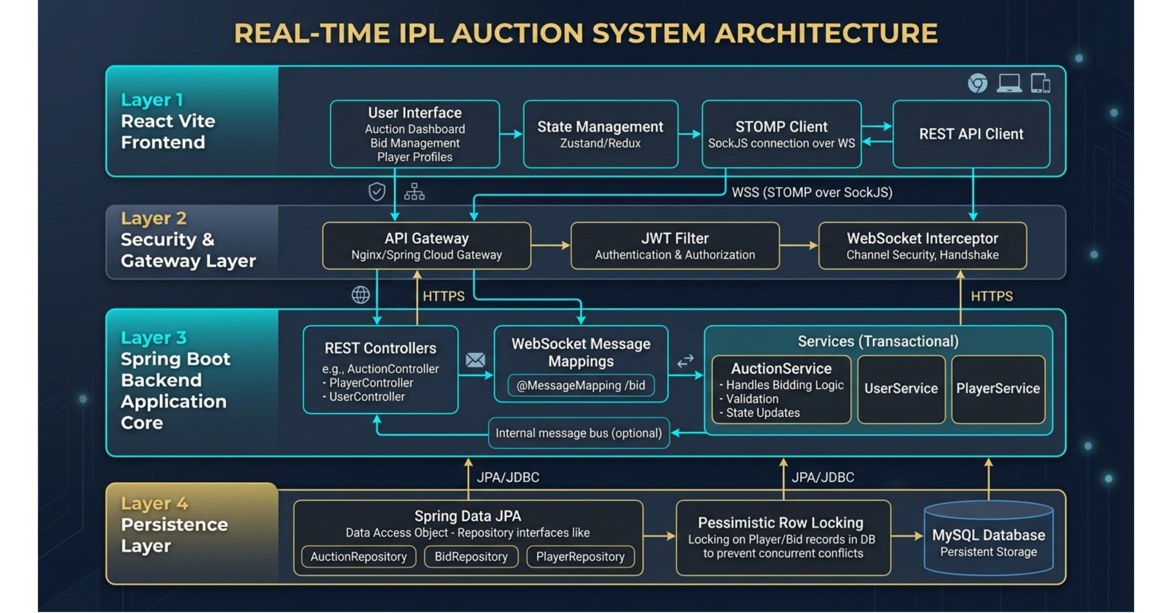
Presentation → Application → Real-Time → Data · Four-layer auction architecture

Slide 4
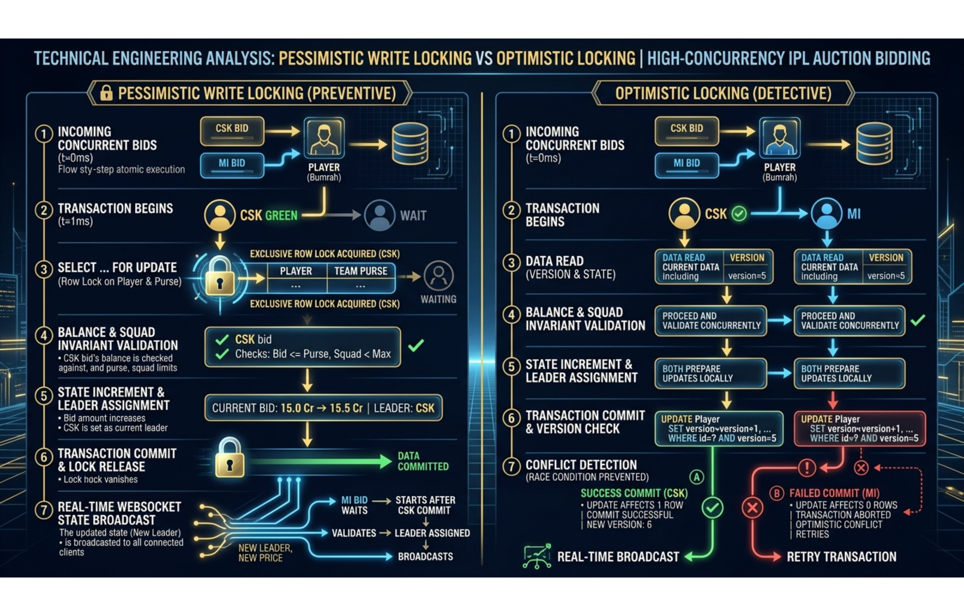
03 · CORE ENGINE
PESSIMISTIC LOCKING
SELECT ... FOR UPDATE
High contention makes explicit row locks safer than repeated retries.
1 Concurrent bids → row lock
2 Validate → update + commit
3 Broadcast the committed state
4 Execution completes
Concurrent Bidding: Why Pessimistic Locking Wins
Pessimistic
Optimistic
Safe resolution under contention.
Explicit race prevention.
Consistency before broadcast.
Reads first, detects conflicts.
Retries get expensive.
Rollback storms delay bidding.
The database serializes the critical Player + Team Purse update before the bid changes state.
04

Slide 5
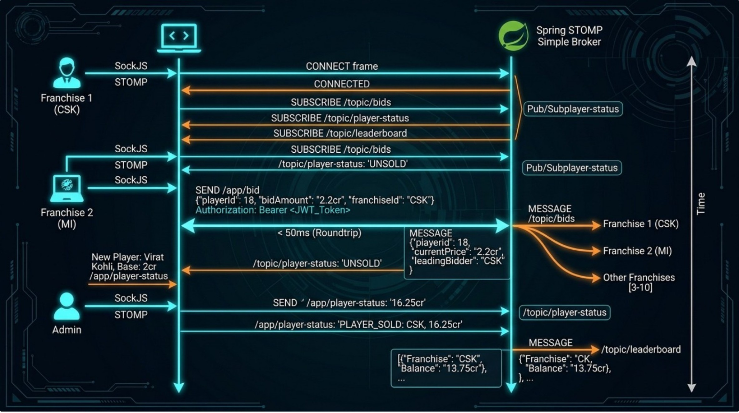
04 · REAL-TIME + SECURITY
One Live State, Secured End-to-End
WebSocket messaging keeps terminals synchronized while JWT protects every connection.
Team → WebSocket → STOMP → Spring Boot → Auction Engine → Broadcast
SECURITY LAYER
JWT carries franchise ID, privileges and expiry.
JWT is validated on WebSocket CONNECT.
ROLE_ADMIN controls lifecycle transitions.
ROLE_FRANCHISE is scoped to its team purse.
Bid, leader and timer updates broadcast.
SOLD / UNSOLD transitions are pushed.
Purse balances stay synchronized.
JWT + RBAC
STATELESS AUTH
STOMP PUB/SUB
05

Slide 6
05 · DATA INTEGRITY
Database Model, State Machine & Edge Cases
Relational state and business rules constrain every accepted bid.
DATABASE MODEL
AUCTION STATE MACHINE
Team | purse · spending · overseasCount · squadSize
Player | basePrice · currentBid · status · currentLeaderId
Bid History | amount · timestamp · franchise ID · audit
AVAILABLE → LIVE → SOLD
↓ UNSOLD
State transitions are controlled by the auction lifecycle.
VALIDATION RULES
Purse overdraft → reject.
Current leader self-bump → reject.
Squad ceiling 25; overseas ceiling 8.
Timer expired or not LIVE → reject.
Foreign key keeps Player.currentLeaderId linked to Team.id.
06

Slide 7
06 · VALIDATION & DELIVERY
Testing, Team Ownership & Demo Plan
Evidence, ownership and a short live path for the defense.
TESTING & DELIVERY
TEAM OWNERSHIP
LIVE DEMO
JUnit 5 integration tests
Mockito mock suites
Automated Postman collection
OpenAPI 3 / Swagger UI
Balance and timer-expiry checks
Srijan — Core Backend
Amit — Security & Auth
Akhilesh — Frontend & UI Lead
Anshika — Database & Bidding Engine
Suryansh — QA, Testing & Docs
1
Admin starts auction
2
Open CSK + MI terminals
3
Fire competing bids
4
Hammer → verify purse + roster
ROADMAP
Redis Pub/Sub · Redisson Locks · AI Proxy Bidding
07

Slide 8
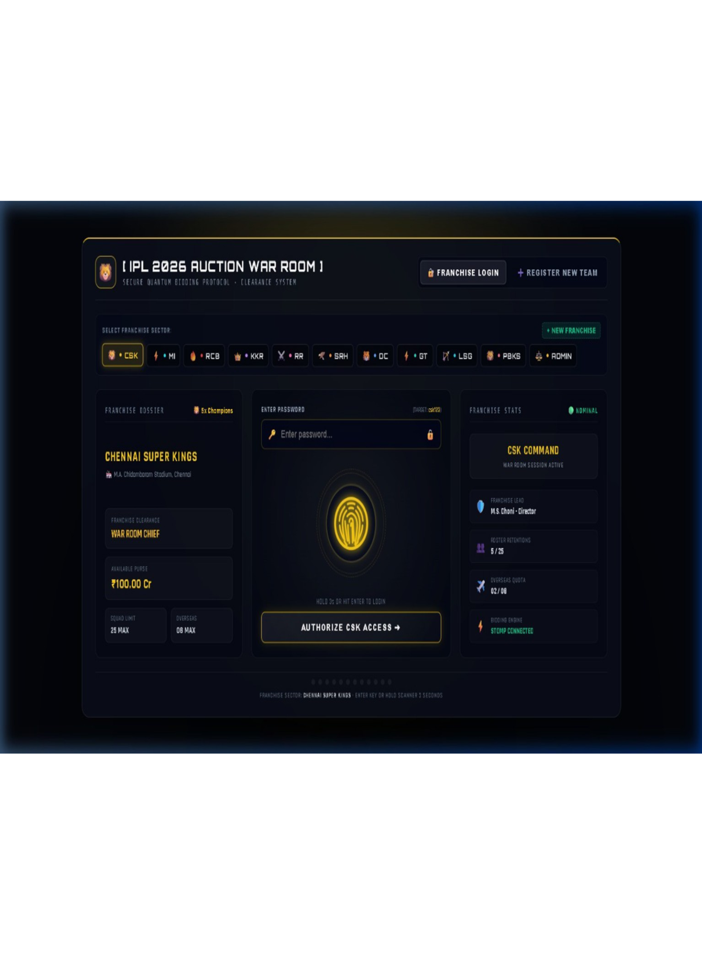
THANK YOU
Questions & Technical Discussion
Deterministic concurrency keeps live bidding consistent, secure and synchronized.
< 50ms
0 Deficit
10 Teams
STOMP synchronization
pessimistic row lock
concurrent war rooms
Achievements: deterministic concurrency · JWT + RBAC · synchronized auction state

