Slide 1
BABU BANARASI DAS UNIVERSITY | MINOR PROJECT
REAL-TIME IPL MEGA AUCTION SYSTEM
High-Concurrency Bidding Engine | Pessimistic Locking | STOMP WebSockets | Spring Boot 3 & React
TEAM: SYNTAX TERROR
MEMBER 1
Project Lead &
Core Backend
MEMBER 2
Security & Auth
Specialist (JWT)
MEMBER 3
Database Schema &
Concurrency Lead
MEMBER 4
Frontend UI &
CSS Design Lead
MEMBER 5
WebSockets &
QA Testing Lead

Slide 2
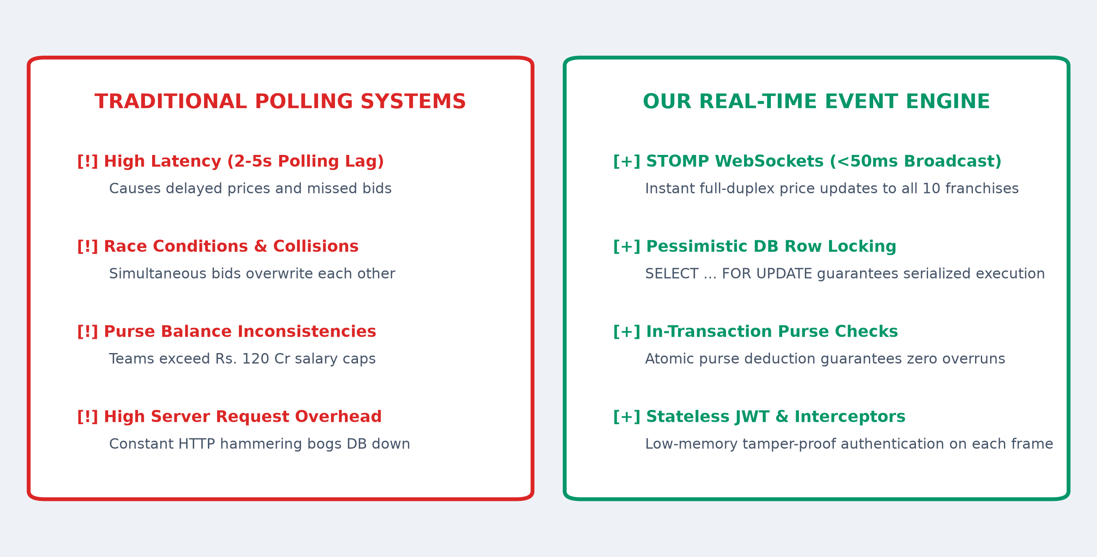
IDEA & SOLUTION
2/6
Proposed Solution & Real-Time Engine Architecture
INNOVATION & CORE USP
✔ Event-Driven STOMP Sockets
Sub-50ms latency replaces traditional 2-5s HTTP polling overhead.
✔ Pessimistic DB Row Locking
SELECT ... FOR UPDATE eliminates millisecond bidding race conditions.
✔ Atomic Purse Balance Guard
Strict in-transaction checks mathematically prevent Rs 120 Cr cap breaches.
✔ Stateless JWT Security
Zero session memory overhead; tamper-proof HMAC-SHA256 signature.
Team: Syntax Terror | Babu Banarasi Das University | Minor Project Presentation

Slide 3
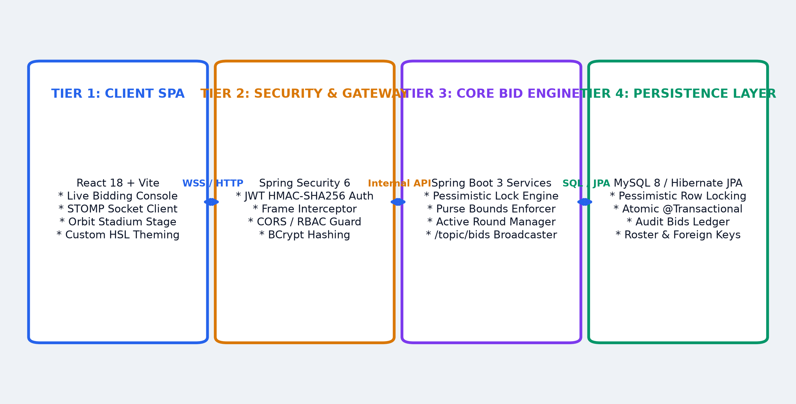
TECHNICAL APPROACH
3/6
Technical Approach & 4-Tier System Architecture
TECHNOLOGY STACK & METHODOLOGY
▶ Backend Core
Java 17 LTS, Spring Boot 3.2, Spring MVC, HikariCP pool, Maven.
▶ Frontend SPA
React 18 + Vite, custom HSL styling, Cyber Stadium UI, Lucide icons.
▶ Real-Time Messaging
SockJS & STOMP Protocol, SimpMessagingTemplate (/topic/bids).
▶ Persistence & Security
MySQL 8 / In-Memory H2, Spring Security 6 (JWT + BCrypt), JPA ORM.
Team: Syntax Terror | Babu Banarasi Das University | Minor Project Presentation

Slide 4
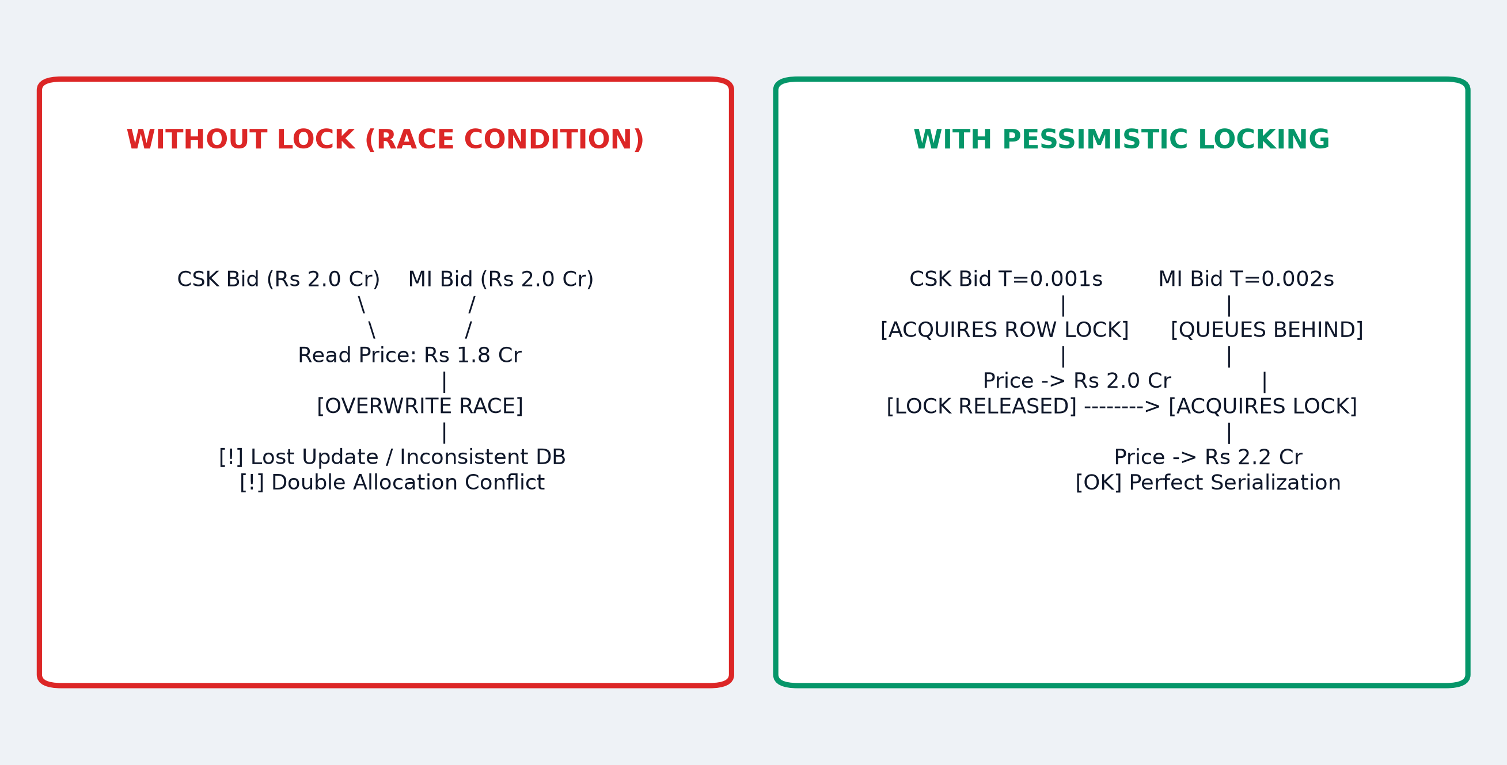
FEASIBILITY & VIABILITY
4/6
Feasibility, Concurrency Risks & Engineering Strategies
RISK MITIGATION MATRIX
🛡 Risk 1: Millisecond Collisions
Mitigation: Pessimistic Row Locking forces incoming bids into a serialized queue without retry storms.
🛡 Risk 2: Network Dropouts
Mitigation: SockJS auto-reconnects with exponential backoff and re-fetches latest auction state.
🛡 Risk 3: Purse Balance Overdraw
Mitigation: Strict in-transaction purse decrement and database constraints ensure zero overruns.
🛡 Risk 4: Token Impersonation
Mitigation: Cryptographic HMAC-SHA256 tokens validated on both HTTP & STOMP frames.
Team: Syntax Terror | Babu Banarasi Das University | Minor Project Presentation

Slide 5
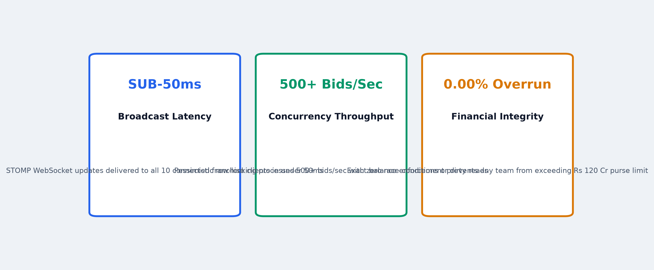
IMPACT & BENEFITS
5/6
System Performance Benchmarks & Measurable Impact
OPERATIONAL & DOMAIN IMPACT
★ 100% Financial Integrity
Eliminates multi-crore reconciliation errors and salary cap disputes in high-stakes auctions.
★ Fair & Real-Time Bidding
Sub-50ms synchronized price broadcast ensures equal bidding opportunities for all franchises.
★ Automated Compliance
Dynamically enforces squad capacity (18-25 players) and overseas quotas (max 8) automatically.
★ Containerized Turnkey Deploy
Production-ready Docker Compose stack enables one-command cloud deployment.
Team: Syntax Terror | Babu Banarasi Das University | Minor Project Presentation

Slide 6
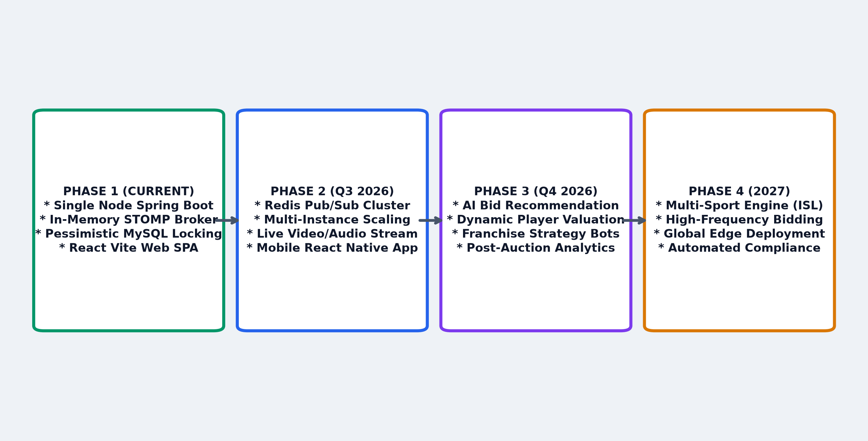
RESEARCH & FUTURE SCOPE
6/6
Research References, Standards & Future Roadmap
RESEARCH & PROTOCOL STANDARDS
📖 RFC 6455 & STOMP 1.2 Protocol
Standards for full-duplex client-server TCP communication over WebSockets.
📖 RFC 7519 (JSON Web Tokens)
Stateless, cryptographic HMAC-SHA256 authorization standards.
📖 ANSI/ISO SQL Transaction Isolation
Concurrency control and Pessimistic Row Locking (SELECT ... FOR UPDATE).
📖 Spring Boot & React Ecosystems
Spring Security 6 architecture, Hibernate 6 ORM, and React 18 Concurrent Mode.
READY FOR LIVE SYSTEM DEMONSTRATION & Q&A
Team: Syntax Terror | Babu Banarasi Das University | Minor Project Presentation

