Slide 1


URBAN
GUARD
From Team : ELECTROSTORM

Slide 2



PROBLEM STATEMENT
Lack of Sustainable Control of Street Lights
Limited CCTV Surveillance Coverage
Inaccurate Weather Data from Satellites:

Slide 3
OUR SOLUTION
Automatic Street Light Management:
Utilizes embedded services to access and control street lights, allowing for intensity adjustments based on traffic conditions. Along with remote access to every node using IoT and Cloud Services.
Accurate Weather Monitoring: Deploy sensors for humidity, rain, and temperature, integrated with an IoT server, to provide precise local weather data, aiding in optimizing delivery schedules.
Enhanced CCTV Surveillance: Host live camera feeds for improved security coverage and analysis.

Slide 4
PRODUCT OUTCOME
Energy Efficiency: Automated lighting reduces energy consumption by up to 25% per street light.
Enhanced Public Safety: Real-time CCTV surveillance reduces crime rates by 20-25%.
Seamless Monitoring: Centralized IoT server ensures real-time data and system control.
Revenue Generation: Monetized weather data can generate up to ₹50,000/month.
Cost Savings: Streetlight automation lowers operational costs by 30-50% annually.

Slide 5

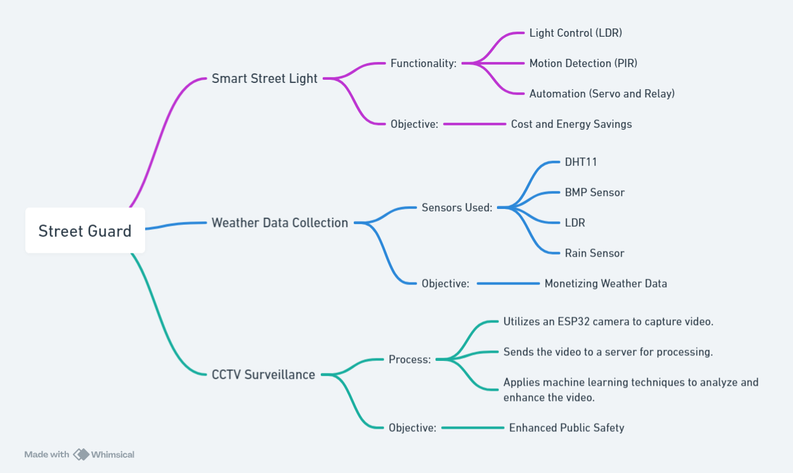
HOW IT WILL WORK
URBAN GUARD

Slide 6
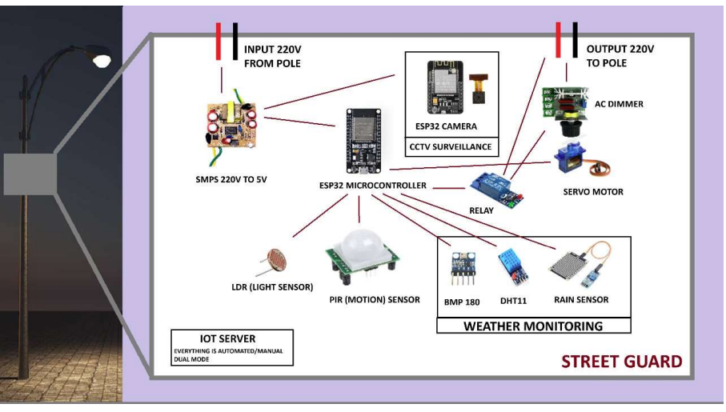

METHDOLOGY
URBAN GUARD

Slide 7
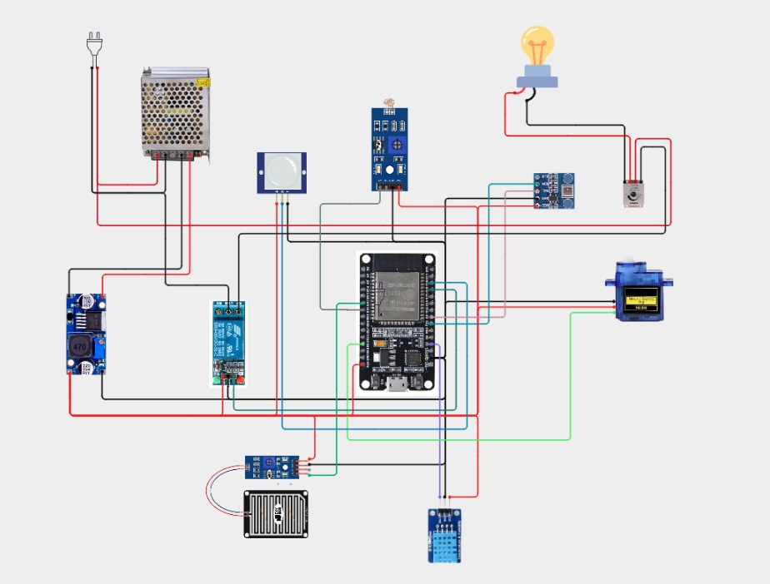
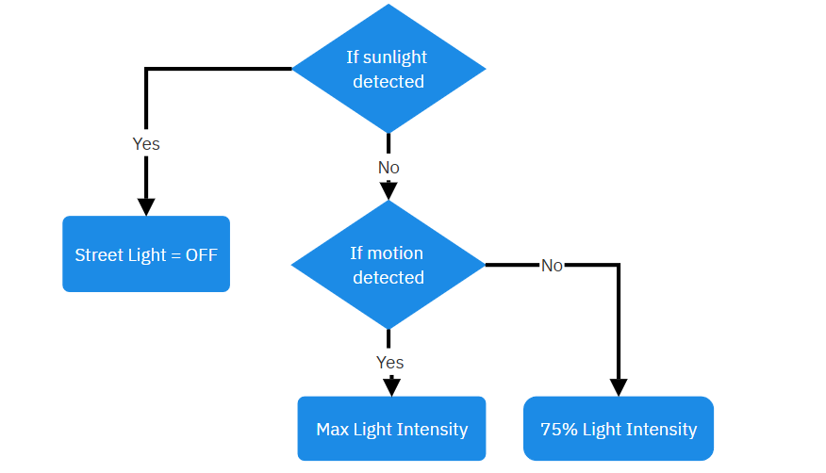
CIRCUIT DIAGRAM & FLOWCHART

Slide 8




RESULT
Overall Impact: Enhances energy efficiency, monetizes real-time weather data, and improves urban safety using AI and IoT technologies.
CCTV Surveillance: Processes video in <1 second, achieves 90% precision and 85% recall for anomaly detection, and may reduce crime by 20-25%.
Smart Street Light: Reduces energy consumption by 25%, activates lights in 500 ms, and cuts operational costs by 30-50% annually.
Weather Data Collection: Achieves data accuracy of ±1°C (temperature) and ±5% (humidity), generates up to ₹50,000/month, and updates every 10 seconds.

Slide 9
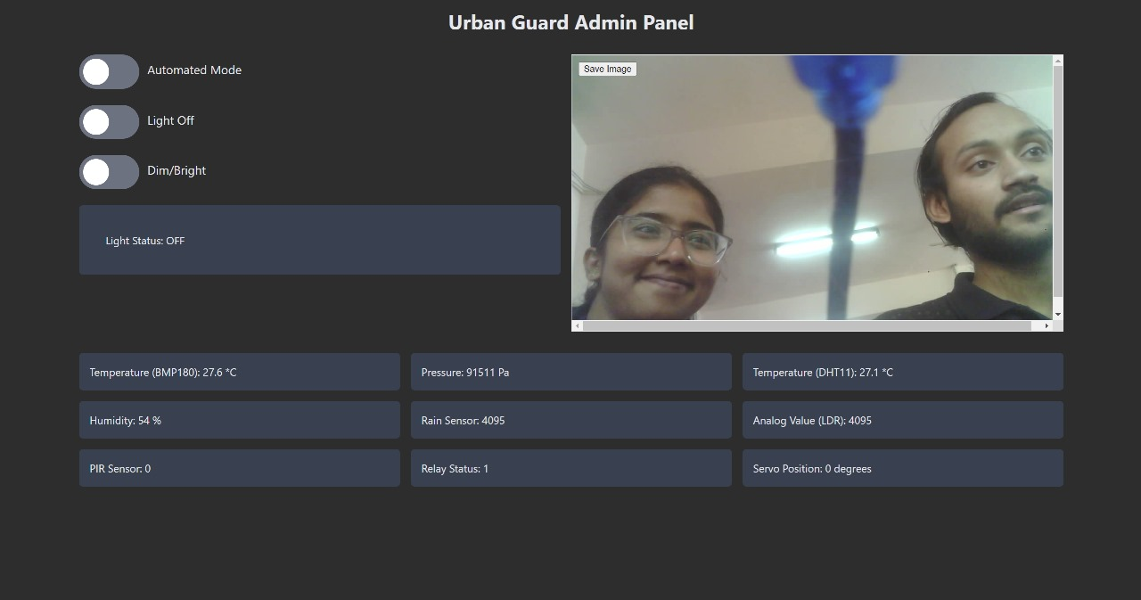

Slide 10


TECHNOLOGY USED
Technologies Used:
ESP32 Microcontroller: Core control and data processing.
ESP32 Camera: Captures and transmits real-time video.
Sensors:
LDR: Light level detection.
PIR: Motion detection.
BMP180, DHT11, Rain Sensor: Weather monitoring.
Relay & AC Dimmer: Controls and adjusts streetlights.
Servo Motor: Automates camera or light adjustments.
SMPS: Converts 220V AC to 5V DC.
IoT Server: Dual-mode control and data storage.

Slide 11
UNIQUE SELLING PROPOSITION (USP)
Energy and Cost Savings: Optimizes energy usage and reduces operational costs by up to 50% through automation.
Integrated Smart Solutions: Combines smart street lighting, weather data collection, and CCTV surveillance in one unified system.
Real-Time Data: Provides continuous, real-time weather data and video surveillance for enhanced public safety.

Slide 12

MARKET ANALYSIS
Cost and Energy Savings: Automated street lights save up to 30% energy by dimming during low-traffic hours.
Monetizing Weather Data: Sell real-time weather data to companies like Zomato for optimized delivery routes and business growth.
Enhanced Public Safety: Provide CCTV data to police for continuous monitoring and crime reduction.

Slide 13
REFERENCES
"Energy-Efficient Lighting Systems in Smart Cities"
Journal: IEEE Access
DOI: 10.1109/ACCESS.2017.2648860
"Cost-Effective Strategies for Energy-Saving in Urban Street Lighting"
Journal: Renewable and Sustainable Energy Reviews
DOI: 10.1016/j.rser.2016.11.025
"IoT-Based Smart Street Lighting Systems: A Review and Case Study"
Journal: Sensors (MDPI)
DOI: 10.3390/s18113815
"Impacts of Light Pollution and Energy Overconsumption in Urban Areas"
Journal: Environmental Research Letters
DOI: 10.1088/1748-9326/abc123
"Smart Street Lighting: Case Studies from European Smart Cities"
Journal: Energy and Buildings
DOI: 10.1016/j.enbuild.2019.04.054
"Solar-Powered Smart Street Lighting Systems: Design and Analysis"
Journal: Energy Procedia
DOI: 10.1016/j.egypro.2015.12.123

Slide 14

THANK YOU

