Slide 1


STREET
GUARD
From Team : ELECTROSTORM

Slide 2



PROBLEM STATEMENT
Lack of Remote Access for Street Lights
Limited CCTV Surveillance Coverage
Inaccurate Weather Data from Satellites:

Slide 3
OUR SOLUTION
Enhanced CCTV Surveillance: Host live camera feeds and employ machine learning to process images for improved security coverage and analysis.
Accurate Weather Monitoring: Deploy sensors for humidity, rain, and temperature, integrated with an IoT server, to provide precise local weather data, aiding in optimizing delivery schedules.
Remote Street Light Management: Utilize IoT and cloud services to remotely access and control street lights, allowing for intensity adjustments based on traffic conditions.

Slide 4

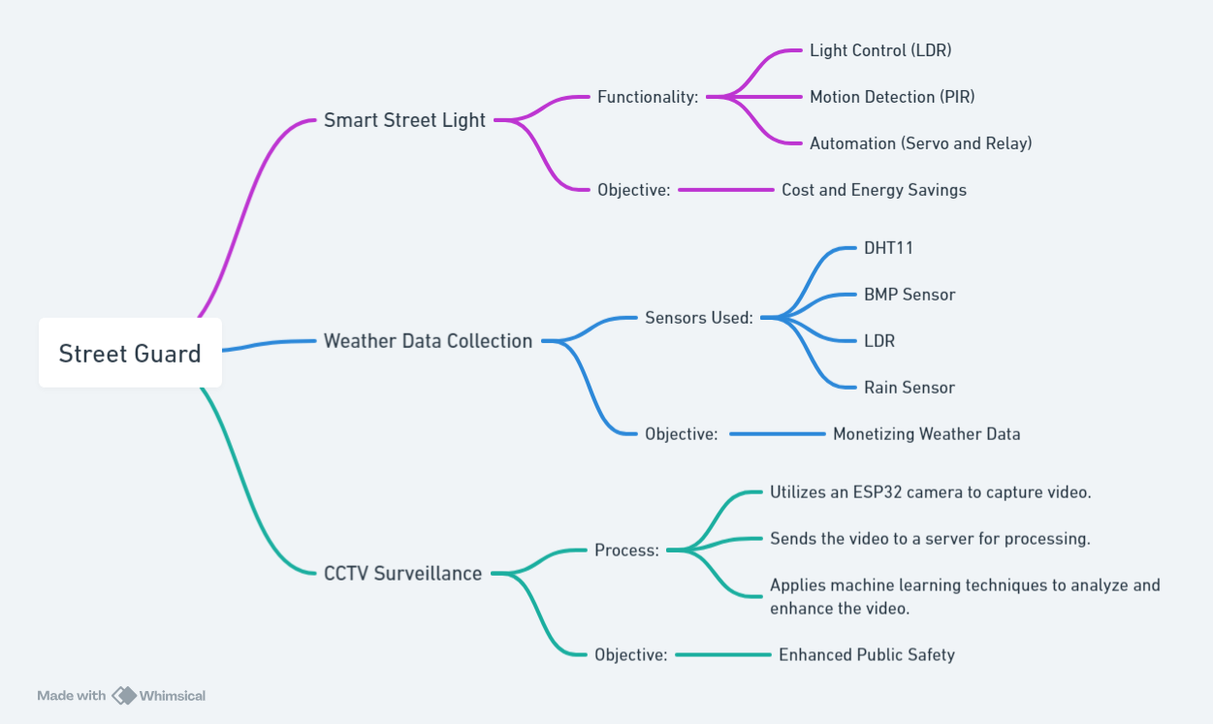
HOW IT WILL WORK

Slide 5

MARKET ANALYSIS
Cost and Energy Savings: Automated street lights save up to 30% energy by dimming during low-traffic hours.
Monetizing Weather Data: Sell real-time weather data to companies like Zomato for optimized delivery routes and business growth.
Enhanced Public Safety: Provide CCTV data to police for continuous monitoring and crime reduction.

