Slide 1
Visitor Design Pattern
By Laxmi Nagda, Mohammad Yasir, Varinder Sahota

Slide 2
Agenda
Overview of Visitor Pattern
Code Example of Visitor Pattern
Use Case
Java API Implementation
Consequences of Visitor Pattern
Design Patterns Links
Notes:
2

Slide 3
Overview of Visitor Pattern
Visitor pattern is used when we have to perform an operation on a group of similar kind of Objects. With the help of visitor pattern, we can move the operational logic from the objects to another class.
Notes:
3

Slide 4
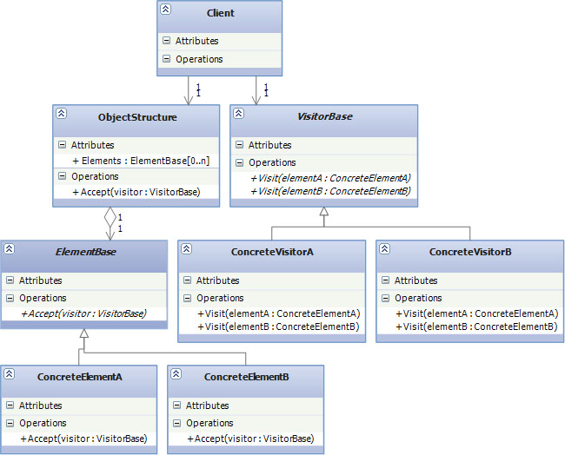
Overview of Visitor Pattern
Notes:
4

Slide 5
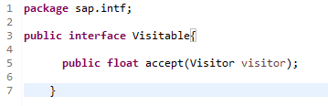
Code Example of Visitor Pattern

Slide 6
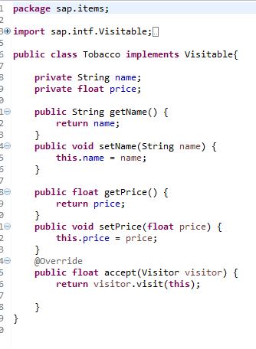
Code Example of Visitor Pattern

Slide 7
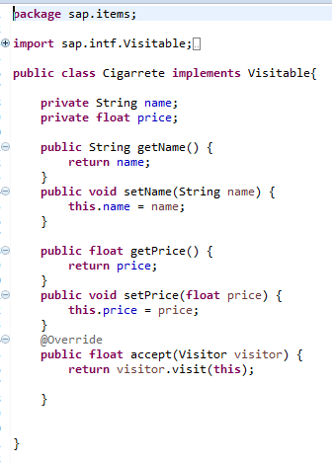
Code Example of Visitor Pattern

Slide 8
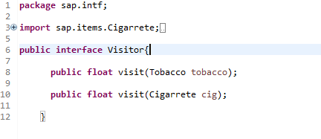
Code Example of Visitor Pattern

Slide 9
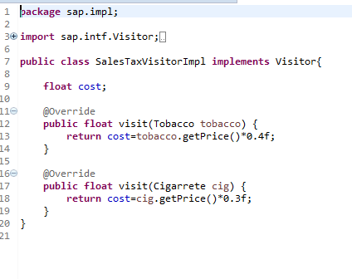
Code Example of Visitor Pattern

Slide 10
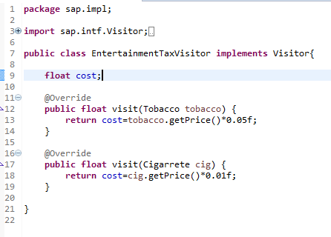
Code Example of Visitor Pattern

Slide 11
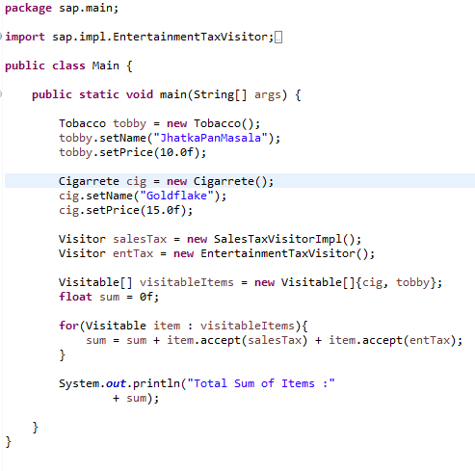
Code Example of Visitor Pattern

Slide 12

Code Example of Visitor Pattern

Slide 13
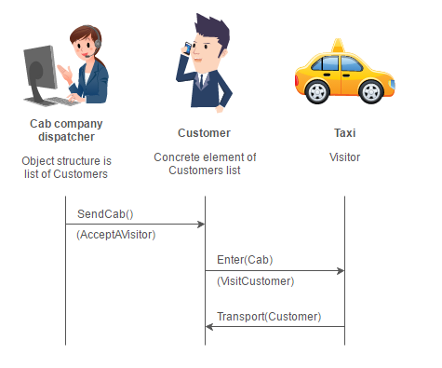
Use Case

Slide 14
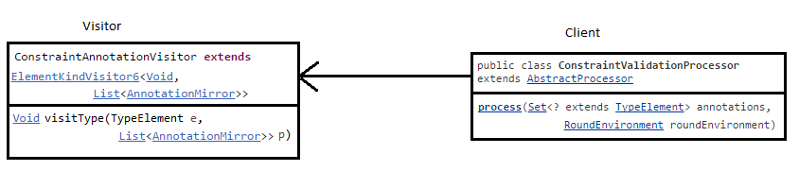
Usage in Java API
Visitor pattern is used in Hibernate API while it process Annotations and other elements.
Hibernate Implement “TypeElement” interface provided by java for their Annotations.
This interface has a method “accept(ElementVisitor e)”
Following diagram shows the implementation
In the figure given below: ElementKindVisitor6 is the class provided by java API
which implements ElementVisitor.

Slide 15
Consequences of Visitor Pattern
If a new class is added to the Composite all Visitor classes are affected.
The indirect recursion that involves Accept and the Visit methods
is more complex than the direct recursion in the natural object-oriented solution

Slide 16
Design Pattern Links
https://sourcemaking.com/design_patterns/visitor/java/1
https://dzone.com/articles/design-patterns-visitor
https://www.tutorialspoint.com/design_pattern/visitor_pattern.htm
http://www.journaldev.com/1769/visitor-design-pattern-java

Slide 17
Questions

Slide 18
Thanks

