Slide 1
STRATEGY DESIGN PATTERN
-Rajat Gupta
Notes:
http://stackoverflow.com/questions/21455403/how-to-get-method-parameter-names-in-java-8-using-reflection

Slide 2
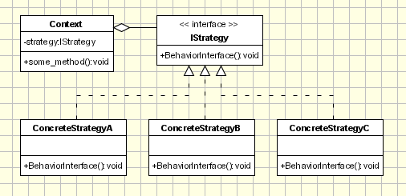
Motivation:
There are common situations when classes differ only in their behavior. For this cases is a good idea to isolate the algorithms in separate classes in order to have the ability to select different algorithms at runtime.
Intent:
Define a family of algorithms, encapsulate each one, and make them interchangeable. Strategy lets the algorithm vary independently from clients that use it.
Implementation:
Notes:
http://stackoverflow.com/questions/21455403/how-to-get-method-parameter-names-in-java-8-using-reflection

Slide 3
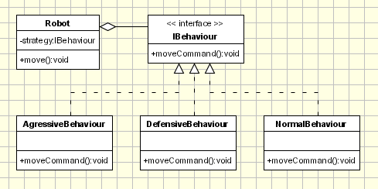
EXAMPLE
Notes:
http://stackoverflow.com/questions/21455403/how-to-get-method-parameter-names-in-java-8-using-reflection

Slide 4
CODE
Strategy:
public interface IBehaviour { public int moveCommand(); } Conctete Strategies: public class AgressiveBehaviour implements IBehaviour{ public int moveCommand() { System.out.println("\tAgressive Behaviour: if find another robot attack it"); return 1; } }
Notes:
http://stackoverflow.com/questions/21455403/how-to-get-method-parameter-names-in-java-8-using-reflection

Slide 5
public class DefensiveBehaviour implements IBehaviour{ public int moveCommand() { System.out.println("\tDefensive Behaviour: if find another robot run from it"); return -1; } } public class NormalBehaviour implements IBehaviour{ public int moveCommand() { System.out.println("\tNormal Behaviour: if find another robot ignore it"); return 0; } }
Notes:
http://stackoverflow.com/questions/21455403/how-to-get-method-parameter-names-in-java-8-using-reflection

Slide 6
public class Robot { IBehaviour behaviour; String name; public Robot(String name) { this.name = name; } public void setBehaviour(IBehaviour behaviour) { this.behaviour = behaviour; } public IBehaviour getBehaviour() { return behaviour; } public void move() { System.out.println(this.name + ": Based on current position" + "the behaviour object decide the next move:"); int command = behaviour.moveCommand(); // ... send the command to mechanisms System.out.println("\tThe result returned by behaviour object " + "is sent to the movement mechanisms " + " for the robot '" + this.name + "'"); } public String getName() { return name; } public void setName(String name) { this.name = name; } }
context class
(It keeps or gets context information such as position, close obstacles, etc, and passes necessary information to the Strategy class.)
Notes:
http://stackoverflow.com/questions/21455403/how-to-get-method-parameter-names-in-java-8-using-reflection

Slide 7
public class Main { public static void main(String[] args) { Robot r1 = new Robot("Big Robot"); Robot r2 = new Robot("George v.2.1"); Robot r3 = new Robot("R2"); r1.setBehaviour(new AgressiveBehaviour()); r2.setBehaviour(new DefensiveBehaviour()); r3.setBehaviour(new NormalBehaviour()); r1.move(); r2.move(); r3.move(); System.out.println("\r\nNew behaviours: " + "\r\n\t'Big Robot' gets really scared" + "\r\n\t, 'George v.2.1' becomes really mad because" + "it's always attacked by other robots" + "\r\n\t and R2 keeps its calm\r\n"); r1.setBehaviour(new DefensiveBehaviour()); r2.setBehaviour(new AgressiveBehaviour()); r1.move(); r2.move(); r3.move(); } }
Notes:
http://stackoverflow.com/questions/21455403/how-to-get-method-parameter-names-in-java-8-using-reflection

Slide 8
Limitation
The strategy design pattern splits the behavior (there are many behaviors) of a class from the class itself. This has some advantages, but the main draw back is that a client must understand how the Strategies differ. Since clients get exposed to implementation issues the strategy design pattern should be used only when the variation in behavior is relevant to them.

