Slide 1
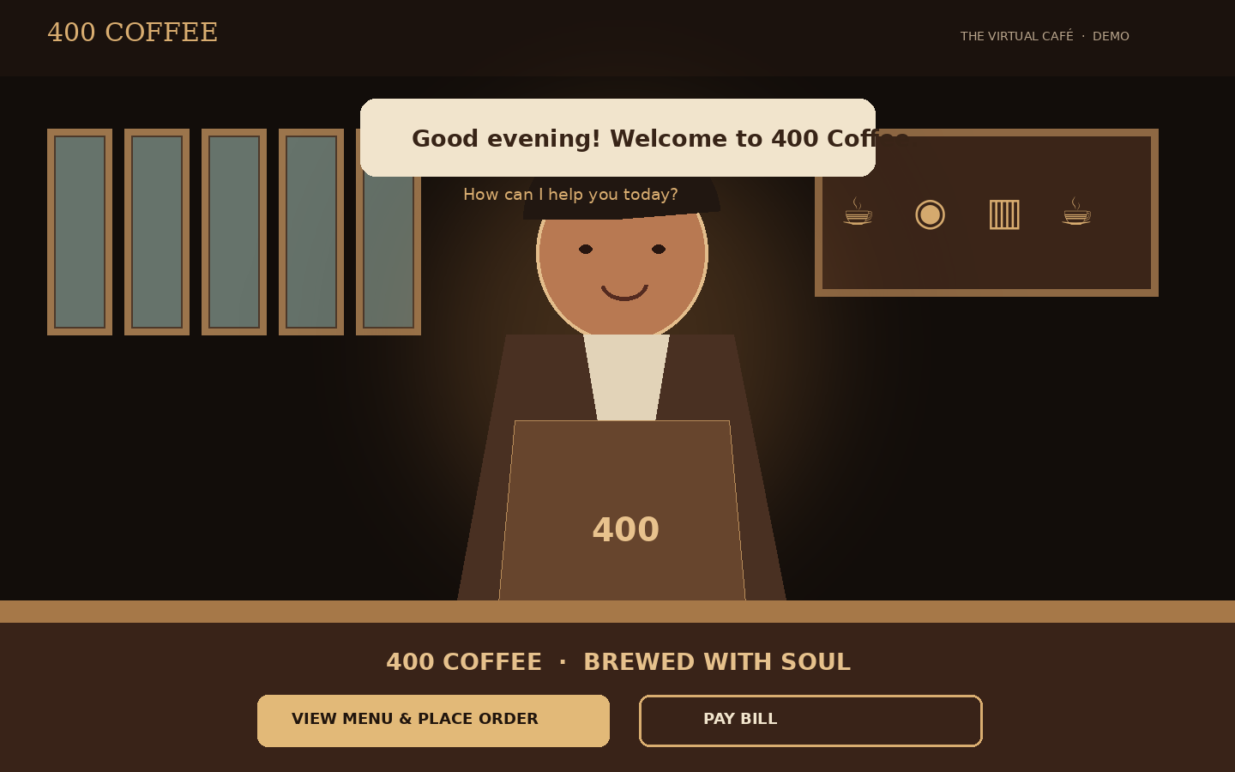
400 COFFEE / CLIENT EXPERIENCE PROPOSAL
A café experience
worth stepping into.
An immersive, guided customer journey — from the first welcome to the final order confirmation.
CUSTOMER EXPERIENCE • ORDERING • PAYMENTS • OPERATIONS HANDOFF
ILLUSTRATIVE CONCEPT UI · NOT A DEPLOYED PRODUCT SCREEN
01

Slide 2
400 COFFEE / THE OPPORTUNITY
Make ordering feel like entering the café.
A memorable front door can still be fast, clear and operationally reliable.
A better first impression
A guided choice
A dependable transaction
A cinematic arrival and a welcoming café manager bring the 400 Coffee brand to life.
Customers are led naturally into the diary menu or directly to bill payment.
The same journey connects to order acceptance, payment verification and customer updates.
ILLUSTRATIVE CONCEPT UI · NOT A DEPLOYED PRODUCT SCREEN
02

Slide 3
400 COFFEE / 01 · WELCOME
A cinematic welcome, not another QR landing page.
The manager greets the guest and offers two clear paths.
THE FIRST MOMENT
“Welcome to 400 Coffee. How can I help you today?”
• View menu & place order
• Pay bill
A skip-intro and reduced-motion option keeps the experience accessible.
ILLUSTRATIVE CONCEPT UI · NOT A DEPLOYED PRODUCT SCREEN
03

Slide 4
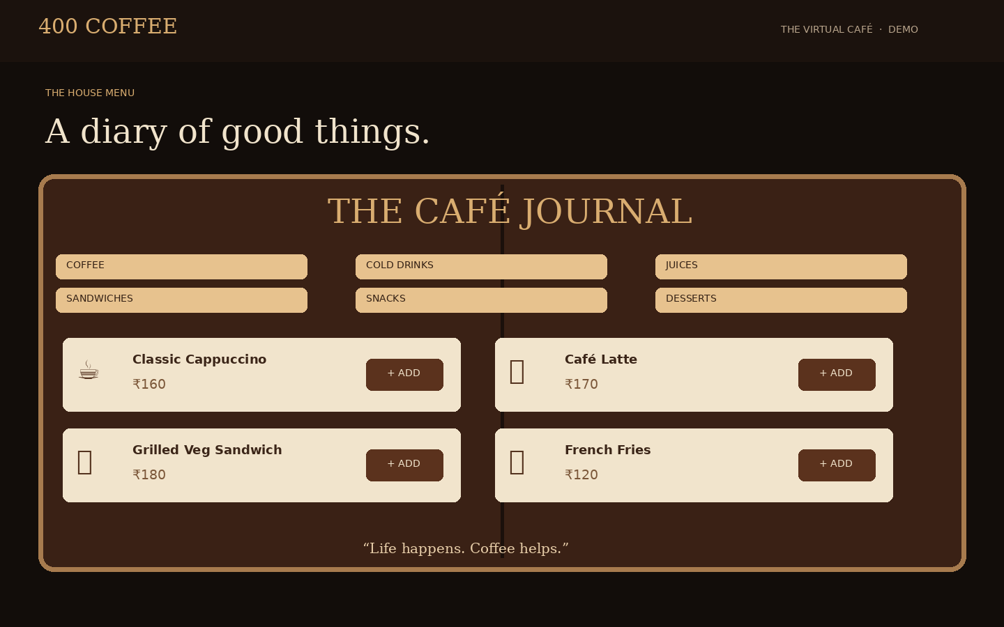
400 COFFEE / 02 · DISCOVER
A vintage café diary becomes the menu.
A tactile, editorial menu experience, powered by live café catalog data.
THE MENU EXPERIENCE
• Categories: coffee, hot and cold beverages, juices, sandwiches, snacks and desserts.
• Product photos, descriptions, availability and live prices.
• Category navigation and a persistent basket.
• Menu content remains configurable by the café.
ILLUSTRATIVE CONCEPT UI · NOT A DEPLOYED PRODUCT SCREEN
04

Slide 5
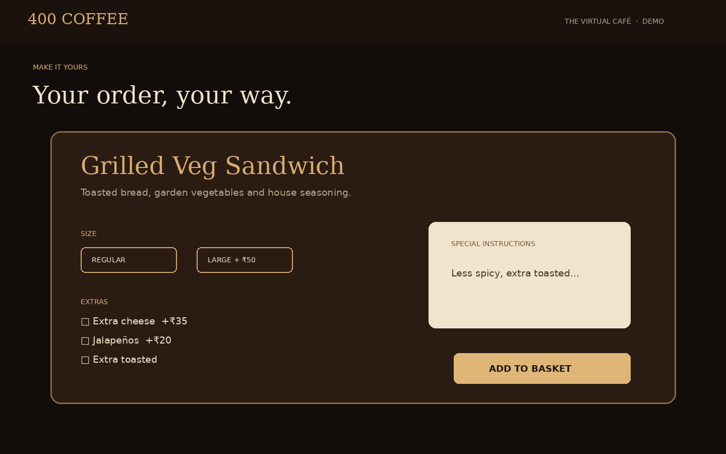
400 COFFEE / 03 · CUSTOMIZE
Every order can be made personal.
Variants, add-ons, quantity and preparation notes are reflected in the final order.
CUSTOMER CONTROL
• Choose size or variant where available.
• Add extras and see price changes.
• Enter preparation instructions such as less spicy or extra toasted.
• Server recalculates the final price before submission.
ILLUSTRATIVE CONCEPT UI · NOT A DEPLOYED PRODUCT SCREEN
05

Slide 6
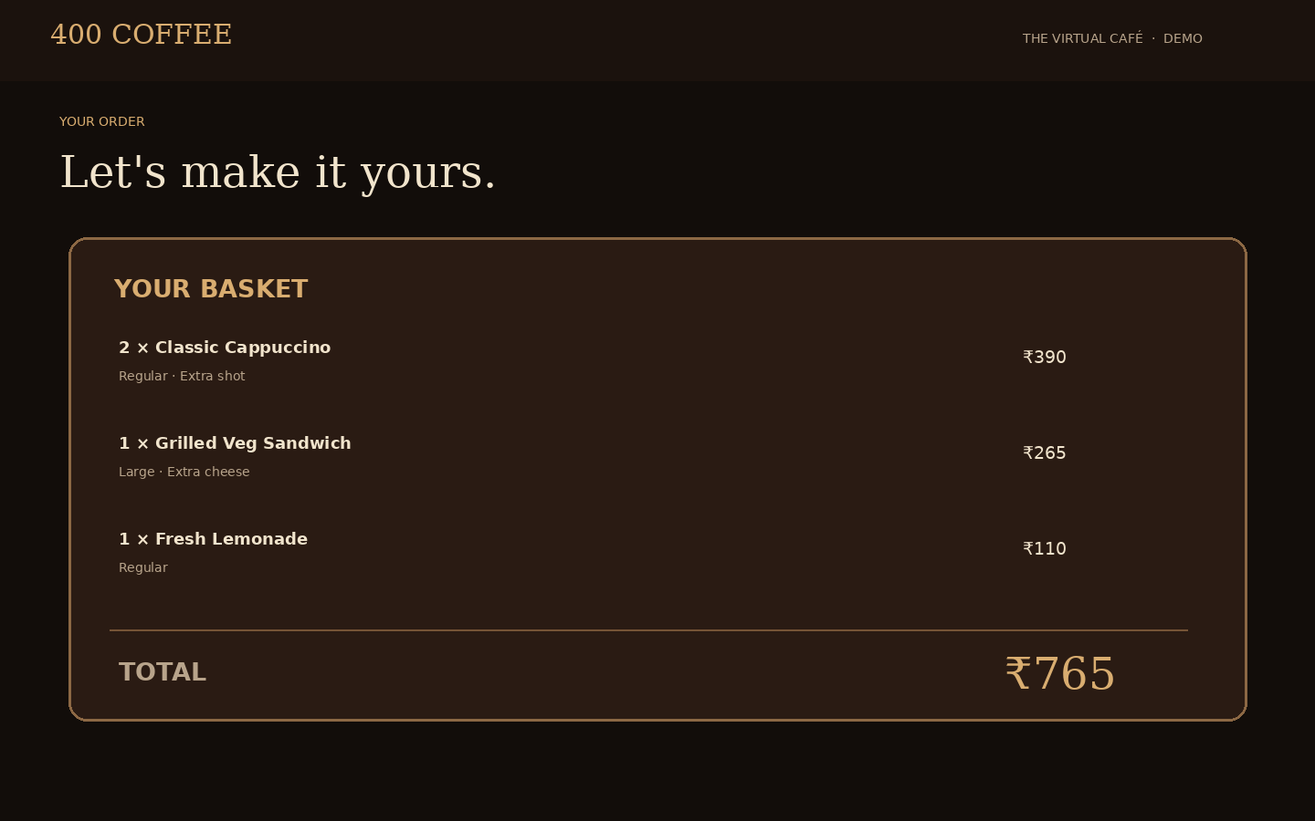
400 COFFEE / 04 · REVIEW
A clear basket. A confident confirmation.
Customers see exactly what they are ordering before submitting.
GUEST CHECKOUT
• Edit or remove basket items.
• Add name and mobile number.
• Review modifiers, notes, taxes/charges and total.
• Transactional WhatsApp consent is separate from marketing consent.
ILLUSTRATIVE CONCEPT UI · NOT A DEPLOYED PRODUCT SCREEN
06

Slide 7
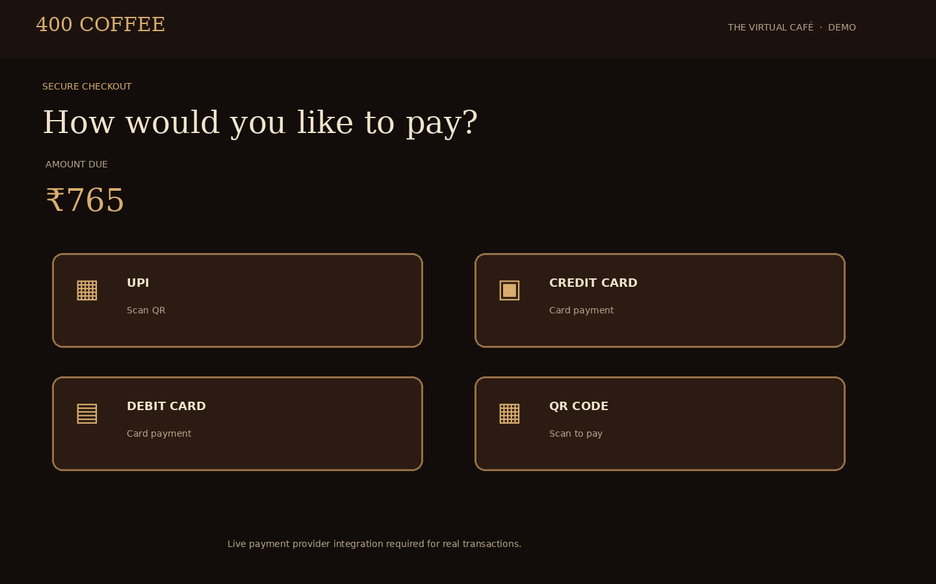
400 COFFEE / 05 · PAY
Pay now — or settle at the takeaway counter.
The customer chooses the payment path that suits the visit.
PAYMENT OPTIONS
• UPI and QR where configured.
• Credit and debit card through an approved provider.
• Pay at takeaway creates an unpaid order.
• Paid status appears only after server-side verification.
ILLUSTRATIVE CONCEPT UI · NOT A DEPLOYED PRODUCT SCREEN
07

Slide 8
400 COFFEE / 06 · OPERATIONS HANDOFF
A customer order becomes an operationally visible order.
The customer experience connects to the café's cashier-led workflow.
CUSTOMER
SHARED ORDER BACKEND
CAFÉ TEAM
Builds basket
Confirms details
Submits order
Validates totals
Creates order reference
Applies acceptance policy
Cashier accepts
Food & beverage stations prepare
Customer sees status
Order submitted ≠ accepted. Accepted ≠ paid. Payment and order states remain separate, auditable and server-authoritative.
ILLUSTRATIVE CONCEPT UI · NOT A DEPLOYED PRODUCT SCREEN
08

Slide 9
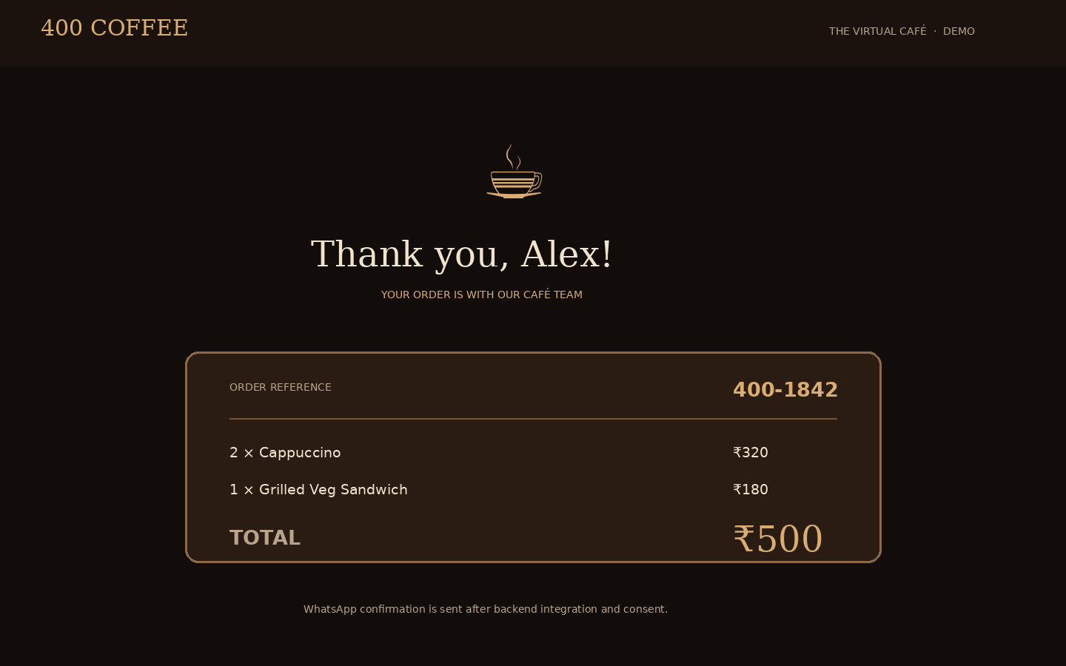
400 COFFEE / 07 · CONFIRMATION
A clear finish — and a clear next step.
The customer receives an order reference and accurate payment/order status.
AFTER SUBMISSION
• Unique order reference and item summary.
• Pay-at-counter clearly shows amount due.
• Pay-now shows paid only after verification.
• WhatsApp confirmation is sent through an approved Business Platform integration.
ILLUSTRATIVE CONCEPT UI · NOT A DEPLOYED PRODUCT SCREEN
09

Slide 10
400 COFFEE / PLATFORM CAPABILITIES
A distinctive customer layer, connected to a disciplined core.
Built to integrate with the broader 400 Coffee operating system.
Customer PWA
Catalog & pricing
Payments
Mobile-first, no mandatory installation, QR entry and session recovery.
Live menu, availability, variants, modifiers and server-side quotes.
Provider-hosted UPI/QR/card flows, verification and exception handling.
Notifications
Order handoff
Security & privacy
Transactional WhatsApp templates, consent and delivery tracking.
Cashier acceptance policy, kitchen events and customer status updates.
Guest session tokens, rate limits, minimal PII and auditable transitions.
ILLUSTRATIVE CONCEPT UI · NOT A DEPLOYED PRODUCT SCREEN
10

Slide 11
400 COFFEE / DELIVERY APPROACH
Build the experience in tested, measurable slices.
The 3D layer never gets to compromise order correctness.
1 · EXPERIENCE FOUNDATION
Responsive PWA, brand system, scene, manager, 2D fallback.
2 · ORDER JOURNEY
Diary menu, customizer, basket, guest identity and review.
3 · TRANSACTIONS
Order submission, payment adapter, bill lookup and WhatsApp.
4 · HARDEN & PILOT
Device testing, accessibility, performance, security and acceptance.
ILLUSTRATIVE CONCEPT UI · NOT A DEPLOYED PRODUCT SCREEN
11

Slide 12
400 COFFEE / NEXT STEPS
Approve the experience. Confirm the integrations. Pilot with confidence.
Items to validate before a binding implementation baseline.
CLIENT INPUTS
IMPORTANT ASSUMPTIONS
• Final menu, prices, descriptions and product imagery.
• Brand assets and approval of manager/3D art direction.
• Fulfilment rules and cashier acceptance policy.
• Merchant payment provider and sandbox credentials.
• WhatsApp Business account and approved templates.
• Privacy, cancellation, refund and tax rules.
• Screens are illustrative concept UI, not deployed captures.
• Payment and WhatsApp require approved provider integration.
• Static UPI QR does not automatically verify a specific order.
• 3D performance and assets require device testing.
• Existing implementation estimates must be revalidated for the immersive scope.
Proposed next action: approve the screen journey and asset direction, then baseline scope, timeline and commercials.
ILLUSTRATIVE CONCEPT UI · NOT A DEPLOYED PRODUCT SCREEN
12

