Slide 1
NARRATIVES
Comparison of Movie Plots

Slide 2
Earlier Work Done
Compilation of test Cases for Narratives Algorithm
Implementation of all the four modules :
NLP PHRASE EXTRACTION WSD MATRIX COMPUTATION
Earlier processing time:
NLP – 2 to 3 mins for 1st plot ------------ after the 1st run 5-6 sec
(many decrease/increase depending upon the processor speed)
Phrase Extraction
WSD
Matrix Computation

Slide 3
Current Work Done
Integrating all the modules
Optimization of all the modules so as to get the overall results in 2-3 min
Applied threading in WSD module and
Normalization of scores
Two methods we have tried:
Max value/Min(row,column)
sum of all elements of matrix/Product of rows and columns
For the first method only 37% accuracy.
For the second method we 75% accuracy

Slide 4
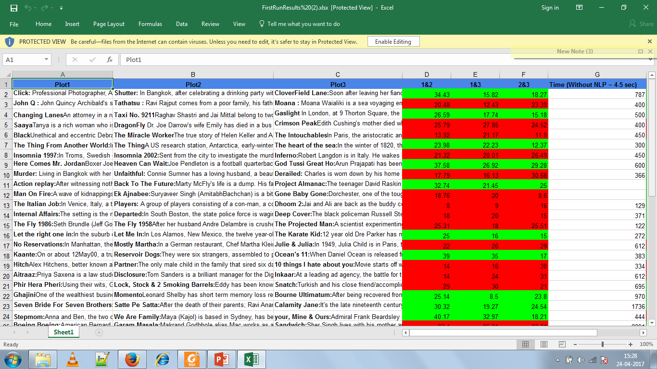

Slide 5
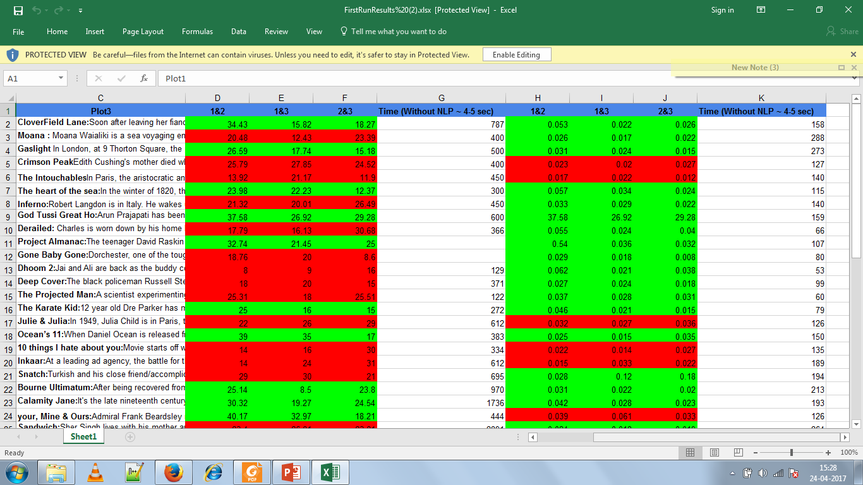

Slide 6
Future Work
Normalization between 0-100
Looking for further use cases.
Absolute comparison between plots

