Slide 2
Delta Lake
Presented by,
Amit Kundu

Slide 3
Introduction
Delta Table Optimization
Z-Order Commands
ACID Transactions
Summary
Q&A

Slide 4
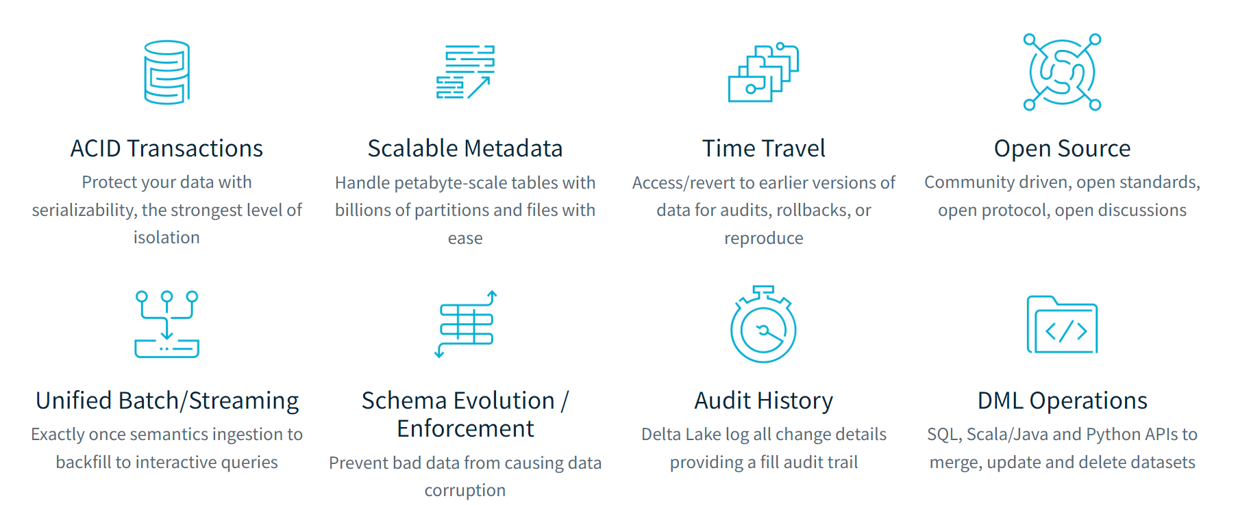
Introduction to Delta Lake
Delta Lake is an open-source storage layer that brings reliability to data lakes.
It provides ACID transactions, scalable metadata handling, and unifies streaming and batch data processing.

Slide 5
Delta Table Optimization
Improve query performance and reduce latency by optimizing how data is stored.
Key Techniques:
File Compaction: Merging small files into larger ones to reduce overhead.
Data Skipping: Using statistics to skip irrelevant data during query execution.

Slide 6
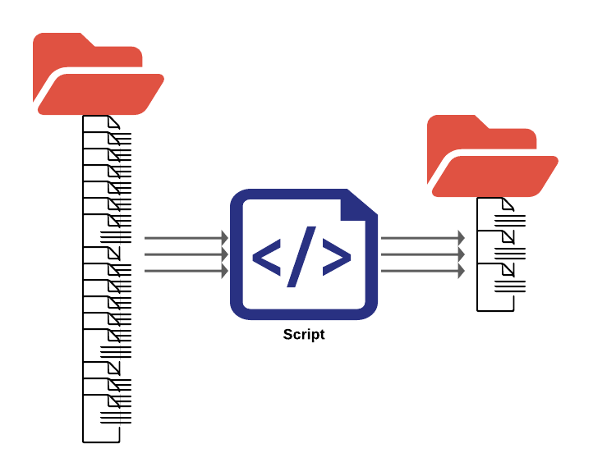
File Compaction
Compaction is the process of merging smaller files into larger ones to optimize storage and read performance.
Benefits:
Reduces the number of files
Decreases query latency

Slide 7
Data skipping
Data skipping leverages file-level statistics to avoid reading irrelevant data, thereby improving query performance.
How It Works:
Statistics such as min and max values are collected for each file.
During query execution, files that do not match the query criteria are skipped.

Slide 8
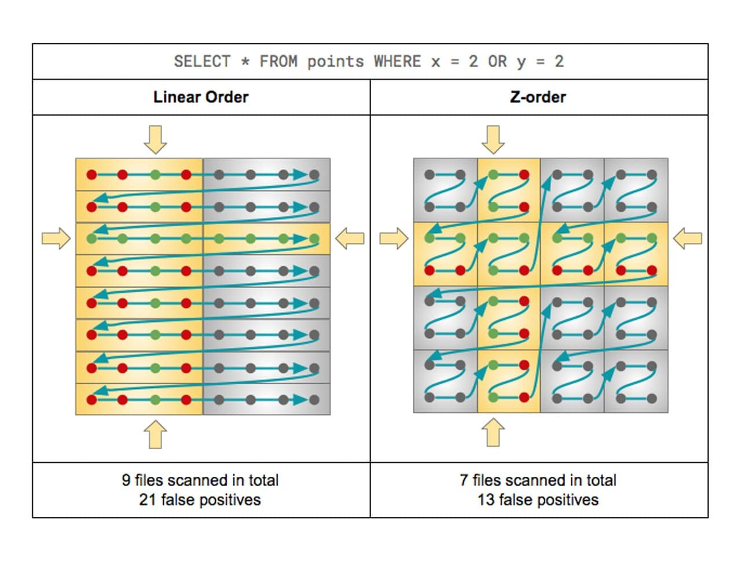
Z-Order Commands
Z-Ordering is a technique to optimize the storage of data by ordering it based on the values of one or more columns.
Benefits:
Improves query performance for queries filtering on multiple columns.
Reduces the amount of data read during query execution.

Slide 9
ACID Transactions
ACID stands for Atomicity, Consistency, Isolation, Durability.
Properties:
Atomicity: Ensures all operations within a transaction are completed successfully or none at all.
Consistency: Ensures data remains consistent before and after the transaction.
Isolation: Ensures transactions are executed in isolation from one another.
Durability: Ensures that once a transaction is committed, it remains so, even in the event of a system failure.

Slide 10
ACID Transactions

Slide 11
Summary
Delta Lake Enhancements:
Delta Table Optimization and Z-Order significantly boost query performance.
ACID Transactions ensure data integrity and support concurrent reads and writes.
Conclusion:
Delta Lake is a powerful addition to data lakes, providing robust features for efficient and reliable data processing.

Slide 12
THANK YOU !!

