Slide 2
Python

Slide 3
Higher Order Functions
Error Handling

Slide 4
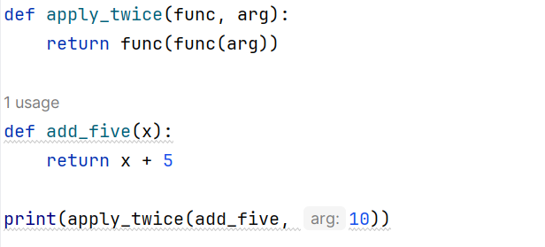
Higher Order Functions
Functions that take other functions as arguments or return functions
Used to achieve code reusability and abstraction
Allow for functional programming style in Python

Slide 5
Higher Order Functions
Built-in higher-order functions in Python:
map(): Applies a function to each item in an iterable
filter(): Creates a new iterable with elements that satisfy a condition
reduce(): Applies a function of two arguments cumulatively to the elements of a sequence

Slide 6
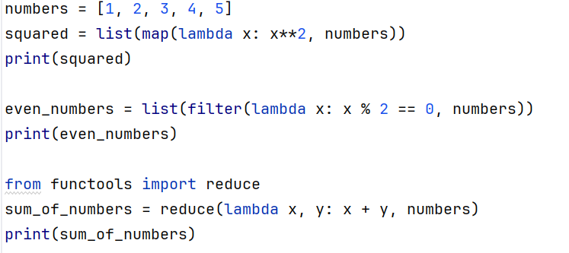
Higher Order Functions

Slide 7
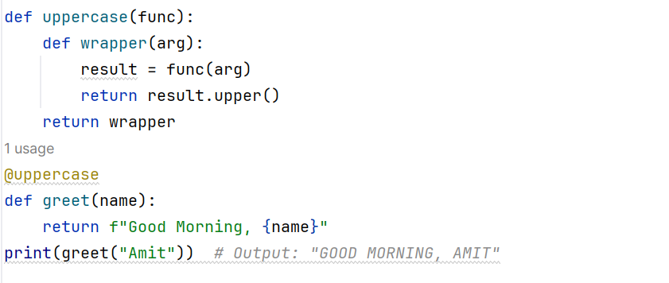
Higher Order Functions
Decorators:
Functions that modify or extend the behavior of other functions
Useful for adding functionality to existing functions without modifying their source code

Slide 8
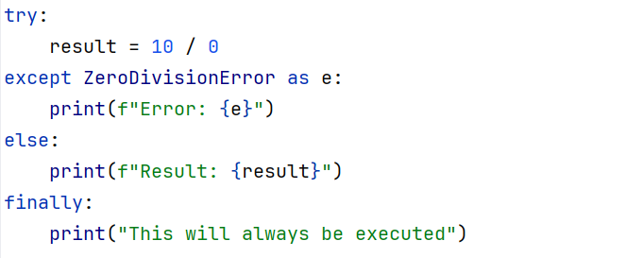
Error Handling
Exceptions and try-except blocks
Raising custom exceptions
finally and else clauses

Slide 9
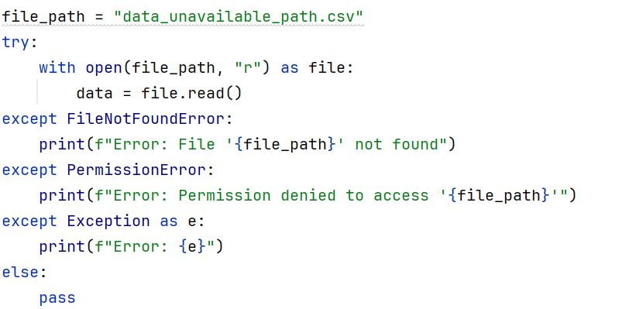
Error Handling
Handling multiple exceptions
Exception hierarchy and catch-all exception handler

Slide 10
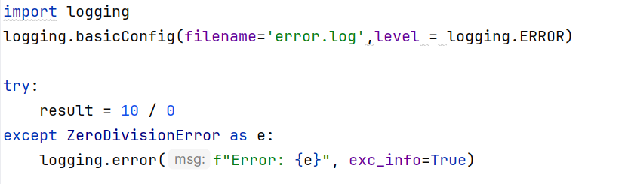
Error Handling
Logging exceptions
Provides a way to track and record errors for debugging and monitoring purposes

Slide 11
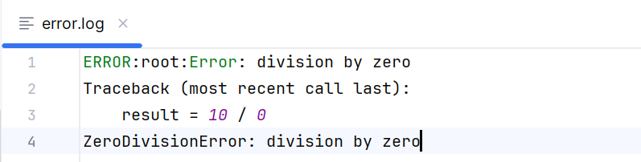
Error Handling

Slide 12
THANK YOU !!

