Slide 2
SQL and Pyspark

Slide 3
Comparing SQL and Pyspark Functions

Slide 4
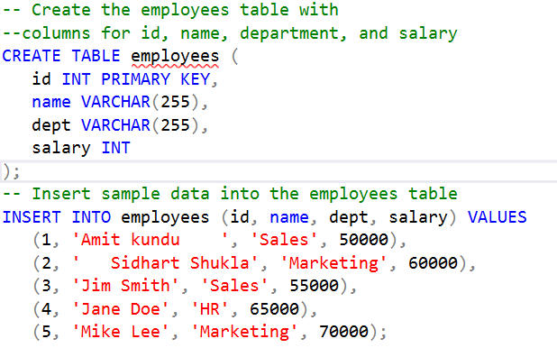
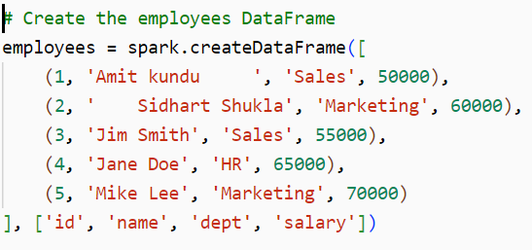
Creating a DataFrame/Table
SQL: Uses CREATE TABLE and INSERT statements
PySpark: Uses spark.createDataFrame() to create a DataFrame from data

Slide 5


Selecting All Rows and Columns
SQL: Uses SELECT * FROM table_name
PySpark: Uses dataframe.display()

Slide 6
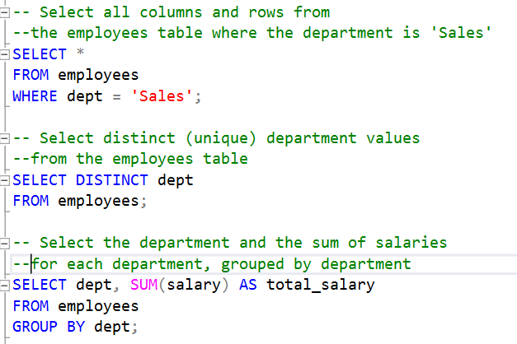
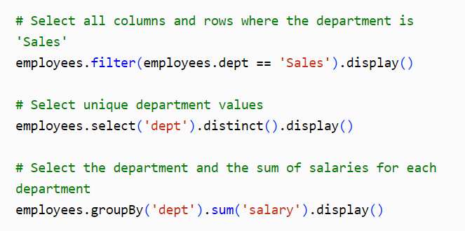
Filter, Distinct Values, Grouping and Aggregating

Slide 7
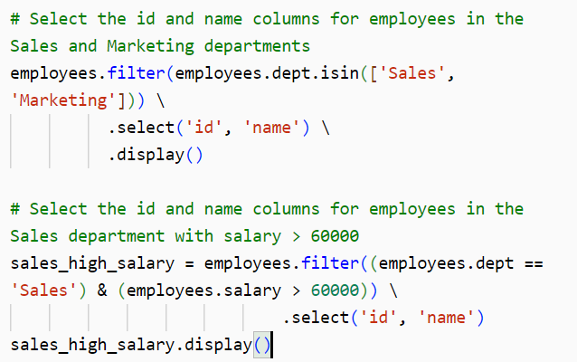
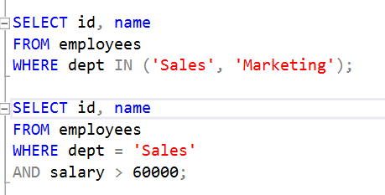
Multiple Conditions

Slide 8
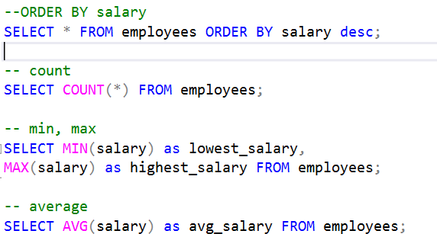
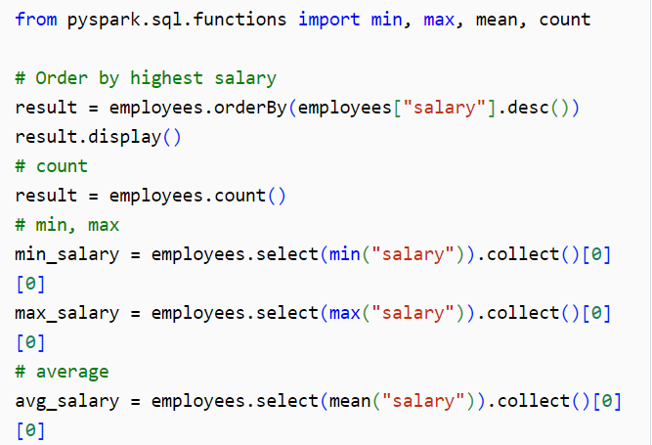
Ordering, Counting, Min, Max, and Averages

Slide 9
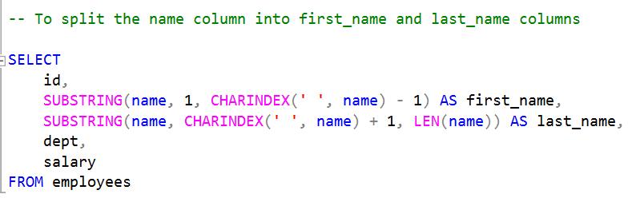
Split Columns
Split one column into multiple columns

Slide 10
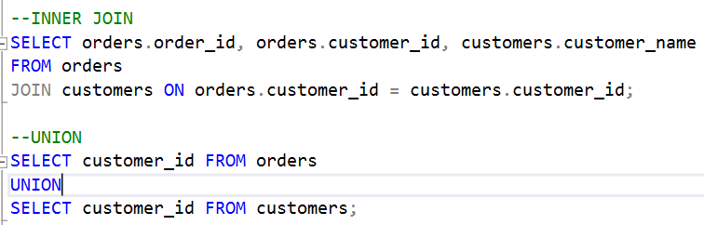
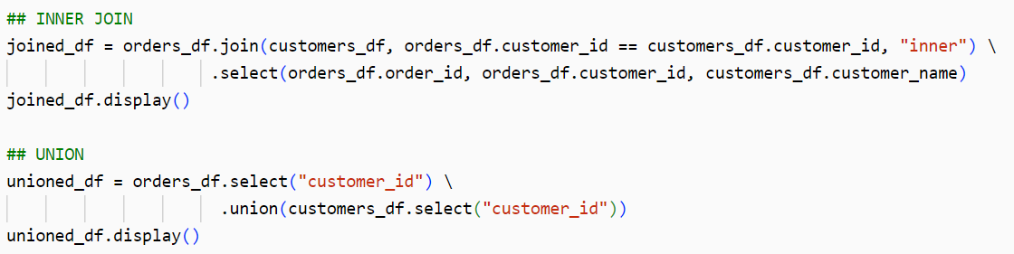
Join & Union
Join Multiple tables and Combine all rows using Union

Slide 11
THANK YOU !!

