Slide 1
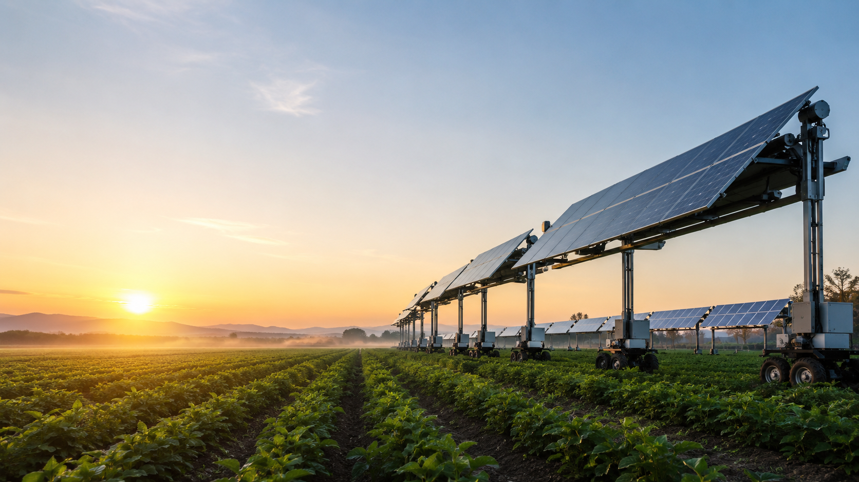
Jessica
Dynamic agrivoltaic platform system
A software-driven product concept for autonomous solar “trains” above agricultural fields.
PRD → Presentation

Slide 2
The core problem
Land must now serve food production and clean-energy demand.
1
2
3
Agricultural land is a scarce, high-value asset.
Solar-energy deployment often competes with crops for the same land.
Farmers need new revenue without sacrificing crop productivity.
Product opportunity
• Use the same land twice: crops below, energy generation above. • Control sunlight exposure dynamically instead of installing static shade. • Add monitoring, control, and security capabilities to the field.
Jessica PRD • Product presentation
02

Slide 3
Jessica’s proposed solution
Autonomous solar platforms that move above crop rows.
Dynamic agrivoltaics
• Solar “trains” move linearly between field support poles. • Local autonomy handles movement, direction reversal, and safety behavior. • Energy meters and cameras feed a responsive web dashboard. • Farmers can monitor, control, and secure the field in real time.
Design principle: the physical system stays modular; the software scales from one platform to many trains.
Jessica PRD • Product presentation
03

Slide 4
Target users
Three user groups create the business case.
🌾
Primary user
🏗️
Opportunity user
⚡
Strategic stakeholder
Farmers & growers
Landowners & developers
Government & infrastructure bodies
Maximize income from existing fields while improving monitoring and security.
Generate temporary revenue on unused land without permanent structures.
Support distributed clean energy while preserving food security.
Jessica PRD • Product presentation
04

Slide 5
Platform and “train” system
Modular platforms can operate alone or as synchronized linked trains.
Platform modules
• Unlimited number of solar platforms in the architecture. • Physical linking enables a longer synchronized train. • Automatic or manual configuration of train composition. • Controlled speed, acceleration, and deceleration to avoid damage.
Linear movement: forward / backward along virtual paths
Jessica PRD • Product presentation
05

Slide 6
Sensors, autonomy, and control
Local intelligence keeps the system operational and safe.
📷
🤖
🖥️
Camera
Local controller
Dashboard
180° visual feed
30 FPS
Move, reverse,
protect safety
Real-time monitoring
and manual control
< 2 sec
< 1 sec
100%
Manual-command response target
Video latency target in good network conditions
Local autonomous safety independent of cloud
Jessica PRD • Product presentation
06

Slide 7
Metrics dashboard & reporting
Live telemetry, historical charts, and one-click data export.
Dashboard features
Data export
• Time range selector: 15 min / 1 hr / 6 hr / 24 hr
• Auto-refresh every 3 seconds
• Live stats: avg solar voltage, distance range, safety incidents
• Mode breakdown: Idle / Manual / Autonomous / Charging
• Interactive SVG line chart with hover tooltips
• Clear metrics database with confirmation dialog
CSV — raw sensor data per reading
• Timestamp, solar voltage, distance, safety state, mode
• Excel-compatible BOM encoding for Excel compatibility
• Filename: jessica-metrics-{range}-{date}.csv
PDF — branded management report
• Summary statistics: voltage, distance, safety incidents
• Operating mode distribution breakdown
• Full telemetry table with colour-coded safety levels
• Filename: jessica-report-{date}.pdf
3 s
4
CSV
PDF
auto-refresh interval
time range options
raw sensor export
branded report export
Jessica PRD • Product presentation
07

Slide 8
Session recorder & replay
Record driving sessions and replay them with camera feed and telemetry in sync.
Record
Data captured per session
• Name the session before starting
• Set speed (1-255) for the entire session
• Live camera feed + real-time sensor panel during recording
• Every movement command timestamped to the millisecond
Session metadata
• Session name, creation date, total duration
• Speed setting (applied throughout session)
Per-event data (ms precision)
• Timestamp (ms), movement direction
• Left motor value, right motor value
Live camera stream
• Active during both record and replay
Replay
• Select any stored session from the session list
• Full-screen playback: camera + telemetry side-by-side
• Commands re-issued to robot at original timing intervals
• Read-only mode — no manual override during replay
Session management
Admin and Operator users can create, view, and delete recordings.
Jessica PRD • Product presentation
08

Slide 9
Security and connectivity
Cloud access with local fallback for fields with weak or no internet.
Role model
Connectivity model
Admin
Full access, user management, settings
• Primary WAN: WiFi • Offline operation: autonomous logic runs locally • Local storage for sensor data
• Secure local WiFi network for LAN access when internet is down
Operator
Control + reports + live feed
Viewer
Read-only reports + live feed
Security controls: password hashing, environment-based secrets, access logs, and critical action logs.
Jessica PRD • Product presentation
09

Slide 10
Non-functional requirements
Operational targets define the quality bar.
< 3 sec
1 sec
99.9%
Dashboard initial load time
Sensor data refresh interval
System uptime target
Scalability target
Backend architecture should support hundreds of farmers and thousands of trains simultaneously, with diagnostics for remote support.
Jessica PRD • Product presentation
10

Slide 11
Future scope and open questions
Decisions to refine before implementation.
Motion model
Is 360° movement required, or only linear forward/back?
Crop optimization
Should farmers define sunlight windows per field zone?
Plant health analysis
Live video only, or automated disease/water-stress detection?
Integrations
Irrigation systems and weather forecasts for automatic storm mode.
Jessica PRD • Product presentation
11

