Slide 1
Honeywell
APM
<<Month>> <<Year>>
End User Training – Asset Performance Management
Honeywell Internal

Slide 2
Agenda
Module 1 : Asset Performance Management (APM) - Introduction
Module 2 : APM - Typical Architecture
Module 3 : APM - Overview
Module 4 : APM - Report View
Module 5 : APM - Type of Users & Roles

Slide 3
Module 1 Asset Performance Management - Introduction

Slide 4
Learning Objective & Audience
This training is intended for asset management users and will aid them to understand the asset performance monitoring and its functionality. After completing this training, user will be able to perform the following tasks:
Navigate from Dashboard to Asset Performance Monitoring Application
Drilldown to the heat map and required asset
Monitor and investigate assets health status
View asset performance, attributes, trends, fault tree etc.
Plan action for faults to avoid future failures.
The course is intended for users from below user roles:
Process Engineering Users
Maintenance and Reliability Users
Operations Users

Slide 5
Asset Performance Monitoring Overview
Who?
Operations
Process Engineer
Mechanical Maintenance or Reliability Engineer
When?
Daily
Why?
Monitor assets and predict/prevent problems and recommend actions.
How?
Using Fault tree, Health Index, Asset Performance Management, Heat Map, reports and trends.

Slide 6
Performance Models
Process Performance Monitoring Models in Asset Performance Management help you do the following:
Use faults, symptoms and fault models so your operators can be informed about the potential damage in assets under unfavorable operating conditions.
Use fault management for KPIs, so your operators can be informed about violations of the nominal asset operating range and deviations from the expected characteristics.
Run the process more efficiently with the help of online thermodynamic based performance calculations for process equipment.
Track key performance indicators in real-time and compare against target operation values.
Improve operating margins by avoiding unnecessary shutdowns.
Prioritize and plan maintenance activities with better decision making.

Slide 7
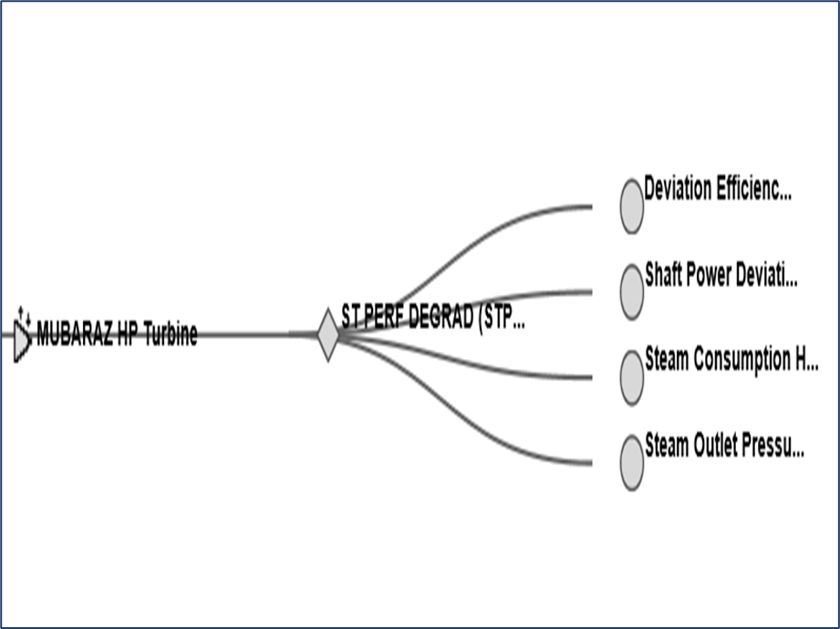
Health & Fault Models
Health and Fault Models in Asset Performance Management help you do the following:
Health models allow for traditional health monitoring relative to established alarm limits
Health models monitor and record standard KPI’s such as RUL, machine availability, efficiency, power, running status or status of needed maintenance, etc..
Fault models provide a ready form of fault tree for identifying where in a system a fault or alarm is creating impact. It also assists in drilling to root cause of faults.
Fault Tree

Slide 8
Advantages/Scope of APM
Monitoring critical parameters to perform predictive and preventive analysis.
Easy identification of root cause.
Standard calculations/monitoring across all sites for similar equipment/plants.
Readily available quality data.
Integration of data with relevant source system.
Removal of time-consuming manual work in collecting, validating and processing the data.
Data analysis in the form of trends.
Monitor past data by moving back in time.
Capture abnormal variation in trends using annotations.

Slide 9
Module 2 APM - Typical Architecture

Slide 10
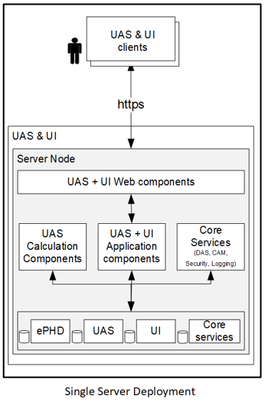
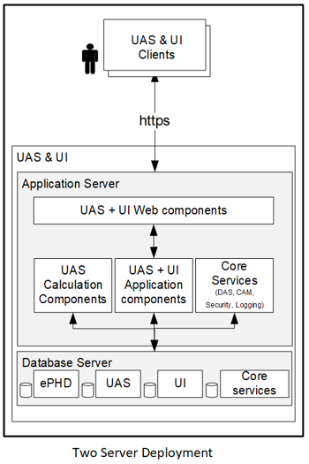
APM Typical Architecture’s

Slide 11
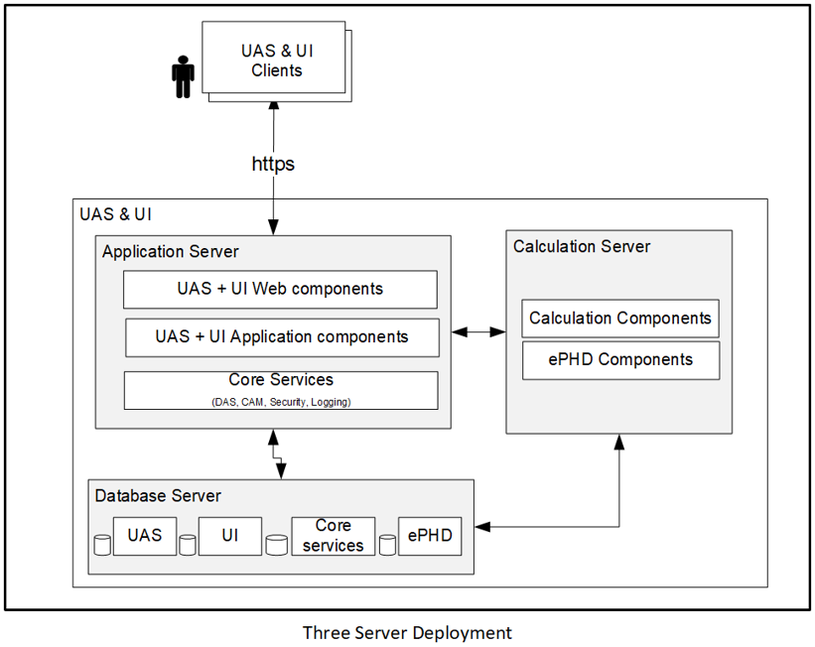
APM Typical Architecture’s

Slide 12
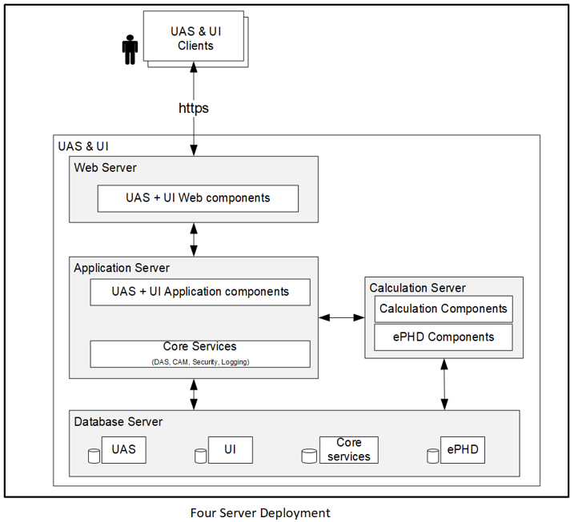
APM Typical Architecture’s

Slide 13
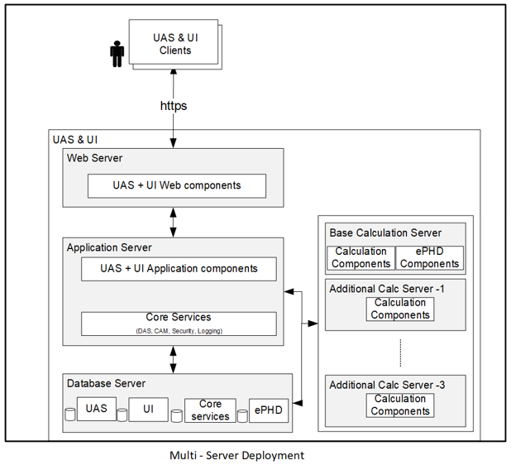
APM Typical Architecture’s

Slide 14
Module 3 APM - Overview

Slide 15
Asset Performance Management
Asset Performance Management is an application designed and developed by Honeywell to monitor close to near real time, maintain, and track the reliability of assets in a plant.
Asset Sentinel identifies the failures at an early stage and notifies through event monitor window, heatmap, Fault Tree, Performance View, Trends, Equipment Display and Email Notification which eliminates the unplanned downtime.
The monitoring and quick identification of failures helps in taking decisions and planning for maintenance.
The Reliability Engineer uses the Uniformance Asset Sentinel application in a plant/ship to monitor the reliability of equipment such as, turbines, engines, reduction gears, generators, pumps, valves, heat exchangers, and to identify any failure/fault.
The application provides various operating conditions of an equipment to the operator. It also consists of a calculation engine that helps the operator to calculate efficiency, ship load factor, and failure modes depending on the operating conditions. It cleanses data before using in models.
In-built Performance and Fault Symptom models for major equipment types like Centrifugal pump, Centrifugal Compressor, Furnace, Heat Exchangers etc., are available in the system. Capable of customizing the fault and calculation models
Allows linking of all related documents to the asset/equipment

Slide 16



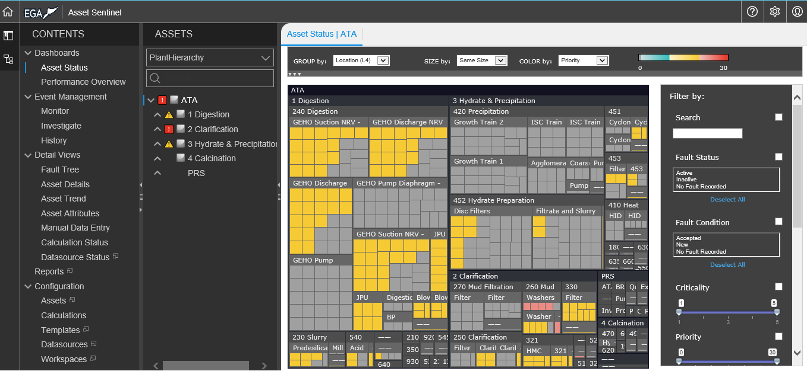
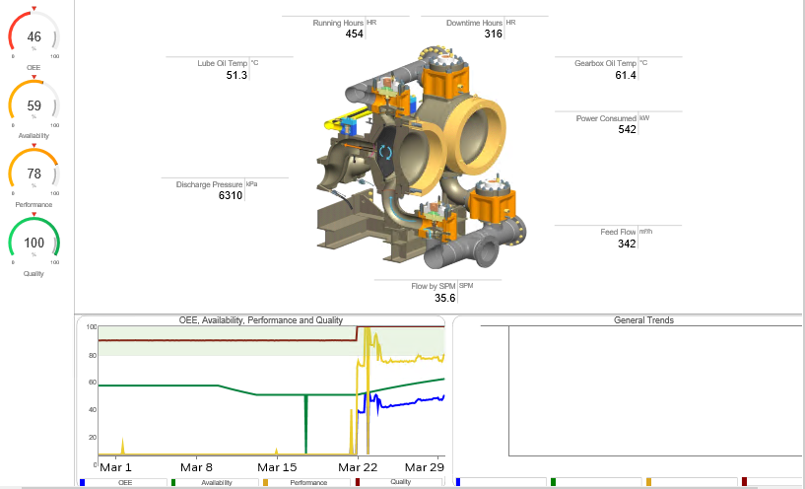






Process and Equipment Surveillance
Engineering Reliability, Maintenance & Process
Uniformance Sentinel
Asset Model
Heat Map Overview / Displays / Trends
Calc Results
Mgt. Reporting & KPI’s
ePHD
Templates
Attributes
Calculations
Rules
Analytics
Standard Model
User Defined / Custom
Event Detection
(Symptoms/Faults)
Alerts & Data
Equipment Lib.
Real-time / Historical Data
Operator
Interface via Matrikon Servers: OPC UA, Modbus TCP & RTU
DCS / PLC

Slide 17
Asset Performance Management
The condition of assets are indicated by different colors such as yellow for warning, red for alert, green for normal operating assets.
Process performance monitoring models are used to calculate the operating performance output, design performance output, and deviation between operating performance output and design performance output.
Asset Sentinel has a capability to perform complex calculations and track events.
Thermodynamic Complex calculations (High Pressure Fluid Stream, Complex Hydrocarbon Mixture)
Historize monitored data for long term performance analysis through trends/reports.
Establish strong linkage between asset performance and Business metrics.
Analyzing and troubleshooting of attributes

Slide 18
Asset Performance Management
Provide the users with a unified interface that shall be used in daily activities.
Management of equipment data that is needed to monitor equipment health.
Aggregate data from different sources and present in a single-window, per equipment, for easy analysis, trending and monitoring.
Displaying equipment properties such as equipment type, manufacturer etc.
Historical trending of performance data.
Manual input interface.
Management overview of equipment condition
Filtering and grouping of equipment condition data

Slide 19


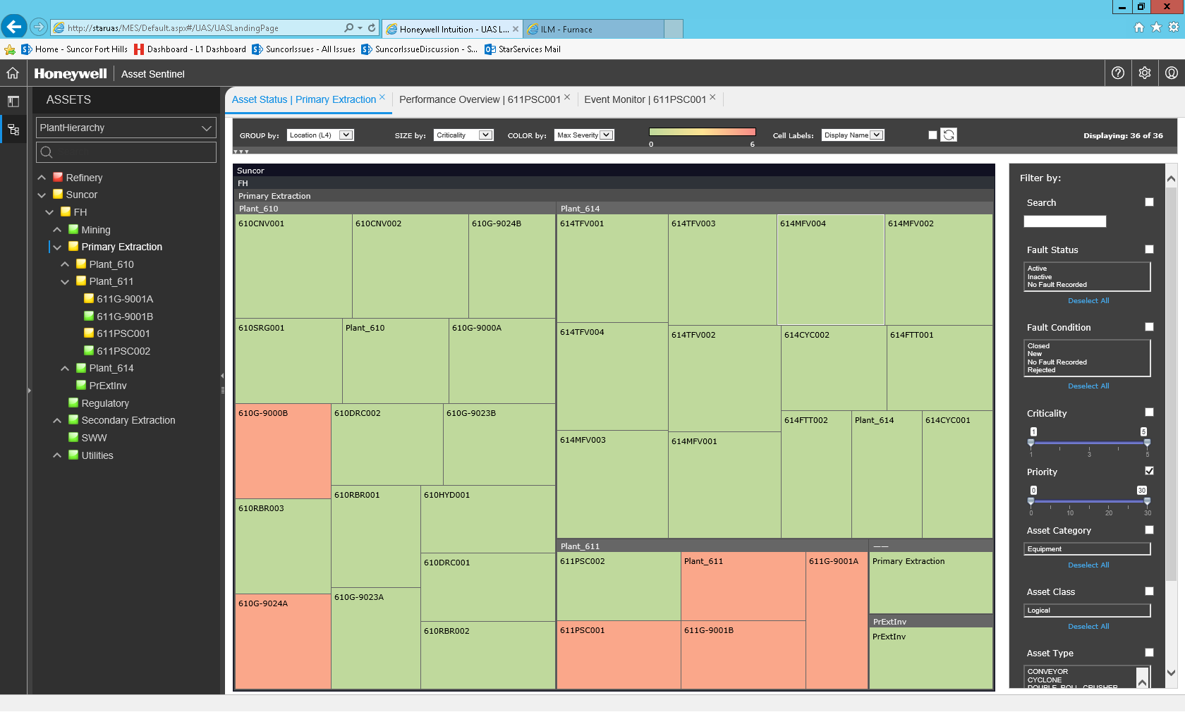

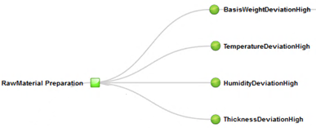
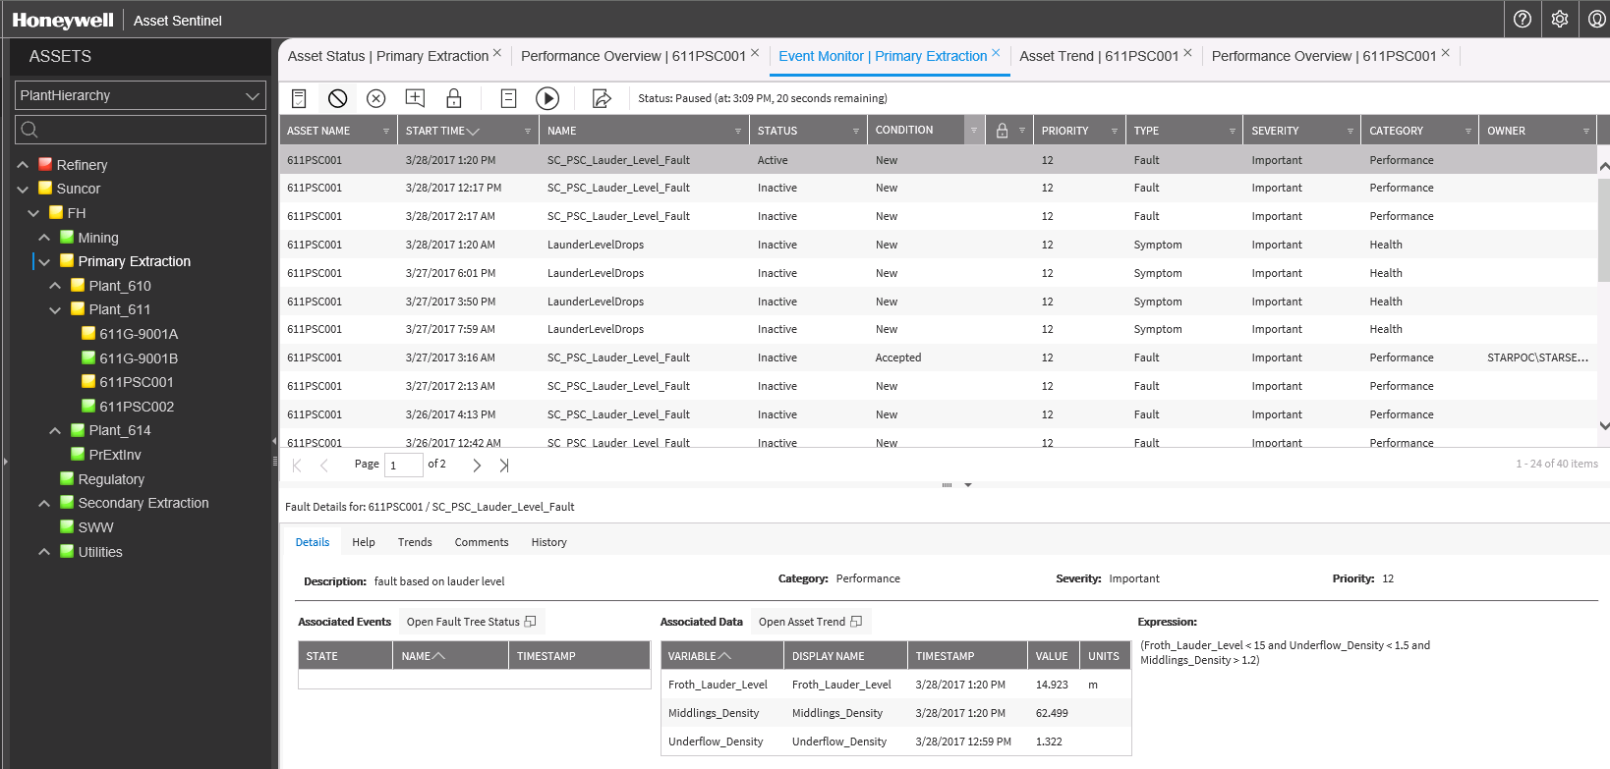

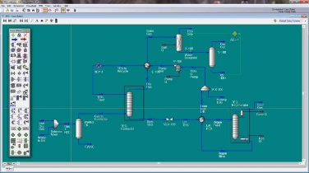
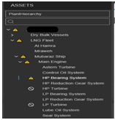
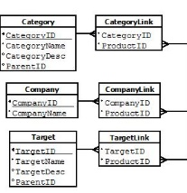

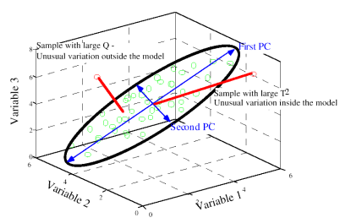
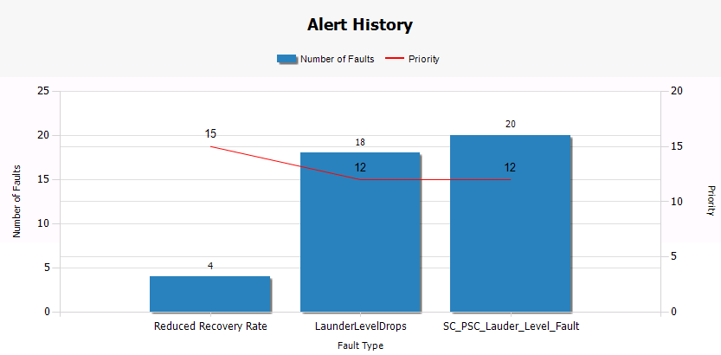
Asset Performance Management
Standard Connectors
Calculations (Runtime Analytics) (Complex Event Processing Engine)
Event Detection
Event Management (Monitor & Investigate)
Sensor (tag) Data
Pre-Processing / Cleansing
Actual vs. Expected
Pump
Asset Status (Heatmap)
Head =3960*HP / Flow
Historian Data
User Defined Calculations
Exchanger
Fault Models
Alarms/Events
Compressor
UniSim® - Estimate/ Predicted
Event Monitor & Investigate
Turbine
Other…
Furnace
Content
Library
Fault Prioritization
(Fault Severity * Asset Criticality)
Data Driven
Trends, Graphics & Reports
Continuously Monitor & Take Action

Slide 20
Asset Performance Management
Process Monitoring:
Process parameters or variables that affect asset health is configured to track and generate symptoms to show relation to potential or impending failure. Example: pump/ compressor suction temperature.
Condition Monitoring:
Mechanical / Reliability engineers monitor the condition of assets which involves the condition leading to failure or after failure effects. Example: Post Lube failure, increase in vibration level etc.
Performance Monitoring:
Engineers in plant wants to analyze equipment performance and identify actions to improve which improves reliability and extension of asset life. Example of the compressor performance monitoring using OEM curves.
Energy Monitoring:
Process or Energy engineer wants to identify bad actor assets with respect to energy consumption based on actual energy deviation from targeted which is calculated using models.

Slide 21
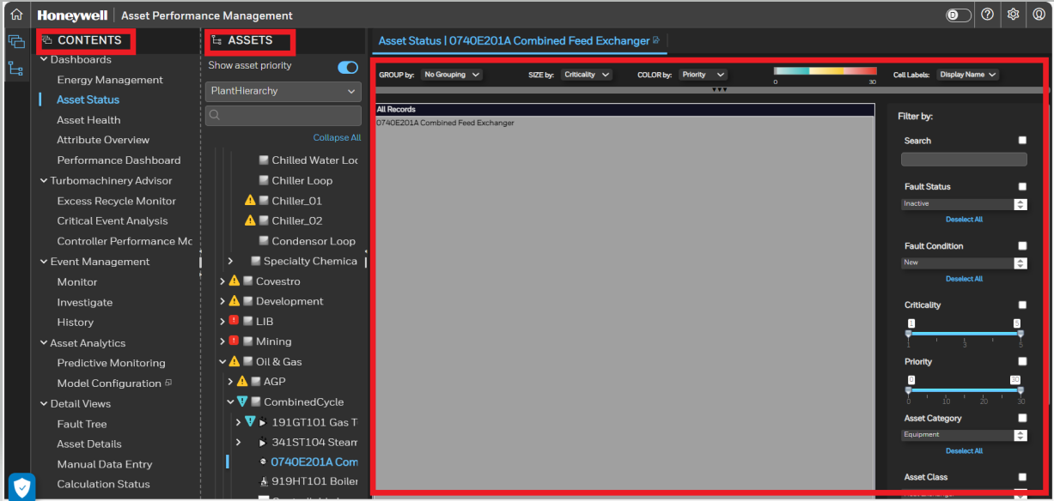
Equipment Performance Overview
a
b
d
c
After navigating to equipment performance application, user is presented with below fields
The left pane of the page contains Contents tab.
The pane to the right of the Contents contains the Assets with selected hierarchy. This shows the list of all assets configured in the hierarchy.
The right pane displays the details of the item selected from the Contents Tab.
It displays the selected Content and Asset Name.

Slide 22
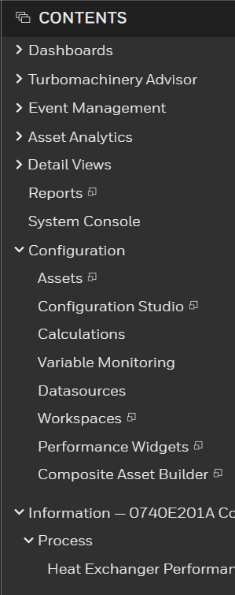
Equipment Performance Overview
1.a
Contents Tab
The content tab is a list of all displays configured on the system. Selecting an item on the content tab opens the respective views. The tab consist of 5 sections:
Dashboards
Event Management
Detail Views
Configuration
Information
The user can click on the arrow next to the asset to expand or collapse the content sub menu items.
Some of the views in the contents tree can be opened either in the current tab, or in a new tab. If the option exists, the Open in New Tab icon appears when you hover the mouse over the selection in the tree.Alternately assets can be searched by their names or key words.
1.b
1.c
1.d
3
1.e
2

Slide 23
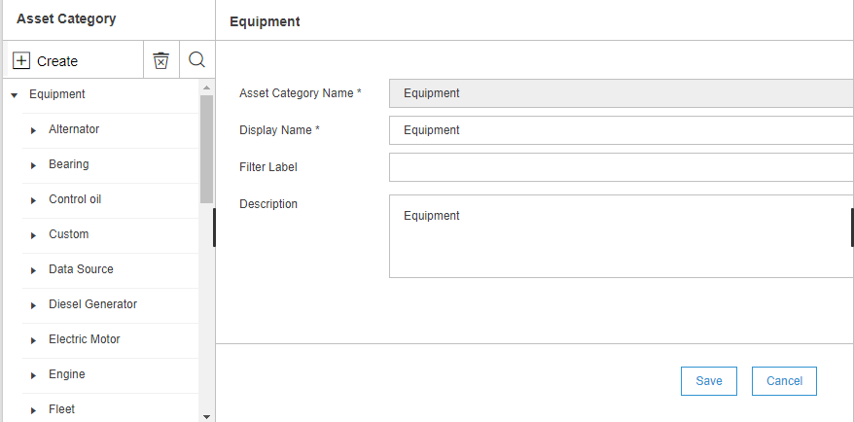
Asset Class
An Asset Class occupies the highest level in the template hierarchy, which is made up of similar asset types.
Two type of asset class examples defined
Physical Class : An example of a physical asset class is a Pump. Centrifugal pump, Turbines, generators, rotary pump, and so on are grouped under the Pump class.
Logical Class : Represents the group of asset that represents location or region.

Slide 24
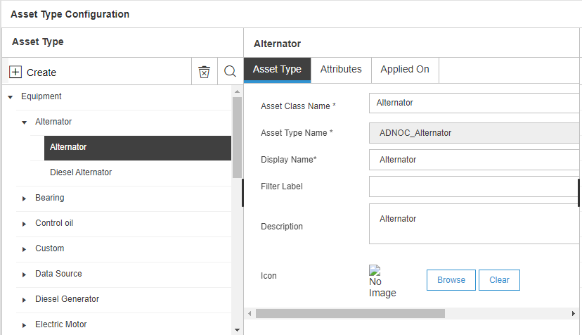
Asset type
Asset Type occupies the next level immediately after the asset classes in the hierarchy.
Asset Type could be created represented as small as bearing or as big as Turbine Unit.
Depending on scope of monitoring one or more asset type will be created to represent physical equipment's.
Logical Asset Type represent different level of logical group of assets such as section, unit, area, plant, site, ship, enterprise.

Slide 25
Asset
Asset is an entity at the finest level of granularity within the system, on which you want to:
Perform data manipulations or calculations.
Define rules (faults and symptoms) for event detection and notifications.
View the status, collect metrics, or report information.
Asset is the last level in the hierarchy, where you specify a unique asset name that identifies the asset in the Ship.
Examples:
Asset Class : Turbine
Asset Type : Steam Turbine
Asset : HP Turbine

Slide 26
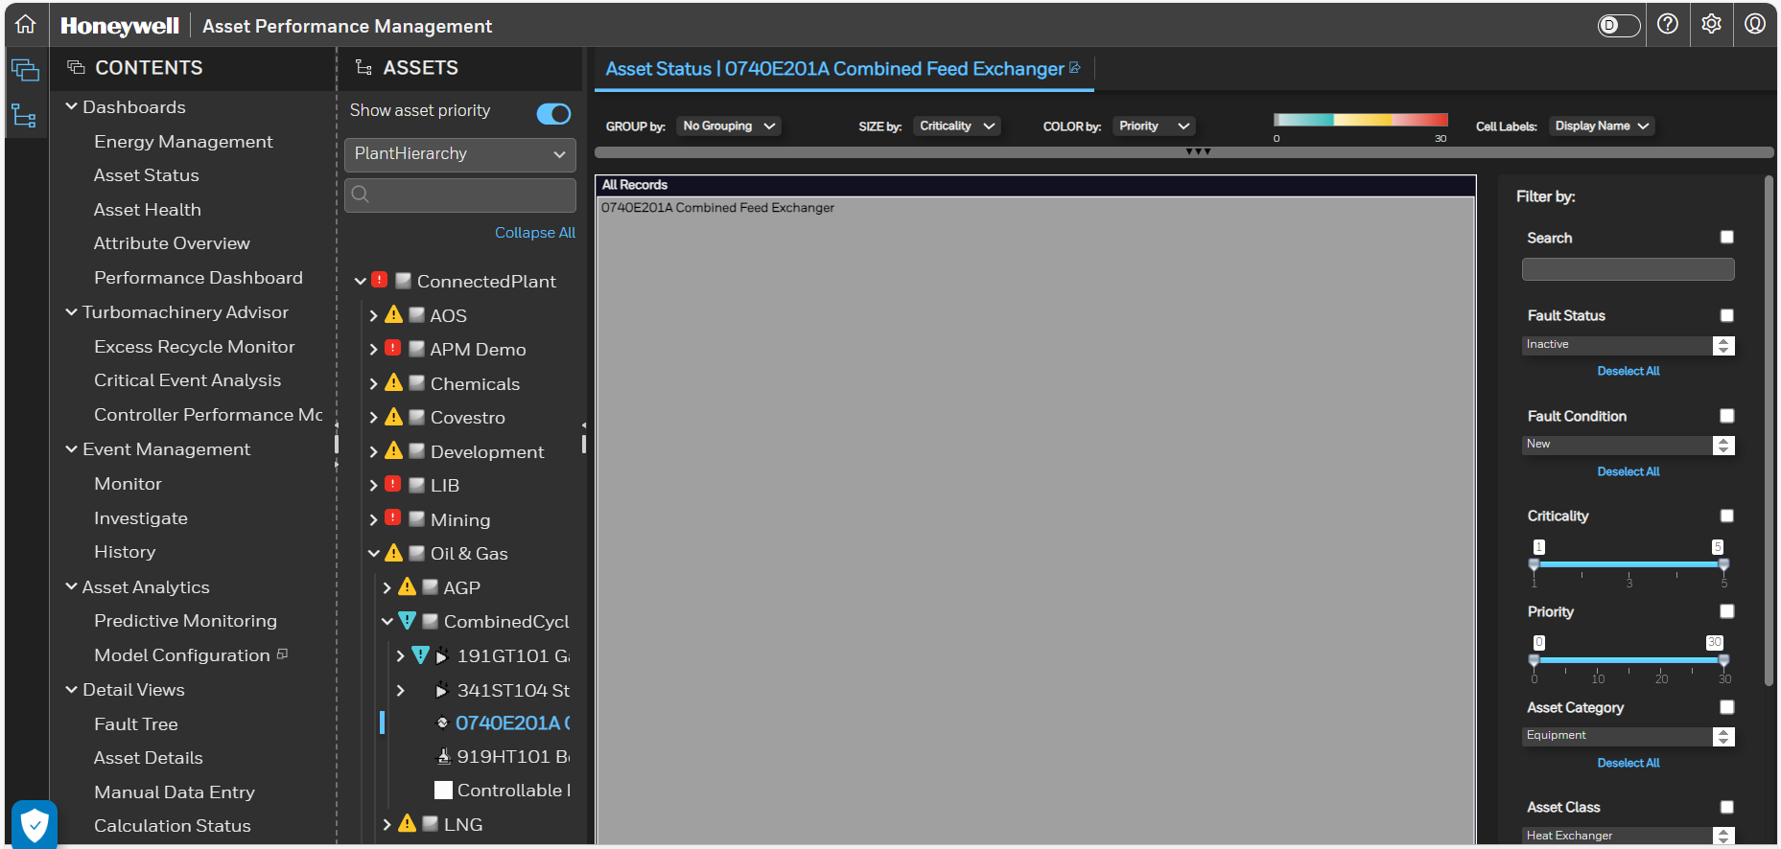
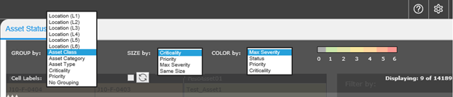
Dashboard – Asset Status
Asset Status
The Asset Status displays a tree map (heat map) showing the criticality and priority values of the item currently selected on the asset tree.
Each box on tree map represents the equipment with it’s current status or priority.
User can change the equipments displayed using:
Group by - To change the parameter used to group the rectangles. User can display the assets based on Asset Class, Asset Category, Asset Type, Criticality, Priority, Location or No Grouping.
Size by- To change the parameter used for size of the rectangle. User can select the size based on Criticality, Priority, Max Severity, Same Size.
Color- To change the parameter used for color of the rectangle. User can select the color based on Criticality, Priority, Max Severity, Same Size. The change in color based on the selection will be visible as shown in 3.c1
3.a
3.b
3.c
3.c1

Slide 27
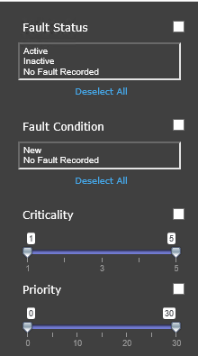
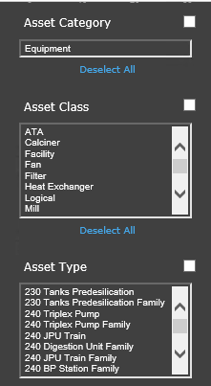
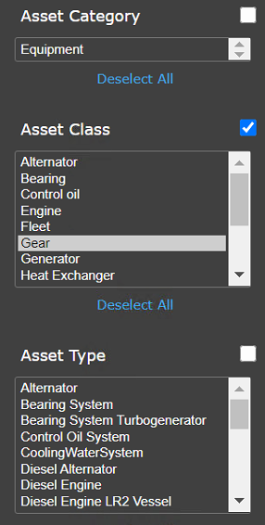
Dashboard – Asset Status
Asset Status
User can filter the equipment's displayed using:
Fault Status – Active, Inactive etc.
Fault Condition – New, No Fault
Criticality – Asset Criticality 1 to 5
Priority – Asset Priority 0 to 30
Asset Class
Asset Type
4.a
4.e
4.b
4.c
4.e
4.d

Slide 28
Dashboard – Asset Status
Asset Rating
The Uniformance Asset Sentinel application uses the following Three asset concepts to determine the relative importance of an asset and an event.
1) Criticality
2) Severity
3) Priority
Criticality is a numeric value associated to an asset. It denotes the relative importance of the asset based on financial and safety considerations. The values of criticality are based on a 5-level rating scale.
None – 1 / Negligible – 2 / Minor – 3 / Major – 4 / Safety – 5
The criticality of an asset is indicated by the size of the rectangle and the priority of the asset is indicated by the colour of the rectangle.
Higher criticality = larger size

Slide 29
Dashboard – Asset Status
Asset Rating
Severity is a numeric value associated with each symptom and fault (event) that indicates the relative impact of the event on corresponding equipment.
None – 1 / Minor – 2 / Required – 3 / Important – 4 / Serious – 5 / Critical – 6
Priority value is calculated by multiplying the numeric values of severity of a fault and criticality of the corresponding equipment. Priority indicates the relative importance of an asset with another asset.
Asset priority is zero when there is no fault or anomaly event raised in an asset.
Asset Priority = Asset Criticality x Active Event Severity
Higher priority = Red / Medium Priority = Yellow / Low or No Priority = Green
Priority = Criticality x Severity
1 to 10 - Indicates that the health of the asset is “Normal” and is displayed in green.
11 to 20 - Indicates that the health of the asset is “Warning” and is displayed in yellow.
Above 20 - Indicates that the health of the asset is “Urgent”, and is displayed in red.

Slide 30
Asset Type Attribute
Information associated with assets are represented through attributes.
Attribute types are classified as below
Static Attributes: Relatively constant and is typically manual user inputs.
Example-Description, connection, etc.
Dynamic Attributes: These attributes are measured , calculated , inferred or manual inputs.
Data Types:
Scalar – Double, String, Date Time
Array –Double Array, String Array, Tabular
Special Asset Connection-Thermo stream
Filter Category: To tag the attributes for filtering a category is defined.

Slide 31
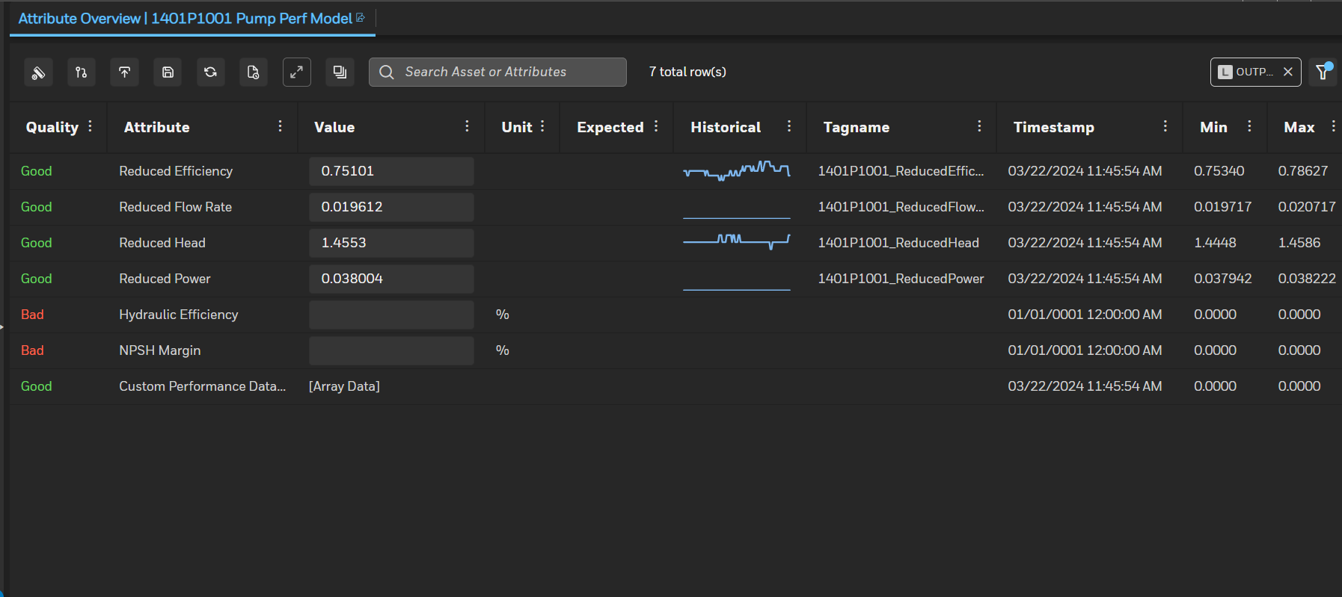
Dashboards – Attribute Overview
2.a
2.c
2.e
3
2.b
2.d
2.f
2.g
Attribute Overview
Attribute overview lists all the attributes applicable to selected Asset with its current value, UoM and Quick trend, Min/Max/Avg for last two hours.
Following options are available for user to
Show values in Asset Type UOM
Include child Assets attributes in current view
Export selected or all attribute data in excel
Save changes (if any value updated manually)
Refresh Attribute overview
Display the Property for selected attribute
Filters the attributes based on asset or attribute.
Clicking on historical (quick trend) opens trend in another tab with more trend options
1

Slide 32
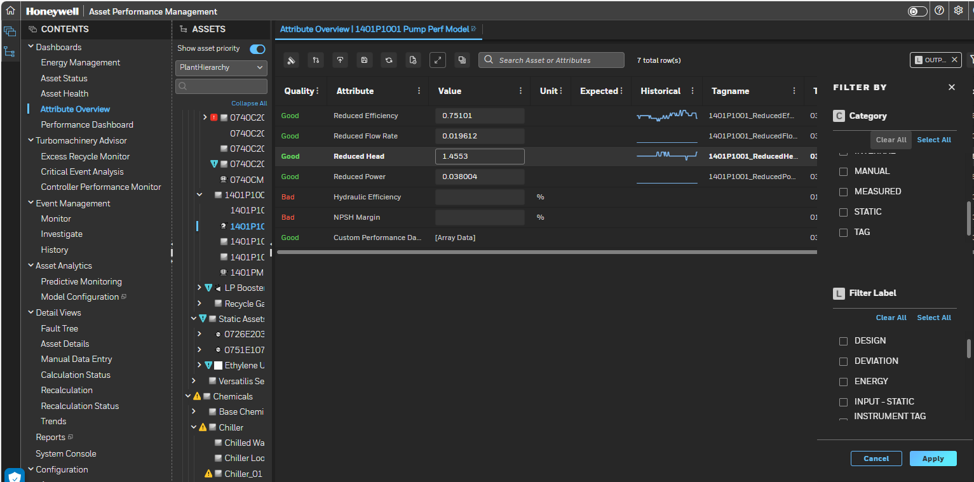
Dashboards – Attribute Overview
4
Attribute Overview
Additional filter criteria can be selected. Click to hide or unhide filter option
Attributes can be further filtered based on “category” or “filter labels” to load attributes having the selected filter label or category.
5

Slide 33
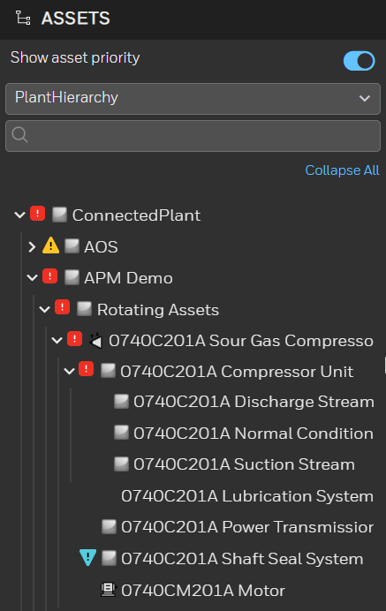
Asset Hierarchy
An asset hierarchy is created to classify an asset into several segments and represent the segments in the tree view.
Each segment in the hierarchy consists of an asset class, asset type, and an asset. The hierarchy enable you to view the whole structure of the plant in a graphical tree.
A four-level hierarchy is shown as a sample below.
Enterprise
Fleet
Ship
Main Asset/Equipment
Sub Asset/Equipment
The user can click on the arrow next to the asset to expand the hierarchy.
Alternately assets can be searched by their names in search box.
Selecting an asset will display all the content details associated with the asset.
The Asset status icon indicates the status of the equipment. If a branch is collapsed, the icon indicates the highest status on any asset in the collapsed branch

Slide 34
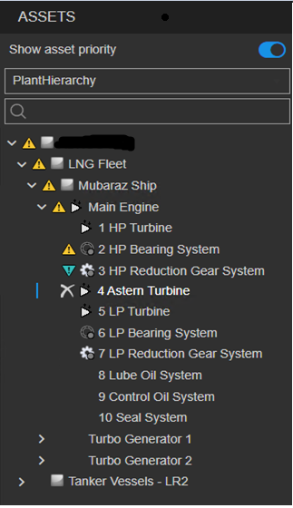
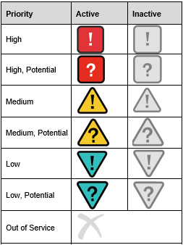
Asset Hierarchy
There is an ‘!’ mark adjacent to the Asset if there is an Active Fault for an Asset.
There is a ‘X’ mark adjacent to the Asset if the Asset is out of service.
Below is the list of all the status icons available
6
7

Slide 35
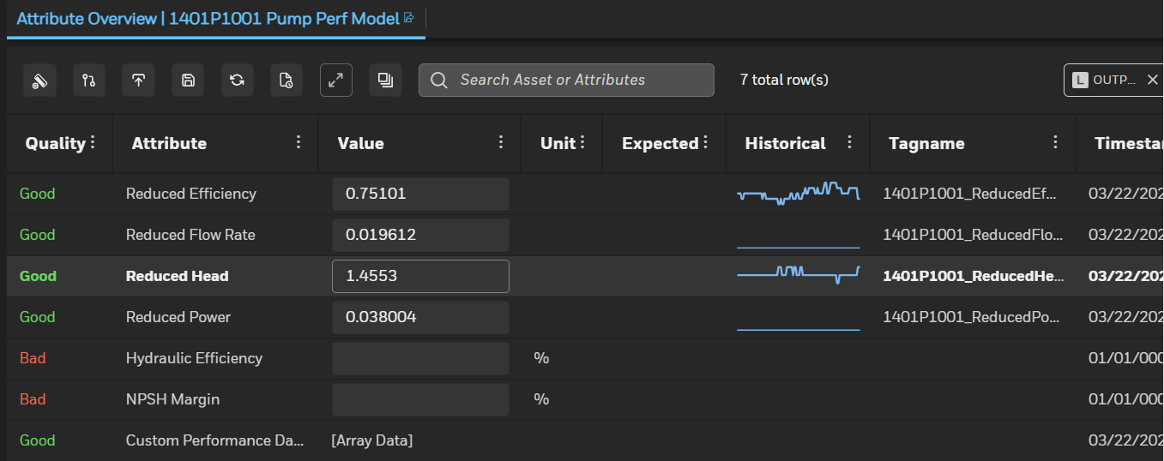
Attribute overview
The Performance Overview dashboard provides a list of the asset attributes and their details, including the current value. User can use this list to review and update asset attribute information, as well as to open an Asset Trend to view more details.

Slide 36
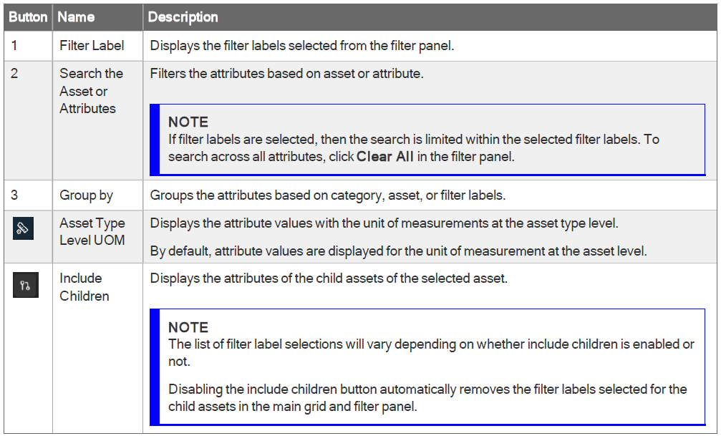
Attribute overview
To open the Attribute Overview
1. On the asset tree, select an asset to set the context.
2. On the Contents tree, under Dashboards, select Attribute Overview.
The event view opens to the Attribute Viewer displaying the Attribute Overview.

Slide 37
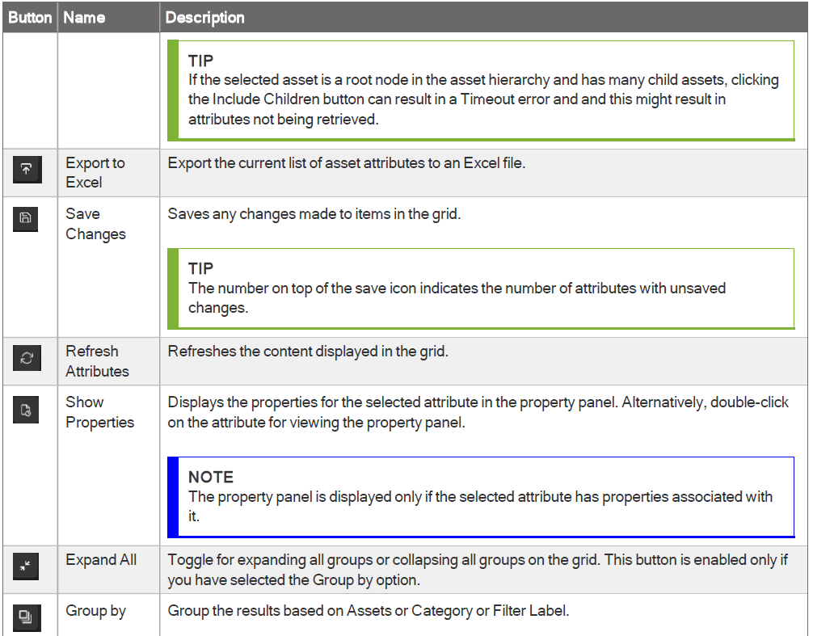
Attribute overview

Slide 38
Fault status
Fault Status Indicates the status of the rules defined in fault and symptom.
Fault Status : Active
Fault condition is satisfied, and a new fault record should be created for tracking.
Fault Status : Potential
Fault condition is not satisfied but one or more symptom status is active and so a new fault record created for tracking.
Fault Status : Inactive
Fault condition is not satisfied, and all symptoms are also inactive.

Slide 39
Fault or symptom state
Fault or Symptom State-Indicates the state or mode of a fault and typically requires user actions.
Fault State : Eliminated
User rejected fault as it confirmed the detected fault is false. This is a feedback to engineer who manages the fault definition.
Fault State : Closeout
User closed fault as it is confirmed required action taken and fault condition is not satisfied.
Fault State : Standing
System or user has latched the fault. In this mode no new fault is added and this is typically used for chattering faults or high value fault which require manual intervention.

Slide 40
Fault tree
Graphical representation in the form of tree for all the possible events (active or inactive) of one asset or of one group of assets or unit or entire site
The red color represent the active events. The greens are inactive
The date represents:
For red colors: the activation time
For green colors: the last closing time
As the color is propagating in the asset hierarchy this fault tree is
important to understand what is the root cause of the problems
at the unit level, for example..

Slide 41
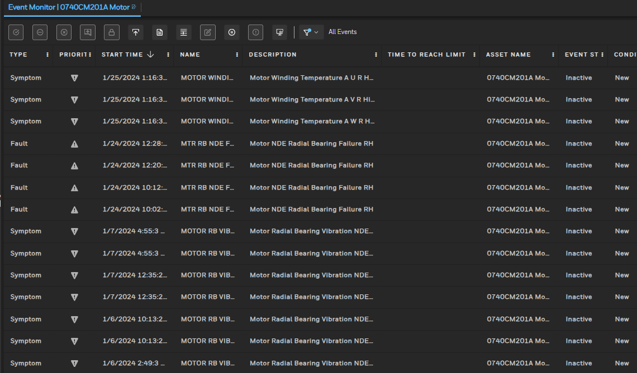
Event Monitoring
The Event Monitor lists all the events that are Active, Potential or Inactive and provides access to the event triage facilities as well as the event detail display showing the factors that have contributed to the triggering.

Slide 42
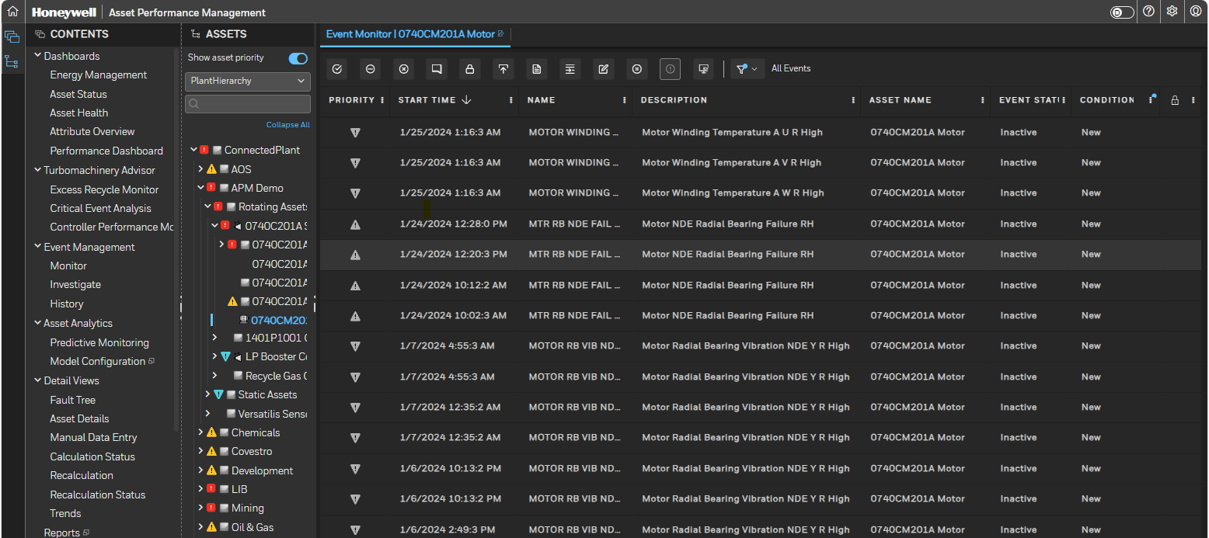
Equipment Performance - Event Management
The Event Management view consists of three sections-
Monitor
Investigate
History
2) Based on the selection the related section is displayed for the selected Asset.
1
1.a
1.b
1.c

Slide 43
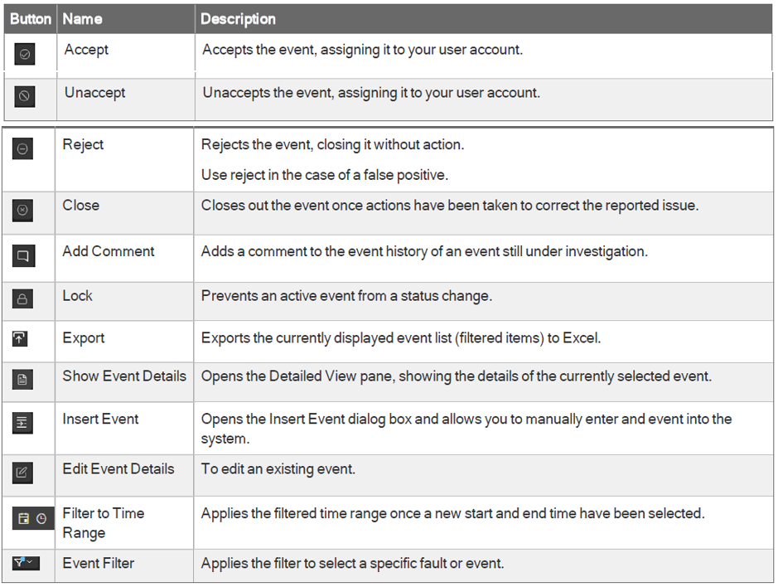
Equipment Performance – Event Management
Event Grid
Event grid shows a list of events applicable to the asset.
Events are listed based on current filter
User can show and hide columns as required.
Toolbar buttons are enabled/disabled based on actions available for currently selected event. Table lists all the toolbar buttons with its description.
User can navigate to next page in event grid by clicking navigation button given at the bottom of grid.
Only accepted events are available in Investigate view.
User inputs/comments are required to reject, close and add comment for an event

Slide 44
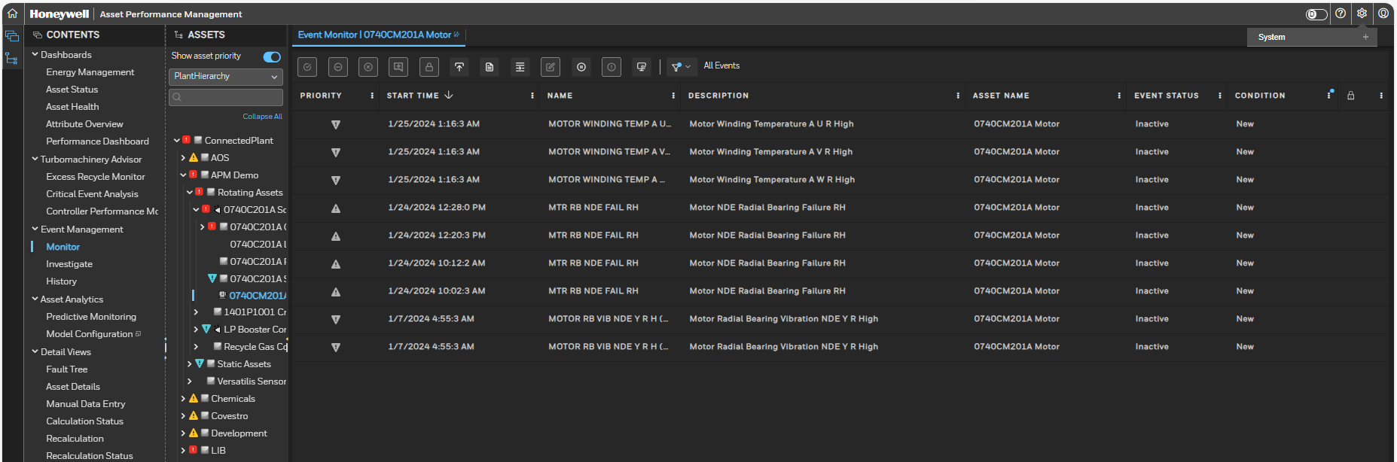
Event Management – Monitor
You can click on the Monitor Section From the Event Management view to monitor the selected Asset as displayed.
The Monitor view displays the following details-
Start Time
Name
Description
Asset Name
Event Status
Condition
Column Setting
k. Accept
l. Reject
m. Close
n. Add Comment
o. Lock
p. Export
q. Show Event Details
r. Insert Event
s. Edit Event Details
t. Resume/Pause
Acknowledge
CMMS Notification
Event Filter
k
l
m
n
o
p
q
r
s
t
u
v
w
d
e
f
g
a
b
c
1

Slide 45
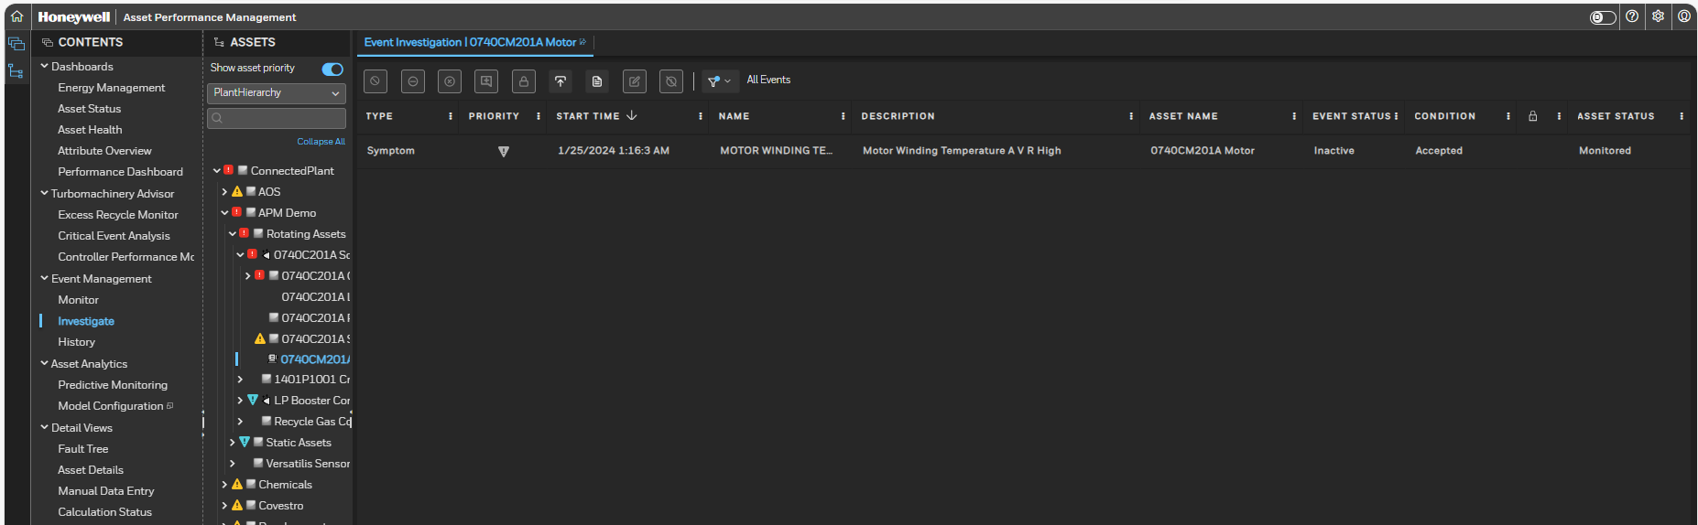
Event Management – INVESTIGATE
On Accepting any Fault from the Monitor View for any Asset we can see the Accepted Fault on the Investigate View. The following details are displayed on the Investigate View-
Type
Priority
Start Time
Name
Description
Asset Name
Event Status
Condition
Asset Status
Locked
Unaccept
Reject
Close
Add Comment
Lock
Export
Show Event Detail
Edit Event Details
Filter to time range
Event Filter
k
l
m
n
o
p
q
r
s
t
a
b
c
d
e
f
g
h
j
i
1

Slide 46
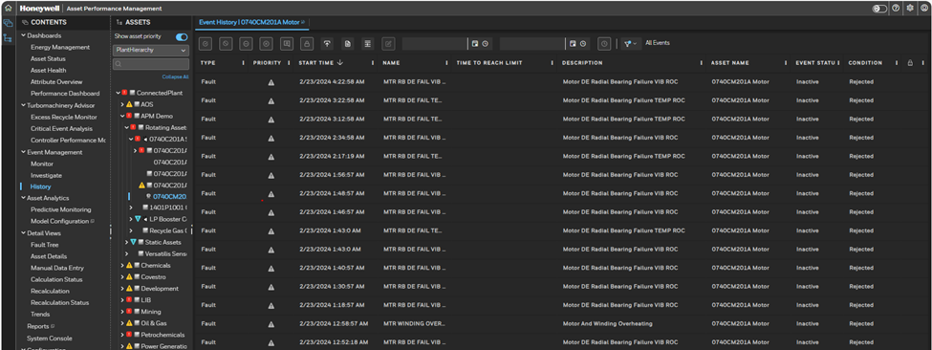
Event Management – History
To check the History of events for a selected asset you can Click on History. The following details are displayed on the History View-
Type
Priority
Start Time
Name
Time To Reach Limit
Description
Asset Name
Event Status
Condition
Locked
Accept
Unaccept
Reject
Close
Add Comment
Lock
Export
Show Event Detail
Insert Event
Edit Event Details
Filter Items From
Filter Items To
Filter Items by Time Range
k
l
m
n
o
p
q
r
s
t
u
v
w
a
b
c
d
e
f
g
h
i
j
1

Slide 47
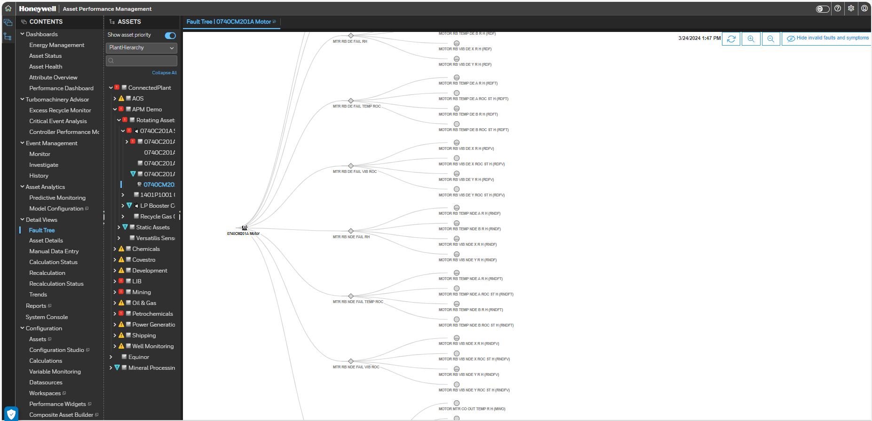
Details View
2
The Detail Views consist of seven sections-
Fault Tree
Asset Details
Manual Data Entry
Calculation Status
Recalculation
Recalculation Status
Trends
Reports
System Console
Based on the selection the related section is displayed for the selected Asset
For example, here Fault Tree is selected.
1
a
b
c
d
e
f
g
h
i

Slide 48
Details View - Fault Tree
2
2
To check the Fault tree for a selected asset from the Asset Hierarchy you can Click on Fault Tree on the Contents View.
All the Faults and Symptoms for the selected Asset will get displayed.
Any active fault is highlighted with ‘!’ mark and colour based on criticality.
3
1

Slide 49
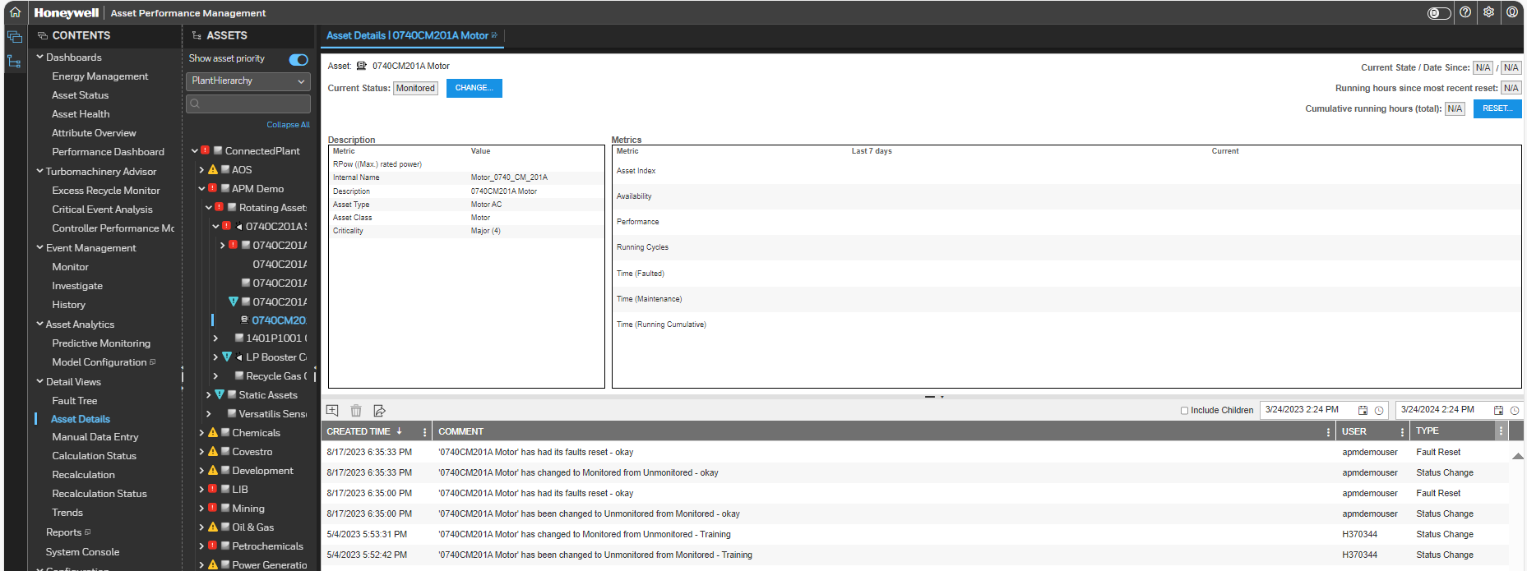
Details View - Asset Details
To check the Asset Details for a selected asset you can Click on Asset Details. The following details are displayed-
Asset
Current Status
Current State/ Date Since
Running hours since most recent reset
Cumulative running hours (total)
Description of the Asset
Changes done in the Description if any
a
c
b
f
d
e
g
1

Slide 50
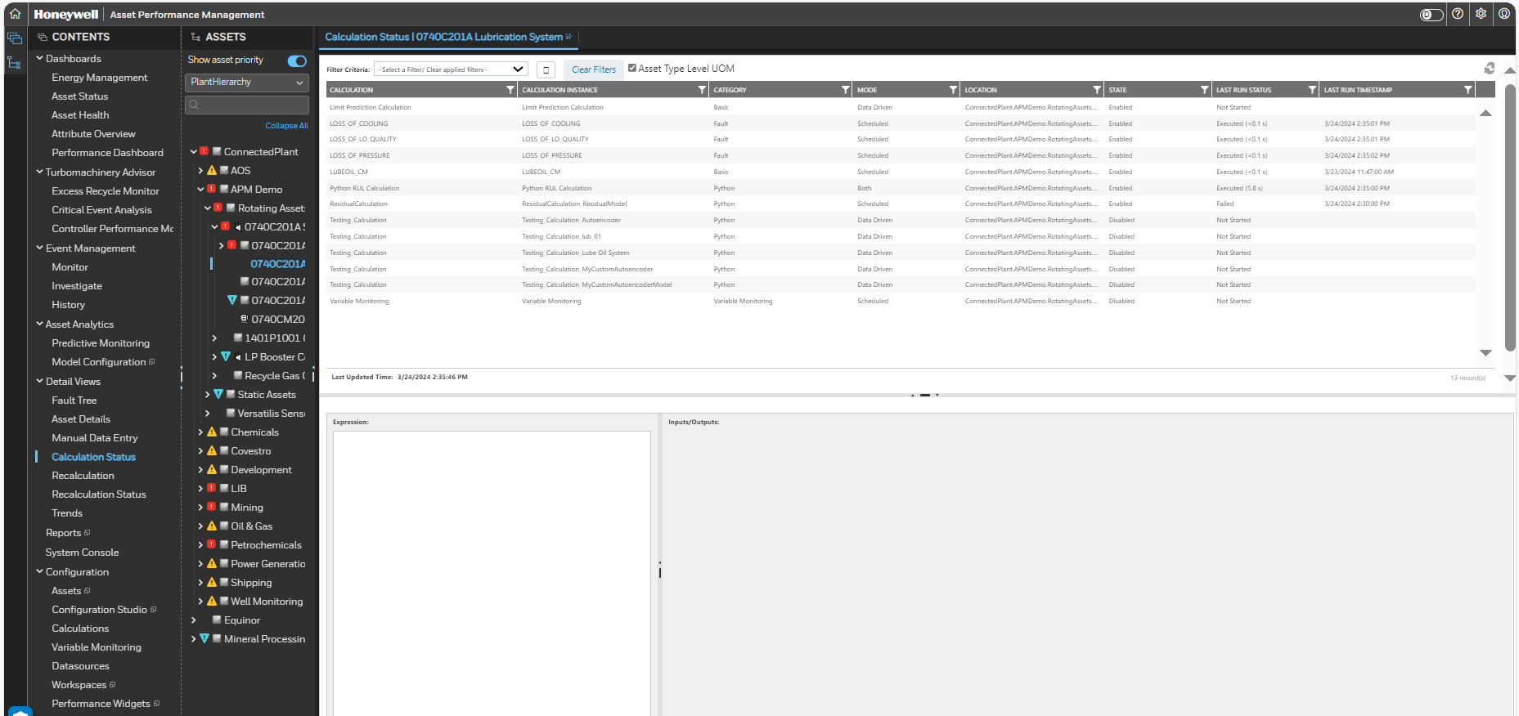
Details View - Calculation status
Allows you to check the calc status of an asset, with calc details and values

Slide 51
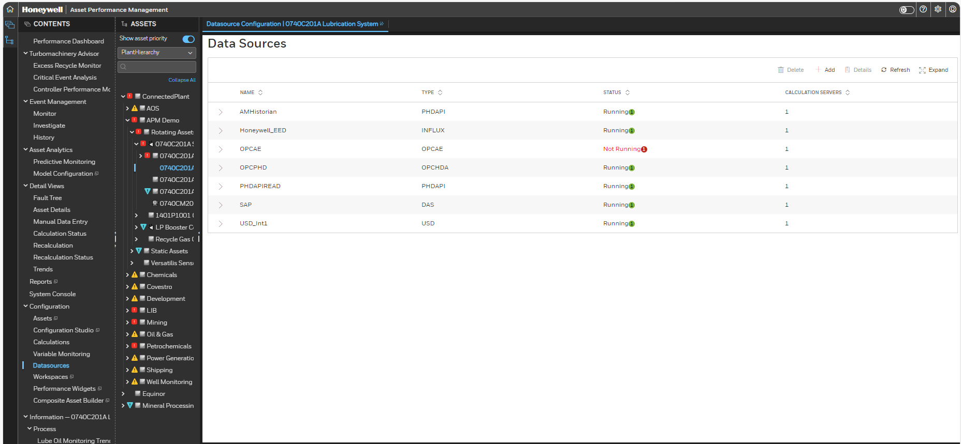
Details View - Datasource Status
To check the status of the calculation engine. Usually maintained by administrator
Navigate from Datasources under CONTENTS menu.

Slide 52
Module 4 APM - Report View

Slide 53
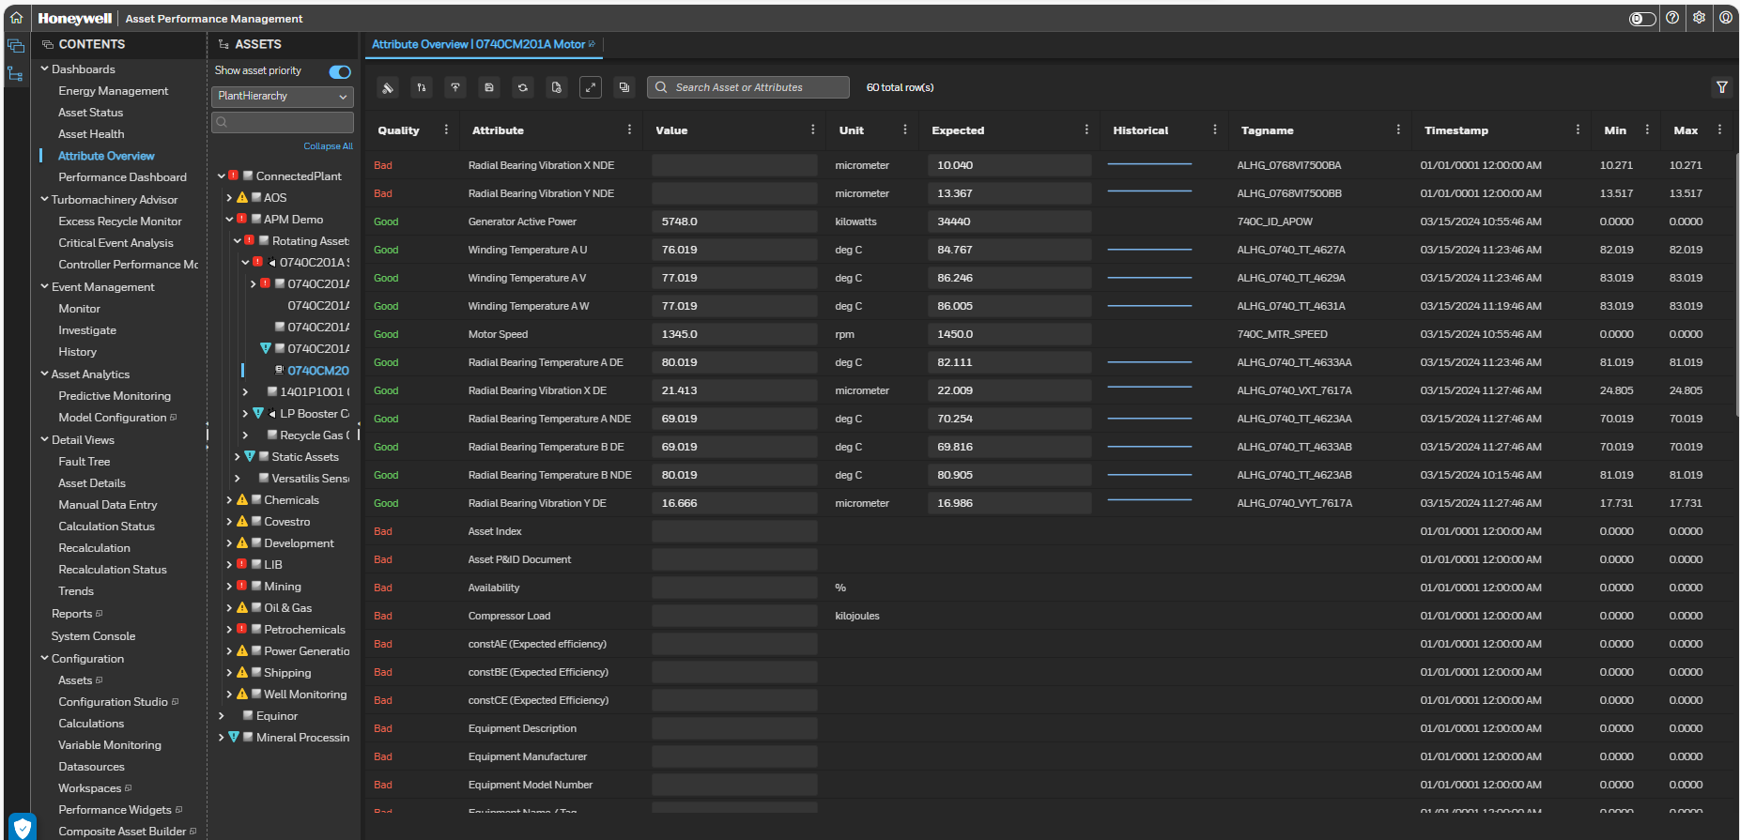
Attribute overview
Attribute Overview Excel Report can be extracted from Asset Sentinel Attribute Overview Page.
Click on “Export to Excel” button.
Excel Report get downloaded from Attribute Overview Dashboard.

Slide 54
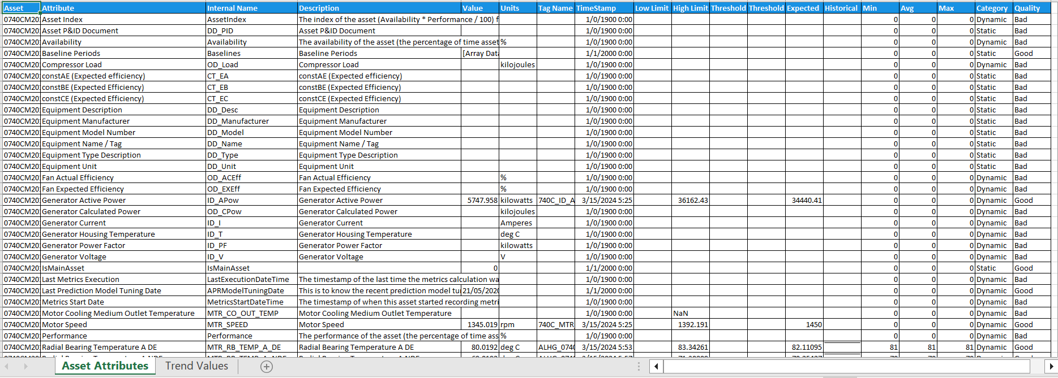
Attribute overview
Asset Attribute: Asset Attribute Report for selected Asset get displayed with its details as Current values, UoM, TagName, Low and High Limit etc.

Slide 55
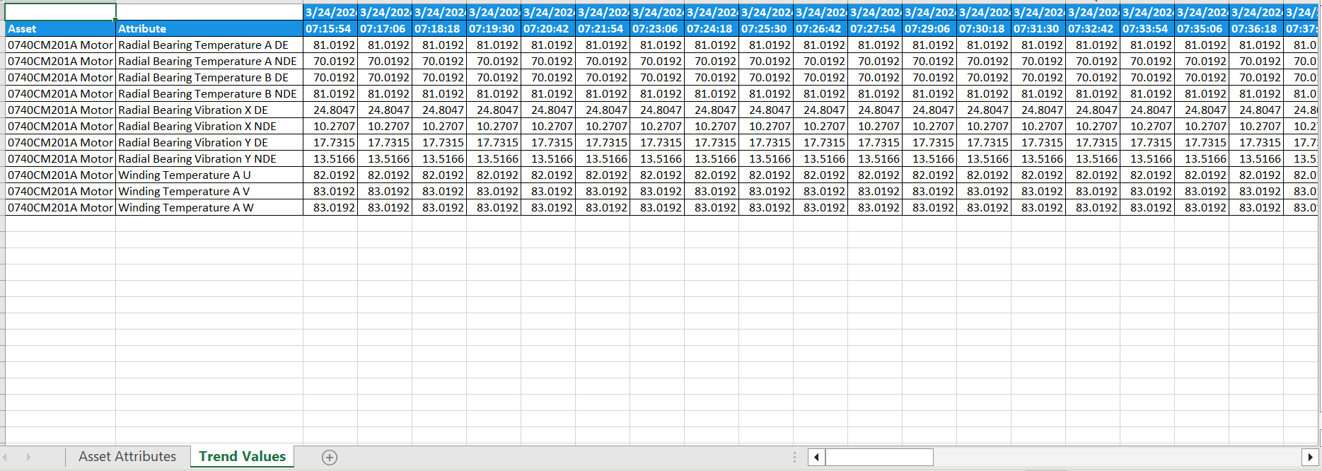
Attribute overview
Trend Values: It reports the Asset Attribute data with date time stamp in Tabular Format

Slide 56
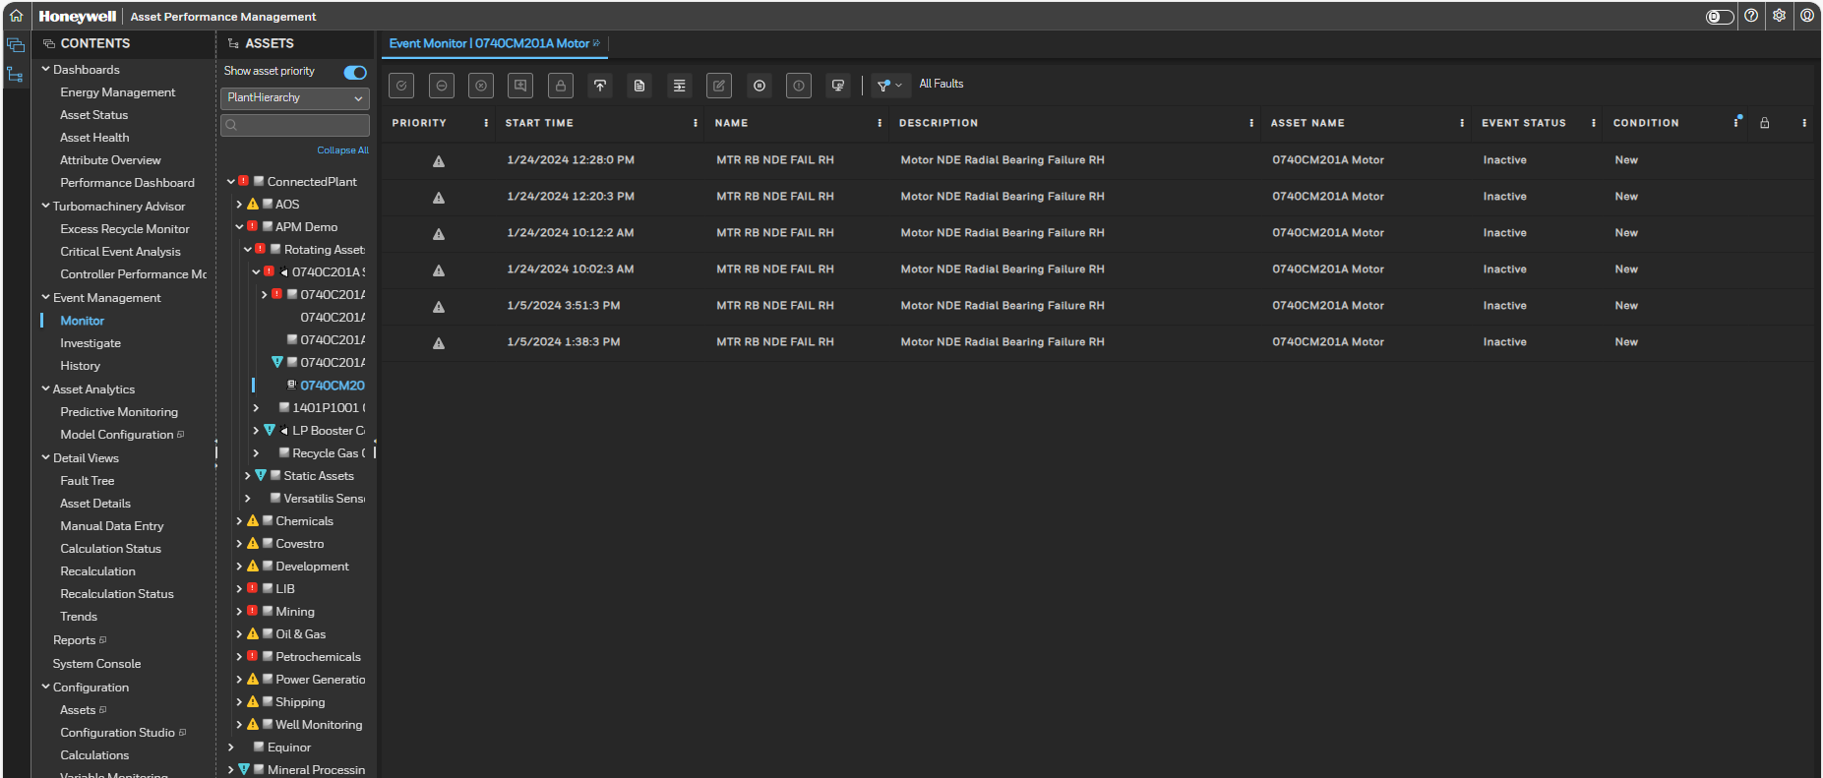
Event monitor
Event Monitor Excel Report can be extracted from Asset Performance Manager Event Monitor Page

Slide 57
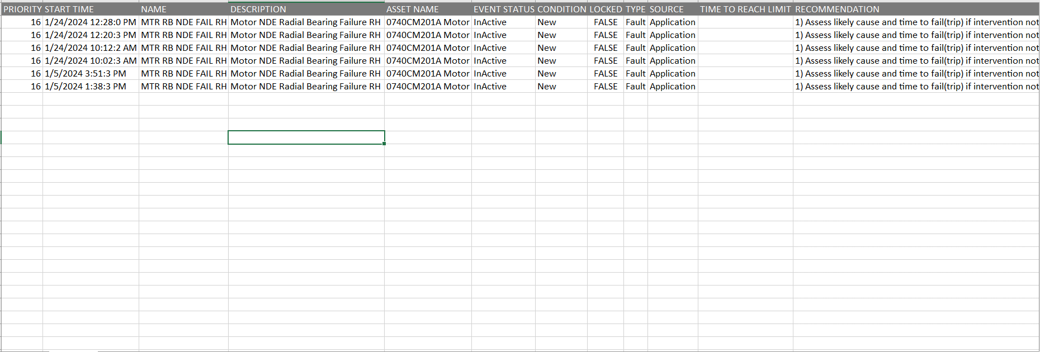
Event monitor
Event Monitor Excel Report: It shows the Asset wise Fault-Symptoms details wit its recommended actions.

Slide 58
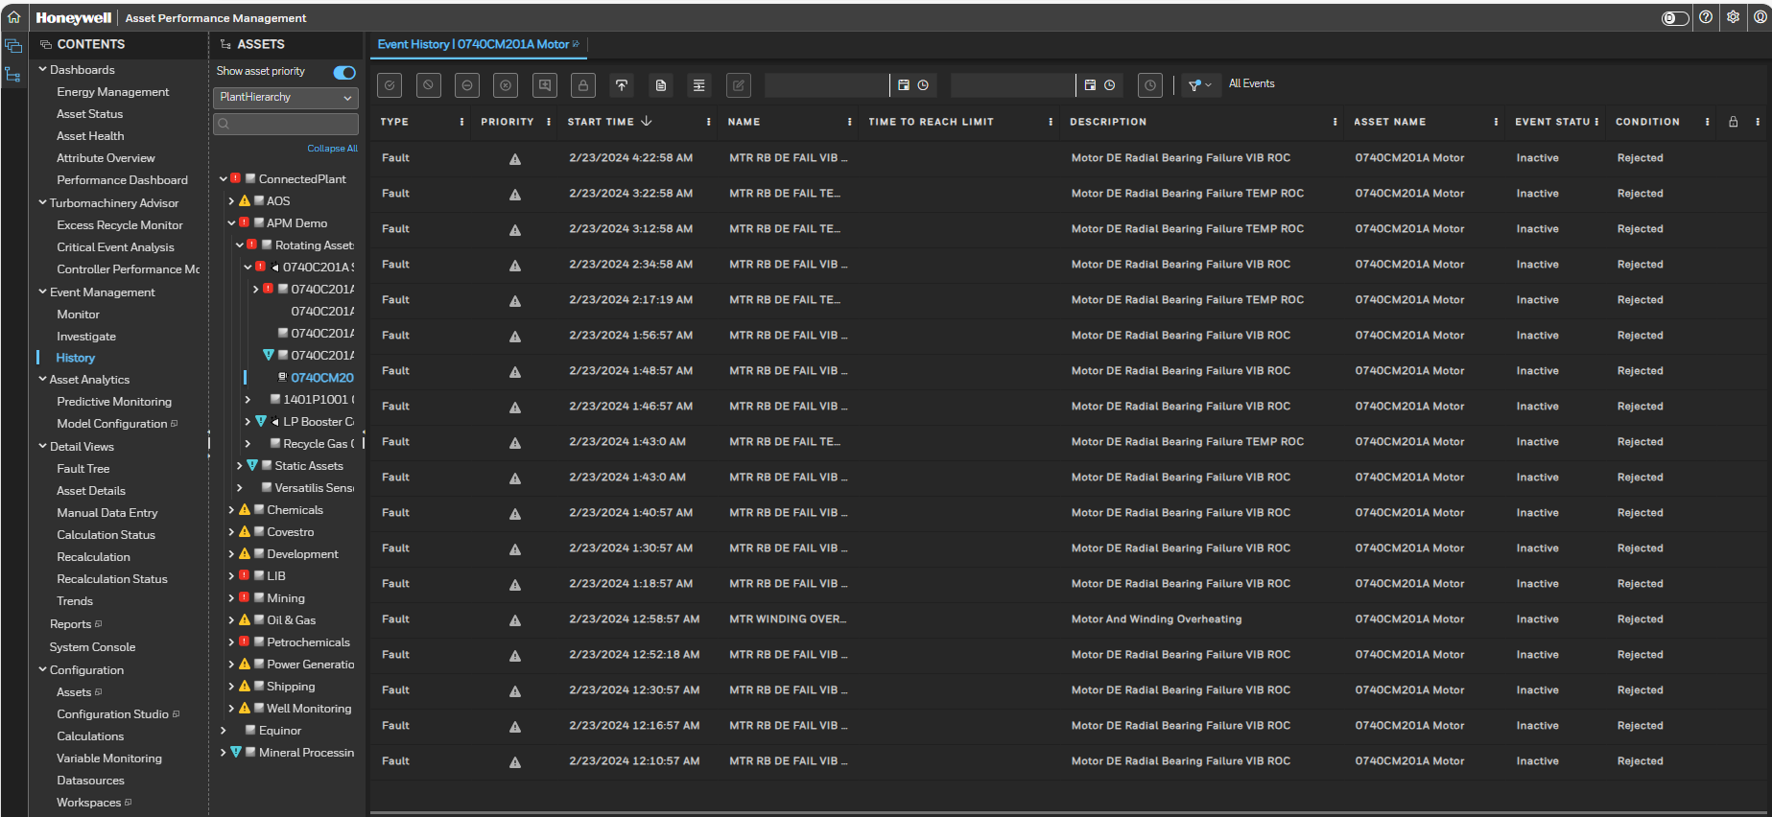
Event history
Event history Excel Report can be extracted from Asset Performance Manager Event Monitor Page for time period.

Slide 59
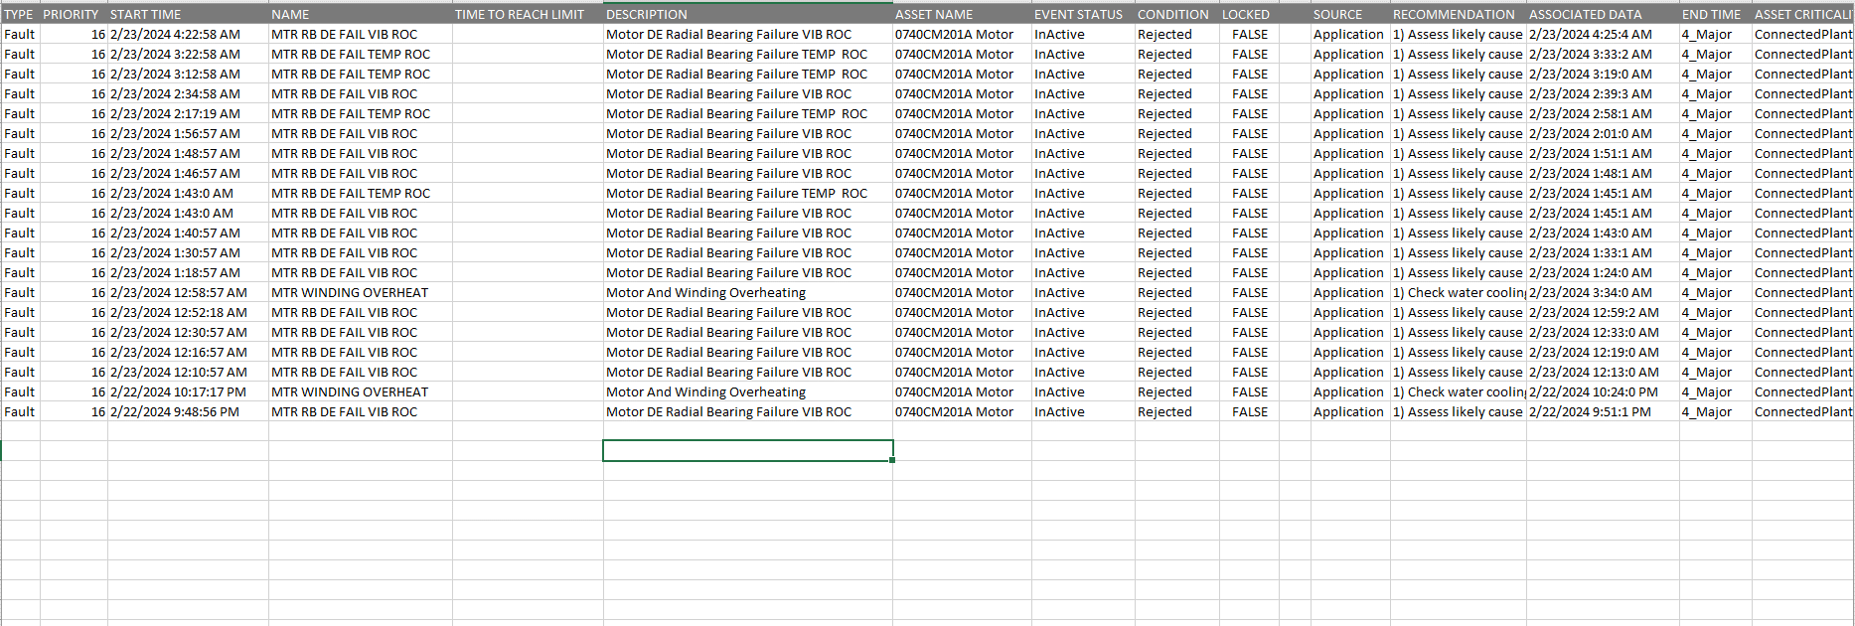
Event history
Event History Excel Report: It shows the Asset wise Fault-Symptoms details wit its recommended actions.

Slide 60
Module 5 APM - Type of Users & Roles

Slide 61
User access control
APM application will provide access to HQ staff as per below roles.
1) Administrator – Access to all dashboards, application & maintenance.
2) Operations – View only Access will be given fleet wise.
3) Engineer – Application Configuration
Role: A role defines a set of tasks that a user can perform and the data that a user can access. After a role is created, it is associated with a scope (set of equipment). When users are assigned, they automatically obtain the right to perform the tasks and gain access to the data.
Application default roles - Engineer, Operator, System Administrator, and View Only.
Sr. No. | User | Description
1 | Operation User | Monitoring- Operations.
2 | Engineer | Engineering & Tech Peoples
3 | Administration | IT, I&C and Automation Engineers

Slide 62
Reference Documents
Doc/Dwg No/Ref | Title | Revision
APMDOC-X481-en-R540.2 | Asset Performance Management Model Library Guide.pdf | R540.2
APMDOC-X391-en-R540.2 | Asset Performance Management Configuration Guide.pdf | R540.2
APMDOC-X390-en-R540.2 | Asset Performance Management Installation Guide.pdf | R540.2
APMDOC-X392-en-R540.2 | Asset Performance Management User’s Guide.pdf | R540.2
APMDOC-X448-en-R540.2 | Asset Performance Management DAS Plugin User Guide.pdf | R540.2

Slide 63

Q & A

