Slide 1
Honeywell
APM
<<Month>> <<Year>>
Admin Training – Asset Performance Management
Honeywell Internal

Slide 2
Agenda
Module 1 : Asset Performance Management (APM) – Introduction
Module 2 : APM – End User Training Modules
Module 3 : APM - Typical Architecture and Concepts
Module 4 : APM – Configuration Overview & Reports View
Module 5 : APM– Type of Users and Roles
Module 6 : APM – Security Configuration
Module 7 : APM – Maintenance and Troubleshooting

Slide 3
Module 1 Asset Performance Mangagement - Introduction

Slide 4
Learning Objective & Audience
This training is intended for asset management users and will aid them to understand the asset performance monitoring and its functionality. After completing this training, user will be able to perform the following tasks:
Navigate from Dashboard to Asset Performance Monitoring Application
Drilldown to the heat map and required asset
Monitor and investigate assets health status
View asset performance, attributes, trends, fault tree etc.
Plan action for faults to avoid future failures.
Maintain/administrate UAS system and enable to do the troubleshooting for some issues encountered in UAS
The course is intended for users for user who maintain/administrate Asset Performance Management system

Slide 5
Asset Performance Monitoring Overview
Who?
Operations
Process Engineer
Mechanical Maintenance or Reliability Engineer
When?
Daily
Why?
Monitor assets and predict/prevent problems and recommend actions.
How?
Using Fault tree, Health Index, Asset Performance Management, Heat Map, reports and trends.

Slide 6
Performance Models
Process Performance Monitoring Models in Asset Performance Management help you do the following:
Use faults, symptoms and fault models so your operators can be informed about the potential damage in assets under unfavorable operating conditions.
Use fault management for KPIs, so your operators can be informed about violations of the nominal asset operating range and deviations from the expected characteristics.
Run the process more efficiently with the help of online thermodynamic based performance calculations for process equipment.
Track key performance indicators in real-time and compare against target operation values.
Improve operating margins by avoiding unnecessary shutdowns.
Prioritize and plan maintenance activities with better decision making.

Slide 7
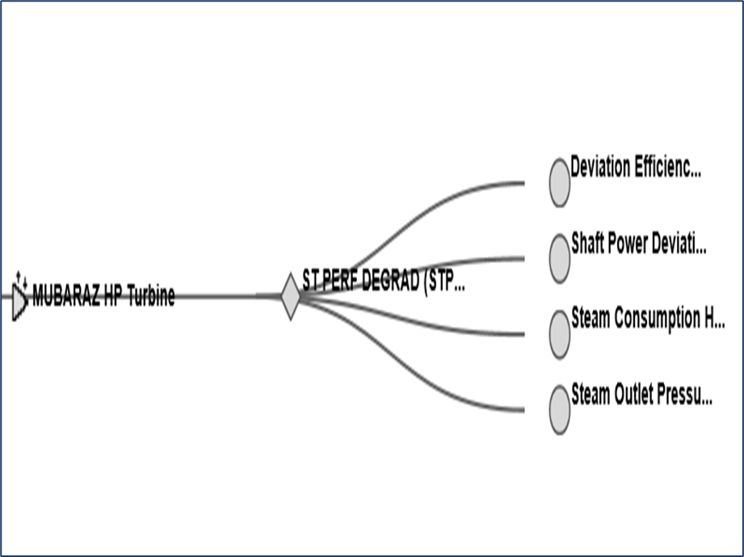
Health & Fault Models
Health and Fault Models in Asset Performance Management help you do the following:
Health models allow for traditional health monitoring relative to established alarm limits
Health models monitor and record standard KPI’s such as RUL, machine availability, efficiency, power, running status or status of needed maintenance, etc..
Fault models provide a ready form of fault tree for identifying where in a system a fault or alarm is creating impact. It also assists in drilling to root cause of faults.
Fault Tree

Slide 8
Advantages/Scope of APM
Monitoring critical parameters to perform predictive and preventive analysis.
Easy identification of root cause.
Standard calculations/monitoring across all sites for similar equipment/plants.
Readily available quality data.
Integration of data with relevant source system.
Removal of time-consuming manual work in collecting, validating and processing the data.
Data analysis in the form of trends.
Monitor past data by moving back in time.
Capture abnormal variation in trends using annotations.

Slide 9
Module 2 APM- End User Training Modules

Slide 10
Module 3 APM- Typical Architecture and Concepts

Slide 11
Asset Performance Management
Asset Performance Management is an application designed and developed by Honeywell to monitor close to near real time, maintain, and track the reliability of assets in a plant.
Asset Performance Management identifies the failures at an early stage and notifies through event monitor window, heatmap, Fault Tree, Performance View, Trends, Equipment Display and Email Notification which eliminates the unplanned downtime.
The monitoring and quick identification of failures helps in taking decisions and planning for maintenance.
The Reliability Engineer uses the Asset Performance Management application in a plant/ship to monitor the reliability of equipment such as, turbines, engines, reduction gears, generators, pumps, valves, heat exchangers, and to identify any failure/fault.
The application provides various operating conditions of an equipment to the operator. It also consists of a calculation engine that helps the operator to calculate efficiency, ship load factor, and failure modes depending on the operating conditions. It cleanses data before using in models.
In-built Performance and Fault Symptom models for major equipment types like Centrifugal pump, Centrifugal Compressor, Furnace, Heat Exchangers etc., are available in the system. Capable of customizing the fault and calculation models
Allows linking of all related documents to the asset/equipment

Slide 12
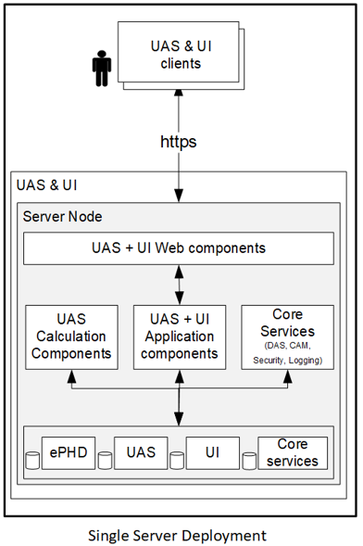
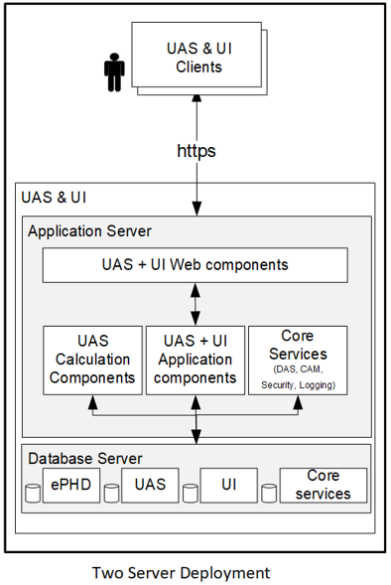
APM Typical Architecture’s

Slide 13
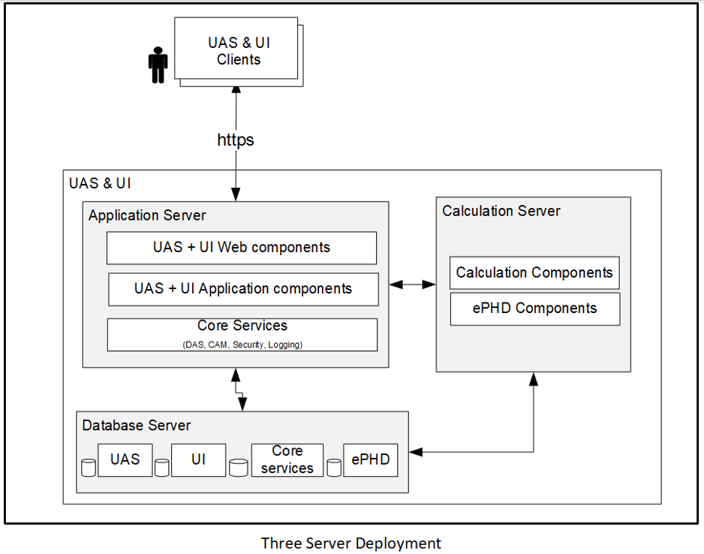
APM Typical Architecture’s

Slide 14
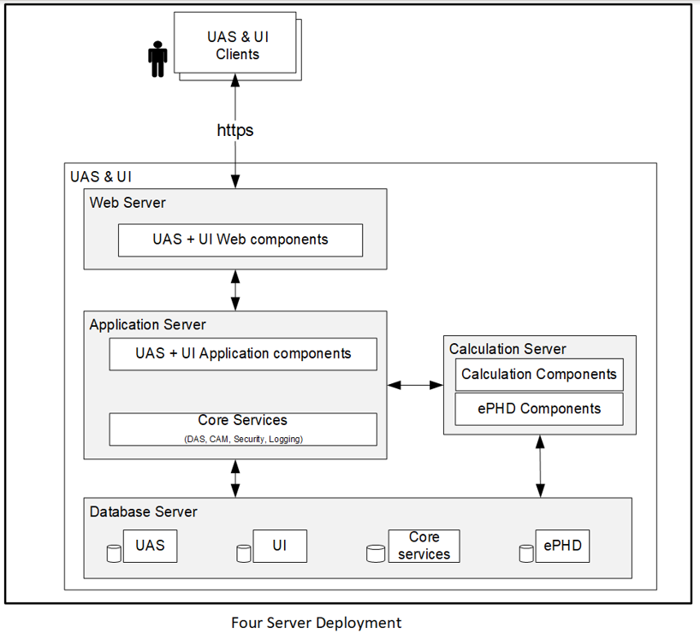
APM Typical Architecture’s

Slide 15
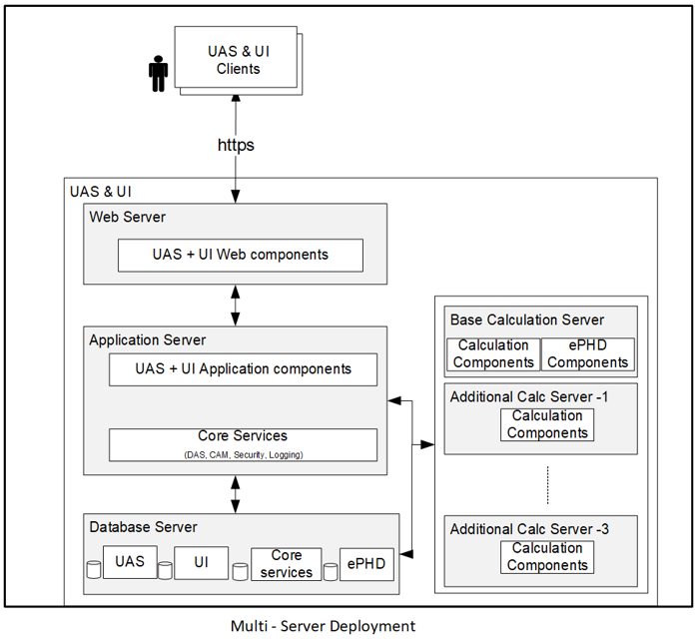
APM Typical Architecture’s

Slide 16
APM Concepts

Slide 17
Data Sources
User can configure data source for connecting to the external applications like OPC, Excel, DAS etc., to read and write the data.
Configured data source acts as an interface between UAS and external application.
The following data sources are configured in Asset Performance Management:
OPC DA
OPC HDA
PHDAPI
DAS
Excel

Slide 18
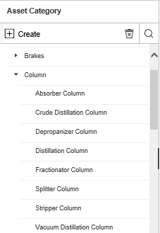
Asset class and types
Asset Class
Asset classes are custom grouping of assets based on the common characteristics of different types of equipment.
An example of an asset class is a Pump. Different types of pumps like the centrifugal pump, reciprocating pump, rotary pump, and so on are grouped under the Pump class.
Asset Types
Asset Type is the next level of grouping similar assets. An Asset class can have one or more asset types. The asset type represents the primary purpose of the asset, model, and the revision of the device.

Slide 19
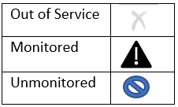
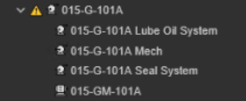
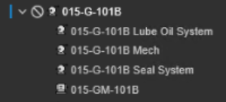
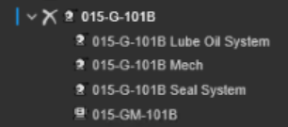
Asset & Asset status
Asset
Asset is an entity at the finest level of granularity within the system, on which you want to Perform data manipulations, tag mapping or calculations. View the status, collect metrics, or report information.
Asset Status
Asset status changes in field due to planned maintenance, unexpected event and trip unit or put in service. In Asset Performance Management, the asset is in one of the following modes or States
Monitor: Asset calculations and rules are configured to execute. The asset is available for operation when required.
Un-Monitor: Asset calculations and rules are disabled. The asset is available for operation when required.
Out of Service: Asset calculations and rules are disabled. The asset is NOT available for

Slide 20
Asset Attributes & property
Attributes
Asset attributes are dimensions associated to fault model/symptoms or calculations for its identification.
For Example – Voltage, Flow, Density
Attribute Property
Properties are additional information of attribute to support improved visualization and managing attribute.

Slide 21
Fault model & symptom
Fault – Fault is defined to identify the abnormality of an Equipment
Symptom – Symptoms are defined based on the possible causes for the Fault
Reactive Symptoms (Backward Chaining) events shall represent diagnostic conditions that characterize the effect of the failures that are represented by the faults they are associated to.
Diagnostic Symptoms shall be used as reactive indicators to warn users of imminent failure
These symptoms shall present advisories or corrective actions on how to repair the failure they are associated to.
Diagnostic Symptoms names shall be configured to start with “DS_”.
Proactive Symptoms (Forward Chaining) events shall represent root cause conditions that can lead to failures that are represented by the fault they are associated to.
Root Cause symptoms shall be active generally before a failure is present.
These symptoms shall present Advisories or corrective actions to remove or mitigate the root cause and prevent the failure from occurring.
Root Cause symptom names shall be configured to start with “RC_”.

Slide 22
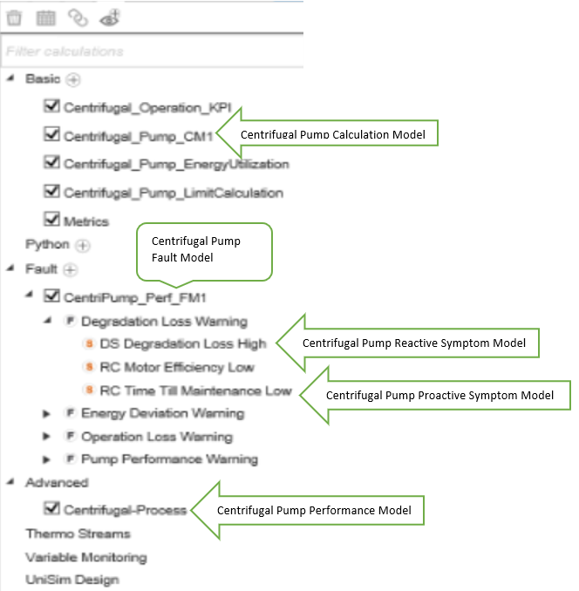
Fault model & symptom

Slide 23
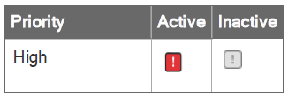
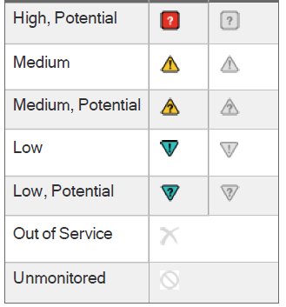
Event status
All events travel through transition statuses during their life cycle in Uniformance Asset Sentinel:
Potential: one or more symptoms is active, but the fault conditions have not been reached.
Active: the expression associated with the event (for example, a fault or symptom) returns value of !=0.
Inactive (Deactivated): the expression associated with the event (for example, a fault or symptom) returns value of 0.
Accepted: the event haves been accepted by a user to address.
Locked: event is locked by the user, so the state does not change irrespective of the fault or the symptom condition. This is typically used to avoid duplicate events when the event is being addressed in field.
Closed: event has been closed by the user (includes a record of the reason code, comments).
Rejected: event has been falsely identified by the system and rejected by a user (possibly marked as a false positive).

Slide 24
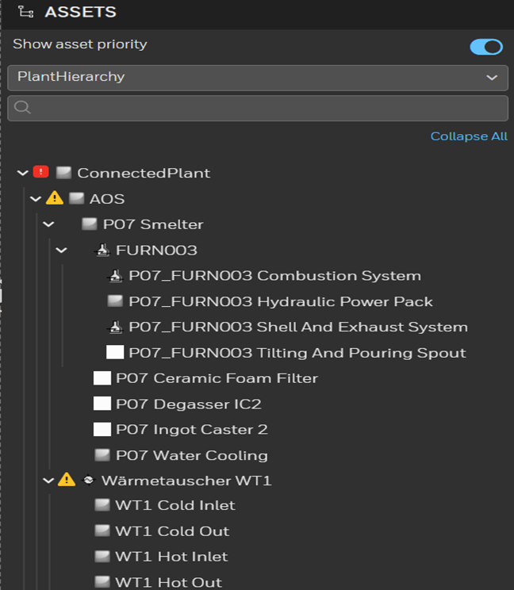
Hierarchy
Asset Hierarchy
In Asset Performance Management , an asset hierarchy is created to classify an asset into several segments and represent the segments in the tree view. The hierarchy enable you to view the whole structure of the plant in a graphical tree.
Custom hierarchy – Assets can be grouped under a different category based on the monitoring requirement and can be viewed as a sperate hierarchy. For example, static equipment monitored, rotating equipment monitored.

Slide 25
Module 4 APM – Configuration Overview & Reports view

Slide 26
APM – Configuration Overview

Slide 27
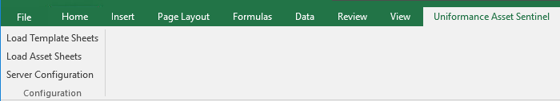
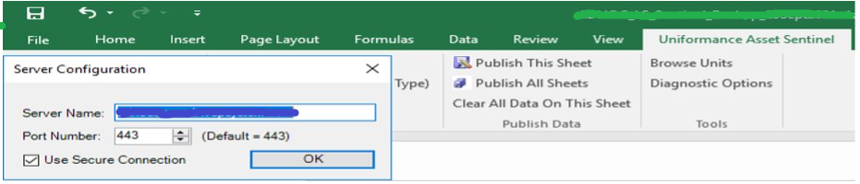
APM – Bulk Configuration Tool
Using Bulk Configuration sheet-
Open the any excel file and Select the “Uniformance Sentinel” tab.
Click on “Load Template Sheets” and all the sheets related to Asset Templates will get loaded.
Uncheck the Use Secure Connection Box and click Load template sheets.
27

Slide 28
Bulk Configuration Sheet
Using the Sentinel Configuration Excel Plugin, you can,
a) Create, update, or delete assets and other system data.
b) Retrieve data from the Uniformance Asset Sentinel database.
c) Upload data to the Uniformance Asset Sentinel database.
There are two categories of sheets for configuring asset data: template sheets and asset sheets.
1) Template sheet
2) Asset Sheet

Slide 29
Bulk Configuration Sheet
The Asset Templates Configuration consists of the following steps (for Bulk Configuration):
Asset Class
Asset Type
Asset Type Attributes
Basic Calculation
Fault
The Asset Instances Configuration consists of the following steps (for Bulk Configuration):
Assets
Assets Calculation
Asset Calculation Mapping
Asset Attribute Mappings Configuration

Slide 30
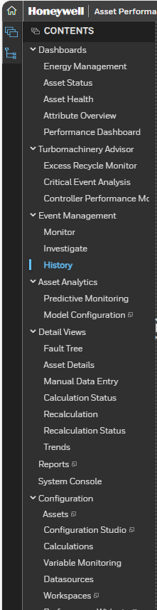
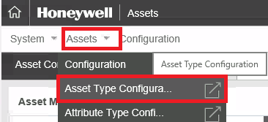
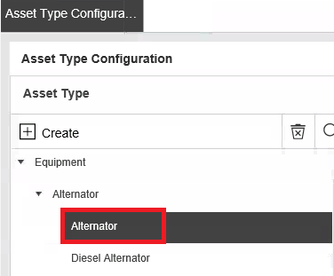
APM – User Interface - Attributes
2
To add an attribute:
On the CONTENT Menu, Click on the Asset under Configuration
Select Asset Type Configuration under Asset dropdown.
In the Tree View under Asset Type pane, expand the asset class you created and click the asset type.
2
3
3
1

Slide 31
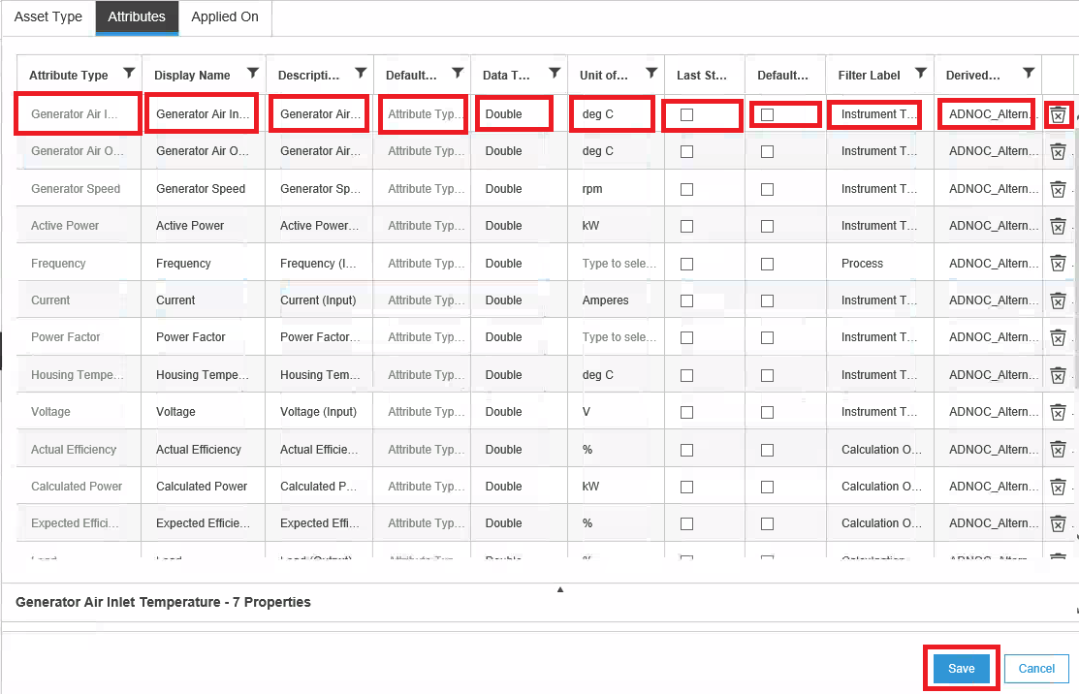
Attributes (Contd.)
To add an attribute:
Click on the Attribute Tab to create attribute.
Click on the blank cell to add a new attribute or edit existing attribute.
In the Display Name box, type the name of the attribute. The Display Name box is used for localization.
In the Description box, provide more details about the attribute.
Enter Attribute type
From the Data Type drop-down list, select the data type to which the attribute belongs to.
Enter Unit of Measure of attribute.
Check if last state to be displayed.
Check if to be historized by default.
4
5
6
7
8
9
10
11
12
13
14
15
17

Slide 32
Attributes (Contd.)
4
5
6
7
8
9
10
11
12
13
14
15
To add an attribute:
In the Filter Category box, mention any filtering criteria to segregate the attribute. Eg: Input, Output, KPI.
It shows the selected attribute is derived from its class.
Click to delete existing attribute if required.
Click Save to save the attribute. The attribute is saved and displayed in the Attribute Configuration pane.
16

Slide 33
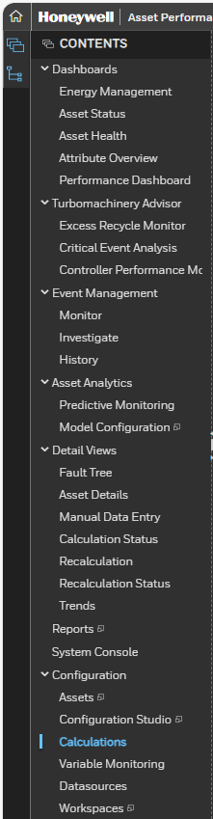
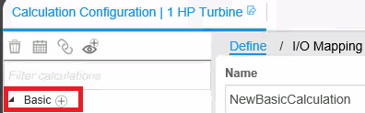
APM – User Interface - Calculation Models
To add a calculation:
Click on the Calculations for selected asset.
On Calculation Configuration tab, click on “+” button to create Basic calculation.
2
1

Slide 34
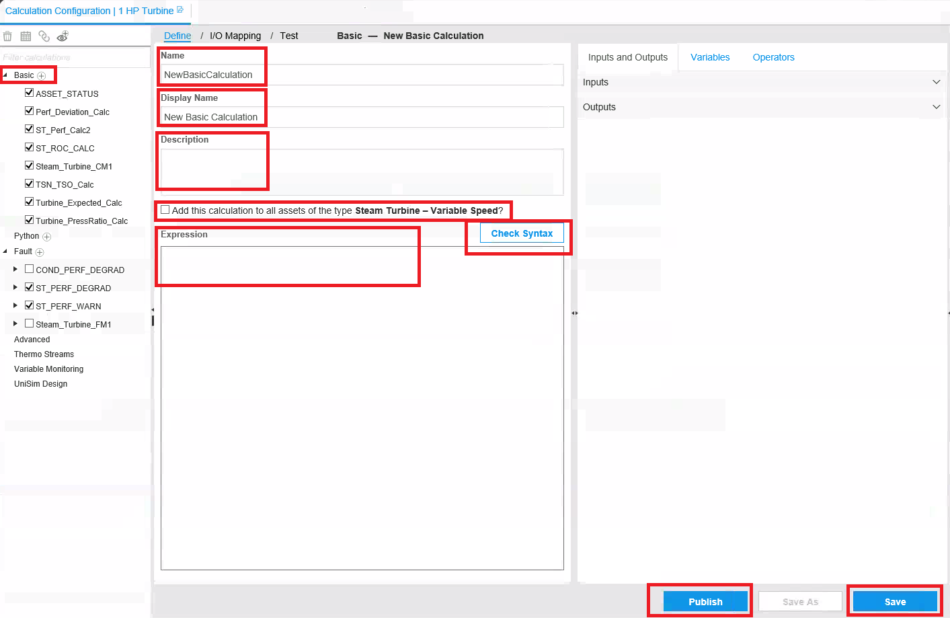
Calculation Models (Contd.)
3
To add a calculation:
In the Name box, type the name of the calculation.
In the Display Name box, type the name of the calculation.
In the Description box, type the description of the calculation.
Check the box if required to add for asset type of selected asset
In the Expression box, type the expression for the calculation.
Click Check Syntax to validate your expression.
Click on the Save button to save the model.
Click on the Publish button to publish calculation model.
4
5
6
7
8
10
9

Slide 35
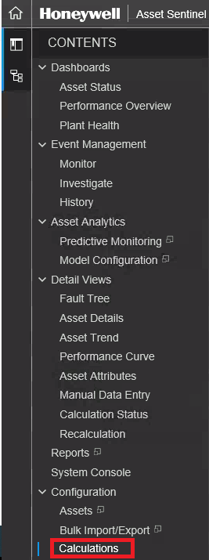
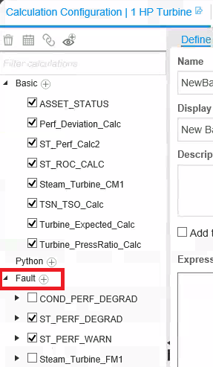
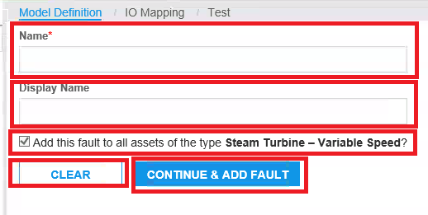
APM – User Interface - Fault Models
To add a calculation:
Click on the Calculations for selected asset.
On Calculation Configuration tab, click on “+” button to create Basic calculation.
Enter Name and Display Name of the Fault Model in the respective boxes.
Check the box if required to add for asset type of selected asset
Click on button to continue to add Fault.
Clear the content if required.
3
3
4
5
6
1
2

Slide 36
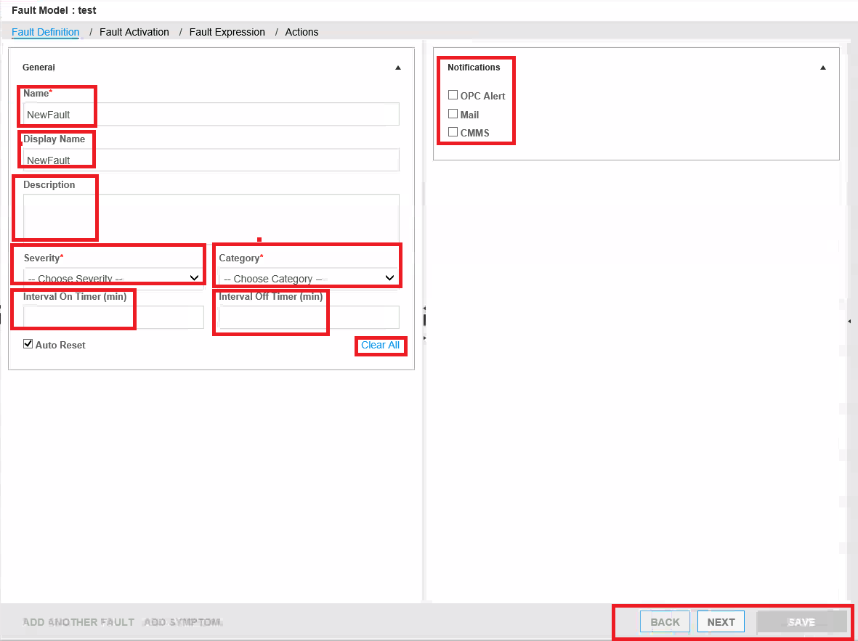
Fault Models (Contd.)
12
7
In the Name, Display Name and Description boxes, type the name of the Fault.
Select the severity of the fault from the dropdown list.
Select the category of the fault from the dropdown list.
Type the time interval for which the fault should be activated to trigger an event.
To clear all content
In the Notification, select the method you want to send the notification for the event.
Click on Next or back or Save.
7
7
10
8
10
9
11
13

Slide 37
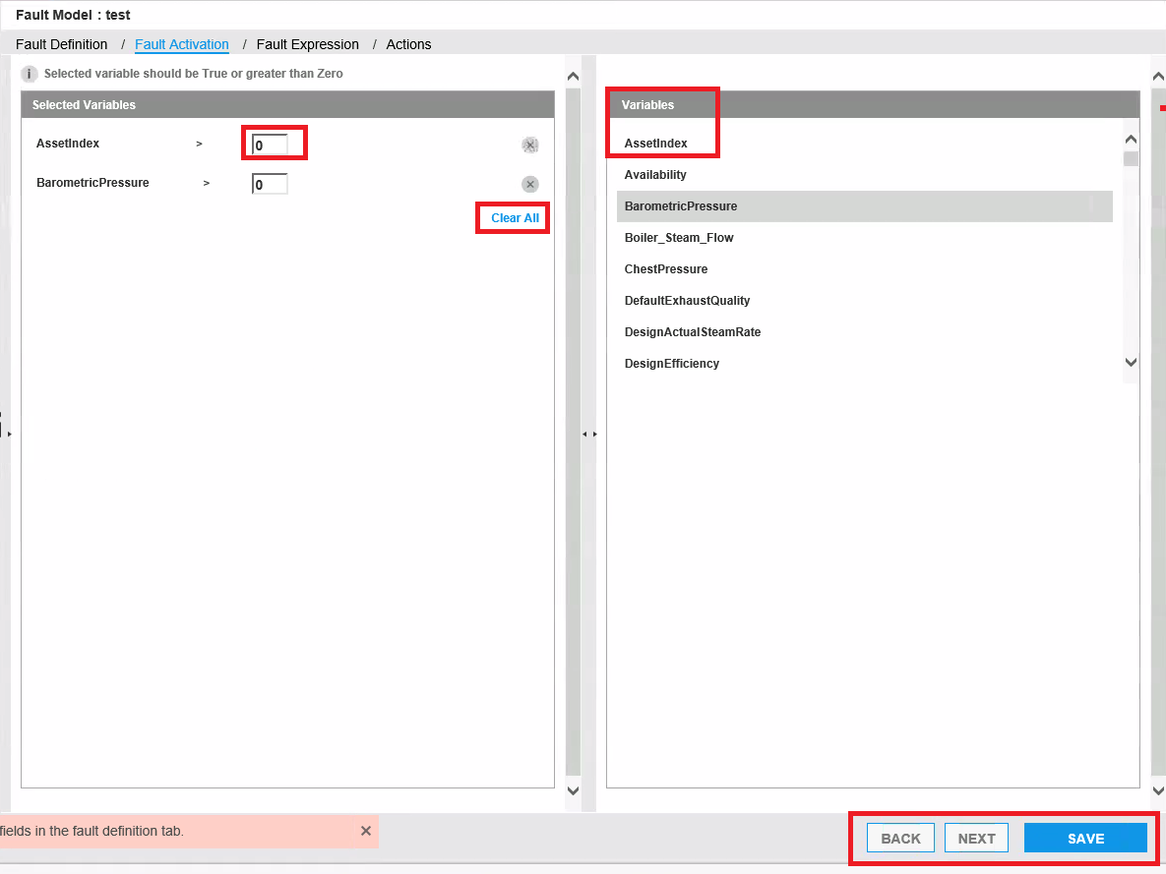
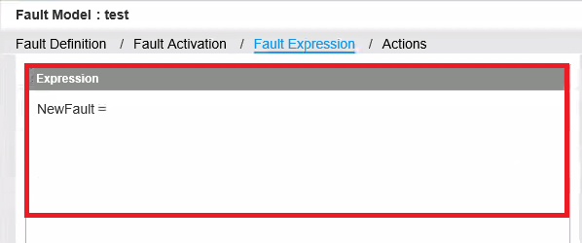

Fault Models (Contd.)
14
15
In the Variable, select the context variable based on which the event will get triggered.
Enter the value for variable to get fault activate.
To clear all content.
Click on Next or back or Save.
Enter the Expression for Fault.
Click on Next or back or Save.
16
18
19
37
17

Slide 38
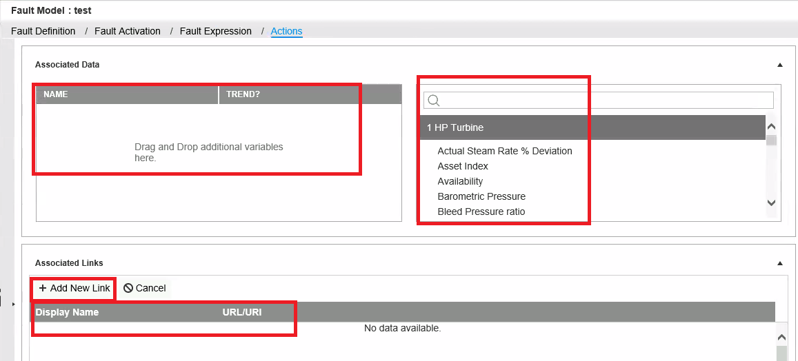
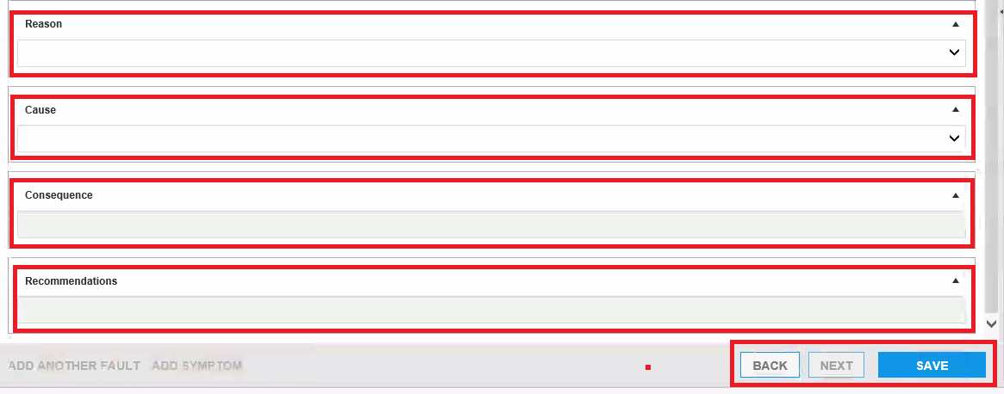
Fault Models (Contd.)
21
20
Select the existing variable for asset for trend.
Drag the variable for trend
To add any link, click on “+” button.
Enter the Display name and URL of the link.
Select the Reasons from the dropdown
Select the Cause from the dropdown
Select the Consequence from the dropdown.
Select the Recommendations from the dropdown.
Click on back or Save.
22
23
24
25
26
27
28

Slide 39
APM – Reports View

Slide 40
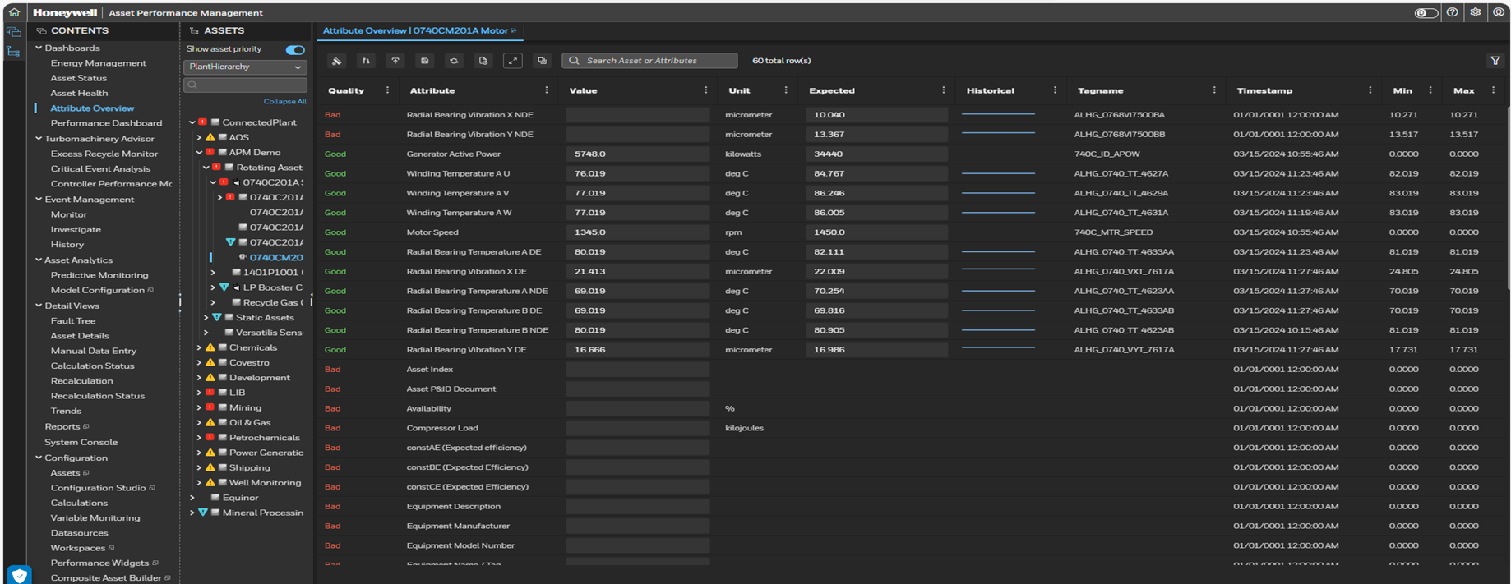
Attribute overview
Attribute Overview Excel Report can be extracted from Asset Performance Management Attribute Overview Page.
Click on “Export to Excel” button.
Excel Report get downloaded from Attribute Overview Dashboard.

Slide 41
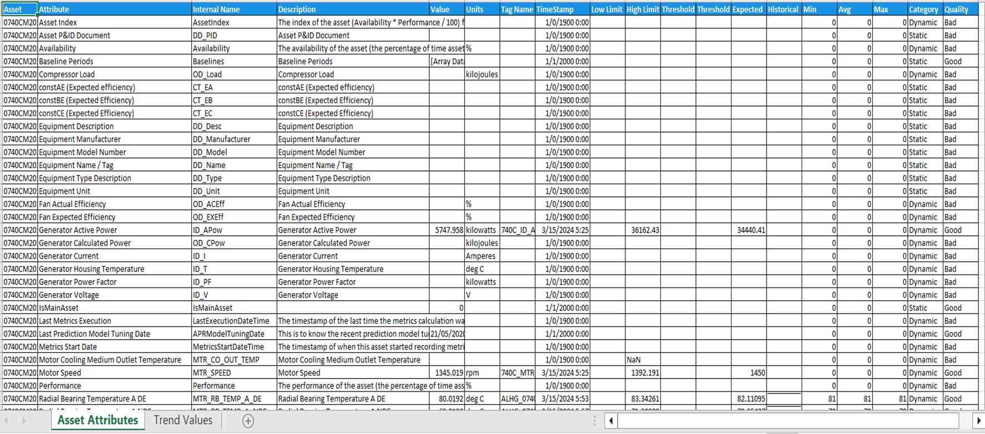
Attribute overview
Asset Attribute: Asset Attribute Report for selected Asset get displayed with its details as Current values, UoM, TagName, Low and High Limit etc.

Slide 42
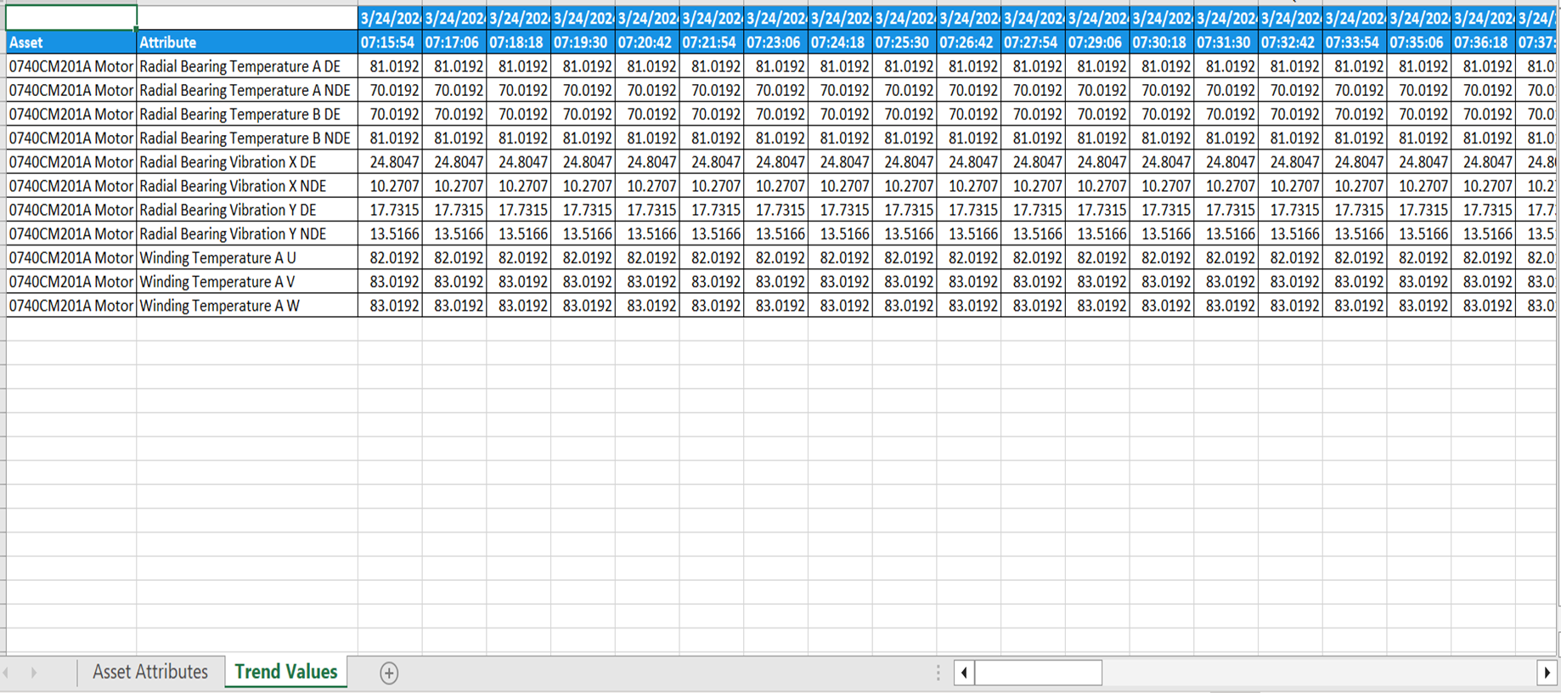
Attribute overview
Trend Values: It reports the Asset Attribute data with date time stamp in Tabular Format

Slide 43
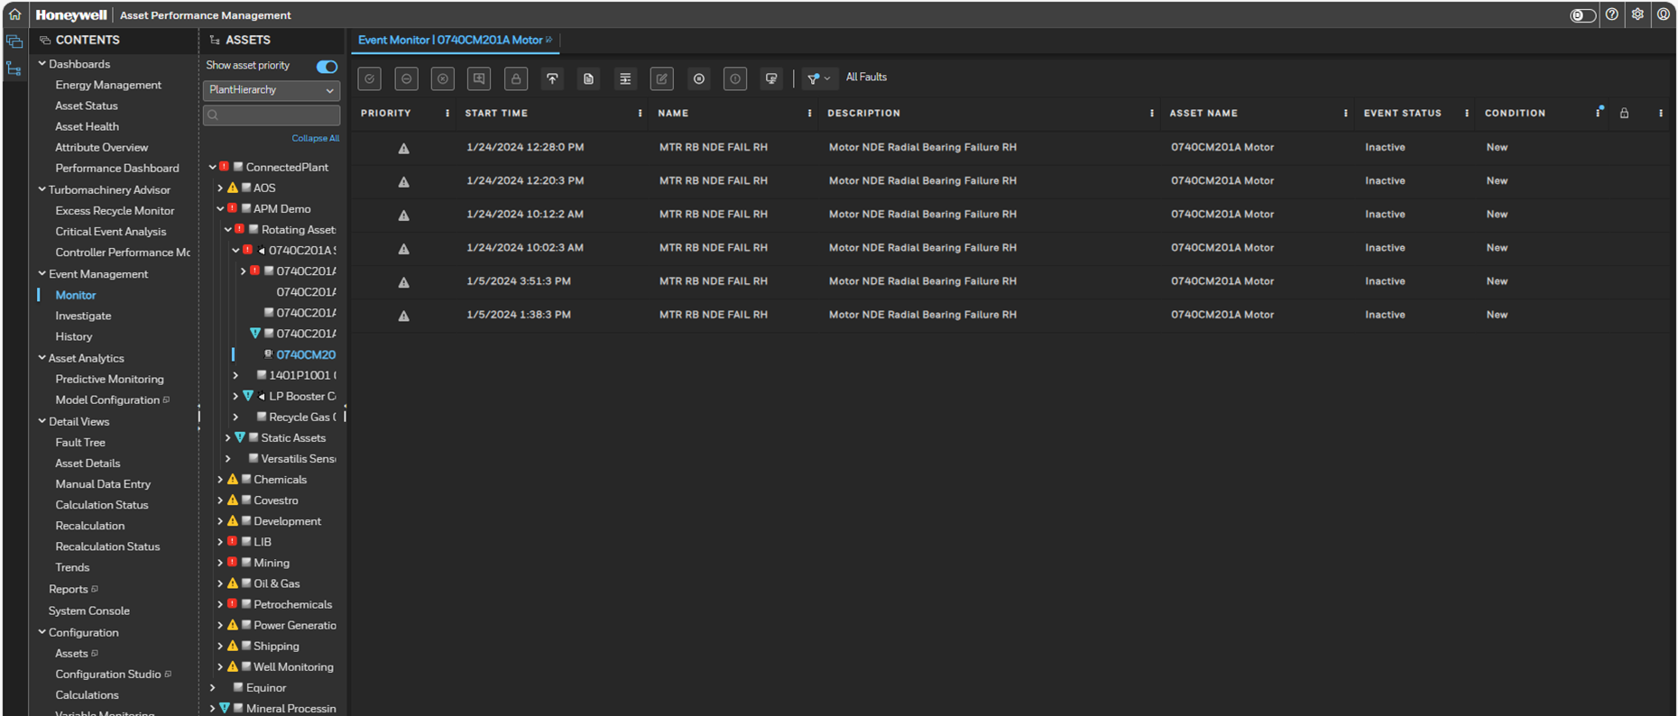
Event monitor
Event Monitor Excel Report can be extracted from Asset Performance Manager Event Monitor Page

Slide 44
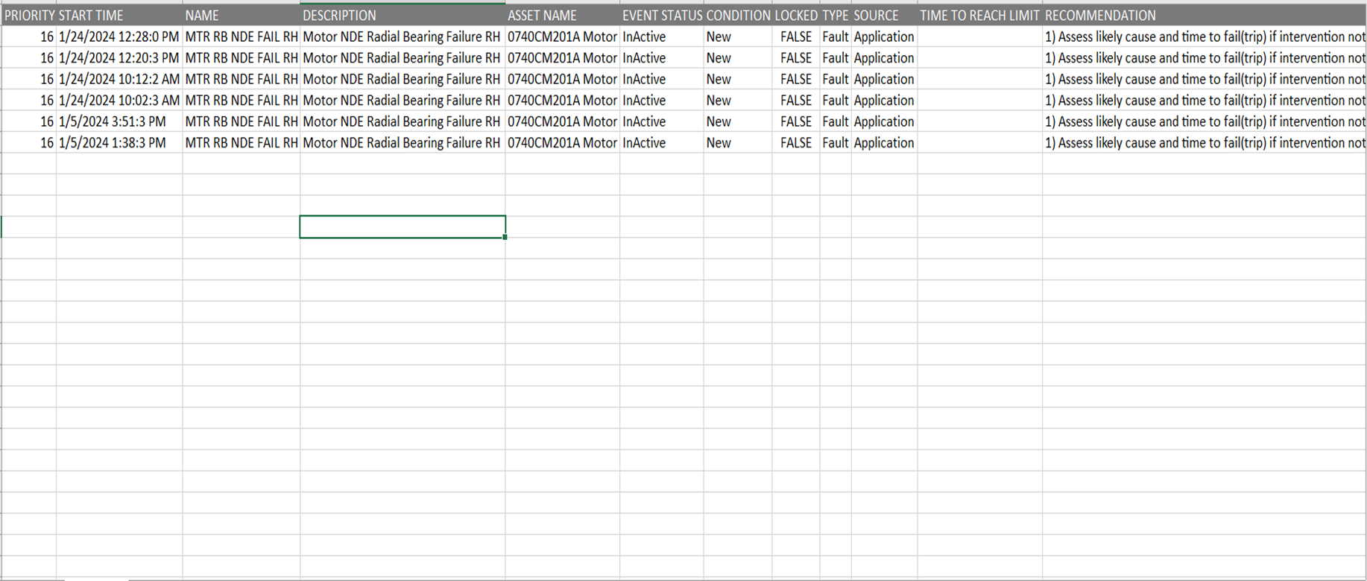
Event monitor
Event Monitor Excel Report: It shows the Asset wise Fault-Symptoms details wit its recommended actions.

Slide 45
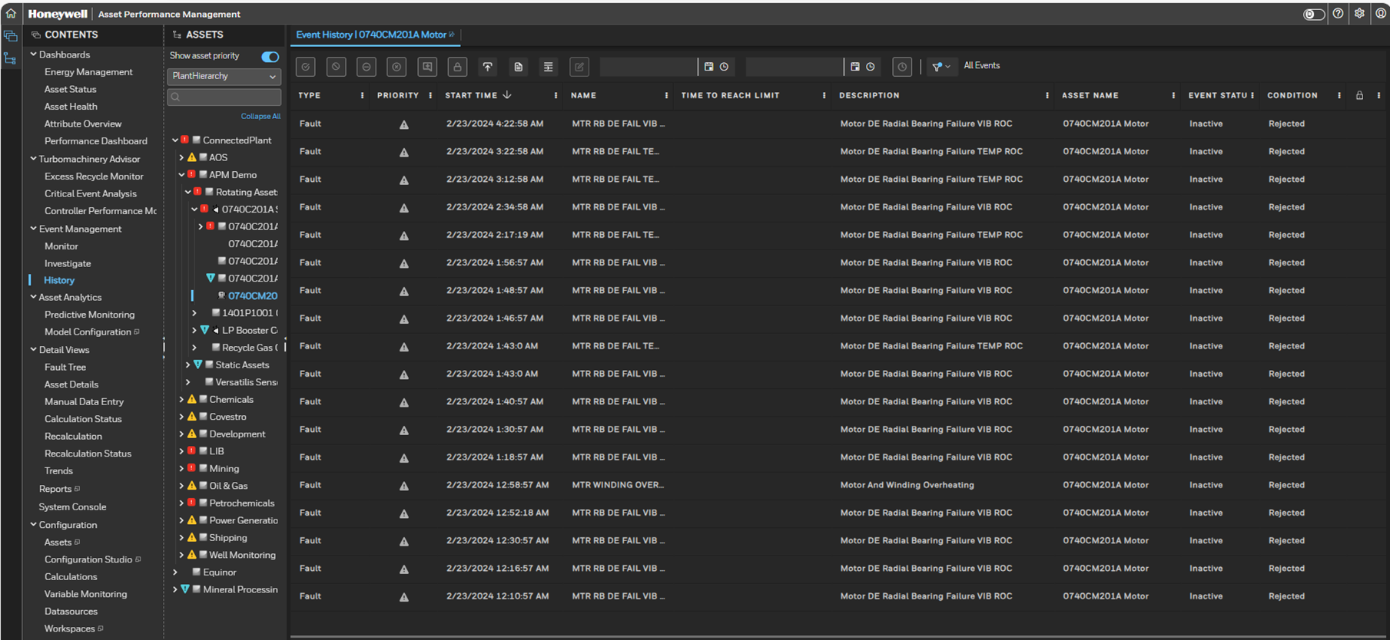
Event history
Event history Excel Report can be extracted from Asset Performance Manager Event Monitor Page for time period.

Slide 46
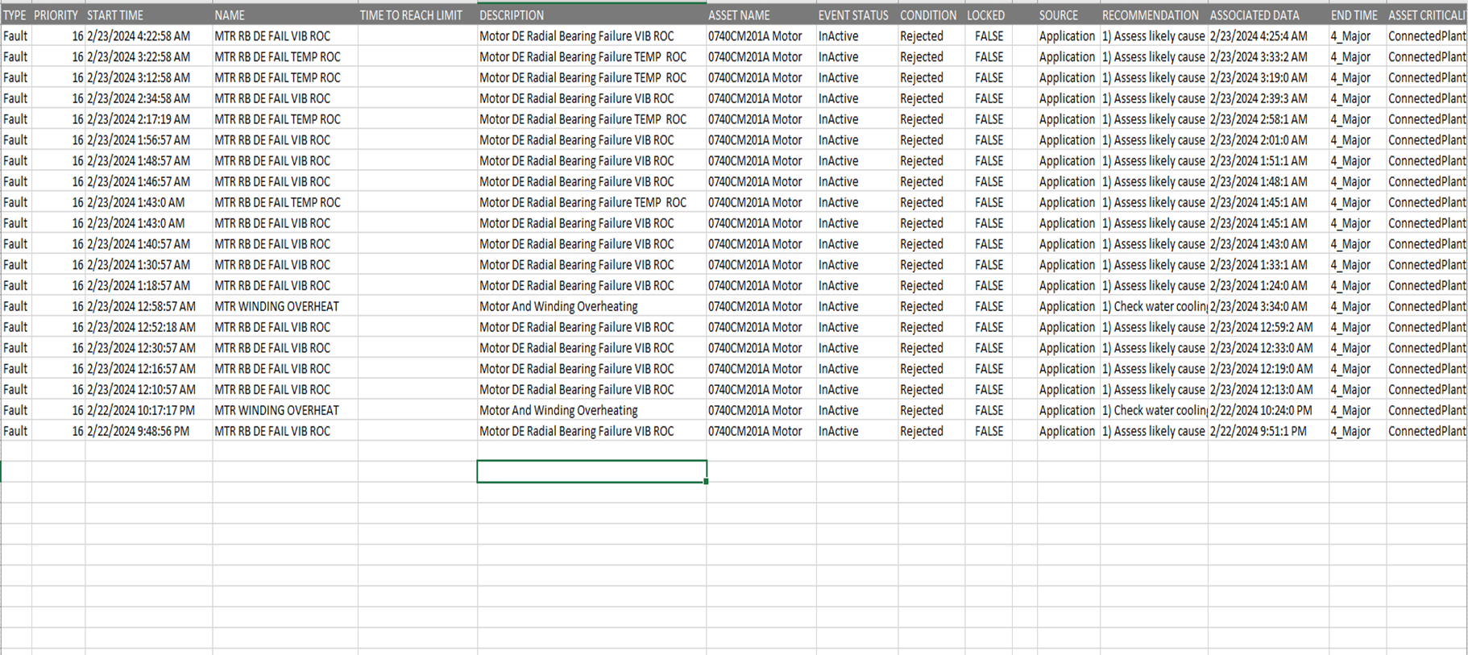
Event history
Event History Excel Report: It shows the Asset wise Fault-Symptoms details wit its recommended actions.

Slide 47
Module 5 APM - Type of Users & Roles

Slide 48
User access control
UAS application will provide access to HQ staff as per below roles.
1) Administrator – Access to all dashboards, application & maintenance.
2) Operations – View only Access will be given fleet wise.
3) Engineer – Application Configuration
Role: A role defines a set of tasks that a user can perform and the data that a user can access. After a role is created, it is associated with a scope (set of equipment). When users are assigned, they automatically obtain the right to perform the tasks and gain access to the data.
Application default roles - Engineer, Operator, System Administrator, and View Only.
Sr. No. | User | Description
1 | Operation User | Monitoring- Operations.
2 | Engineer | Engineering & Tech Peoples
3 | Administration | IT, I&C and Automation Engineers

Slide 49
Module 6 APM - Security Configuration

Slide 50
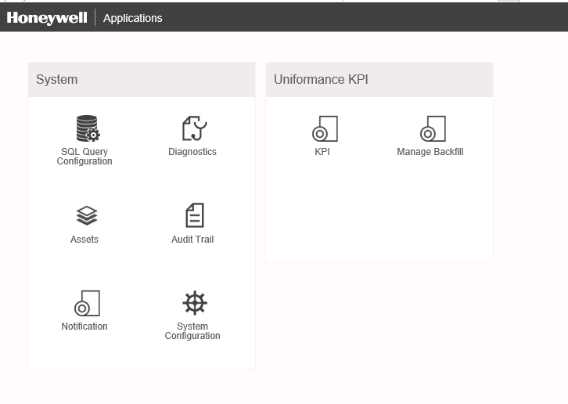
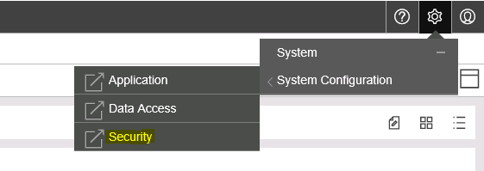
Security Role Configuration
Navigate to home page.
Select System Configuration under System box. Once page opens, select Security in the navigation links.
Alternately from any page in the Asset Sentinel application, mouse over the Settings icon and click on Security under System Configuration tab.
3
2
3
3

Slide 51
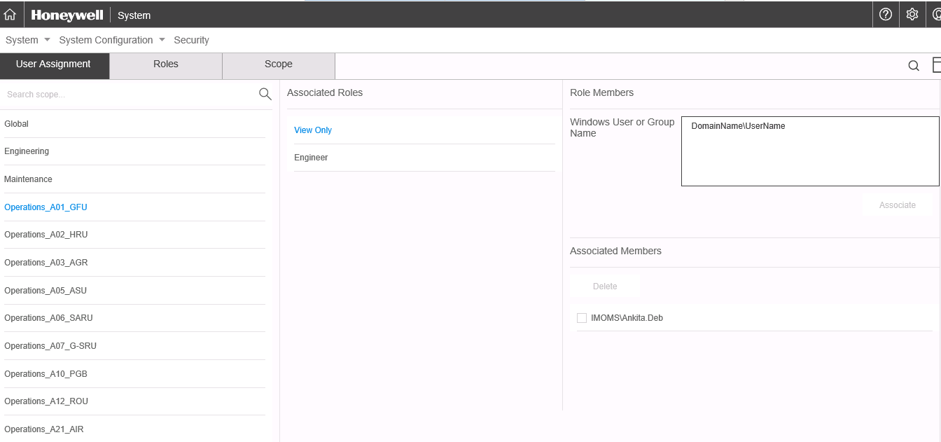
Security Role Assignment
For View Only User:
Select User Assignment in the Security page.
There are scopes created for each function: Engineering, Maintenance, Planning & HR and Operations (1 group for each plant).
Select the scope under which the new user needs to be added.
Click on “View Only” in the associated roles pane.
Type the user name in the “domain name\user name” format and then click on Associate.
The user name will get listed in the Associated members list.
To remove the access for a user, select the user name in the associated members list and then click on “Delete”.
1
4
5
3
5
7
6
7

Slide 52
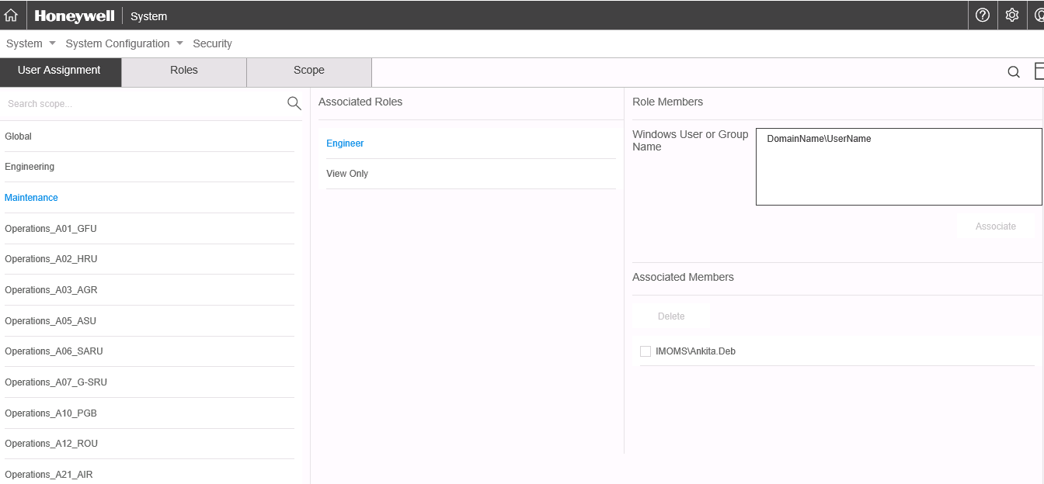
Security Role Assignment (Contd.)
For Power User:
Select User Assignment in the Security page.
There are scopes created for each function: Engineering, Maintenance, Planning & HR and Operations (1 group for each plant).
Select the scope under which the new user needs to be added.
Click on “Engineer” in the associated roles pane.
Type the user name in the “domain name\user name” format and then click on Associate.
The user name will get listed in the Associated members list.
To remove the access for a user, select the user name in the associated members list and then click on “Delete”.
1
5
4
3
5
7
6
7

Slide 53
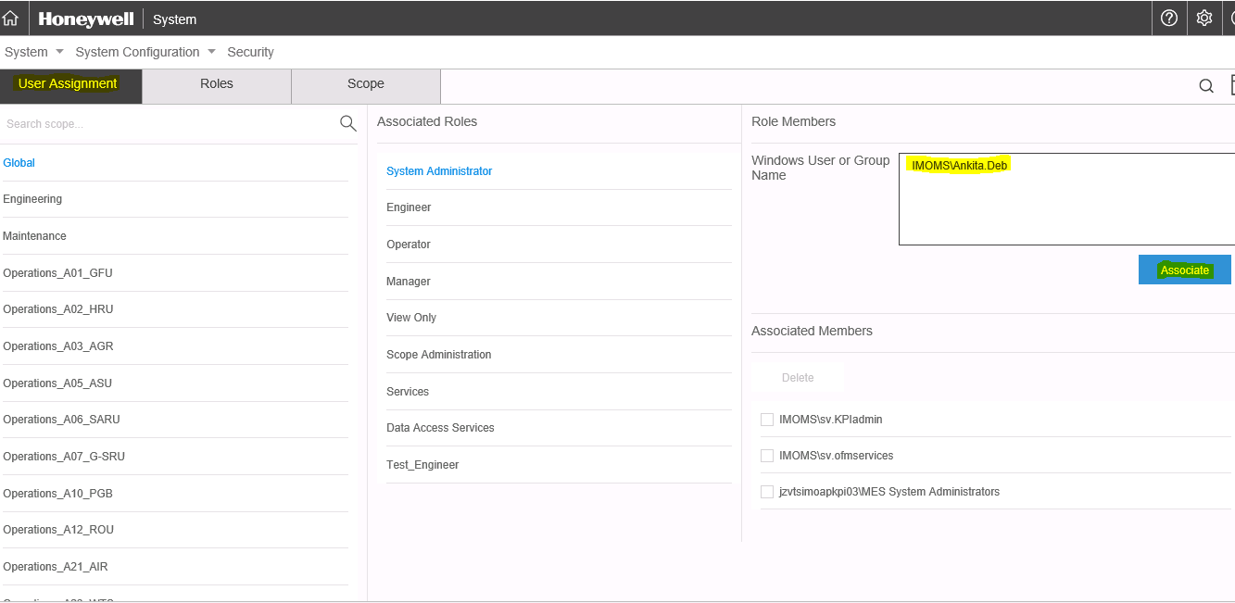
Security Role Assignment (Contd.)
For System Administrator:
Select User Assignment in the Security page.
Select the scope “Global”.
Click on “System Administrator” in the associated roles pane.
Type the user name in the “domain name\user name” format and then click on Associate.
The user name will get listed in the Associated members list.
To remove the access for a user, select the user name in the associated members list and then click on “Delete”.
1
2
3
4
4
6
5
6

Slide 54
Security Role Assignment (Contd.)
For System Administrator:
Select User Assignment in the Security page.
Select the scope “Global”.
Click on “System Administrator” in the associated roles pane.
Type the user name in the “domain name\user name” format and then click on Associate.
The user name will get listed in the Associated members list.
To remove the access for a user, select the user name in the associated members list and then click on “Delete”.
1
2
3
4
4
6
5
6

Slide 55
Module 7 APM – Maintenance and Troubleshooting

Slide 56
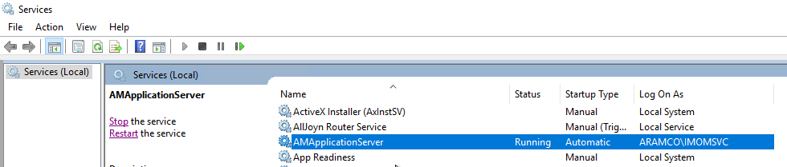
Asset Performance Management Service
56
Asset Performance Management Service
APM application uses the below windows services for executing calculation and checking the external datasource health.
This service is installed in APM calculation server.

Slide 57
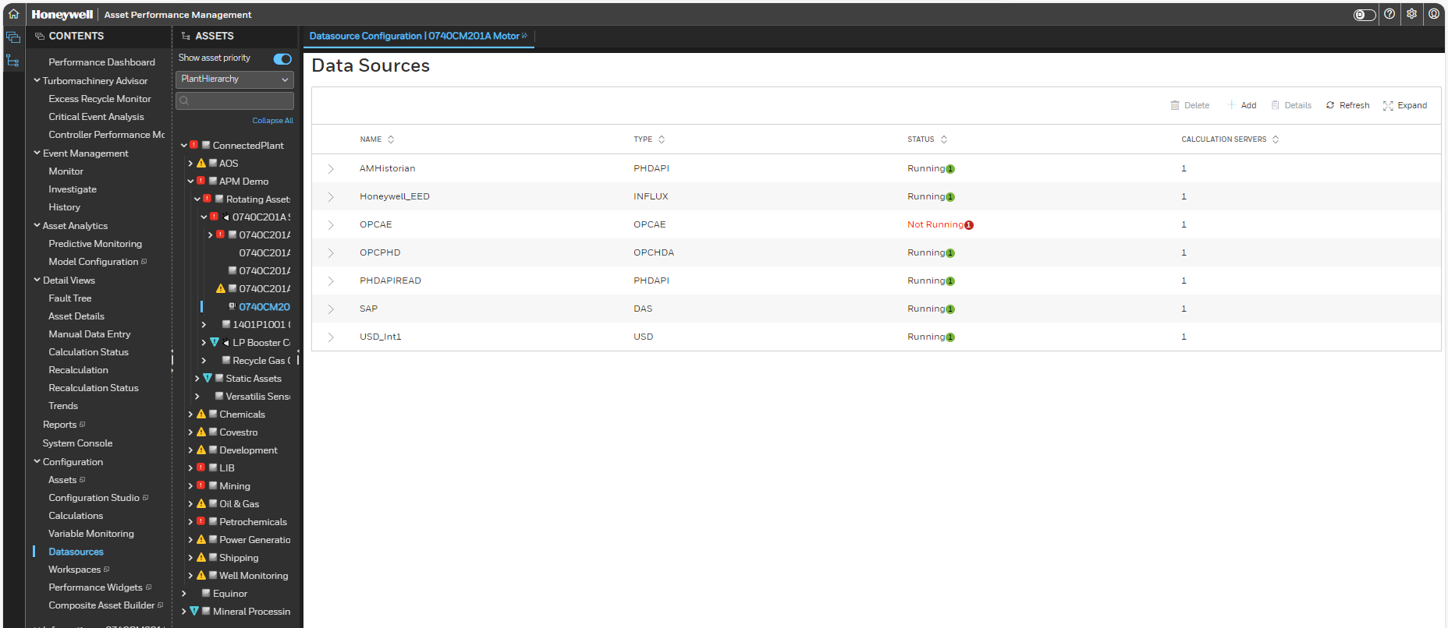
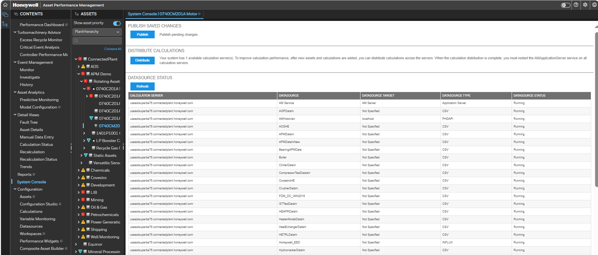
External Datasource Health
57
Detail View
If Data from the external datasource are not updating, from the System Console view status of the data source can be seen.
To test the connection between interface, navigate to Data Sources>>Select Datasource>>Details and click on Test Connection
System Console View

Slide 58
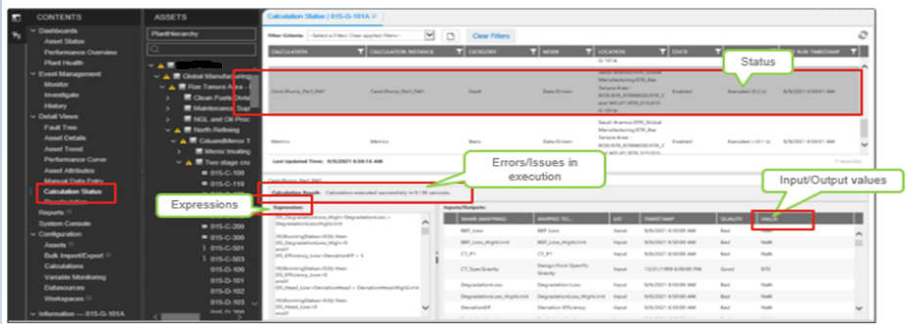
Viewing Calculation and Fault Model Execution status
58
Fault Model and Calculation execution status for each equipment shall be viewed from Calculation Status option.

Slide 59
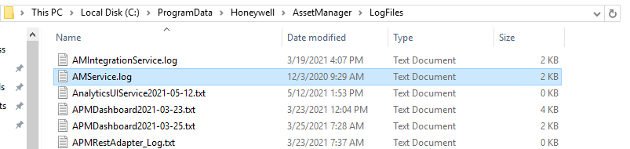
Application Logs
59
In Sentinel Application Server, Application Logs are available in the below path. All the issues related to application interface, services, fault/symptom/calculation execution is
C:\ProgramData\Honeywell\Asset Manager\LogFiles\AMservice.Log
Note: For more troubleshooting contents, refer to Asset Sentinel Troubleshooting guide

Slide 60
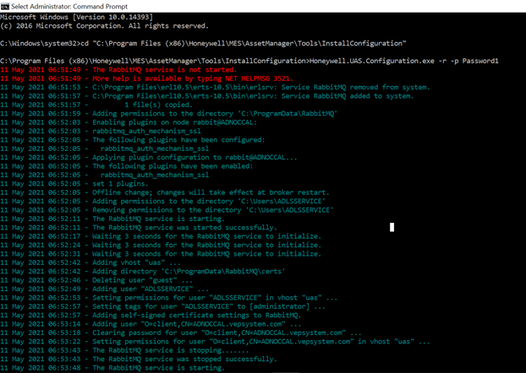
Rabbit MQ not starting
If services are not getting started do the RabbitMQ step as shown in screenshot.
Password – Service account

Slide 61
Reference Documents
Doc/Dwg No/Ref | Title | Revision
APMDOC-X481-en-5202A | Asset Performance Management Model Library Guide.pdf | R540.2
APMDOC-X391-en-532.3A | Asset Performance Management Configuration Guide.pdf | R540.2
APMDOC-X390-en-532.3A | Asset Performance Management Installation Guide.pdf | R540.2
APMDOC-X391-en-532.3A | Asset Performance Management User Guide.pdf | R540.2
APMDOC-X448-en-532.3A | Asset Performance Management DAS Plugin User Guide.pdf | R540.2

Slide 62

Q & A

