Slide 1
Honeywell
APM
<<Month>> <<Year>>
Power User Training – Asset Performance Management
Honeywell Internal

Slide 2
Agenda
Module 1 : Asset Performance Management (APM) – Introduction
Module 2 : APM – End User Training Modules
Module 3 : APM - Typical Architecture and Concepts
Module 4 : APM – Configuration & System Demo / Hands On
Module 5 : APM – User Roles and Permission

Slide 3
Module 1 Asset Performance Management - Introduction

Slide 4
Learning Objective & Audience
This training is intended for asset management users and will aid them to understand the asset performance monitoring and its functionality. After completing this training, user will be able to perform the following tasks:
Navigate from Dashboard to Asset Performance Monitoring Application
Drilldown to the heat map and required asset
Monitor and investigate assets health status
View asset performance, attributes, trends, fault tree etc.
Plan action for faults to avoid future failures.
Modify/Update the UAS configuration and enable to do the troubleshooting for some issues encountered in UAS
The course is intended for users for user who maintain/update Asset Performance Management configuration

Slide 5
Asset Performance Monitoring Overview
Who?
Operations
Process Engineer
Mechanical Maintenance or Reliability Engineer
When?
Daily
Why?
Monitor assets and predict/prevent problems and recommend actions.
How?
Using Fault tree, Health Index, Asset Performance Management, Heat Map, reports and trends.

Slide 6
Performance Models
Process Performance Monitoring Models in Asset Performance Management help you do the following:
Use faults, symptoms and fault models so your operators can be informed about the potential damage in assets under unfavorable operating conditions.
Use fault management for KPIs, so your operators can be informed about violations of the nominal asset operating range and deviations from the expected characteristics.
Run the process more efficiently with the help of online thermodynamic based performance calculations for process equipment.
Track key performance indicators in real-time and compare against target operation values.
Improve operating margins by avoiding unnecessary shutdowns.
Prioritize and plan maintenance activities with better decision making.

Slide 7
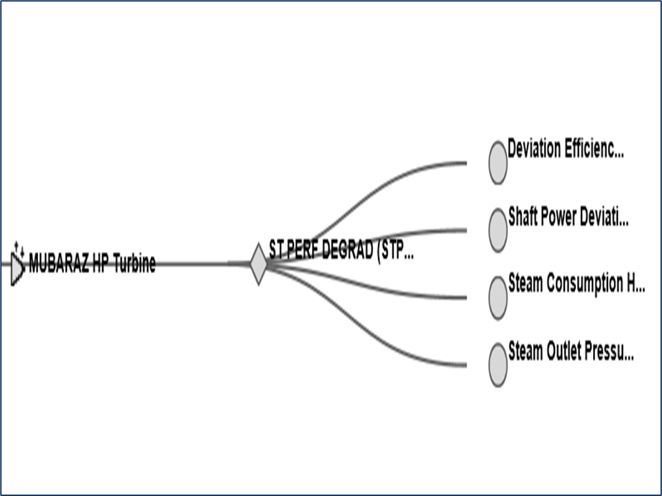
Health & Fault Models
Health and Fault Models in Asset Performance Management help you do the following:
Health models allow for traditional health monitoring relative to established alarm limits
Health models monitor and record standard KPI’s such as RUL, machine availability, efficiency, power, running status or status of needed maintenance, etc..
Fault models provide a ready form of fault tree for identifying where in a system a fault or alarm is creating impact. It also assists in drilling to root cause of faults.
Fault Tree

Slide 8
Advantages/Scope of APM
Monitoring critical parameters to perform predictive and preventive analysis.
Easy identification of root cause.
Standard calculations/monitoring across all sites for similar equipment/plants.
Readily available quality data.
Integration of data with relevant source system.
Removal of time-consuming manual work in collecting, validating and processing the data.
Data analysis in the form of trends.
Monitor past data by moving back in time.
Capture abnormal variation in trends using annotations.

Slide 9
Module 2 APM- End User Training Modules

Slide 10
Module 3 APM- Typical Architecture and Concepts

Slide 11
Asset Performance Management
Asset Performance Management is an application designed and developed by Honeywell to monitor close to near real time, maintain, and track the reliability of assets in a plant.
Asset Performance Management identifies the failures at an early stage and notifies through event monitor window, heatmap, Fault Tree, Performance View, Trends, Equipment Display and Email Notification which eliminates the unplanned downtime.
The monitoring and quick identification of failures helps in taking decisions and planning for maintenance.
The Reliability Engineer uses the Asset Performance Management application in a plant/ship to monitor the reliability of equipment such as, turbines, engines, reduction gears, generators, pumps, valves, heat exchangers, and to identify any failure/fault.
The application provides various operating conditions of an equipment to the operator. It also consists of a calculation engine that helps the operator to calculate efficiency, ship load factor, and failure modes depending on the operating conditions. It cleanses data before using in models.
In-built Performance and Fault Symptom models for major equipment types like Centrifugal pump, Centrifugal Compressor, Furnace, Heat Exchangers etc., are available in the system. Capable of customizing the fault and calculation models
Allows linking of all related documents to the asset/equipment

Slide 12
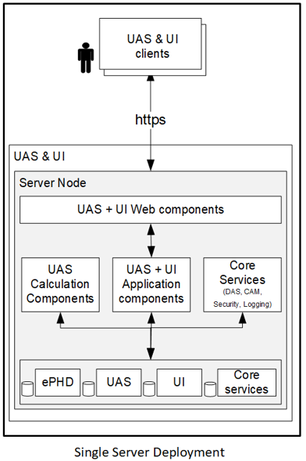
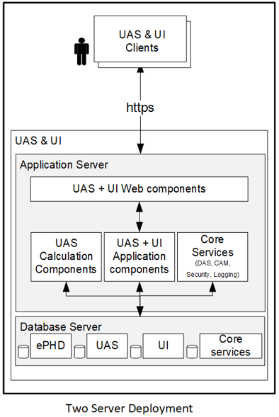
APM Typical Architecture’s

Slide 13
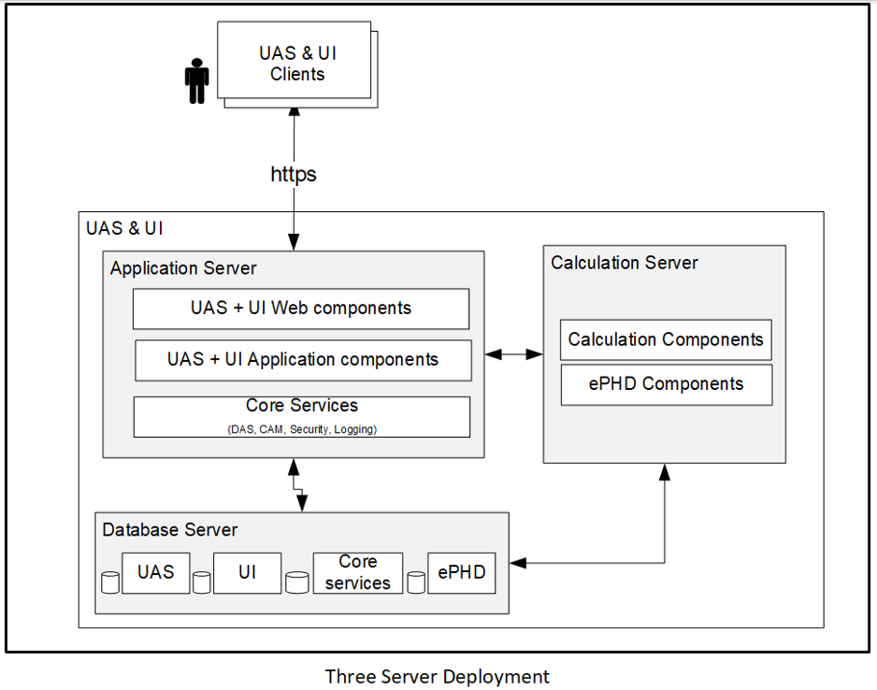
APM Typical Architecture’s

Slide 14
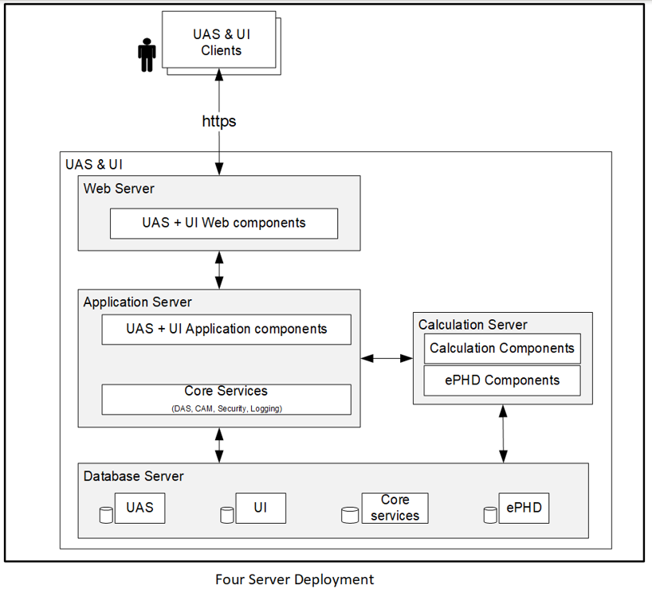
APM Typical Architecture’s

Slide 15
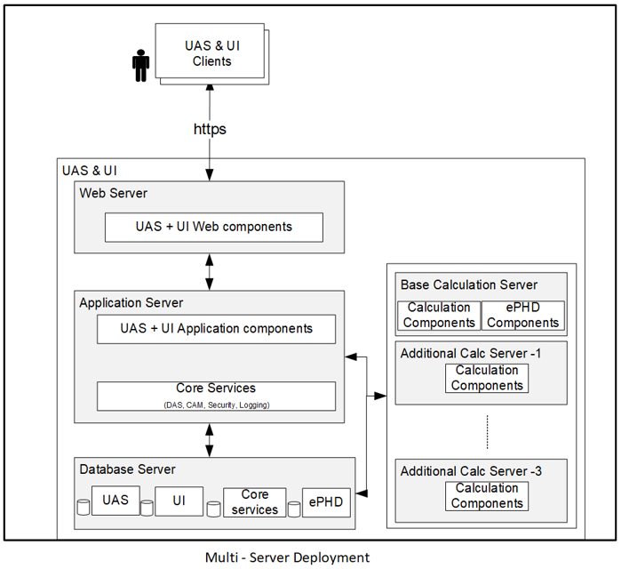
APM Typical Architecture’s

Slide 16
APM Concepts

Slide 17
Data Sources
User can configure data source for connecting to the external applications like OPC, Excel, DAS etc., to read and write the data.
Configured data source acts as an interface between APM and external application.
The following data sources are configured in Uniformance Asset Sentinel:
OPC DA
OPC HDA
PHDAPI
DAS
Excel

Slide 18
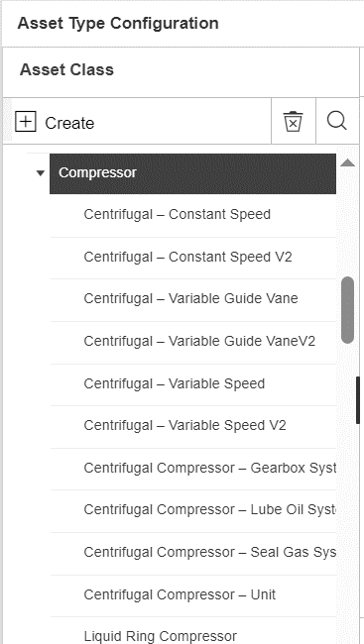
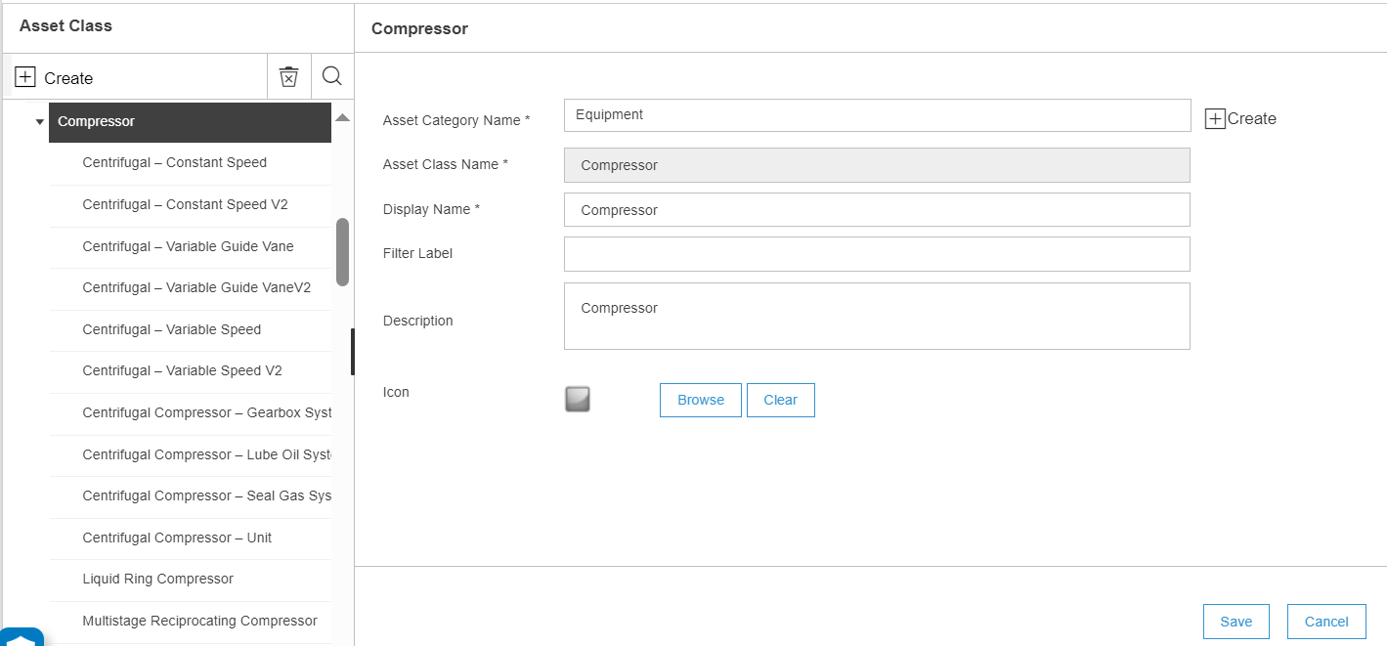
Asset class and types
Asset Class
Asset classes are custom grouping of assets based on the common characteristics of different types of equipment.
An example of an asset class is a Pump. Different types of pumps like the centrifugal pump, reciprocating pump, rotary pump, and so on are grouped under the Pump class.
Asset Types
Asset Type is the next level of grouping similar assets. An Asset class can have one or more asset types. The asset type represents the primary purpose of the asset, model, and the revision of the device.

Slide 19
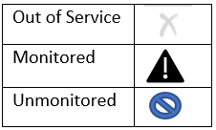
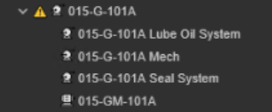
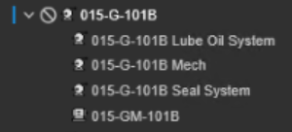
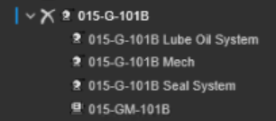
Asset & Asset status
Asset
Asset is an entity at the finest level of granularity within the system, on which you want to Perform data manipulations, tag mapping or calculations. View the status, collect metrics, or report information.
Asset Status
Asset status changes in field due to planned maintenance, unexpected event and trip unit or put in service. In Uniformance Asset Sentinel, the asset is in one of the following modes or States
Monitor: Asset calculations and rules are configured to execute. The asset is available for operation when required.
Un-Monitor: Asset calculations and rules are disabled. The asset is available for operation when required.
Out of Service: Asset calculations and rules are disabled. The asset is NOT available for

Slide 20
Asset Attributes & property
Attributes
Asset attributes are dimensions associated to fault model/symptoms or calculations for its identification.
For Example – Voltage, Flow, Density
Attribute Property
Properties are additional information of attribute to support improved visualization and managing attribute.

Slide 21
Fault model & symptom
Fault – Fault is defined to identify the abnormality of an Equipment
Symptom – Symptoms are defined based on the possible causes for the Fault
Reactive Symptoms (Backward Chaining) events shall represent diagnostic conditions that characterize the effect of the failures that are represented by the faults they are associated to.
Diagnostic Symptoms shall be used as reactive indicators to warn users of imminent failure
These symptoms shall present advisories or corrective actions on how to repair the failure they are associated to.
Diagnostic Symptoms names shall be configured to start with “DS_”.
Proactive Symptoms (Forward Chaining) events shall represent root cause conditions that can lead to failures that are represented by the fault they are associated to.
Root Cause symptoms shall be active generally before a failure is present.
These symptoms shall present Advisories or corrective actions to remove or mitigate the root cause and prevent the failure from occurring.
Root Cause symptom names shall be configured to start with “RC_”.

Slide 22
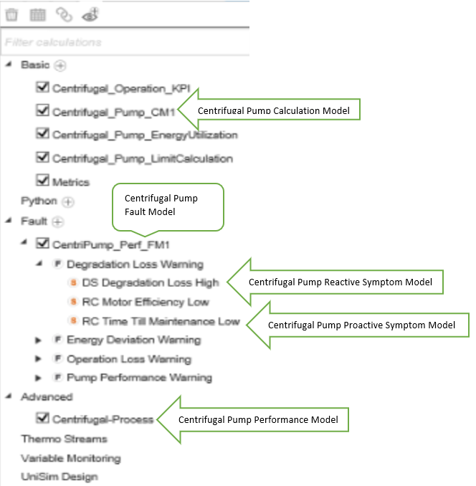
Fault model & symptom

Slide 23
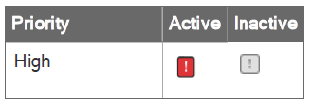
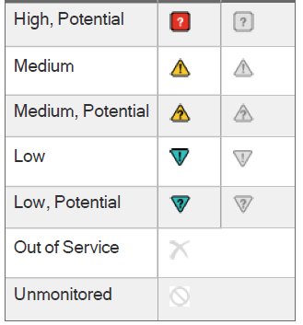
Event status
All events travel through transition statuses during their life cycle in Asset Performance Management :
Potential: one or more symptoms is active, but the fault conditions have not been reached.
Active: the expression associated with the event (for example, a fault or symptom) returns value of !=0.
Inactive (Deactivated): the expression associated with the event (for example, a fault or symptom) returns value of 0.
Accepted: the event haves been accepted by a user to address.
Locked: event is locked by the user, so the state does not change irrespective of the fault or the symptom condition. This is typically used to avoid duplicate events when the event is being addressed in field.
Closed: event has been closed by the user (includes a record of the reason code, comments).
Rejected: event has been falsely identified by the system and rejected by a user (possibly marked as a false positive).

Slide 24
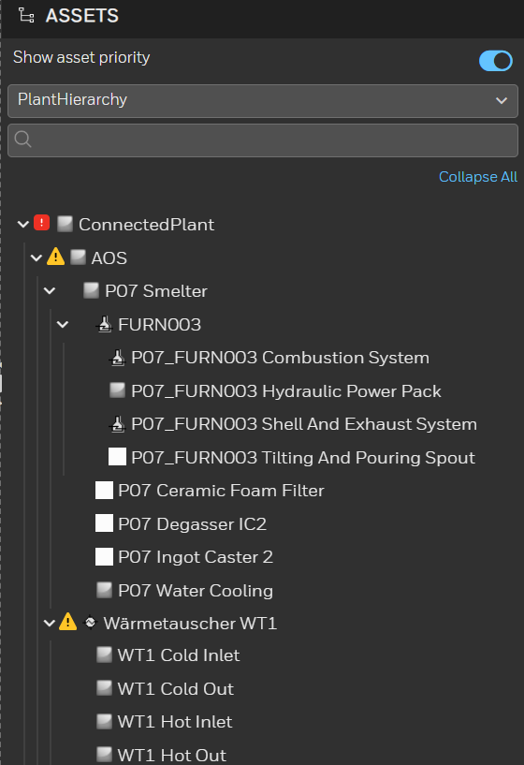
Hierarchy
Asset Hierarchy
In Asset Performance Management , an asset hierarchy is created to classify an asset into several segments and represent the segments in the tree view. The hierarchy enable you to view the whole structure of the plant in a graphical tree.
Custom hierarchy – Assets can be grouped under a different category based on the monitoring requirement and can be viewed as a sperate hierarchy. For example, static equipment monitored, rotating equipment monitored.

Slide 25
Module 4 APM- Configuration & System Demo/Hands On

Slide 26
APM Excel Plugin – Bulk Configuration Tool

Slide 27
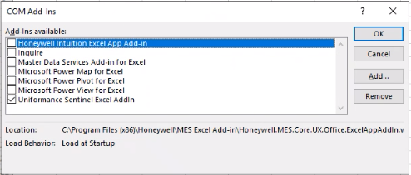
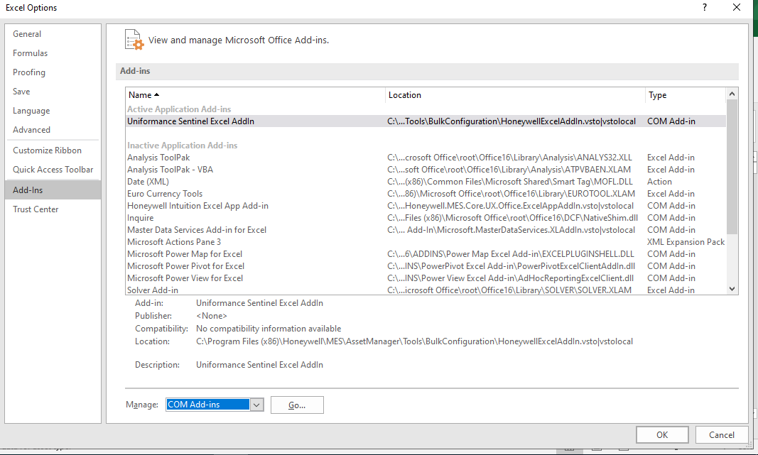
Data Source Configuration
Sentinel Configuration Excel Plugin is an add-in installed as part of UAS client Installation.
Once Installation is completed, enable the Asset Performance Management as shown below
Open excel and navigate to File>>Options>>Add-ins>>Manage
Select Manage>> COM-Add-ins from the drop down and click Go
Select Asset Performance Management Excel Add-in and Click OK.
Uniformance Asset Sentinel add-in appears in the excel ribbon.

Slide 28
Contd..
Sentinel Configuration Excel Plugin is an add-in installed as part of UAS client Installation.
Below are the operations performed using excel plugin
Create, update, or delete assets and other application related configurations.
Retrieve configuration for an asset or asset type
Upload configuration for an asset or asset type
Delete configuration for an asset or asset type

Slide 29
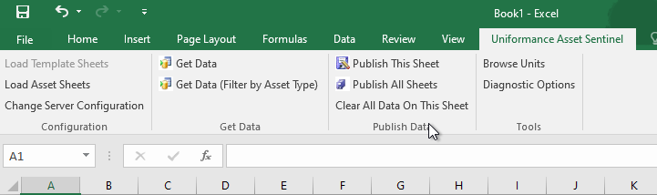
Contd..
To open the Sentinel Configuration Excel Plugin
Open a new spreadsheet in Microsoft Excel.
On the ribbon, select the Asset Performance Management tab.
Click Load Template Sheets or Load Asset Sheets.
The Server Configuration dialog box appears.
Do all the following:
In the Server Name box, type the Web Server name or IP address.
In the Port Number box, type the port number used on the Web Server.
If the Web Server is installed using https, select Use Secure Connection.
If using http, clear the checkbox Click OK.

Slide 30
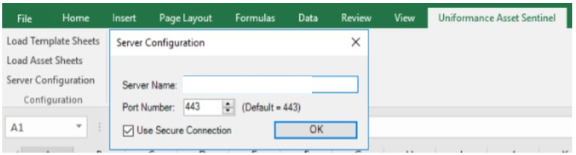
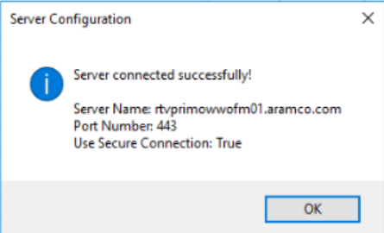
Contd..
30
ATTENTION
To connect using https, the server's name and the certificate name must match. For example, TLS certificates are usually issued for the fully qualified domain name, so the fully qualified domain name is required to connect.
Enter Fully qualified domain name

Slide 31
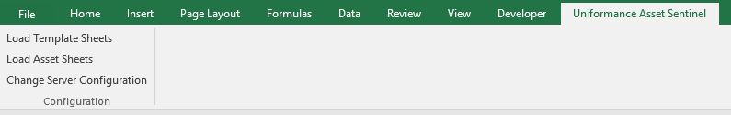
Contd.. APM Excel Plugin Configuration – Loading Worksheets
31
To Loading Sheets for configuration
To enter your data, you need to load the sheets in Excel. There are two categories of sheets for
configuring asset data: template sheets and asset sheets
For configuring the templates, select the Load Template Sheets
For configuring the assets, select Load Asset Sheets
Select sheets

Slide 32
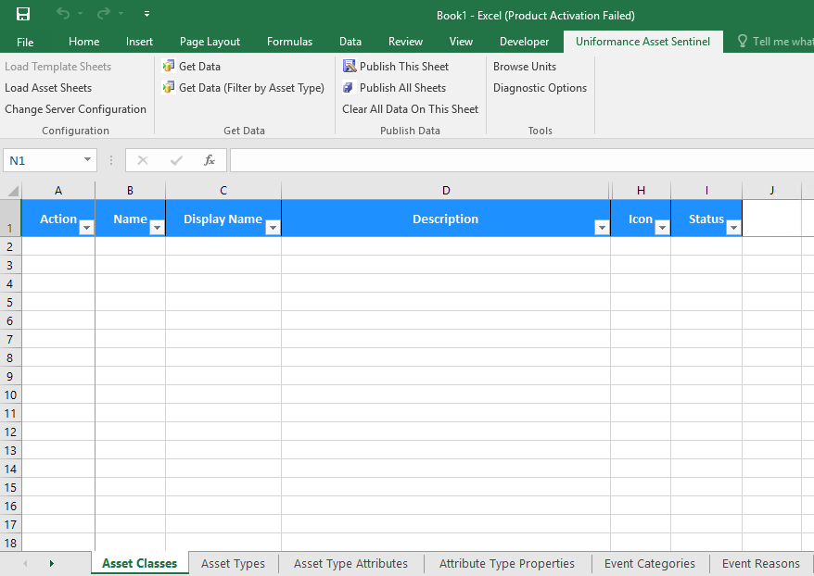
Contd.. APM Excel Plugin Configuration - Worksheets
32
Loading template sheets opens the following:
Asset Classes
Asset Types
Asset Type Attributes
Attribute Type Properties
CMMS Configuration
Faults
Symptoms
Enrichment
Basic Calculations
Link Templates
External Data Sources
Select Template sheets for configuration
Template Worksheets

Slide 33
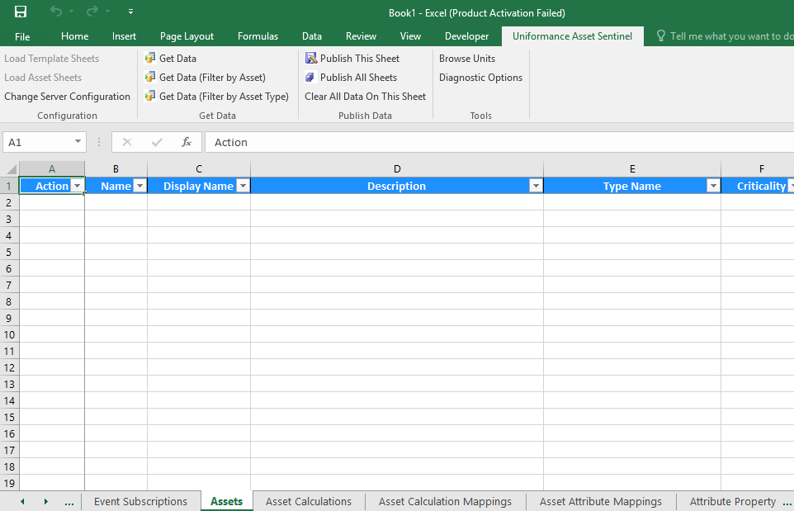
Contd.. APM Excel Plugin Configuration - Worksheets
33
Loading Asset Sheets opens the following:
Assets
Asset Calculations
Asset Calculation Mappings
Asset Attribute Mappings
Attribute Property Mappings
Asset Links
CMMS Asset Mapping
Select Asset Sheets for configuration
Asset Worksheets

Slide 34
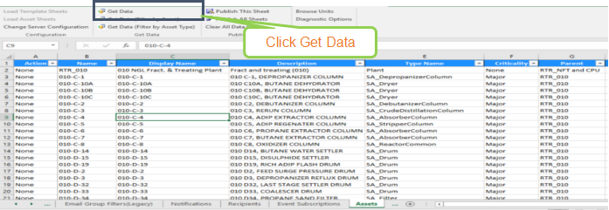
Contd.. Retrieving configuration data from application
34
Configuration data from the server for each assets shall be retrieved using the worksheets.
1. Select the required sheet for which you want to retrieve/view data.
2. On the Asset Performance Management tab on the ribbon, select Get Data.
3. If a warning dialog box appears, do one of the following:
To save a copy of the existing data in the workbook, click Yes.
To delete the existing data on the sheet and replace it with the data from the server, click No.
To cancel the get data operation, click Cancel.
The data appears on the sheet.

Slide 35
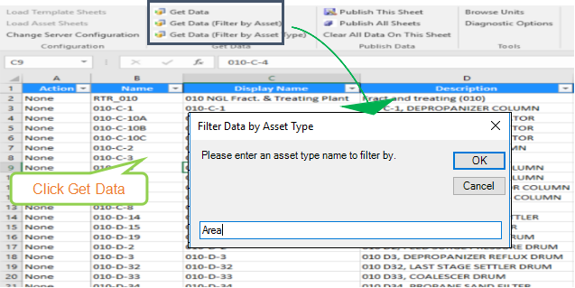
Contd.. Retrieving filtered data
35
Select the sheet for which data to be retrieved
The filtered Get Data options in the ribbon vary depending on the sheet you have selected.
Click one of the following, based on the currently selected sheet and type of data you want to retrieve:
Get Data (Filtered by Asset)
Get Data (Filtered by Asset Type)
Get Data (Filtered by Calculation)
Get Data (Filtered by Calculation Instance)
In the dialog box, type the name of the asset or type in the text box.
Important
The search terms are case sensitive. If the cases do not match, no data is returned.
If a warning dialog box appears, do one of the following:
To save a copy of the existing data in the workbook, click Yes.
To delete the existing data on the sheet and replace it with the data from the server, click No.
To cancel the get data operation, click Cancel.
The data for the asset appears on the sheet.

Slide 36
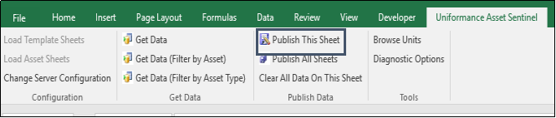
Contd.. Publishing data
36
Select the required sheet for which you want to publish the data.
On the Uniformance Asset Sentinel tab on the ribbon, select Publish.
In the warning dialog box, do one of the following:
A. To save the changes on the sheet to server, click Yes.
B. To cancel the publish operation, click No.
The database updates with the changes on the current sheet, and a success/error dialog box appears.
Click OK to close the dialog box.
To view the changes on the site immediately, do the following:
A. On the Contents tree, select System Console.
B. In the Publish Saved Changes section, click Publish.

Slide 37
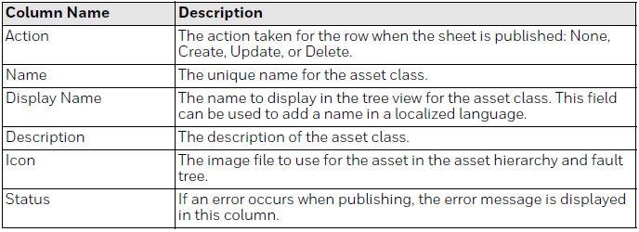
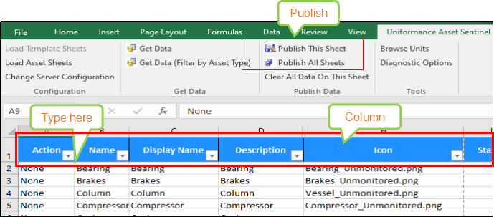
Contd.. Asset Class, Type, Attribute, Property Configuration Sentinel Configuration Excel Plugin Worksheets
Asset Class
Type the data against each column as per the instruction provided in the table and publish to the server
Actions:
None: This row does not contain any changes, or contains changes that should not be published yet, and should be skipped.
Create: This row contains a new asset class that should be added to the database.
Update: This row contains changes to an existing asset class that must be updated.
Delete: This row contains an asset class that should be deleted from the database

Slide 38
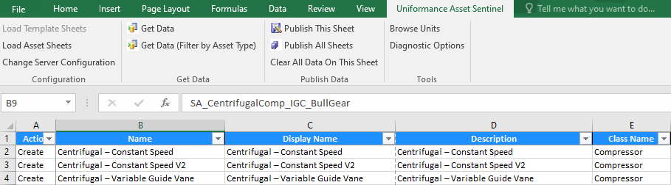
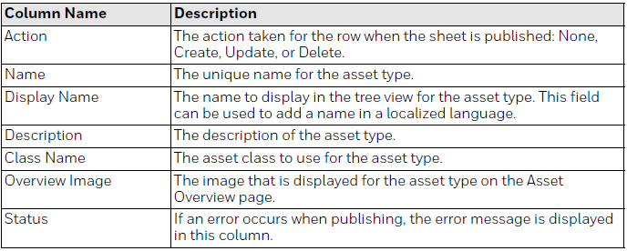
Contd.. Asset Class, Type, Attribute, Property Configuration Sentinel Configuration Excel Plugin Worksheets
38
Asset Type
Type the data against each column as per the instruction provided in the table and publish to the server
Actions:
None: This row does not contain any changes, or contains changes that should not be published yet, and should be skipped.
Create: This row contains a new asset class that should be added to the database.
Update: This row contains changes to an existing asset class that must be updated.
Delete: This row contains an asset class that should be deleted from the database

Slide 39
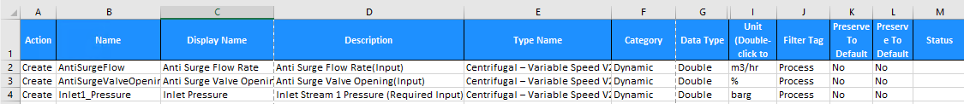
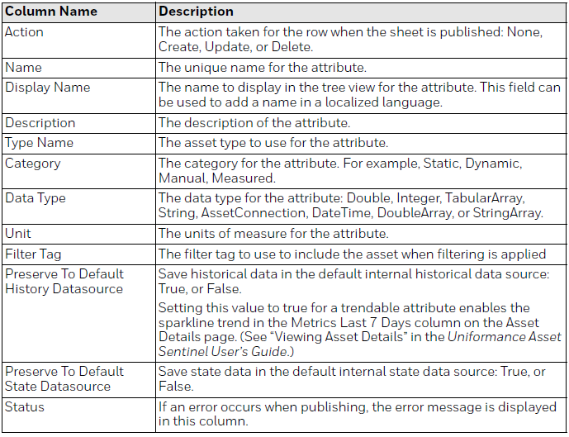
Contd.. Asset Class, Type, Attribute, Property Configuration Sentinel Configuration Excel Plugin Worksheets
39
Asset Type Attributes
Type the data against each column as per the instruction provided in the table and publish to the server
Actions:
None: This row does not contain any changes, or contains changes that should not be published yet, and should be skipped.
Create: This row contains a new asset class that should be added to the database.
Update: This row contains changes to an existing asset class that must be updated.
Delete: This row contains an asset class that should be deleted from the database

Slide 40
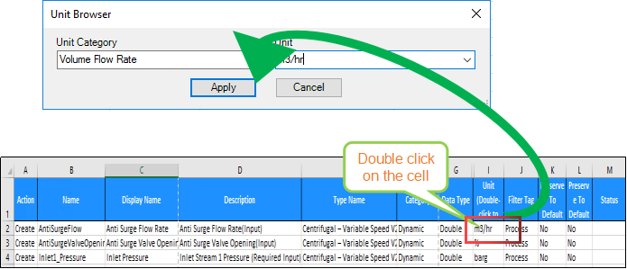
Contd.. Asset Type Attributes – Unit of Measurement selection
40
To select a unit of measure instead of typing a value, do the followings

Slide 41
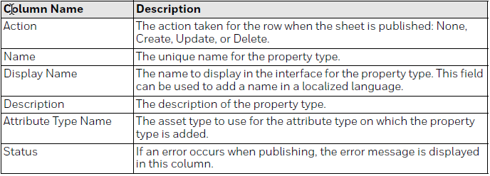
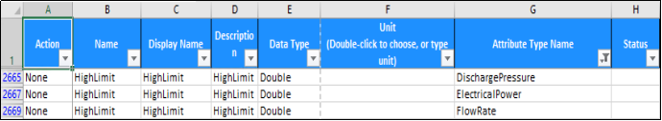
Contd.. Asset Type Property
41
Type the data against each column as per the instruction provided in the table and publish to the server
Actions:
None: This row does not contain any changes, or contains changes that should not be published yet, and should be skipped.
Create: This row contains a new asset class that should be added to the database.
Update: This row contains changes to an existing asset class that must be updated.
Delete: This row contains an asset class that should be deleted from the database

Slide 42
APM - Fault/Symptoms and Calculation Configuration

Slide 43
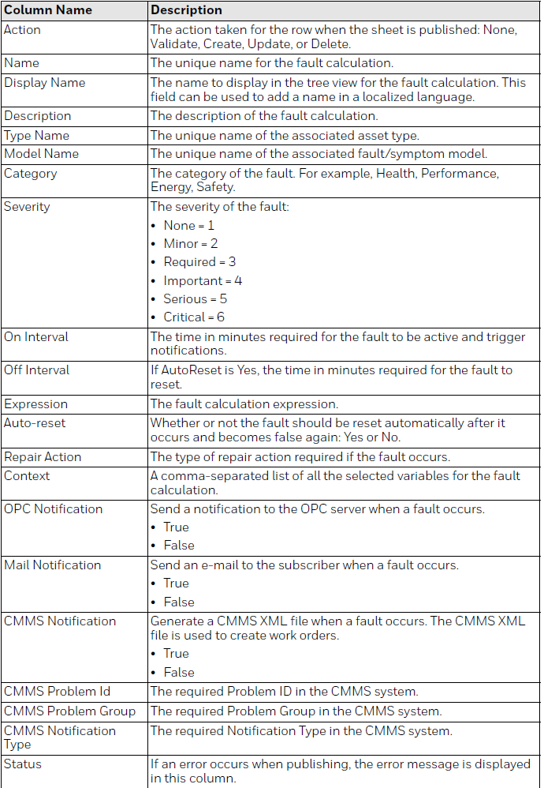
Fault Configuration
Type the data against each column as per the instruction provided in the table and publish to the server
Actions:
None: This row does not contain any changes, or contains changes that should not be published yet, and should be skipped.
Validate: The expression in this row is validated to ensure it is valid, but no changes are published yet.
Create: This row contains a new fault symptom calculation that should be added to the database.
Update: This row contains changes to an existing fault symptom calculation that must be updated.
Delete: This row contains a fault symptom calculation that should be deleted from the database.

Slide 44
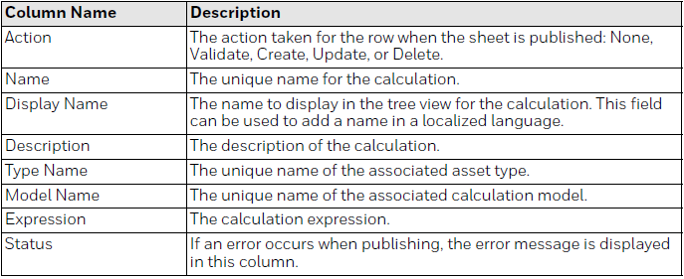
Calculation Configuration
Type the data against each column as per the instruction provided in the table and publish to the server.
Actions:
None: This row does not contain any changes, or contains changes that should not be published yet, and should be skipped.
Validate: The expression in this row is validated to ensure it is valid, but no changes are published yet.
Create: This row contains a new fault symptom calculation that should be added to the database.
Update: This row contains changes to an existing fault symptom calculation that must be updated.
Delete: This row contains a fault symptom calculation that should be deleted from the database.

Slide 45
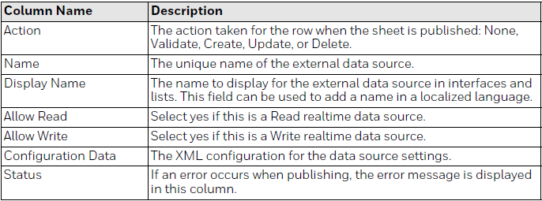
Datasource Configuration
Type the data against each column as per the instruction provided in the table and publish to the server.
Actions:
None: This row does not contain any changes, or contains changes that should not be published yet, and should be skipped.
Validate: The expression in this row is validated to ensure it is valid, but no changes are published yet.
Create: This row contains a new fault symptom calculation that should be added to the database.
Update: This row contains changes to an existing fault symptom calculation that must be updated.
Delete: This row contains a fault symptom calculation that should be deleted from the database.

Slide 46
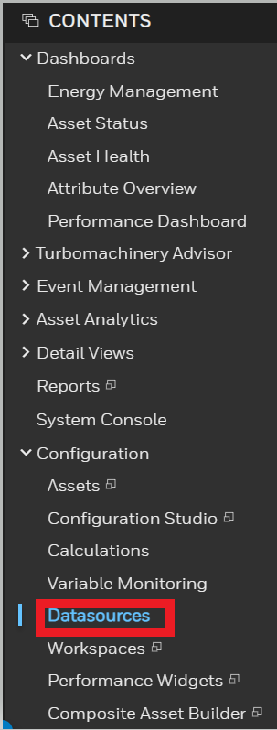
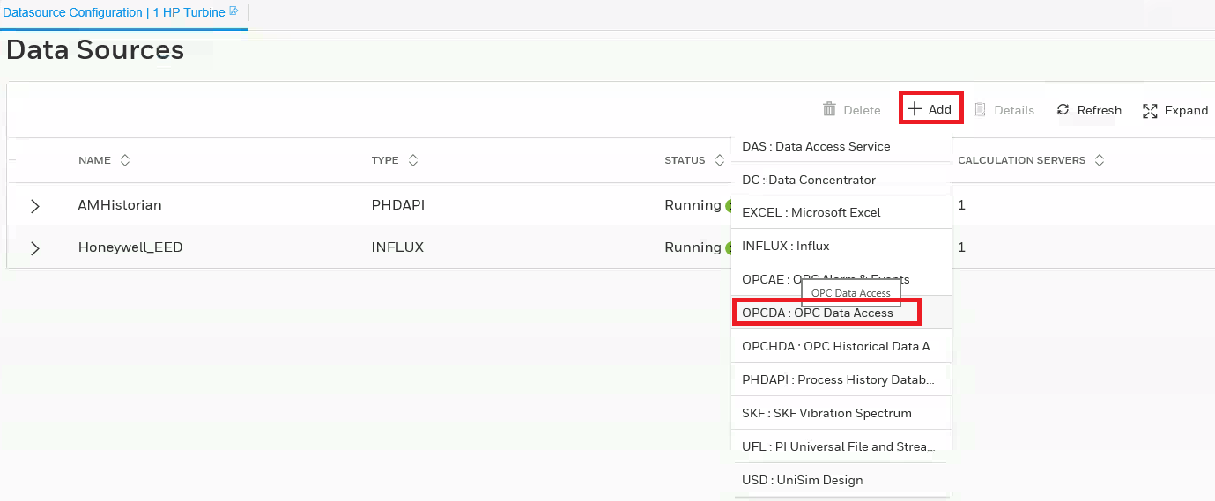
OPC Data Source
To configure a OPC data source:
In the Contents Tree click on Datasource
In the Datasource page, click the on “+Add”
Select OPCDA data source type.
2
3
1

Slide 47
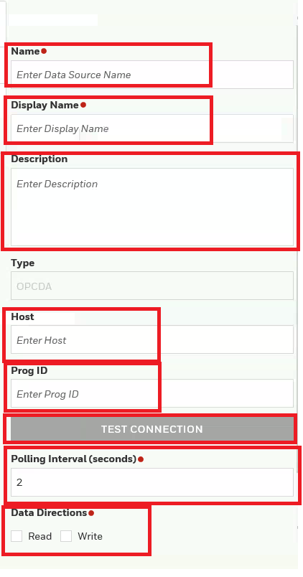

OPC Data Source (Contd.)
To configure a OPC data source:
In the Data Source Name & Display Name box, and Description, type a name for the data source.
In the Host box, type the machine name where the external application OPC Server is running.
In the Prog ID box, type the program ID of the server.
In the Polling Interval box, type the sampling rate for the data source (between 2 and 60 seconds)
Click Test Connection to verify the connection to the data source. A message in the status bar indicates if the connection has succeeded or failed.
Check on Read or Write or both for data direction whether to ready only or write.
Click Save to save the external data source configuration.
4
4
4
5
6
8
7
9
10

Slide 48
APM – Configuration System Demo / Hands On

Slide 49
Template Configuration – System Demo / Hands-On
Assignment 1
Asset Performance Management Excel Plugin configure as below
Step 1. Create Asset Class
Step 2. Create Asset Type
Step 3. Create few attribute with valid unit of measurement
Step 4. Create property for the attributes
Step 5. Create a calculation using the above attributes
Step 7. Set the calculation to execute
Step 6. Create a Fault and 2 Symptoms – Note use the calculation put and attributes in symptom for rule building
Step 7. Create a data source with OPC DA connection – Connect to PI server
Note: For more information on configuration refer the Uniformance Asset Sentinel Configuration guide

Slide 50
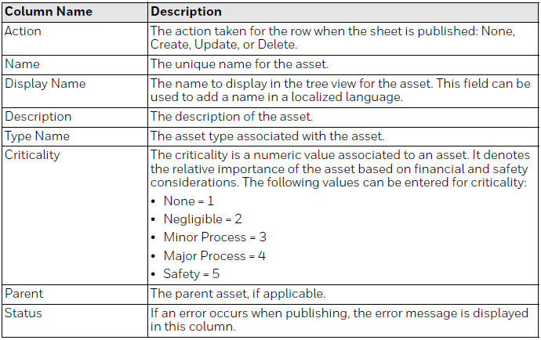
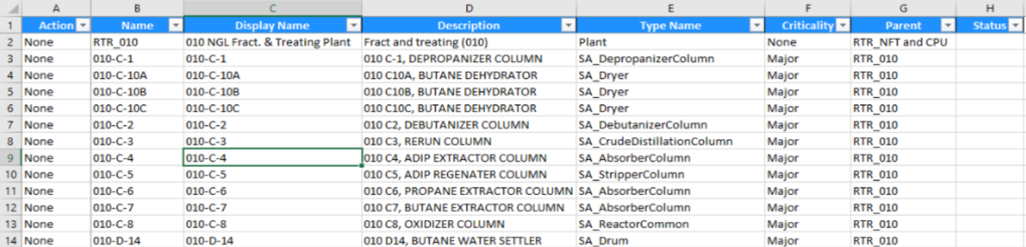
Asset Configuration APM Excel Bulk Configuration Tool (BCT) – Asset Configuration Sentinel Configuration Excel Plugin Worksheets
Asset Configuration
Type the data against each column as per the instruction provided in the table and publish to the server
Actions:
None: This row does not contain any changes, or contains changes that should not be published yet, and should be skipped.
Create: This row contains a new fault symptom calculation that should be added to the database.
Update: This row contains changes to an existing fault symptom calculation that must be updated.
Delete: This row contains a fault symptom calculation that should be deleted from the database.

Slide 51
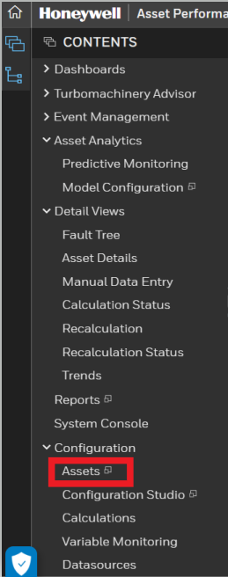
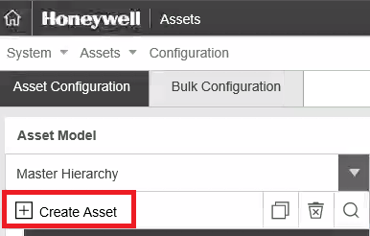
Asset Configuration
2
To add an Asset:
On the CONTENT Menu, Click on the Asset under Configuration
From Asset Configuration, Click on “+ Create Asset” to create new asset.
In the Tree View under Asset Type pane, expand the asset class you created and click the asset type.
1

Slide 52
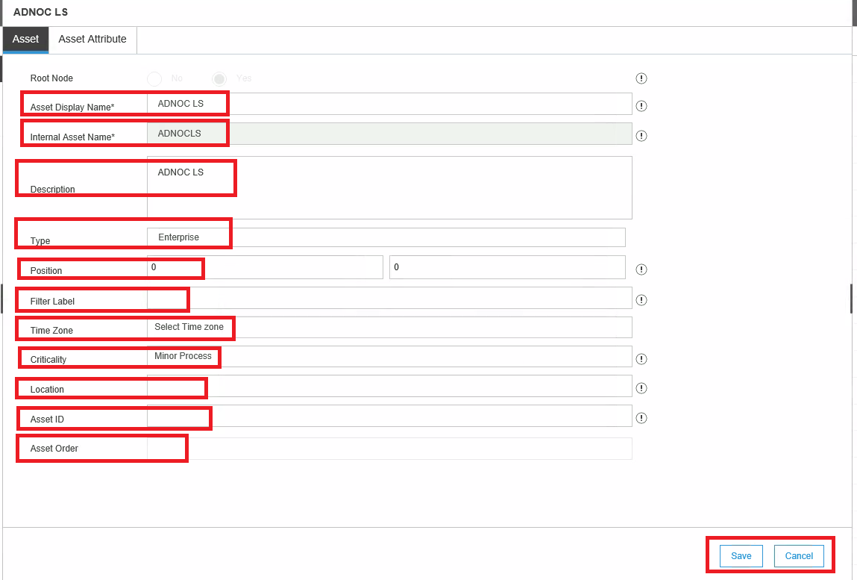
Asset Configuration (Contd.)
To add an Asset:
In Asset tab, enter Asset display name
Enter the Asset name to be configured. There should not any space in name.
Enter the description of asset
Select the Asset Type from dropdown.
Enter the GPS Position Coordinate in degree (Latitude and Longitude).
Enter the label for filtering or search
Enter the time zone of asset.
Enter the Criticality of asset as Minor, Major etc.
Enter the location of Asset
Enter the Unique id for asset.
Enter the order no. of asset in the hierarchy.
Click to Save or cancel.
4
5
6
7
8
9
10
11
12
13
14
15

Slide 53

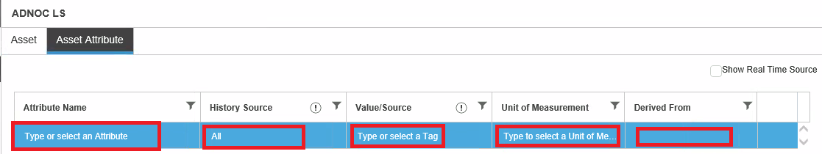
Asset Tag Mapping
For selected asset, go to Asset Attribute Tab.
Select Attribute to be mapped for Tag
Select the History Source from the dropdown.
Enter the Tag name or value of attribute.
Enter Unit of Measurement of Attribute.
Select its class which derived as its parent.
Click Save to save the changes made to the attribute.
6
1
2
3
4
5

Slide 54
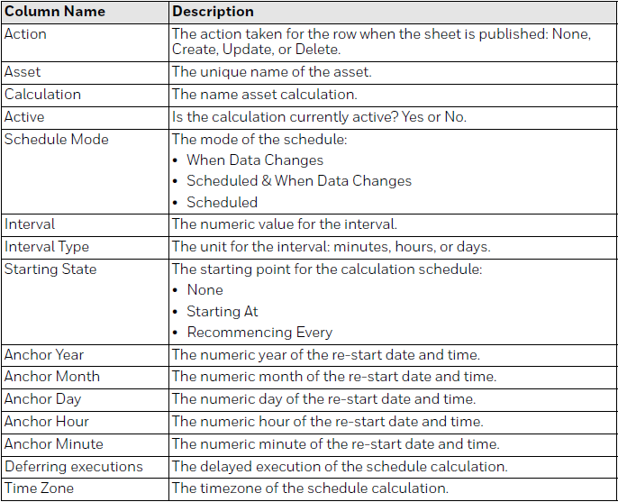
Fault Model/Calculation Association
Asset and Calculation Association
Type the data against each column as per the instruction provided in the table and publish to the server
Actions:
None: This row does not contain any changes, or contains changes that should not be published yet, and should be skipped.
Create: This row contains a new fault symptom calculation that should be added to the database.
Update: This row contains changes to an existing fault symptom calculation that must be updated.
Delete: This row contains a fault symptom calculation that should be deleted from the database.

Slide 55
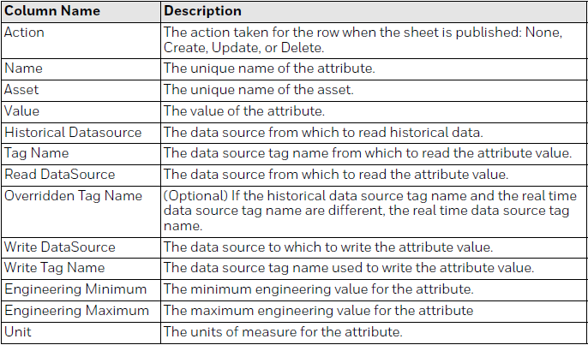

Asset Attribute Mapping
Type the data against each column as per the instruction provided in the table and publish to the server
Actions:
None: This row does not contain any changes, or contains changes that should not be published yet, and should be skipped.
Create: This row contains a new fault symptom calculation that should be added to the database.
Update: This row contains changes to an existing fault symptom calculation that must be updated.
Delete: This row contains a fault symptom calculation that should be deleted from the database.

Slide 56

Attribute Property Mapping
Attribute Property Mapping
Type the data against each column as per the instruction provided in the table and publish to the server
Actions:
None: This row does not contain any changes, or contains changes that should not be published yet, and should be skipped.
Create: This row contains a new fault symptom calculation that should be added to the database.
Update: This row contains changes to an existing fault symptom calculation that must be updated.
Delete: This row contains a fault symptom calculation that should be deleted from the database.

Slide 57

Asset Links
Type the data against each column as per the instruction provided in the table and publish to the server
Actions:
None: This row does not contain any changes, or contains changes that should not be published yet, and should be skipped.
Create: This row contains a new fault symptom calculation that should be added to the database.
Update: This row contains changes to an existing fault symptom calculation that must be updated.
Delete: This row contains a fault symptom calculation that should be deleted from the database.

Slide 58
Asset Configuration– System Demo / Hands-On
Assignment 2
Asset Performance Management Excel Plugin configure as below
Step 1: Create Asset of type as created in Assignment 1
Step 2: Associate the Calculation and Fault Models
Step 3: Map the real time tags for the attributes
Step 4: Check Calculation Execution.
Note: For more information on configuration, refer the Uniformance Asset Sentinel Configuration guide.
Note: For more information on configuration, refer the Uniformance Asset Sentinel Configuration guide.

Slide 59

Data Cleansing Configuration
Asset Performance Management -Data Cleansing Configuration
Below are the steps involved in Data Cleansing configuration
Select the particular asset in the Hierarchy.
Click variable monitoring in content menu.
In the Replacement and filtering tab, select the Tag from asset windows.
Specify the replacement type
- Interpolate / Average / Last Good Value / Next Good Value / None
Specify the Filter type (EMWA, LOES, Average / None) and specify filter param.
Specify the Lower and upper limit for the variable and enable event.
Save and Publish
Note: For more information on data cleansing, refer Asset Sentinel users guide

Slide 60

Check Calculation Execution Status
Navigate to Calculation Status

Slide 61
Data Cleansing Configuration– System Demo / Hands-On
Assignment 3
Step 1: Select already configured asset and perform data cleansing for an asset
Step 2: Use cleansed value in calculation.
Step 3: Check the calculation status for any issue.
Note: For more information on configuration refer the Uniformance Asset Sentinel Configuration guide.

Slide 62
Module 5 APM – User Roles and Permission

Slide 63

User Roles and Permission
63
Roles Configured
Below are the roles configured
Administrators
Engineers
Reliability Engineers
View Only Users

Slide 64

Associating Users to Roles
64
User to specific roles shall be added at the respective domain user groups. These Domain groups are associated to the respective roles in UAS security
Following are the user group created at Domain, and users shall be added.
APM Admin
Engineers
Reliability Engineers
View Only Users

Slide 65

Q & A

