Slide 1
Pimpri Chinchwad Education Trust’s
Pimpri Chinchwad College of Engineering (PCCoE)
Affiliated to Savitribai Phule Pune University(SPPU)
Department of Information Technology
Third Year (2025-26 Sem – V)
AI-Powered Forestfire Detection using Satellite Image Processing
Course Name-Fundamentals of Digital Image Processing
Formative Assessment II
Presented By :
Amit Mali [123B1F058]
Guided By : Dr. Harsha Bhute

Slide 2
Aim:
The aim is to build an efficient system for detecting wildfires accurately from satellite images.
Objectives:
To preprocess satellite images by enhancing quality, resizing, and augmenting to improve feature extraction for fire detection.
To build and train a deep learning model that learns important visual features from processed images to classify wildfire presence accurately.
To validate the model’s performance across diverse satellite images to ensure reliable wildfire detection in various real-world scenarios.

Slide 3
Literature Survey:
Author & Year | Features | Methodology Used | Limitations
Ali & Kurnaz (2025) | Multi-sensor satellite wildfire data. | CNN, U-Net, Autoencoder models | Needs large data; affected by clouds, delays
Yu & Singh (2025) | Real-time remote sensing, GANs | U-Net, ConvLSTM, Attention ConvLSTM | Data gaps; risks of overfitting; regional
Urbanelli et al. (2023) | Multi-satellite thermal hotspot data | Multimodal supervised ML | Small fires and real-time detection hard
Ghali & Akhloufi (2024) | RGB & thermal aerial wildfire images | Ensemble CNN and transformer models | Dataset narrow; may confuse smoke & others
Kang et al. (2022) | Geo-stationary satellite temporal data | CNN with spatial and temporal info | Low spatial detail; false alarms; cloudy areas

Slide 4

Methodology:
[1]
Data Preprocessing: Resize images, normalize pixels, and apply augmentations like rotation and flipping
Build Model: Use pretrained ResNet18, modify final layer for wildfire classification (fire/no fire)
Train Model: Train using cross-entropy loss and Adam optimizer with learning rate scheduling
Test Model: Evaluate accuracy and loss on validation and test datasets
Deploy Model: Use the trained model for real-time wildfire detection on new images
[2]
[3]
[4]
[5]
4

Slide 5
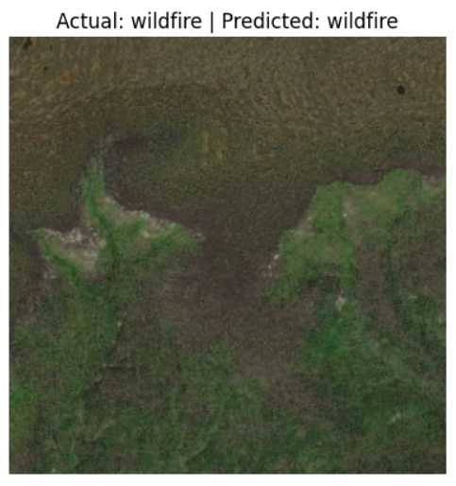
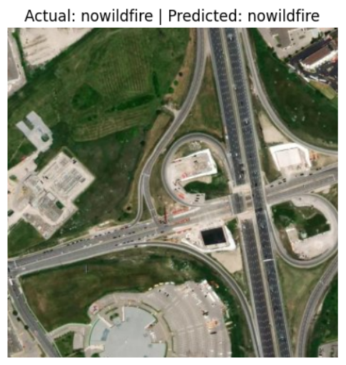
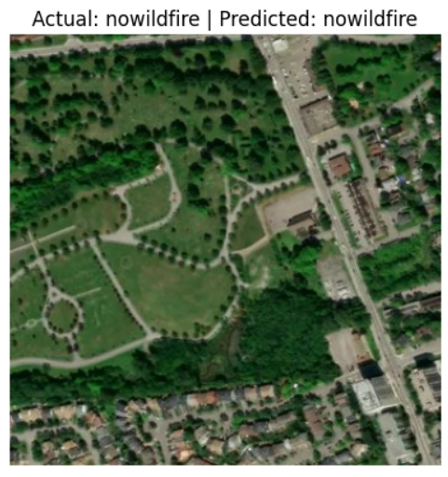
Output:
5

Slide 6
Conclusion:
The model demonstrated high accuracy in detecting wildfires from satellite images, effectively distinguishing fire and non-fire areas. Using a pretrained ResNet18 and with proper data preprocessing and augmentation helped the model generalize well despite limited training data.This method can help detect wildfires faster to protect people and the environment.
6

