Slide 1
Finding Frequent Items in
Distributed Data Streams
Amit Manjhi
V. Shkapenyuk, K. Dhamdhere, C. Olston
Carnegie Mellon University
ICDE 2005
Notes:
Use consistent terminology.

Slide 2

Usage Monitoring in Large Networks
A
B
C
Internet
A
B
C
B
Time
B
B
B
B
C
B
…
…
…
…
Find bandwidth hogs—users using a lot of bandwidth across all machines, and their bandwidth usage
Packet: item, Machine: node monitoring a stream
Notes:
Mention: we want to solve the problem “efficiently”

Slide 3
Other Applications of the Same Problem
Find globally frequent items and their frequencies
Items | Nodes | Applications
Accesses to web pages | Web servers | Keep tab on popular webpages
Packets to specific destinations | Machines | Detect DDoS attacks
Signatures of different worms | Routers | Detect prevalent worms

Slide 4
Simple approach may not be scalable
Frequencies
Node 1
……
Items
+
Node 2
1%
……
=
+
……
…
Sum
Not scalable, particularly for large ‘m’
+
Node m
……
Notes:
“shipped” → “shipped periodically”

Slide 5
Hierarchical approach alleviates load on the root
R
Answers
1%
.
Combine histograms using in-network aggregation
…
Excessive communication
due to long tails
M₁
M₂
M_{m}
.
.
Notes:
Hierarchy picture – still no error
Combine histograms using in-network aggregation

Slide 6
For acceptable communication, need approximation
R
Approximate
Answers
1%
.
Combine histograms using in-network aggregation
…
Where to introduce
approximation?
M₁
M₂
M_{m}
X
X
.
.

Slide 7
Outline
Motivation
Problem statement
Drawback of existing solution
Our solutions
Evaluation
Summary

Slide 8
Formal Problem Statement
Find frequencies of all items whose
frequency exceeds s% of total
Error tolerance: ε% of total, s À ε
Example: s=1, ε=0.1
Periodic answers
(every “epoch” seconds)
R
Approximate
Answers
…
Goal:
Minimize Communication
M₁
M₂
M_{m}
.
.
Notes:
Two simplifications: Data comes only at the monitoring nodes, and 2) The tree has a regular structure.

Slide 9
Simple solution: Early drop
Obtain approximate answers
R
Combine histograms
…
Collect and decrement data Manku, Motwani VLDB’02
M₁
M₂
M_{m}
.
.
Notes:
Have a histogram example (no numbers just pictorial), say we extend MM02 technique; and say Math works out correctly, explain the idea of undercounting and how it generalizes the idea of pruning
Explain decrementing, results in pruning

Slide 10
Drawback of Early Drop
ε = 0.3
ε = 0.3
R
5
R
5
Legend
I3
1
1
I3
5
5
A
B
C
I2
I2
1
1
5
5
Drawback: Locally frequent items reach the root
Reason: Decrements based on local decisions
1
1
I1
I1
4
4
6
4
4
3
2
2
1
1
1
1
2
2
M1
M2
M3
M1
M2
M3
4
4
6
4
4
4
4
6
4
4
2
2
2
2
2
2
2
2
Notes:
Explain that this is only part of a larger tree
How did you decide how much to decrement?

Slide 11
Solution space: Setting precision gradient
Leaf
Root
(Exact)
Late drop
??
Precision
??
Need to balance two competing pressures:
Early reduction of data
Informed reduction of data
??
Early drop
(Max possible error ε)
Height
Notes:
What does “precision margin” mean? Note that all settings provide the same guarantees. Only performance is different.

Slide 12
Optimal precision gradient depends on the application
Optimal precision gradient depends on the objective the application wants to achieve
We study two objectives:
Minimize total load on root node – conserve resources for other tasks
Minimize load on maximally loaded link – maximize ability to scale to large datasets
Load: number of counters traversing a link
Notes:
Why are these two metrics interesting?
Large datasets -> large number of monitoring nodes. And link load is proportional to number of monitoring nodes.

Slide 13
Objective 1: Minimize load on root
Simple; all decrements done by children of root node
Intuition: delay decrementing until most information about distribution is available
Leaf
Root
(Exact)
Late drop
Precision
MinRootLoad
Early drop
(Max possible error ε)
Height
Notes:
We first start with the simpler metric.

Slide 14
Objective 2: Minimize maximum link load
For different inputs, different precision gradients are optimal
Find the “precision gradient” that minimizes the maximum load on any link, in the worst-case across all possible inputs
I
I_{WC}
For any input I2 I – I_{WC} , 9 I’2 I_{WC} that has max. load no lower than I for any precision gradient
Notes:
Say “significantly harder” and this is our main contribution.
Need to drill in the concept, spend more time on this slide

Slide 15
Properties of I_{WC}
No item occurrence common to any two streams
All items in a stream occur with equal frequency
The same number of items occur in each input stream; the same number of distinct items occur in each input stream
Notes:
Don’t try to provide any intuition. Just state each property, say proof is in the paper

Slide 16
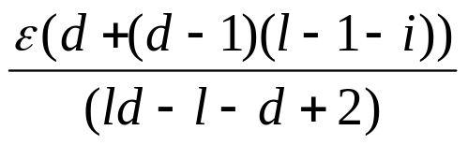
Minimize maximum link load
To minimize the maximum load for any input in I_{WC}
Set ε_{i} = (Proof in paper)
Intuition: gradual gradient
Leaf
Root
(Exact)
Late drop
Precision
MinMaxLoad_WC
Early drop
(Max possible error ε)
Height
Notes:
Emphasize that this is the main contribution, but proof is too complex to cover in the talk. Say gradient is given by this formula

Slide 17
Non-worst-case inputs
Real data unlikely to exhibit worst-case characteristics – optimal for worst case may not perform well in practice
Hybrid Solution: MinMaxLoad_NWC
: measure commonality between streams by sampling data
commonality: locally frequent items, also globally frequent
No commonality, γ = 0
Max. commonality, γ =1
γ
MinMaxLoad_WC
Early drop

Slide 18
Outline
Motivation
Problem statement
Drawback of Existing Solution
Our Solutions: MinRootLoad, MinMaxLoad_WC, MinMaxLoad_NWC
Evaluation
  Workloads
  Simulation results for the two metrics
Summary

Slide 19
Workloads
Internet 2 traffic logs (5 mins epoch)
  Find hosts receiving large number of packets – can be used as evidence of DoS attack
Auction and bulletin-board site – ran in a distributed manner (15 mins epoch)
  Find frequent database queries – usage monitoring
Topology used:
  216 leaf nodes, fan-out = 6, 3 levels
s = 1%, ε = 0.1%
γ: Bulletin-board (0.57), Internet2 (0.68), Auction (0.84)
Notes:
Give the number of packets, and the number of unique items. Also, point out that data is heavy-tailed.

Slide 20
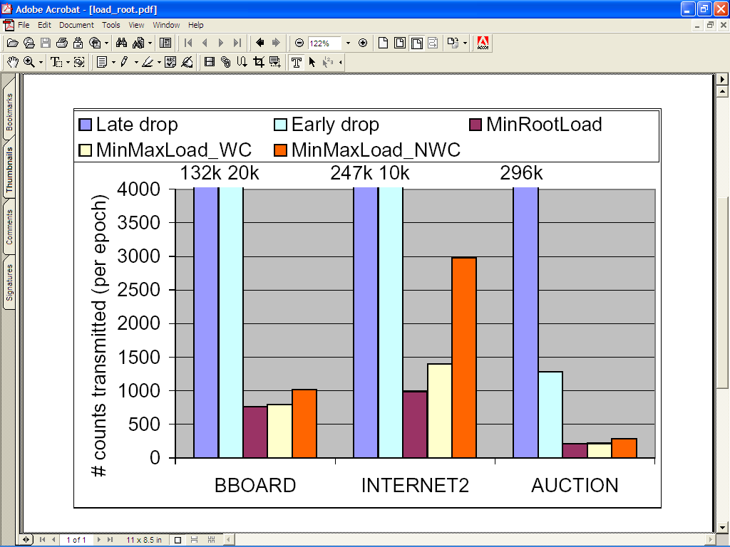
Load on root node
Notes:
The overhead of late drop is excessive. Strategy MinRootLoad incurs least load on root node R; outpeforms both early drop and late drop by factor of over 5 in all cases.

Slide 21
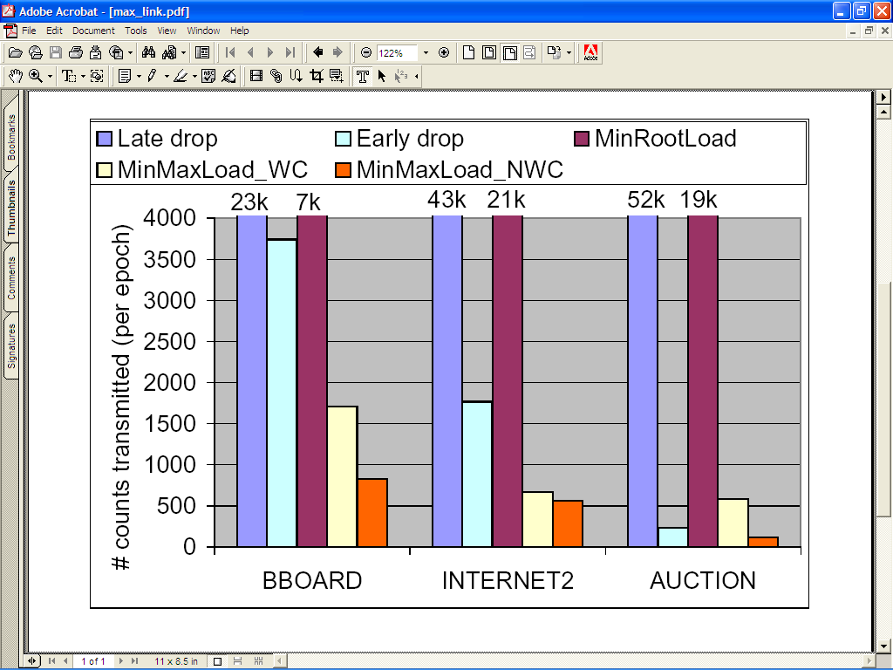
Maximum load on any link
Notes:
MinMaxLoad_NWC is a factor of 2 better than the simple settings, b) It outperforms both settings, of which it is a hybrid, c) Our “commonality parameter” measure works.

Slide 22
Related Work
Most prior work does not consider a distributed setting –
single-stream case. e.g. [Manku, Motwani VLDB ’02; Demaine et al. ESA ’03; Karp et al. TODS ’03; Estan, Varghese SIGCOMM ’02]
Top-k monitoring [Babcock, Olston SIGMOD’03] – did not study precision gradient setting in a hierarchy
Most closely related work [Greenwald, Khanna PODS ‘04] – more general problem; do not find optimal gradient

Slide 23
Summary
Find frequent items in distributed streams; use hierarchical topology
Gradual precision gradient minimizes communication
Theoretical result: proof of optimality
Empirical result: Compared to existing solutions
  Factor of 5 improvement in load on the root
  Factor of 2 improvement in max. load on any link
Notes:
“Straightforward” adaptation of the single stream case

Slide 24
Questions?
Thank You!
Proofs, details found at:
http://www.cs.cmu.edu/~manjhi/

Slide 25
Results in detail
Internet2
23 million total, 71K unique
3 above 1%, 5 above 0.9%, 139 above 0.1%
Auction:
2.2 million total, 140K unique
12 above 0.9% and 12 above 1%, 32 above 0.1%
BBoard:
1.5 million total, 113K unique
11 above 0.9% and 11 above 1%, 44 above 0.1%

Slide 26
Worst Case
Extended set of inputs:
  Items with fractional frequencies
  Items with fractional weights
w(I): max load on a link, input instance I
Any input I 2 I – I_{WC} , 9 I’ 2 I_{WC} such that w(I’) ¸ w(I), I_{wc} characterized next

