Slide 1
Implementing a Compiler based I/O prefetching system for Linux
CS 15-712 Course Project
Amit Kumar Manjhi
Mahim Mishra

Slide 2
Introduction
For large scientific applications, working set often exceeds size of available physical memory
Result: large page fault penalties for access to out-of-core data
  Large performance hit when an in-core application becomes out-of-core
Remedy: Prefetch data!

Slide 3
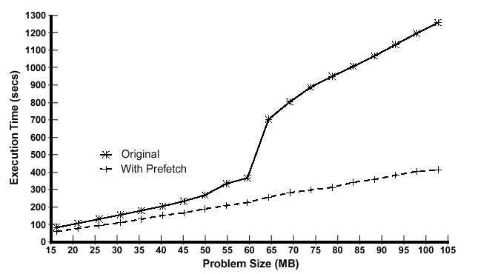
Performance w and w/o prefetch

Slide 4
Prefetching Architecture
Compiler to analyze a program’s data usage and insert prefetch instructions
  Other approaches: run-time analysis by the OS; hints provided by the programmer; explicit I/O management by the programmer
Kernel should provide non-blocking prefetch and release calls
Also, a user level run-time library that filters out unnecessary prefetch calls

Slide 5
Pref. Architecture continued
Angela Demke Brown implemented this on Hector/Hurricane and SGI/IRIX
Compiler: set of SUIF passes
Tested her results with the NAS parallel benchmark suite
  Highly regular code written in Fortran
  Scalable data set

Slide 6
Porting to Linux
Compiler: should be easily portable
Run Time Library: statically linked shared library that intercepts prefetch and release calls from the application and makes appropriate system calls
Kernel system call handlers which bring in a page and remove it asynchronously
  Code very similar to Linux page fault code

Slide 7
Linux Implementation Issues
Kernel hacking: time consuming for newbies.
Needs modification to basic Kernel data structures like task_struct, mm_struct etc.
Changes required in page fault and other memory management code for inter-operability and performance stats.
Also, test runs take a loooong time. Plus they can crash the kernel.

Slide 8
Current Status
Compiler generated code working on Linux
  Although the compiler still runs on IRIX
Run time layer: done
Kernel prefetch code: on it’s way. A preliminary version doesn’t crash, although correctness needs to be tested
Work ahead:
  polish implementation
  measure actual performance gains for apps.

