Slide 1
Invalidation Clues for Database Scalability Services
Amit Manjhi*¹, Phillip B. Gibbons^{z}, Anastassia Ailamaki*, Charles Garrod*, Bruce M. Maggs^{*y}, Todd C. Mowry^{*z}, Christopher Olston©*, Anthony Tomasic*, Haifeng Yu^{x}
* Carnegie Mellon University | ¹ Buxfer, Inc.
^{z} Intel Research Pittsburgh | ^{y} Akamai Technologies
© Yahoo! Research | ^{x} National University of Singapore

Slide 2
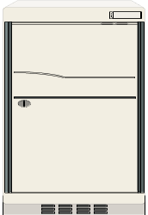
Typical Architecture of Dynamic Web Applications
Execute
code
Access
DB
Users
Request
Internet
Response
Web Server
App Server
DB
Home server
Dynamic Web applications need to provision for
variable and unpredictable load

Slide 3

Content Delivery Networks
CDN nodes
Users
Internet
Scales central web server
Works well for static content

Slide 4
CDN Application Services
CDN nodes
Users
Internet
Database server is still a bottleneck

Slide 5
Database Scalability Service (DBSS) Architecture
Users
Internet
User queries answered from DB cache
How to guarantee privacy of data?
Notes:
Next logical step: replicate the DB. We have ourselves built one such shared infrastructure system, … each proxy caches previous query results
forwards all updates to the back-end database
However, the web and application server are basically read-only systems
database needs to handle frequent updates.

Slide 6
Privacy concerns dictate that:
DBSS is provided encrypted data
Cache base tables: does not work
Cache query results – invalidate on updates
Home server maintains master copy and handles updates directly
Users
Internet
Notes:
Next logical step: replicate the DB. We have ourselves built one such shared infrastructure system, … each proxy caches previous query results
forwards all updates to the back-end database
However, the web and application server are basically read-only systems
database needs to handle frequent updates.

Slide 7
A Simple Example
comments (id, rating, story)
No Invalidations
Q:id=11,15
Empty
11 | 1 | Wintel
15 | 1 | Wintel
Nothing is encrypted
Q: id=11,15
11 | 1 | Wintel
15 | 2 | Wintel
Q
U
DBSS node
Home server database
Q:SELECT id FROM comments WHERE story=“Wintel” AND rating>0
U:UPDATE comments SET rating=2 WHERE id=15
Invalidate
Result
Q:
Empty
11 | 1 | Wintel
15 | 2 | Wintel
Results are encrypted
11 | 1 | Wintel
15 | 1 | Wintel
Q:
Result
Q
U
More encryption can lead to more invalidations
toy_id=15
Notes:
Just need to check whether the comment id is present in the query result. If it is, then don’t need to invalidate. Otherwise, need to invalidate

Slide 8
Privacy-Scalability Space for Query Result Caching
No encryption
Encrypt data not useful for invalidation (Our prior work, SIGMOD 2006)
No
Want solutions in this space
Prior
Encrypt everything
Scalability
Full
(Maximum privacy, read-only scalability)
Privacy

Slide 9
Our Approach: Invalidation Clues
Invalidations (query clue, update clue)
Limit home server overhead
Limit unnecessary invalidation
Limit revealed information
update clue
Result
query clue
Update
Query
Query
Result
Database
query clue
Empty
Result
Query
Home server
DBSS
Query
Update
Invalidation clues offer a more general, flexible framework
Notes:
Clues could be anything.
Why do we call it a clue?

Slide 10
Example Bulletin-Board Application
SELECT id FROM comments WHERE story=? AND rating>?
UPDATE comments SET rating=? WHERE id=?
2
5
Extra invalidation in no encryption scenario: results with rating_param<2 and no id=5 in result
Example clue:
  story of comment being updated (update clue)
Invalidation clues enable more precise invalidations
than the “No” encryption scenario
Notes:
Note that the home server doesn’t actually tell what to invalidate.

Slide 11
Privacy-Scalability Space for Query Result Caching
clues offer fine-grained tradeoff
No encryption
Encrypt data not useful for invalidation (Our prior work, SIGMOD 2006)
(Code-analysis privacy, maximum scalability)
Database
No
Want solutions in this space
Prior
Encrypt everything
Scalability
Full
(Maximum privacy, read-only scalability)
Privacy

Slide 12
Outline
Introduction to invalidation clues framework
Improving scalability in the clues framework
Improving privacy in the clues framework
Evaluation results
Related work and summary

Slide 13
Improving Scalability in the Clues Framework
As a first cut,
Fewer invalidations → More scalability
What is the “most precise” invalidation that can be done?
Database Inspection Strategy: Invalidate as if
using the database
Extra data (database clues) can either be attached to query results (query result clue) or updates (update clue)
Notes:
Computing update clues is possible because there is a predefined set of queries and updates

Slide 14
Database Clues and Beyond
SELECT id FROM comments WHERE story=? AND rating>?
UPDATE comments SET rating=? WHERE id=?
Query Clue:
Story of ALL
comments
id | story
Auxiliary view
Consistency
Privacy
Story of the comment
being updated
On-the-fly
Update Clue:
Still better: Opportunistic Strategy – use database clues only when benefit exceeds overhead
Notes:
Database update clues are better: because there are consistency and privacy concerns of auxiliary views.

Slide 15
Outline
Introduction to invalidation clues framework
Improving scalability in the clues framework
Improving privacy in the clues framework
Evaluation results
Related work and summary

Slide 16
Attack Model of the DBSS
DBSS can pose as a user – chosen-plaintext attack
1. DBSS learns from query clues, update clues, and invalidations – ciphertext-only attack
Users
Internet
Notes:
DBSS has an honest-but-curious behavior
Invalidate correctly, but tries to infer the contents of encrypted data. Ciphertext-only attacks
It can also pose as a user
Can issue queries and updates, observe which clues are generated. Chosen-plaintext attacks

Slide 17
Results on Improving Privacy
SELECT id FROM comments WHERE story=? AND rating>?
UPDATE comments SET rating=? WHERE id=?
Invalidation decision involves equality on id and story; order comparison on rating
Key idea
Needless invalidations can improve privacy
Extreme: If all query results are always invalidated,
DBSS can’t distinguish between any two query results
Paper has details on improving privacy for equality and order comparisons

Slide 18
Outline
Introduction to invalidation clues framework
Improving scalability in the clues framework
Improving privacy in the clues framework
Evaluation results
Related work and summary

Slide 19
Benchmark Applications
Auction (RUBiS, from Rice)
Bulletin board (RUBBoS, from Rice)
Bookstore (TPC-W, from UW-Madison)
Notes:
RUBiS and RUBBoS are from researchers at Rice University, TPC-W implementation from Wisconsin.

Slide 20
Evaluation Methodology
Scalability: max # concurrent users with acceptable response times
5 ms
100 ms
Users
CDN and DBSS
Home server

Slide 21
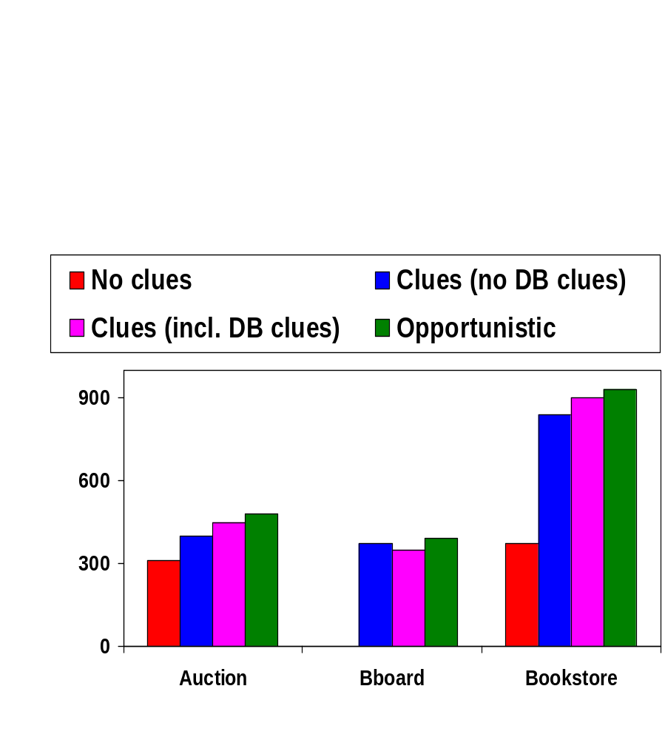
Scalability (number of concurrent users supported)
0
Benchmark Applications
Clues help
Opportunistic has the best scalability

Slide 22
Related Work
Outsource database: [Hacigumus+ 2002], [Hacigumus+ 2002], [Agrawal+ 2004]
Outsource database scalability: DBCache [Luo+ 2002, Altinel+ 2003], DBProxy [Amiri+ 2003], NEC cache portal [Li+ 2003], MTCache [Larson+ 2004], [Manjhi+ 2006]
Notes:
Tonnes of work.

Slide 23
Related Work
View invalidation strategies: [Levy and Sagiv 1993], [Candan+ 2002], [Choi and Luo 2004]
Privacy: [Agrawal+ 2004], [Hore+ 2004], [Manjhi+ 2006]
Notes:
Tonnes of work.

Slide 24
Summary
Invalidation clues: general framework for limiting
  Unnecessary invalidation
  Revealed information
  Home server overhead
  Fine-grained tradeoff between privacy and scalability
Database clues
  Update clues better than query clues
  Opportunistic use of database clues → best scalability
Evaluation on three application benchmarks

Slide 25
Back-up slides….

