Slide 1
Simultaneous Scalability and Security for Data-Intensive Web Applications
Amit Manjhi*, Anastassia Ailamaki*, Bruce M. Maggs^{*y}, Todd C. Mowry^{*z}, Christopher Olston* ©, Anthony Tomasic*
* Carnegie Mellon University | ^{y} Akamai Technologies
^{z} Intel Research Pittsburgh | © Yahoo! Research

Slide 2
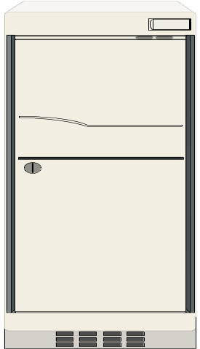

Provisioning for Web applications is difficult
Need on-demand scalability
A scalability service can provide on-demand scalability
Example: CDN for static content
Home server
Client
Client
Web server
App server
Database
Dynamic data-intensive Web applications: need scalability service
Notes:
The natural question is why do we want to develop a scalability service for dynamic web applications? And the reason is that “provisioning for Web applications is difficult”. An application deployed on the Internet has a large number of potential users.
Explain all the components.

Slide 3
Distributed Scalability Service Architecture
Shared Database Scalability Service Provider (DSSP)
Client
DSSP
nodes
Client
DSSP
nodes
Client
Client
How to guarantee security of data?
Notes:
Does it matter where the Internet is??
Scalability architecture:
The application servers can be thought of as content delivery nodes.
Talk about result cache caching query results, which are kept consistent with the back-end database through invalidations.

Slide 4
A simple solution for guaranteeing security
Outsource database scalability
  Home server: master copies of all data—handles updates directly
No query execution on the DSSP
  DSSP caches query results—kept consistent by invalidation
All data passing through the DSSP can be encrypted:
  Query, Update, Query results
Notes:
However, encrypting all the data means that when updates occur, the DSSP has to invalidate a larger region of its cache.

Slide 5
A Simple Example
toys (toy_id, toy_name)
No Invalidations
Q1:toy_id=15
Empty
11 | Barbie
15 | GI Joe
Nothing is encrypted
Q1: toy_id=15
Q1
U1
DSSP node
Home server database
Q1: SELECT toy_id FROM toys WHERE toy_name=“GI Joe”
U1: DELETE FROM toys WHERE toy_id=5
Invalidate
Result
Q1:
Empty
Results are encrypted
11 | Barbie
15 | GI Joe
Q1:
Result
Q1
U1
More encryption can lead to more invalidations
toy_id=15

Slide 6
Challenge: providing scalability while guaranteeing security
When updates occur, for correctness,
DSSP needs to invalidate “affected” cache entries
Invalidations depend on what data is not encrypted:
  Encrypt everything → conservative invalidation, poor scalability
  Encrypt nothing → more precise invalidation, poor security
Security-scalability tradeoff
Notes:
While it might seem like more encryption leads

Slide 7
Opportunity for managing the tradeoff
Not all data is equally sensitive
Data Sensitivity
Completely
insensitive
Moderately
sensitive
Extremely
sensitive
Bestsellers
list
Inventory records
Credit card
information
Care but worried about scalability impact
Secure at
all costs
Don’t care
But for most data, nontrivial to assess:
Data-sensitivity
Scalability impact of securing the data

Slide 8
Managing the security-scalability tradeoff
Encrypt sensitive data
Our approach
Encrypt data not useful for invalidation
Scalability
Encrypt sensitive and moderately sensitive data
Extremely
sensitive
Moderately
sensitive
Security
Tradeoff has to be managed only over remaining data

Slide 9
Key insight: Queries and updates can only be instantiations of templates
cust_name
John
SELECT cust_name FROM customers WHERE cust_id=123
template
parameter
Query result
Q1: SELECT cust_name FROM customers WHERE cust_id=?
U1: DELETE FROM toys WHERE toy_id=?
Parameters and results not useful for invalidation
Encrypting them has no scalability overhead
Given templates:
Can identify data not useful for invalidation
Notes:
Queries and updates can only be instantiations of templates. And the templates can be found by inspecting the code.

Slide 10
Outline
Security-scalability tradeoff
Four operating points in the tradeoff space
Identifying data not useful for invalidation
Evaluation results
Related work and summary
Notes:
Identifying data not needed for precise invalidation as function of “…”

Slide 11
Invalidation Strategies: Overview
Invalidations
Key | Value
(Query template, query parameters) | Query result
Update template, update parameters
View
DSSP node
Statement
Data not encrypted → Invalidations
Four natural invalidation strategies
Template
Blind
Notes:
Fill the table entries one by one.

Slide 12
Invalidation Strategies: View
Q1 | SELECT toy_id FROM toys WHERE toy_name=?
Q2 | SELECT qty FROM toys WHERE toy_id=?
Q3 | SELECT cust_name FROM customers WHERE cust_id=?
(Template, Parameters) Query result
DELETE FROM toys
WHERE toy_id=5
View
View
DSSP node
Statement
No data is encrypted
Invalidate all Q1 results with toy_id=5, all Q2 results with toy_id=5
Template
Blind
Notes:
Fill the table entries one by one.

Slide 13
Invalidation Strategies: Statement
Q1 | SELECT toy_id FROM toys WHERE toy_name=?
Q2 | SELECT qty FROM toys WHERE toy_id=?
Q3 | SELECT cust_name FROM customers WHERE cust_id=?
(Template, Parameters)
DELETE FROM toys
WHERE toy_id=5
Result
View
DSSP node
Statement
Query results are encrypted
Invalidate all Q1 results,
all Q2 results with toy_id=5
Template
Blind
Notes:
Fill the table entries one by one.

Slide 14
Invalidation Strategies: Template
Q1 | SELECT toy_id FROM toys WHERE toy_name=?
Q2 | SELECT qty FROM toys WHERE toy_id=?
Q3 | SELECT cust_name FROM customers WHERE cust_id=?
(Template, )
DELETE FROM toys
WHERE toy_id=
Result
View
Param
5
DSSP node
Statement
Results and parameters are encrypted
Invalidate all Q1 results,
all Q2 results
Template
Blind
Notes:
Fill the table entries one by one.

Slide 15
Invalidation Strategies: Blind
Q1 | SELECT toy_id FROM toys WHERE toy_name=?
Q2 | SELECT qty FROM toys WHERE toy_id=?
Q3 | SELECT cust_name FROM customers WHERE cust_id=?
( , )
Template
Template
Param
Result
View
5
DSSP node
Statement
All data are encrypted
Invalidate all Q1 results,
all Q2 results,
all Q3 results
Template
Blind
Notes:
Fill the table entries one by one.

Slide 16
Invalidation Strategies: Summary
Q1 | SELECT toy_id FROM toys WHERE toy_name=?
Q2 | SELECT qty FROM toys WHERE toy_id=?
Q3 | SELECT cust_name FROM customers WHERE cust_id=?
U1 DELETE FROM toys WHERE toy_id=5
 | Template | Parameters | Query result | Invalidations
View |  |  |  | Q1 with toy_id=5 Q2 with toy_id=5
Statement |  |  |  | All Q1, Q2 with toy_id=5
Template |  |  |  | All Q1, Q2
Blind |  |  |  | All Q1, Q2, Q3
Accessible by DSSP?
x
Security
Scalability
x
x
x
x
x
: Yes
x
: No
Notes:
Fill the table entries one by one.

Slide 17
Outline
Security-Scalability Tradeoff
Four operating points in the tradeoff space
Identifying data not useful for invalidation
Evaluation results
Related work and summary

Slide 18
Sometimes invalidation strategies have same invalidation behavior
Q1: SELECT cust_name FROM customers WHERE cust_id=?
U1: DELETE FROM toys WHERE toy_id=?
Template and View have same behavior
Parameters and results can be encrypted
Invalidation behavior characterization:
Find template pairs for which different invalidation strategies have same invalidation behavior
Find query and update classes for which same behavior:
Blind and Template
Template and Statement
Statement and View
Notes:
Hiding data sometimes does not hurt invalidations. Here are two examples. Have to identify which data to hide. Data about query and update templates can be hidden on a per-template basis.
Say what is invalidation behavior.

Slide 19
Applications can expose (not encrypt) on a per-template basis
Invalidation Matrix
Query Exposure
 | Nothing | Template | Template, parameters | Template, parameters, result
Nothing
Template
Template, parameters
Update Exposure
Encrypt data as long as invalidations
do not increase for any template pair
Blind
Notes:
Leave the boxes blank. More generally, applications can expose on a per-template basis. And here is the generalized invalidation matrix. For each query/update template pair, the application can decide which box to live in. Our goal is to live in the box closest to the upper-left corner that does not hurt scalability.
What is same invalidation behavior. A strategy A invalidates iff strategy B invalidates, then A and B have same invalidation behavior.

Slide 20
Outline
Security-Scalability Tradeoff
Four operating points in the tradeoff space
Identifying data not useful for invalidation
Evaluation results
Related work and summary

Slide 21
Benchmark Applications
Auction (RUBiS, from Rice)
Bulletin board (RUBBoS, from Rice)
Bookstore (TPC-W, from UW-Madison)
Notes:
RUBiS and RUBBoS are from researchers at Rice University, TPC-W implementation from Wisconsin.

Slide 22
Evaluation Methodology
Scalability: max # concurrent users with acceptable response times
Security: # templates with encrypted results
5 ms
100 ms
Users
CDN and DSSP
Home server
California Privacy Law determined sensitive data

Slide 23
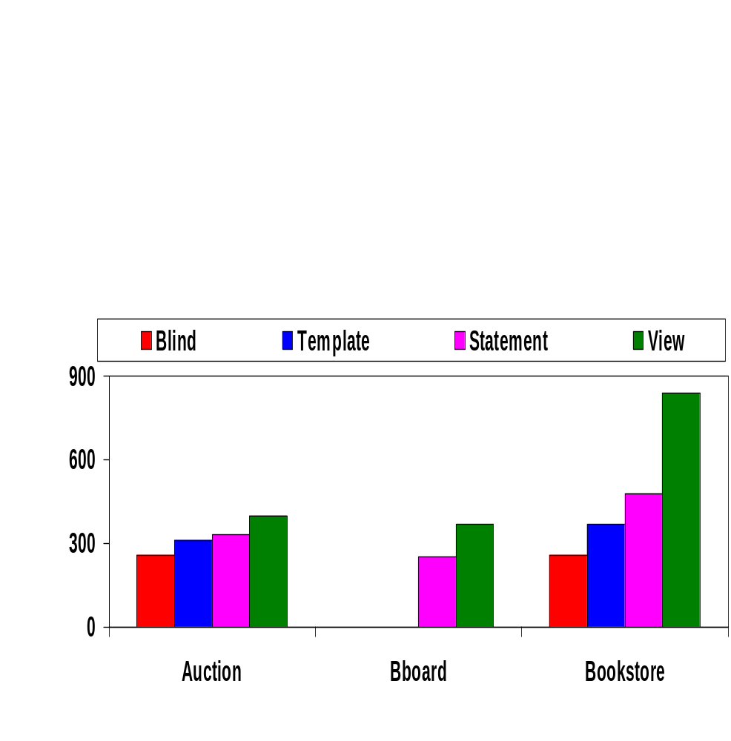
Magnitude of Security-Scalability tradeoff
Scalability (number of concurrent users supported)
0
0
Benchmark Applications
Blanket encryption (Blind) hurts scalability
View has the best scalability

Slide 24
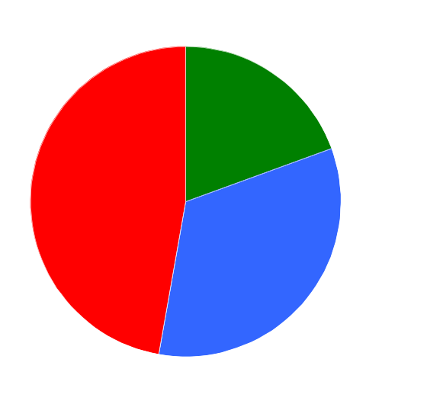

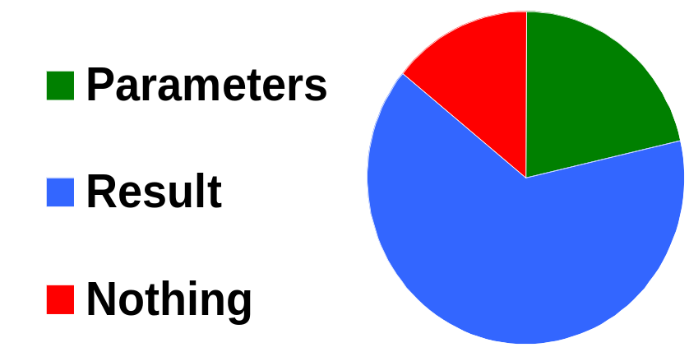
Security Results
Additional query data that can be encrypted using our approach, without hurting scalability
4
6
17
7
7
7
and result
18
12
14
Auction
Bboard
Bookstore
Different numbers denote the # query templates
Can encrypt results for over 50% of the templates
Notes:
Green and blue regions are good, the red is the useless region.

Slide 25
Security Results in Detail
Auction: The historical record of user bids was not exposed
Bboard: The rating users give one another based on the quality of their posting
Bookstore: Book purchase association rules discovered by the vendor – customers who purchase book A also purchase book B

Slide 26
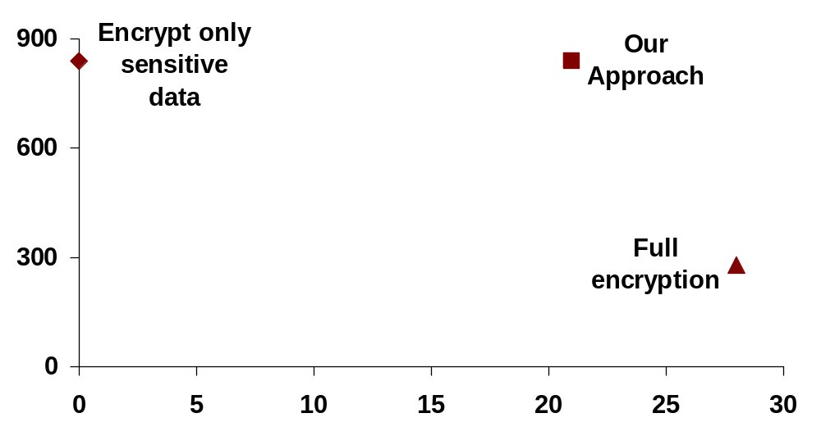
Bookstore benchmark: security-scalability results
Scalability (Number of concurrent users supported)
Security (Number of query templates with encrypted results)

Slide 27
Related Work
Outsource database: [Hacigumus+ 2002], [Hacigumus+ 2002], [Agrawal+ 2004]
Outsource database scalability: DBCache [Luo+ 2002, Altinel+ 2003], DBProxy [Amiri+ 2003], NEC cache portal [Li+ 2003]
View invalidation strategies: [Levy and Sagiv 1993], [Candan+ 2002], [Choi and Luo 2004]
Notes:
Tonnes of work.

Slide 28
Summary
Security-scalability tradeoff in presence of DSSP
Shortcut to manage the tradeoff
  Static analysis of database templates
  Find data not useful for invalidation
  Tradeoff has to be managed only over remaining data
Evaluation on three application benchmarks
  Blanket encryption hurts scalability
  Data identified by our approach is moderately sensitive

Slide 30
Back-up slides….

Slide 31
Key insight: Set of queries and updates can be determined by inspecting the code
function get_toy_id ($toy_name) {
$template:=“SELECT toy_id FROM toys
WHERE toy_name=?”;
$query:=attach_to_template ($template, $toy_name);
execute ($query);
…
}
Given templates:
Statically identify data not useful for invalidation
Notes:
Queries and updates can only be instantiations of templates. And the templates can be found by inspecting the code.

Slide 32
Summary of Our Approach
Privacy law
Initial list of
encrypted data
(highly sensitive)
Static analysis
of templates
Final list of
encrypted data
For each query, update template pair, construct an IM. Use IM characterization results to see if Blind=Template, Template=Statement, and Statement=View in each case
Use a greedy algorithm to find all data that is not useful for invalidation
Tradeoff needs to be managed over reduced data

Slide 33
Flow of Invalidations
update
query
CDN
cache
DSSP (untrusted)
invalidate
(upon miss)
home
organization

Slide 34
Template Exposure Levels
Four levels of how much data is exposed per template
Nothing
Template
Template,
Parameters
Template,
Parameters,
Result
blind
template
statement
view
greater exposure (more help for invalidation)
greater security
Control the security-scalability tradeoff by controlling exposure levels

Slide 35
View Invalidation Strategies
Query | Update | Strategy
blind
blind
Blind
template
template
Template-Inspection
statement
statement
Statement-Inspection
view
statement
View-Inspection
For each class:
correct: at least as many invalidations as “required”
minimal: fewer invalidations than any strategy in its class

Slide 36
Invalidation Matrix
Not encrypted == exposed
Application can expose on a per-template basis
Query Exposure
 | Nothing | Template | Template, parameters | Template, parameters, result
Nothing
Template
Template, parameters
Blind
Blind
Blind
Blind
Update Exposure
Blind
Template
Template
Template
Blind
Template
Statement
View
Blind
Notes:
Spend a few seconds on this slide.

Slide 37
Simple Examples
If View and Template have the same invalidation behavior, parameters and query result need not be exposed.
SELECT cust_name FROM customers WHERE cust_id=?
DELETE FROM toys WHERE toy_id=5
If Template and Blind have the same invalidation behavior, template need not be exposed.
SELECT qty FROM toys WHERE toy_id=?
DELETE FROM toys WHERE toy_id=5

Slide 38
Hierarchy of Invalidation Strategies
correct view-inspection
minimal view-inspection
correct statement-inspection
minimal statement-inspection
correct template-inspection
minimal template-inspection
correct blind
minimal blind
Notes:
Mention t

Slide 39
Query and Update Classification?
Symbol | Meaning
S (U^{T}) | Attributes used in selection predicates
M (U^{T}) | Attributes modified
S (Q^{T}) | Attributes used in selection predicates or order-by constructs
P (Q^{T}) | Attributes retained in the result
Ignorable: M (U^T) \cap (S (Q^T)

Slide 40
Query and Update classification (1/2)
Update: selection S (U) and modified attributes M (U)
UPDATE customers SET cust_name=? WHERE cust_id=?
modified attributes
selection attributes
Query: selection S (Q) and preserved attributes P (Q)
SELECT toy_id FROM toys WHERE toy_name=?
preserved attributes
selection attributes

Slide 41
Query and Update classification (2/2)
Ignorable update for a query: M(U) Å (S(Q) [ P(Q)) = { }
UPDATE customers SET cust_name=? WHERE cust_id=?
SELECT toy_id FROM toys WHERE toy_name=?
No instance of the update ever invalidates the result of any instance of the query
Result-unhelpful: S(U) Å P(Q) = { }
UPDATE customers SET cust_name=? WHERE cust_id=?
SELECT toy_id FROM toys WHERE toy_name=?
The result is not helpful in ruling out invalidations

Slide 42
Blind vs. Template?
Blind: always invalidates
Template: always invalidates if not ignorable
Example:
If update is not ignorable, then Blind=Template
SELECT toy_id FROM toys WHERE toy_name=?
DELETE FROM toys WHERE toy_id=5

Slide 43
Template vs. Statement?
If ignorable, then neither template nor statement invalidates
If not ignorable, and selection predicates of query and update don’t overlap, then both template and statement invalidate
SELECT toy_id FROM toys WHERE toy_name=?
UPDATE toys SET toy_id=? WHERE toy_id=?
Assumptions rule out updates like
UPDATE toys SET toy_id=5 WHERE toy_id=5

Slide 44
Statement vs. View?
If the update is result-unhelpful then Statement=View
If update is an insertion and query is a SPJ with conjunctive selection predicates and equality as join operator, Statement=View
Significant
contribution

Slide 45
Simple Example
If View and Template have the same invalidation behavior, parameters and query result need not be exposed
View Minimal View-Inspection Strategy Template Minimal Template-Inspection Strategy
Whenever Template invalidates, View also invalidates:
SELECT toy_name FROM toys WHERE qty>?
DELETE FROM toys WHERE toy_id=5
When View does not invalidate, Template does not invalidate:
SELECT cust_name FROM customers WHERE cust_id=?
DELETE FROM toys WHERE toy_id=5

Slide 46
Scalability-conscious security
Web Applications have templates:
SELECT toy_id FROM toys WHERE toy_name=?
Not all data is useful for invalidation purposes
Such data can be found by statically analyzing the templates
Initial list of
encrypted data
(highly sensitive)
Static analysis
of templates
Final list of
encrypted data
Data encrypted for “free” – a lot is moderately-sensitive data
Managing tradeoff becomes simpler – manage over substantially reduced data

Slide 47
Security without hurting scalability
Data not needed for invalidation
Can secure “for free” (without hurting scalability)
Security Conscious Scalability Approach
As a result,
Tradeoff has to be only managed over remaining data

