Slide 1

Increasing the Scalability of Dynamic Web Applications
Thesis Defense
Amit Manjhi
March 4, 2008
Thesis committee:
Bruce Maggs (co-chair)
Todd Mowry (co-chair)
Chris Olston (co-chair)
Mahadev Satyanarayanan
Mike Franklin (UC Berkeley)
School of Computer Science
Carnegie Mellon

Slide 2
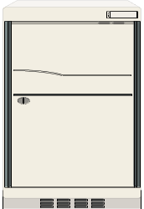
Typical Architecture of Dynamic Web Applications
Execute
code
Access
database
Users
Request
Internet
Response
Web Server
App Server
Database
Home server
Web applications need to provision for
variable and unpredictable load
Notes:
Let me start by providing a background of dynamic Web applications.
oo A dynamic Web application has 3 tiers: a web server, an application server, and a database.
oo <advance> User requests are handled by the Web server which then based on the request passes it to an application server, and the application server executes code that makes database requests.
oo Of course, on the Internet, there are thousands of applications and millions of users.
oo Web applications need to provision for variable and unpredictable load because anyone with an Internet connection can access a Web application.

Slide 3
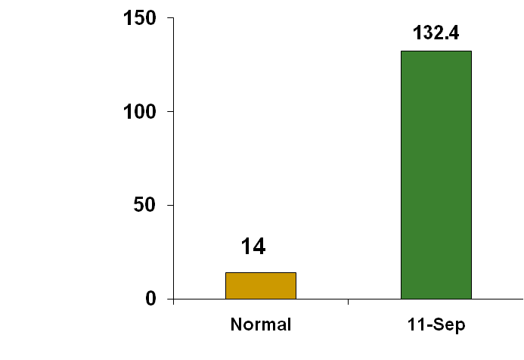
An Example of Unpredictable Load
CNN.com
CNN, NY Times, ABC News
unavailable from 9-10 AM
(Eastern Time)
Daily page views
(in millions)
Applications face a dilemma: how much resources to provision?
Need on-demand scalability
Notes:
Variable load occurs especially due to events such as breaking news (9/11 or Hurricane Katrina) and Slashdot effect.
oo For example, this graph shows the load on CNN.com on Sept 11, 2001 and on a normal day.
ooo The Y-axis is the daily page view in millions, and the 2 bars are for the page views CNN.com receives normally and on 9/11.
ooo CNN.com received an order of magnitude more load than usual.
ooo Because of this high load, many news sites were down from 9-10 AM eastern time.
oo Due to this high variability in load, applications face a dilemma in how much resources to provision.
ooo On the one hand, provisioning too little is risky since the peak load can then easily overwhelm the infrastructure.
ooo On the other hand, provisioning too much is also risky since the expected customers might not come.
oo Web applications need on-demand scalability - they should be able to handle load as and when it arrives, without a priori provisioning of the infrastructure.

Slide 4

Content Delivery Networks
CDN nodes
Users
Internet
Scales central web server
Works well for static content
Large infrastructure → handle load spikes
Shared infrastructure → charge on a usage basis
Notes:
* A typical strategy for achieving scalability is to replicate the
data to as many computers as possible, and CDNs successfully scale
static content by doing just that with the web server.
oo CDNs are able to provide on-demand scalability by maintaining a
large infrastructure to handle load spikes in any individual application.
oo They are able to do so economically by sharing the infrastructure across
multiple applications. Thus they are able to charge on a usage basis.
oo But for dynamic content <advance> the application server and
database server remain a system bottleneck.

Slide 5
CDN Application Services
CDN nodes
Users
Internet
Database server is still a bottleneck
Notes:
* Some CDNs go a step further by replicating the application server, and while this offloads some computation from the central home server, the database is still a bottleneck.

Slide 6
A distributed architecture still has database as a bottleneck
users:
Content Delivery Network
home server
database
Notes:
* This slide shows the resulting architecture.
oo The Web server and the app server can even be handled by a CDN
oo A distributed architecture still has the database as the bottleneck.

Slide 7
Methods to Scale the Database Component
In-house database scalability: [DBCache, DBProxy, MTCache, NEC Cache Portal]: Not economical
Database outsourcing: Database as a service [Hacigumus+ ICDE ’02, Hacigumus+SIGMOD ’02]: Applications have to cede control of data
Database Outsourcing: Commercial Efforts [Amazon SimpleDB, Longjump, Zoho Creator]
  Useful only for simple applications
  Must trust the provider
Notes:
* There has been prior work on scaling the database:
oo First there is work on in-house database scalability, which proposes caching of data from the database, and the cache can then offload work from the database. While such proposals are often cheaper than investing in scaling the capacity of the database, such proposals again require investment in infrastructure. It is not economical to provision for the peak load.
oo Second there is work on outsourcing the management of the database, where a third party takes care of all aspects of the database management. But it requires applications to cede control of their data.
oo Many new businesses are offering the database outsourcing model, where the database management is being offered as a service.
oo The most prominent among these companies is Amazon, which is offering a SimpleDB service.
ooo However, the simpleDB service is simple. It allows the applications to model only individual tables and does not permit any relationship among
tables.
ooo Because of this simple data model, the query model is also very simple. So this model is useful only for the most simple applications.
ooo Additionally, these applications would need to trust the third party offering this service.

Slide 8
Secondary Goals
Generate response as the application developer intended
  [Ramaswamy+ WWW ’04, Challenger+ INFOCOM ’00]
Execute code written for the traditional architecture
  [Yang+ ICDE ’06, WWW ’07]
Must work on three benchmark applications
  AUCTION (ebay.com)
  BBOARD (slashdot.org)
  BOOKSTORE (amazon.com)
Notes:
* In addition to scaling the database component, we desire that our solution for scaling dynamic Web applications:
oo generates the response as the application developer desired it to be. Rules out approaches that try to detect the fragments of a dynamically generated Web page and then generate the Web page.
oo must execute the same application code written for a centralized architecture. No additional burden on the application developer. The chances of any solution being adopted is low if it places additional burden on the application developer.
oo Additionally, it must work for three benchmark applications we use: an auctin benchmark, a bookstore benchmark, and a bulletin-board benchmark

Slide 9
Our Approach
Database Scalability Service (DBSS): Shared infrastructure that caches applications’ data
[Olston, Manjhi+ CIDR ’05, Manjhi+ SIGMOD ’06, Manjhi+ ICDE ’07]
Apply benefits of CDN to scaling the database
Large infrastructure → handle load spikes
Shared infrastructure → charge on a usage basis
Notes:
* We propose a database scalability service (DBSS) for providing on-demand scalability to the database component. A DBSS is a shared database caching service, which will cache applications' data, and answer query results on their behalf.
oo Like CDNs, a scalability service will maintain a large infrastructure to absorb load spikes in load of individual applications. For cost-effectiveness, the infrastructure will be shared across multiple applications.

Slide 10
Database Scalability Service Architecture
users:
Request
Response
Content Delivery Network
Database queries and updates
Query results
Database Scalability Service (DBSS)
Database queries and updates
Data
home server
databases
Data security concerns
Reducing user latency
Notes:
Our Database scalability service architecture looks as follows:
oo user requests are handled by a CDN, which executes application code in response to the requests.
oo the CDN in turn fires off database queries and updates that are handled by a DBSS
oo queries that cannot be answered by the DBSS and updates are sent to home server database within the application's home organization.
oo The DBSS is shared across multiple home organizations.
oo We have built a prototype DBSS with this architecture, and used it to scale three data-intensive Web application benchmarks
oo A key concern in this scenario is guaranteeing the security of data that passes through the untrusted DBSS.
oo Another concern is to ensure that applications written for a traditional centralized environment are still interactive in this setting, i.e., delays should not increase dramatically.

Slide 11
Thesis Statement
It is possible to economically scale
dynamic Web applications
while respecting their security concerns

Slide 12
Outline
Need for on-demand scalability
Guaranteeing security in a DBSS setting
  Security-scalability tradeoff
  Security without hurting scalability
  General framework to manage the tradeoff
Reducing user latency in a DBSS setting
Contributions

Slide 13
Guaranteeing Security in a DBSS Setting
Goal: limit DBSS from observing an application’s data
DBSS caches query results —kept consistent by invalidation
Content Delivery Network
Home server handles updates directly
Database Scalability Service
All data passing through the DBSS can be encrypted:
Query, Update, Query results
Notes:
* The security goal is to limit DBSS from observing an application's data.
oo Home servers maintain master copies of their data and handle updates directly.
oo To limit the DBSS from observing an application’s data, all data passing through the DBSS be encrypted. However, in this case, the DBSS cannot cache base tables because there is a fundamental tradeoff between the efficiency with which queries can be executed at the DBSS and security guarantees.
oo So no query execution can take place on the DBSS.
oo The DBSS then caches encrypted query results and sees encrypted queries and updates.
oo However there is a downside to encryption as the next slide shows.

Slide 14
A Simple Example
comments (id, rating, story)
No Invalidations
Q:id=11,15
Empty
11 | 1 | Intel
15 | 1 | Intel
Nothing is encrypted
Q: id=11,15
11 | 1 | Intel
15 | 2 | Intel
Q
U
DBSS node
Home server database
Q:SELECT id FROM comments WHERE story=“Intel” AND rating>0
U:UPDATE comments SET rating=2 WHERE id=15
Invalidate
Result
Q:
Empty
11 | 1 | Intel
15 | 2 | Intel
Results are encrypted
11 | 1 | Intel
15 | 1 | Intel
Q:
Result
Q
U
More encryption can lead to more invalidations
toy_id=15
Notes:
Just need to check whether the comment id is present in the query result. If it is, then don’t need to invalidate. Otherwise, need to invalidate

Slide 15
Security-Scalability Space for Query Result Caching
No encryption
No
Encrypt everything
Scalability
Full
(Maximum security, read-only scalability)
Security
(Not to scale. Just for illustration)
Easy to either get good scalability or good security

Slide 16
Providing Scalability While Guaranteeing Security
When updates occur, DBSS must decide what to invalidate
Applications face a dilemma in what to encrypt (secure)
More encryption
Less encryption
Conservative Invalidation
Precise Invalidation
Security
Scalability
Security-scalability tradeoff
Notes:
oo When updates occur, the DBSS needs to invalidate entries from its cache.
oo There is the security/scalability tradeoff. On the one hand, if the application does not provide help to the DBSS, the DBSS is forced to employ conservative invalidation strategies which are bad for scalability. On the other hand, providing any help to the database inevitably reveals something about the data and compromises security.

Slide 17
Outline
Need for on-demand scalability
Guaranteeing security in a DBSS setting
  Security-scalability tradeoff
  Security without hurting scalability
  General framework to manage the tradeoff
Reducing user latency in a DBSS setting
Contributions

Slide 18
Key Insight: Arbitrary Queries and Updates Not Possible
function get_toy_id ($toy_name) {
$template:=“SELECT toy_id FROM toys
WHERE toy_name=?”;
$query:=attach_to_template ($template, $toy_name);
$result:=execute ($query);
…
}
Important
contribution
Given templates:
An algorithm for statically identifying data
that does not help in invalidation
Notes:
oo The key insight is that arbitrary queries and updates are not possible in Web applications.
oo The queries and updates can simply be instantiations of templates embedded in the Web application code.
oo For example, this slide shows an example query template. to which parameters
are attached at run-time, and which produces a certain query result when
executed against the database.
oo Given templates, we provide an algorithm to automatically identify data that is
never useful for invalidation purposes. It is an important contribution. I do not have time
to explain the algorithm in this talk, but I will provide two examples of how such data
can be identified.

Slide 19
Examples of Data Not Useful for Invalidation
Example 1:
SELECT toy_id FROM toys WHERE toy_name=?
SELECT toy_name FROM toys WHERE toy_id=?
Any data passing through the DBSS is not useful
Example 2:
SELECT toy_id FROM toys WHERE toy_name=?
DELETE FROM toys WHERE toy_id=?
Query parameters are not useful for invalidation

Slide 20
Security without Hurting Scalability
Data not useful for invalidation
Can secure “for free” (without hurting scalability)
Scalability Conscious Security Approach
[Manjhi+ SIGMOD ’06]
As a result,
Tradeoff has to be managed only over remaining data

Slide 21

Security-Scalability Space for Query Result Caching
No encryption
Encrypt data not useful for invalidation [Manjhi+ SIGMOD 06]
No
Want solutions in this space
SCSA
Encrypt everything
Scalability
Full
(Maximum security,
read-only scalability)
Security
(Not to scale. Just for illustration)

Slide 22
Outline
Need for on-demand scalability
Guaranteeing security in a DBSS setting
  Security-scalability tradeoff
  Security without hurting scalability
  General framework to manage the tradeoff
Reducing user latency in a DBSS setting
Contributions

Slide 23
Invalidation Clues: Motivation
#1
SELECT toy_id, price FROM toys WHERE toy_name=?
DELETE FROM toys WHERE toy_id=?
Want to encrypt part of the query result
SELECT id FROM comments
WHERE story=‘Intel’
AND rating>0
UPDATE comments SET rating=?
WHERE id=?
#2
BULLETIN-BOARD: comments
(id, rating, story)
Knowing ‘story’ of the comment helps in invalidation
(If comment’s story is not ‘Intel’ → no invalidations)
Notes:
o Previously, the encryption was all-or-nothing. However, applications would want to encrypt part of the query result. And in general, applications would want to encrypt data at any granularity. We need a framework that allows applications to do so.
o Introduce example
<advance>
The ‘story’ of the comment being updated is data that normally does not pass through the DBSS. Knowing this information however helps in making invalidation decisions. We need a framework that allows applications to provide help to the DBSS beyond data that is normally passing through the DBSS.

Slide 24
How do invalidation clues work?
[Manjhi+ ICDE 07]
Invalidations (query clue, update clue)
update clue
Result
query clue
Update
Query
Query
Result
Database
query clue
Empty
Result
Query
Home server
DBSS
Query
Update
Home servers attach query clues to query results and update clues
to updates. DBSS uses query and update clues for invalidation.
Notes:
Clues could be anything. Applications are free to compute any clues they desire. Clues must meet three goals: (1) help in invalidation, (2) reveal less data, (3) place less burden on the home server.

Slide 25
Security-Scalability Space for Query Result Caching
No encryption
Encrypt data not useful for invalidation [Manjhi+ SIGMOD 06]
(Code-analysis security, maximum scalability)
Database
No
Want solutions in this space
SCSA
Encrypt everything
Scalability
clues offer fine-grained tradeoff
Full
Security
(Not to scale. Just for illustration)
Notes:
As we saw, using clues, an application can provide more help to the DBSS for invalidation than is possible using ‘no encryption’. We denote the maximum such scalability as Database.
Using a technique as SCSA, applications can get code-analysis scalability. Furthermore, using more techniques like hashing and bloom filters, applications can appropriately move in this tradeoff space.

Slide 26
Minimizing Invalidations in the Clues Framework
What is the “most precise” invalidation that can be done?
-- may need more data than what passes through the DBSS
SELECT id FROM comments WHERE story=? AND rating>?
UPDATE comments SET rating=? WHERE id=?
Invalidation logic on an update with id ‘5’:
Is comment id ‘5’ present in the result?
Yes: invalidation decision is based on rating values
No: Based on rating values, need to know story
Database Inspection Strategy: Invalidate as if using the database
Notes:
Next we look at how we can minimize invalidations in the clues framework
Clearly it may need more data than what passes through the DBSS.
Consider the example from before. The invalidation logic is: ....
We call such a strategy a database inspection strategy. Imagine that the DBSS had access to the database. On an update, it could apply the update to the database, recompute the query result, and invalidate only if the result changed.
Of course, the entire database is not required. Less data suffices.

Slide 27
Database Inspection Strategy and Beyond
SELECT id FROM comments WHERE story=? AND rating>?
UPDATE comments SET rating=? WHERE id=?
On an update, need the story of the comment id being updated
Query Clue:
id | story
Auxiliary view
Consistency
Privacy
OR
Update Clue: send story of the comment
On-the-fly
Opportunistic Strategy: Use database clues
only when benefits exceed overhead
Notes:
For a Database Inspection Strategy, however, the entire database is not required. In fact, prior research at Stanford on view maintenance in the context of data warehousing has proposed a notion of view self-maintenance which is a collection of views that can be updated (on any update) without accessing the database. We can use that research to find out what query clue is necessary for database inspection strategy.
Alternatively, an application can also provide the help using an update clue. Computation of update clues is possible because the query and update templates are known in advance.
Database update clues are better: because there are consistency and privacy concerns of auxiliary views.
Database clues are not always useful. We use a simple OPPORTUNISTIC strategy that monitors the workload for invalidation savings and then generates database update clues only when the savings exceeds an estimated threshold of the (appropriately normalized) cost to generate the clue.

Slide 28
Methodology of Sample Experiment
Scalability: max # concurrent users with response time less than 2 seconds
5 ms
100 ms
Users
CDN and DBSS
Home server
Machines on Emulab
Notes:
California Privacy Law determined sensitive data
Non-transactional invalidation

Slide 29
Scalability Benefits of Clues
No DBSS
Clues
(excl. DB clues)
Clues
(incl. DB clues)
Hybrid
900
Scalability (number of concurrent users supported)
600
300
0
Auction
Bboard
Bookstore
Factor of 2-5 improvement over using no DBSS
Using more clues is not necessarily a win
Benchmark Applications

Slide 30
Related Work: View Invalidation
View invalidation strategies: Levy and Sagiv VLDB ’93, Candan+ VLDB ’02, Choi and Luo APWeb ’04
View Maintenance: Gupta and Blakeley Information Systems ’95, Quass+ PDIS ’96
Database update clues: Candan+ VLDB ’02
Cheap but conservative invalidator: Satya PODS ’96
Our work:
compares view-invalidation strategies
study database update clues formally
Notes:
oo There has been prior work related to view invalidation strategies,
o Several view invalidation strategies have been proposed.
o As we mentioned, there has been work on view maintenance at Stanford in the context of data warehousing.
o Candan et al. use database update clues has a heuristic for better invalidation.
o With clues, applications can control the precision with which DBSS invalidates data. The coarser the invalidation, the cheaper it is. We see these effects in our implementations. This idea of a cheap but conservative invalidator was mentioned by Satya in the context of mobile computing.
oo We focus on studying the tradeoff between the invalidation strategies. Our idea of invalidation clues provides a general framework---all existing works on view invalidation/maintenance become a special case. Moreover, we also study database update clues formally, that provides precise invalidation yet reveals little data to the DBSS.

Slide 31
Related Work: Privacy
Order preserving encryption [Agrawal+ SIGMOD ’04]
  Fails under a model where DBSS can pose as a user
Privacy-scalability tradeoff in the “coarseness” of index on encrypted data [Hore+ VLDB ’04]
  Different domain and different objectives
Privacy metrics: k-anonymity [Sweeney IJUFK’02], L-diversity [Machanavajjhala+ ICDE ’06], t-closeness [Li+ ICDE ’07]
  The tradeoff does not depend on the privacy metric
Notes:
So far, we have only talked about security in which the purpose is to not allow the DBSS to view an application’s data. However, in the thesis, we also focus on privacy, which is stronger than security – the idea is to not allow the DBSS to even infer the data.
A previous paper by Hore et al. also identified the tradeoff. However, the tradeoff was identified in the different domain of data outsourcing.
K-anonymity: remove the identifying attribute altogether – don’t publish it. And then for each quasi-identifying, make it such that there are at least k tuples for any set of quasi-identifying values. Each equivalence class contains at least ‘k’ records.
L-diversity: The values corresponding to these should be dissimilar. Each equivalence class has at least l-represented values. K-anonymity prevents identity disclosure, but does not prevent attribute disclosure.
T-closeness: distribution of a sensitive attribute in an equivalence class should be close to the overall distribution.

Slide 32
Managing Security Scalability Tradeoff: Contributions
Identify security-scalability tradeoff
Static analysis of database templates for identifying data not useful for invalidation
Most data encrypted for free is moderately sensitive
Study “precise” invalidation – Database (update) clues
Using database clues is not always good for scalability—hybrid strategy
Applications can manage tradeoff at a fine granularity
Factor of 2-5 improvement in scalability
Notes:
Equality comparisons: Used the size of the range – how many distinct values in the encrypted data.
Order comparisons: Out of n choose 2 comparisons, how many comparisons are correct?

Slide 33
Outline
Need for on-demand scalability
Guaranteeing security in a DBSS setting
  Security-scalability tradeoff
  Security without hurting scalability
  General framework to manage the tradeoff
Reducing user latency in a DBSS setting
Contributions

Slide 34
Contributors to User Latency
Request, high latency
Response, high latency
Web server
App server
Database
Traditional architecture
high latency
CDN
DBSS
Database
DBSS architecture
A single HTTP request ➔ Multiple database requests
Notes:
User studies have shown that users go away if the latency is greater than a threshold value. To be able to reduce latency, we need to understand the contributors of user latency.
In a traditional architecture, a single HTTP request has to suffer high latency in reaching the Web server. And after that, the request results in multiple database requests, but they don’t cause extra latency because the application server and the database are close by.
In a DBSS architecture, any database request that misses in the DBSS cache has to suffer the high latency of accessing the database. Even after techniques to improve cache hit rate are employed, if there is more than one database request that misses, the overall user latency could increase.
Because a single HTTP request results in multiple database requests, and the cost of a database request missing in the DBSS cache is high, therefore it is desirable to lower the number of database requests per HTTP request.

Slide 35
Sample Web Application Code
function find_comments ($user_id) {
$template:=“SELECT from_id, body FROM comments
WHERE to_id=?”
$query:=attach_to_template ($template, $user_id)
$result:=execute ($query)
foreach ($row in $result)
print (get_body ($row), get_name (get_id ($row)))
}
(N+1) queries are issued because:
Convenient for programmers to abstract database values
No effect on performance in the traditional setting
Found many examples in the benchmark applications
Notes:
To reduce the user latency, it is desirable to either eliminate database requests or hide their latencies.
There are several reasons why opportunities to do so appear in current Web applications.
For example, this slide shows a sample Web application code for an AUCTION-like benchmark.

Slide 36
Reducing User Latency in a DBSS Setting
Transformations to reduce number of round-trips
Group execution of queries: MERGING transformation
Overlap execution of queries: NONBLOCKING transformation
Web Application Code
Transformed Code
Procedural
program with
embedded SQL
Transformed
program and SQL
Holistic transformations using src-to-src compilers
Notes:
We propose two transformations for doing so.
Talk about the transformations.
Holistic transformations: the database query is declarative, whereas the surrounding code is procedural. Our transformations affect both the query and the surrounding code.
Our transformations can be carried out automatically using src-to-src compilers.

Slide 37
The MERGING Transformation
www.ebay.com
John
Names of users who
have posted comments
about John
Content Delivery Network
1 Query
Find user_ids who
have made comments
For each user_id, find
name of the user
Database Scalability Service
N Queries
High latency

Slide 38
The MERGING Transformation
Find names of users who have commented about John
Names of users who
have posted comments
about John
SELECT from_id, u.name
FROM comments, users u
WHERE from_id = u.id AND to_id = ?
➔
Find user_ids who
have made comments
For each user_id, find
name of the user
Assuming constant cache hit rate, the #round-trips to the database decreases by a factor of (N+1)

Slide 39
The NONBLOCKING Transformation
www.amazon.com
John
Home page
Content Delivery Network
Greet user
Get names of
related books
Database Scalability Service
High latency
Issue queries concurrently to reduce latency

Slide 40
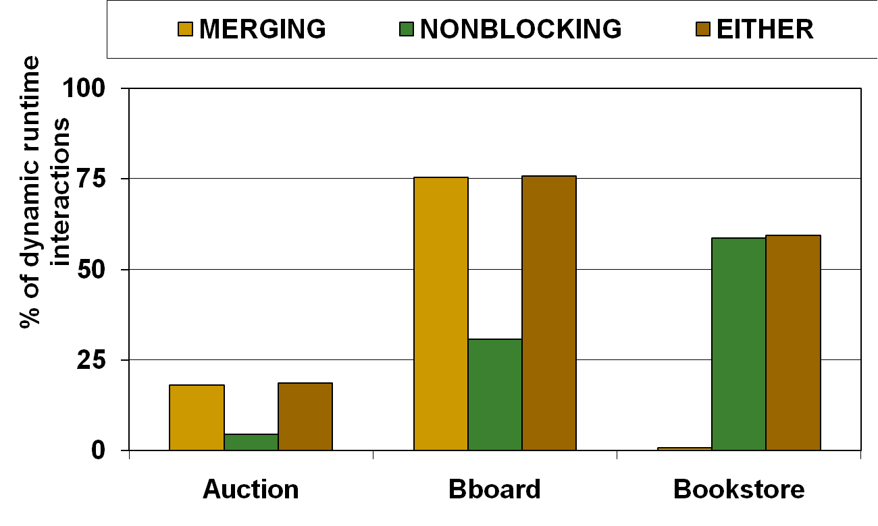
Applicability of the Transformations
Either transformation applies to 25% (Auction), 75% (Bboard),
and 50% (Bookstore) dynamic runtime interactions
Notes:
Auction and Bboard had about 10% static interactions.
Because developers like to abstract database values, and because doing so has no effect on the performance in a traditional setting, we believe that these transformations will continue to be widely applicable even to other Web applications.

Slide 41
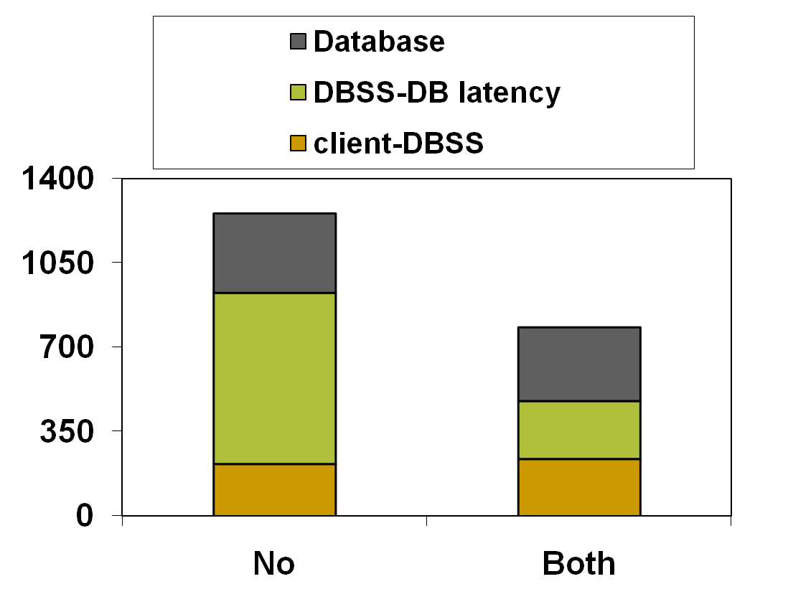
BBOARD Application: Impact on Latency
Average latency in ms
Transformations
Overall latency decreases by 38%,
the DBSS-DB latency decreases by 65%
Notes:
1257 vs. 781 – decrease of 38%.
DBSS – DB latency: decrease of 65%.

Slide 42
Impact of Latency on Scalability
Improved scalability
Scalability
Threshold
Latency curve
Latency
Reduced latency curve
Simultaneous users supported
Reducing latency improves scalability
Notes:
So far, in this section, we have focussed on the latency. But to measure the effectiveness of any our techniques, we measure scalability with a latency threshold.
This graph here shows the simultaneous users supported on the x-axis and the average latency of the interaction on the y-axis.
<advance> We measure scalability as the number of users that can be supported with the latency remaining under a threshold value.
<advance> Reducing latency improves scalability.

Slide 43
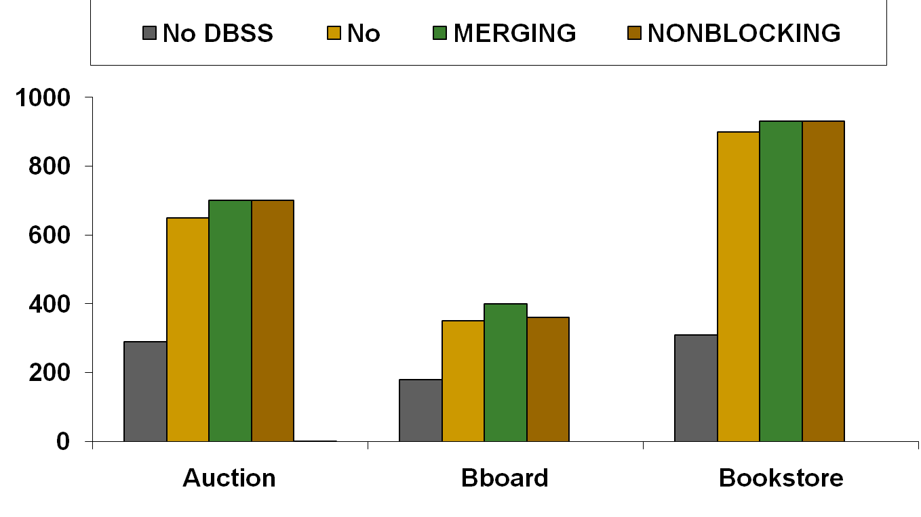
Effect of the Transformations on Scalability
Scalability (number of concurrent users supported)
Notes:
Either transformation improves scalability.
Because we measure scalability in a convoluted way, there is not much impact on scalability even though the latency reduction is sizable in many cases.
Applying both transformations yields the best scalability. The MERGING transformation applies when queries are related, whereas the NONBLOCKING applies when queries are not related.

Slide 44
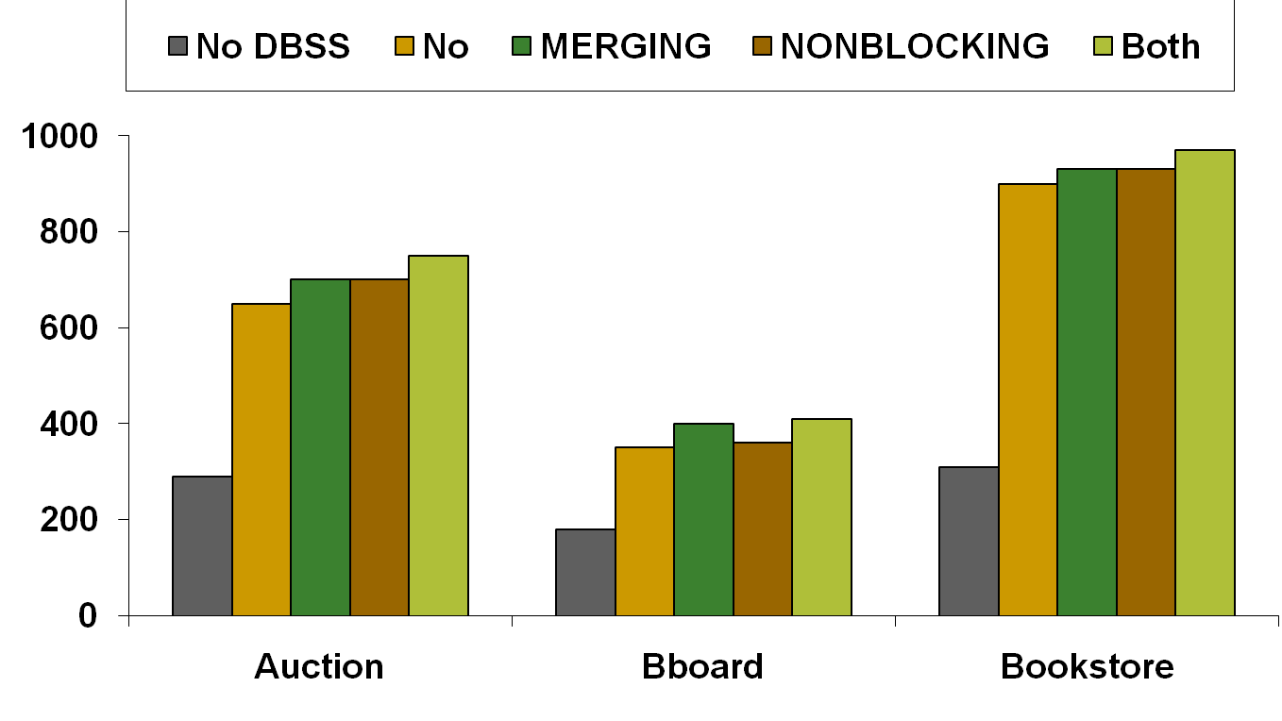
Effect of the Transformations on Scalability
Scalability (number of concurrent users supported)
Applying both transformations yield the best scalability
Notes:
Either transformation improves scalability.
Because we measure scalability in a convoluted way, there is not much impact on scalability even though the latency reduction is sizable in many cases.
Applying both transformations yields the best scalability. The MERGING transformation applies when queries are related, whereas the NONBLOCKING applies when queries are not related.

Slide 45
Related Work: MERGING transformation
Cassyopia [HOT OS’03]: cluster system calls
  Preliminary work; in different domain
Hilda [Yang+ WWW ’07], Abacus [Amiri+ ATC ’00]
  Use a custom language
Stored procedures
  Difficult to optimize and cache
Nested query optimization [TODS ’82, SIGMOD ’87]
Multi-query optimization [SIGMOD 00]
  Database optimizes instead of compiler
Notes:
The work most closely related is Cassyopia, where the idea was to use compiler techniques for clustering system calls so that the overhead of crossing address spaces is reduced. However, the work was preliminary and of course in a different domain.
The MERGING transformation can be viewed as repartitioning of work between the application and the database server. There have been prior efforts to partition the execution of an application across machines to optimize certain objectives. However, the previous works require a custom language.
Most database vendors support stored procedures which allow applications to invoke a block of procedural and declarative code at the database. Our approach has many key advantages. First, it is significantly harder for the database to optimize the execution of queries that use stored procedures. And it is difficult to maintain consistency of a cache containing results of stored procedures.
Nested Query Optimization: Decorrelation: transform query to avoid nesting
Similar to the loop-to-join pattern
Database optimizes instead of compiler
Multi-query optimization: Identify common subexpressions to speed up query.

Slide 46
Related Work: NONBLOCKING transformation
Use application specific knowledge for prefetching
  [Brown+ OSDI ’00, Mowry+ OSDI ’96] , [Patterson+ SOSP ’95]
  Different domain: No SQL analysis was necessary
Issue prefetches by detecting patterns in misses
  Page faults [Curewitz+ SIGMOD’93], web pages [Nanopoulos+ TKDE’03], file-systems [Kroeger+ ATC’96]
  Patterns must be established
  Mis-prediction if pattern changes
Notes:
Compiler-assisted management of memory: Add release, prefetch calls [Brown+ OSDI ’00, Mowry+ OSDI ’96]
Application provides access hints for file reads and writes [Patterson+ SOSP ’95]

Slide 47
Reducing User Latency in a DBSS Setting: Contributions
Proposed two holistic transformations that
Reduce the #round-trips in accessing the data
Apply in 25% to 75% of the interactions
Improve scalability by over 10% in a DBSS setting
Can be applied automatically by src-to-src compilers

Slide 48
Thesis Contributions
Identified and studied the security-scalability tradeoff
  Secured about 75% of data without hurting scalability
  Proposed invalidation clues that provide better tradeoffs
Proposed transformations to reduce user latency
  Improved scalability by 10%
Evaluated all techniques on a prototype DBSS using three benchmark applications
  Overall scalability improved by a factor of 3
Notes:
It is possible to scale dynamic Web applications while addressing their security concerns.

Slide 49
Thanks!
Questions?

Slide 50
Backup Slides

Slide 51
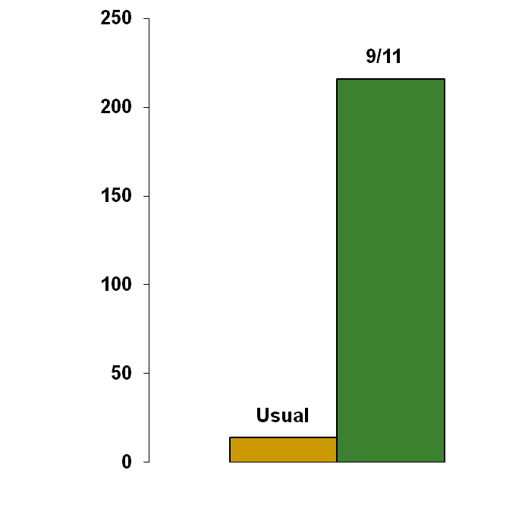
Number of requests a website receives is also unpredictable
CNN, NYtimes, ABCnews
unavailable from 9-10 EDT
Page views/day for CNN.com (in millions)
Source: 1. CNN news release Sept 12, 2001; 2. Keynote’s news release Sept 11, 2001 1. http://archives.cnn.com/2001/TECH/internet/09/12/attacks.internet/ 2. http://www.keynote.com/news_events/releases_2001/091101.html
Notes:
Customer load is variable and unpredictable.

Slide 52
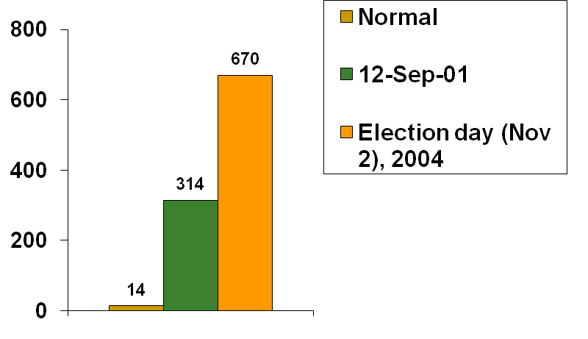
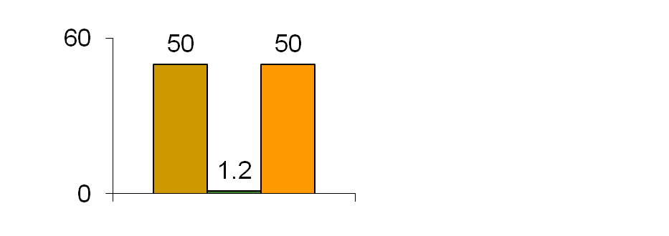
An appealing solution is to use a CDN
Traffic at CNN.com
Page views/day
(in millions)
Page size
(in kB)
Used Akamai on Election Day
Large infrastructure → handle load spikes
Shared infrastructure → charge on a usage basis
Source: http://www.tcsa.org/lisa2001/cnn.txt http://www.akamai.com/en/html/about/press/press479.html
Notes:
The CDN solution does not scale the database component. 50k, 1.2k, 50k
2K split page was not enough reduction - light page was 1247 bytes of text, logo, one image - lowest ever amount of text

Slide 53



CDNs do not provide a way to scale the database component
Request
Users
Execute
code
Access
DB
Response
Web Server
App Server
DB
Home server
Dynamic content sites are becoming increasingly popular

Slide 54
Trusting the Site of Code Execution
Code is executed at a much larger trustworthy company
  Akamai vs. database-scalability-service startup
Code is executed by the application
  Database is the big bottleneck
Code is executed at the end-user’s site
Trusted computing initiative

Slide 55
A Simple Example
toys (toy_id, toy_name)
No Invalidations
Q1:toy_id=15
Empty
11 | Barbie
15 | GI Joe
Nothing is encrypted
Q1: toy_id=15
Q1
U1
DBSS
Home server Database
Q1: SELECT toy_id FROM toys WHERE toy_name=“GI Joe”
U1: DELETE FROM toys WHERE toy_id=5
Invalidate
Result
Q1:
Empty
Results are encrypted
11 | Barbie
15 | GI Joe
Q1:
Result
Q1
U1
Encryption leads to more invalidations
toy_id=15

Slide 56
Security-Scalability Tradeoff
Q1 | SELECT toy_id FROM toys WHERE toy_name=?
Q2 | SELECT qty FROM toys WHERE toy_id=?
Q3 | SELECT cust_name FROM customers WHERE cust_id=?
U1: DELETE FROM toys WHERE toy_id=5
 | Template | Parameters | Query result | Invalidations
Blind |  |  |  | All Q1, Q2, Q3
Template |  |  |  | All Q1, Q2
Statement |  |  |  | All Q1, Q2 with toy_id=5
View |  |  |  | Q1 with toy_id=5 Q2 with toy_id=5
x
x
x
x
x
x
Security
Scalability
Notes:
Fill the table entries one by one.

Slide 57
Security-Scalability tradeoff
900
Nothing
encrypted
600
Scalability (Number of concurrent users supported)
300
Everything
encrypted
0
0
5
10
15
20
25
30
Security (Number of query templates with encrypted results)
Security-Scalability tradeoff for the BOOKSTORE application

Slide 58
Opportunity for Managing the Tradeoff
Not all data is equally sensitive
Data Sensitivity
Completely
insensitive
Moderately
sensitive
Extremely
sensitive
Bestsellers
list
Inventory records,
customer records
Credit Card
Information
Care but worried about scalability impact
Secure at
all costs
Don’t care
But for most data, nontrivial to assess:
Data-sensitivity
Scalability impact of securing the data

Slide 59
SCSA [SIGMOD ’06]
Privacy Law
Invalidation Matrix (IM)
characterization results
Other
constraints
Construct IM for each template pair
Apply a greedy algorithm
Find data not useful for invalidation
Tradeoff needs to be managed over reduced data

Slide 60
Methodology of Sample Experiment
Scalability: max # concurrent users with acceptable response times
Security: # templates with encrypted results
5 ms
100 ms
Users
CDN and DBSS
Home server
BOOKSTORE application
Notes:
California Privacy Law determined sensitive data
Non-transactional invalidation

Slide 61
Scalability Conscious Security Approach (SCSA) for Managing the Tradeoff
900
Nothing
encrypted
SCSA
600
Scalability (Number of concurrent users supported)
300
Everything
encrypted
0
0
5
10
15
20
25
30
Security (Number of query templates with encrypted results)
1. Easy to either get good scalability or good security
2. SCSA presents a shortcut to manage the tradeoff

Slide 62
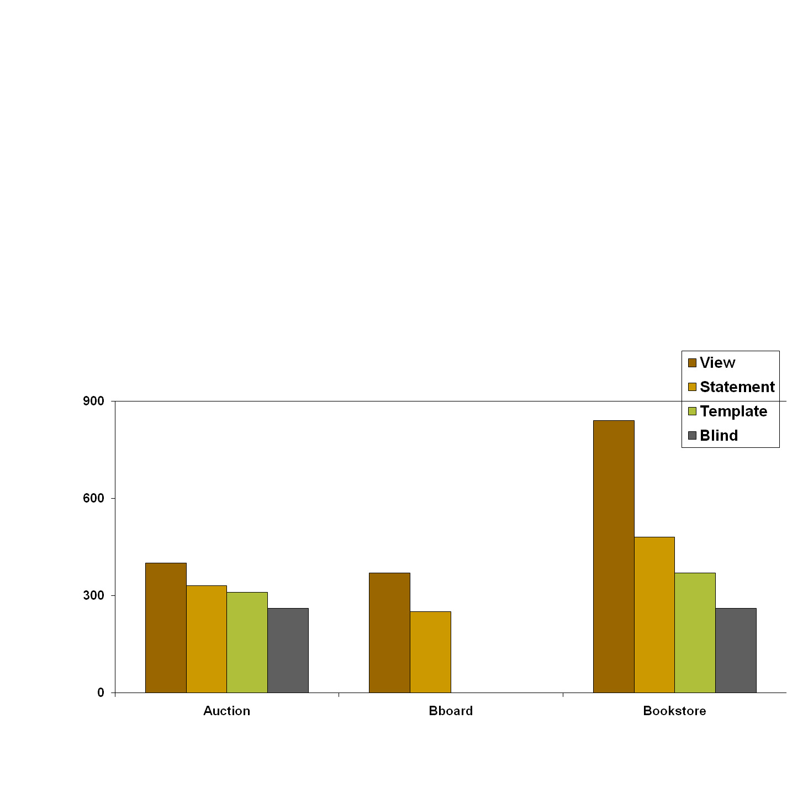
Magnitude of Security-Scalability Tradeoff
Scalability (number of concurrent users supported)
0
0
Benchmark Applications

Slide 63


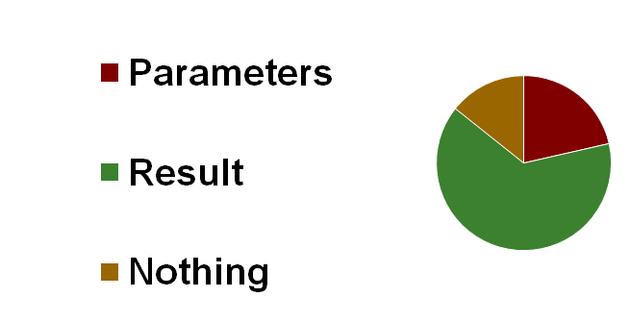
Security Results
Query data that can be encrypted “for free”
4
6
17
7
7
7
and result
18
12
14
Auction
Bboard
Bookstore
Notes:
Put actual numbers in the slides, over the

Slide 64
Security Results in Detail
Auction: The historical record of user bids was not exposed
Bboard: The rating users give one another based on the quality of their posting
Bookstore: Book purchase association rules discovered by the vendor – customers who purchase book A also purchase book B

Slide 65
Scalability Conscious Security Approach: Contributions
Identify security-scalability tradeoff
Shortcut to manage the tradeoff
  Static analysis of database templates for identifying data not useful for invalidation
  Tradeoff must be managed over the remaining data
Evaluation
  Blanket encryption hurts scalability
  Most data encrypted for free is moderately sensitive

Slide 66
Invalidation Clues: Motivation
Augmented example template:
SELECT toy_id, price FROM toys WHERE toy_name=“GI Joe”
template
parameter
DELETE FROM toys WHERE toy_id=5
Previous solution:
Coarse grained—either encrypt query result or not
Not possible to get the best scalability
No general framework for studying the tradeoff
Did not consider specific attack models from DBSS

Slide 67
Invalidation Clues [ICDE 2007]
Limit unnecessary invalidations
  Rule out most unnecessary invalidation
Limit revealed information
  Achieve a target security/privacy by hiding information from the DBSS
Limit database overhead
  Don’t enumerate what to invalidate—provide “hints”

Slide 68
Illustrative Example of Clues
Q^{T}
SELECT item_id, category, end_date FROM items WHERE seller = ?
U^{T}
UPDATE items SET end_date = ? WHERE item_id = ?
UPDATE items SET end_date = 20080304 WHERE item_id = 7
Query clue
Update clue
Query result invalidated if
none
none
any update occurs
query result
20080304, 7
item_id = 7 in query result
item_id values
7
item_id = 7 in query result
Bloom-filter of item_id values
Bloom-filter of {7}
item_id =7 present as per Bloom-filter
Notes:
Query clues are attached to query results, and update clues are attached to updates, and they are together used for invalidations.

Slide 69
Database Update Clues: UPDATE
SELECT item_id FROM items
WHERE items.category=‘books’
AND items.end_date>=tomorrow
UPDATE items SET end_date=end_date+? DAYS WHERE item_id=?
For “precise” invalidation need to know: category of the item

Slide 70
Database Update Clues: INSERT
SELECT item_id FROM items, users
WHERE items.seller=users.user_id
AND items.category=‘books’
AND items.end_date>=tomorrow
AND users.region=PA
INSERT INTO items VALUES (…)
For “precise” invalidation need to know: category of the item, region of the seller

Slide 71
An application has to make multiple round-trips to access its data
function get_comments_on_user ($user_id) {
$template:=SELECT from_user_id FROM comments
WHERE to_user_id=?
$query:=set_parameters ($template, $user_id)
$result:=execute ($query)
foreach ($row in $result) {
$from_id:=get_id_from_row ($row)
$template:=“SELECT user_name FROM users
WHERE user_id=?”
$query:=set_parameters($template, $from_id)
$result:=execute ($query)
}
Affects interactivity in a DBSS setting

Slide 72
MERGING Transformation
Names of users who have posted comments about John
comments (from_id,to_id,…), users (id,name)
$query1:=“SELECT from_id FROM comments
WHERE to_id=?”;
$result1:=execute ($query1);
foreach ($from_id in $result1)
$query2:=“SELECT name FROM users
WHERE id=$from_id”;
$result2:=execute ($query2);
Application
join
Notes:
There seems to be a disconnect between what gets executed at the application and what gets executed at the database.

Slide 73
Example for NONBLOCKING Transformation
User viewing details of a book
items(iid, iname, related), users(uid, uname)
SELECT iname FROM items i1, items i2
WHERE i1.iid=i2.related AND i2.iid=?
SELECT uname FROM users WHERE uid=?
Related
item
Greet user
User latency decreased by issuing the queries concurrently
Do it automatically by code analysis tools

Slide 74
Why opportunities for applying these transformations exist?
Almost no overhead for code like “application join” in a centralized setting
Developers find it convenient to abstract database elements as values (ORMs like Ruby-on-Rails), and use object-oriented development
When presenting data to the user, developers find it convenient to get data as and when needed

Slide 75
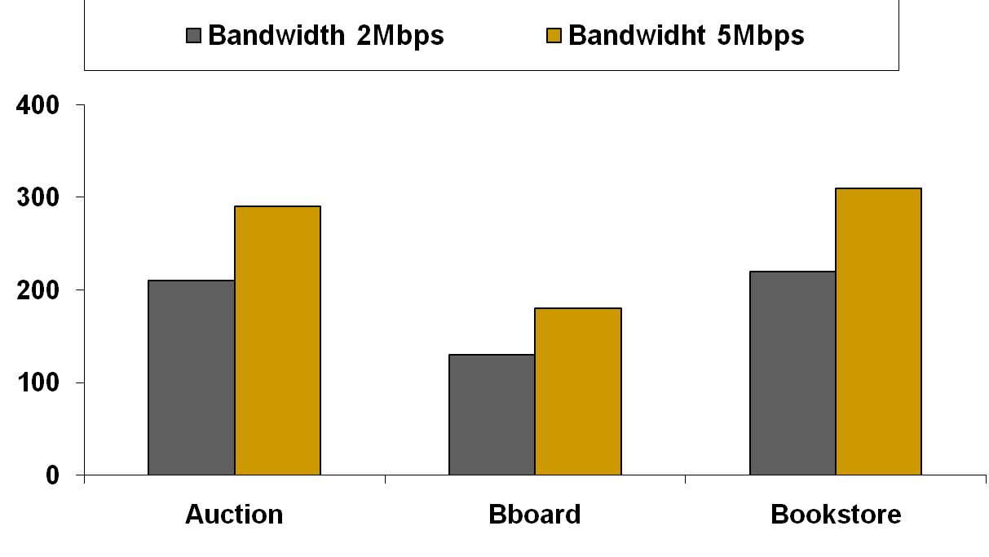
Scalability Effects of Increasing Home Server Bandwidth
Scalability (number of concurrent users supported)
Home server bandwidth was the bottleneck
Scalability increased by 20% in each case

Slide 76
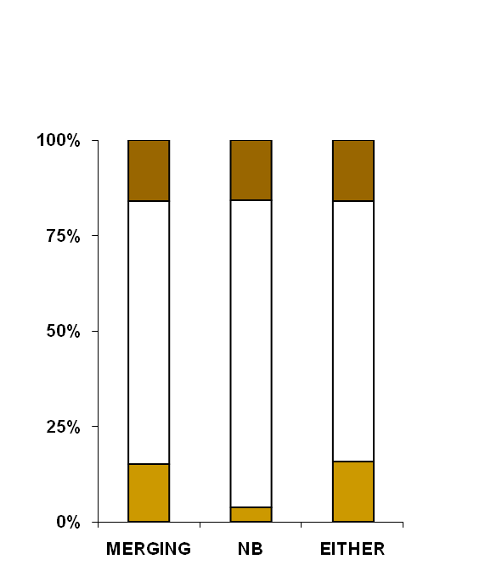
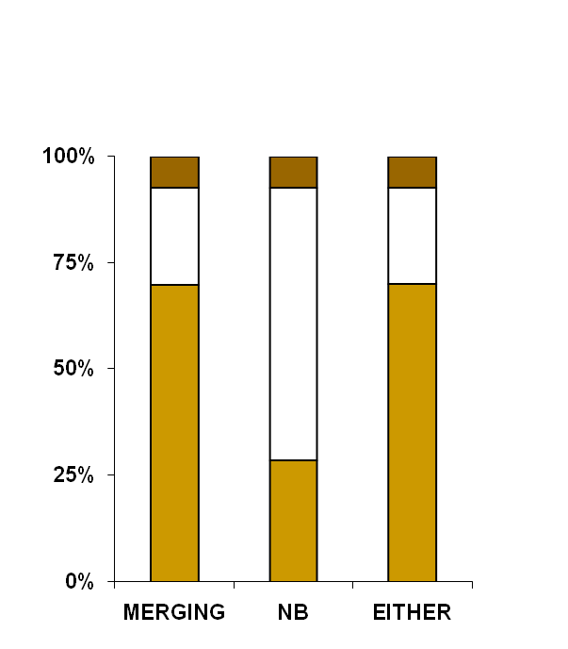
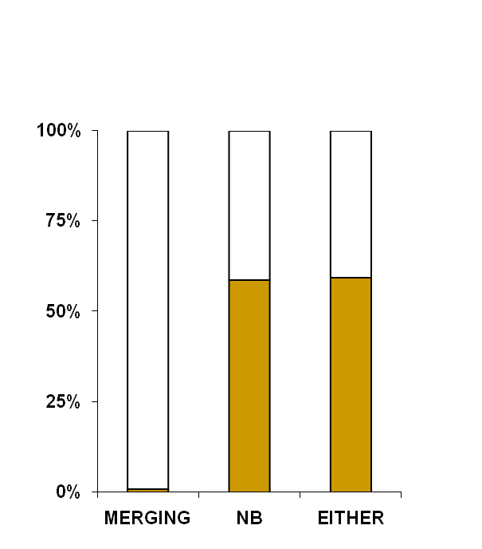
Applicability of the Transformations
Applicable
Not applicable
Static
% of runtime interactions
AUCTION
BBOARD
BOOKSTORE
Transformations widely applicable
Notes:
How widely are the transformations applicable?

Slide 77
Benchmark Applications
Auction (RUBiS, from Rice)
  Modeled after Ebay
Bulletin board (RUBBoS, from Rice)
  Modeled after Slashdot
Bookstore (TPC-W, from UW-Madison)
  Online bookseller, a standard web benchmark
  Changed the popularity of books
Benchmarks model popular websites
Notes:
RUBiS and RUBBoS are from researchers at Rice University, TPC-W implementation from Wisconsin.

Slide 78
Related Work: Consistency
Two levels of consistency
  Best-effort consistency (eventual consistency): sacrifice performance for consistency – BBOARD
  Strong consistency: Civic emergency example
If queries carry “freshness constraints”, serializability can be guaranteed

Slide 79
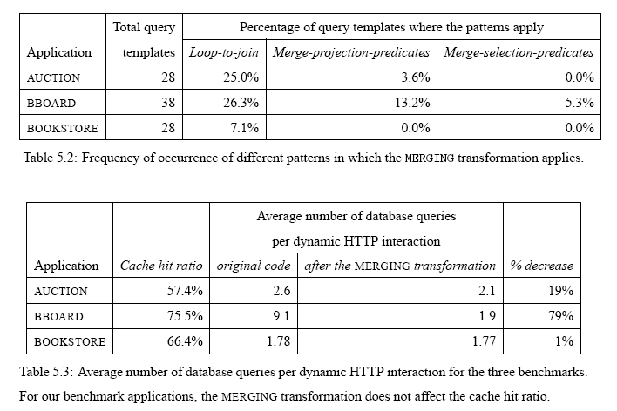
Coverage of the MERGING Transformation

Slide 80
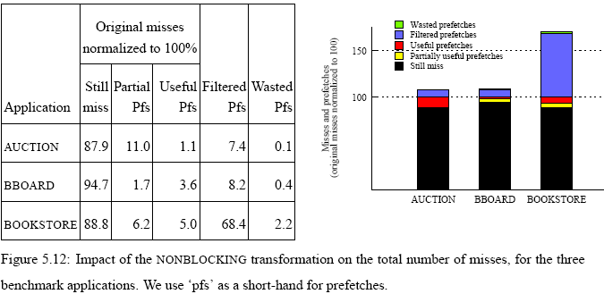
Coverage of the NONBLOCKING Transformation

Slide 81
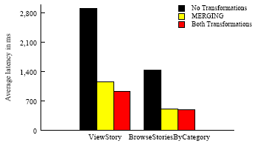
Impact of the MERGING Transformation on Latency
The MERGING transformation is more effective
in reducing latency of the BBOARD benchmark

