Slide 1


@mi$oft
Presentation On
MysqlPlus-GUI For Mysql
By
Amit Anil Bhalerao(MCA-III)

Slide 2
Databases
@mi$oft
Oracle
Mysql
Postgresql
Sybase
Informix
Sqlite
Ingres
Mimer
MicroSoft SQL Server

Slide 3




What is MysqlPlus ?
@mi$oft
+
=
It is an Application developed by using Java and
Mysql to perform database operations easily and quickly.

Slide 4
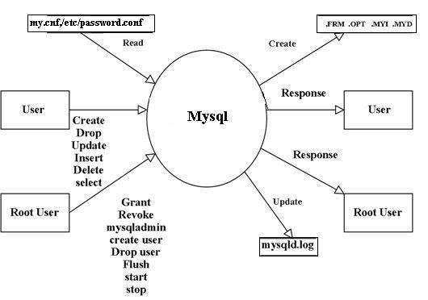
@mi$oft
How Mysql Works ?

Slide 5
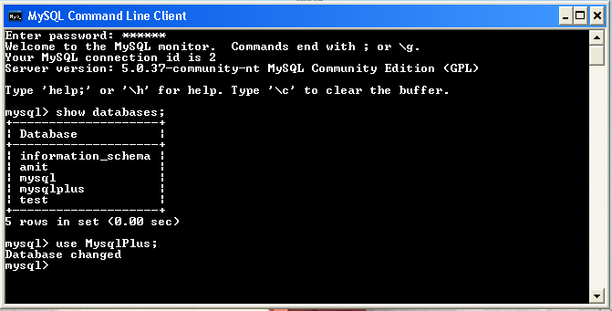
@mi$oft
MySQL Command Line Client-Windows

Slide 6
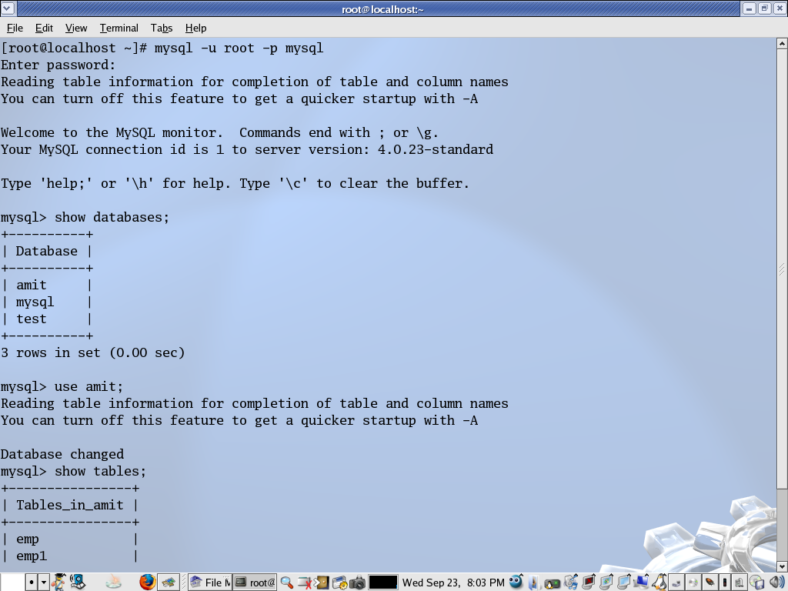
@mi$oft
MySQL Command Line Client-Linux

Slide 7
@mi$oft
Limitations of Command Line MySQL
→ User needs to remember the Syntax of each Command
→ Problems while understanding the errors
→ Not a User Friendly Environment
→ Too technical explanation of Help
→ No proper explanation of errors
→ Help without examples

Slide 8
@mi$oft
What MysqlPlus Can do ?
→ Creating, dropping and Listing, databases
→ Creating and dropping tables
→ Inserting, Deleting, Updating,Altering tables data
→ Creating, Dropping and Altering Views and Indexes
→ Loading and Storing Query to and from a text file
→ Cut Copy, Paste, Undo, Redo text to and from System
→ Starting and Stopping MySql Service

Slide 9
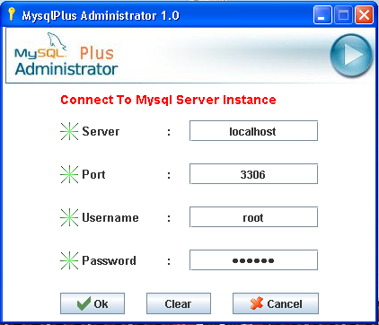
@mi$oft
Login Screen

Slide 10
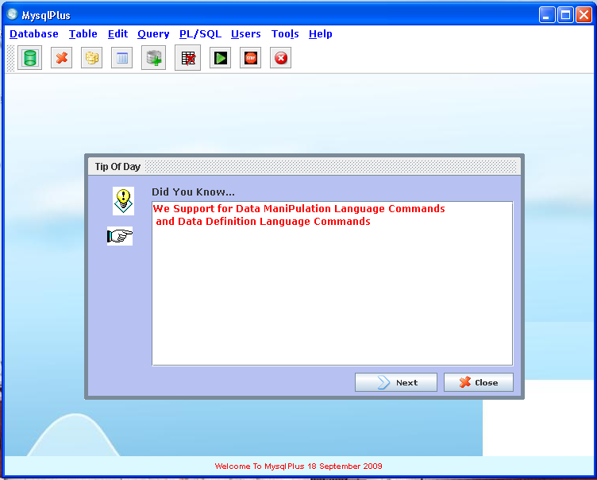
Main GUI Screen
@mi$oft

Slide 11
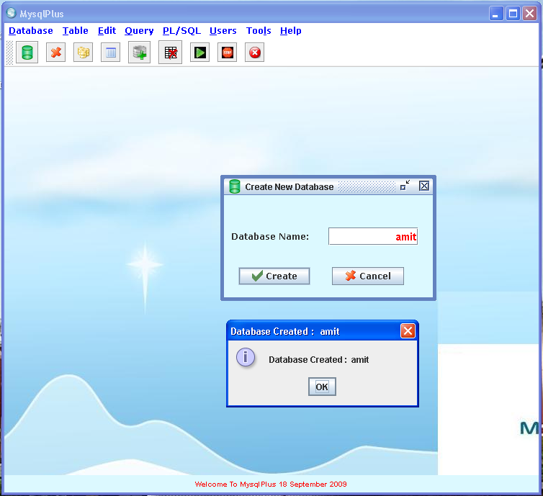
Create Database
@mi$oft

Slide 12
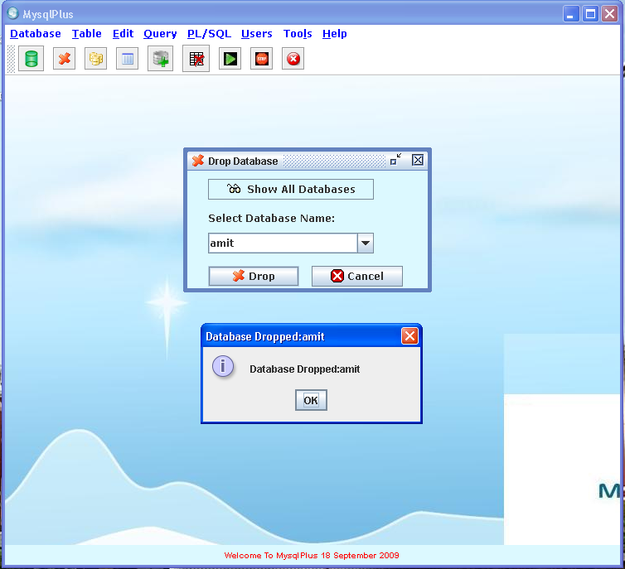
Drop Database
@mi$oft

Slide 13
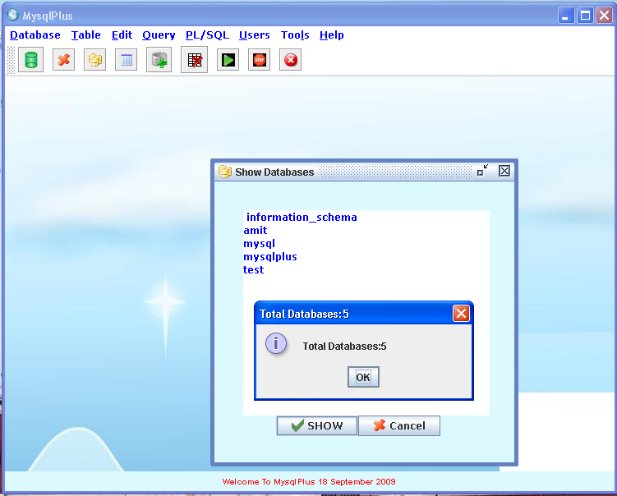
Show Databases
@mi$oft

Slide 14
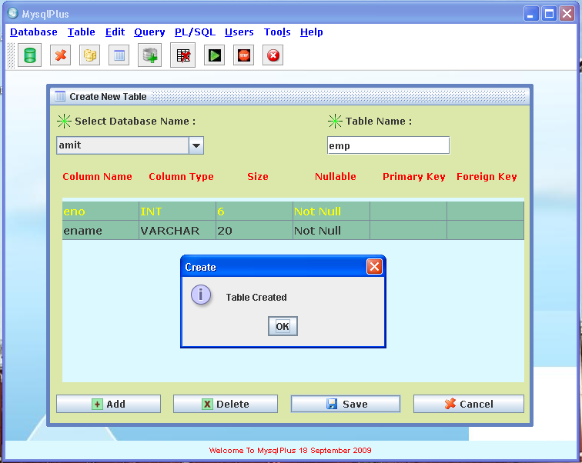
Create Table
@mi$oft

Slide 15
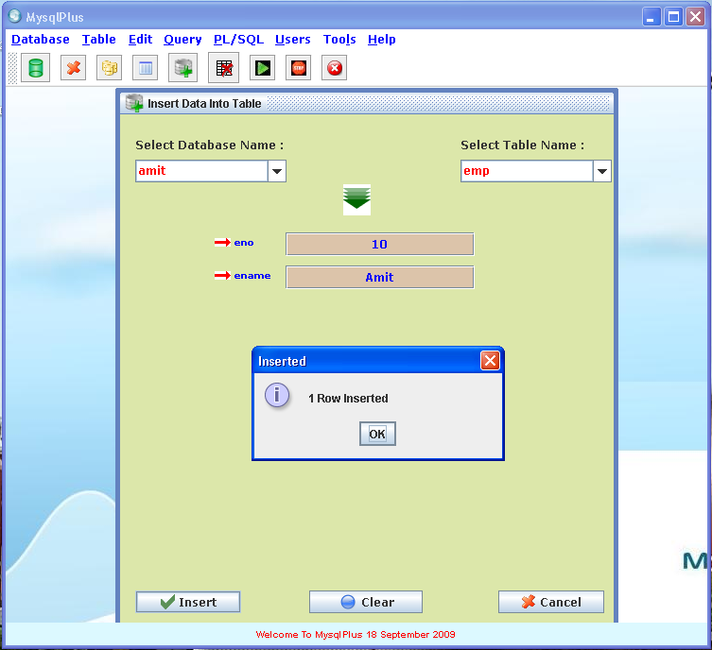
Insert Data into Table
@mi$oft

Slide 16
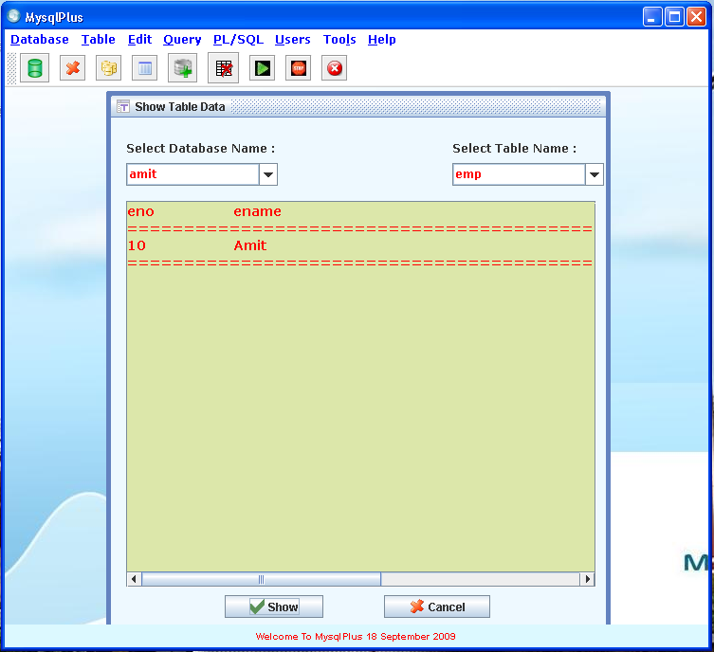
Show Table Data
@mi$oft

Slide 17
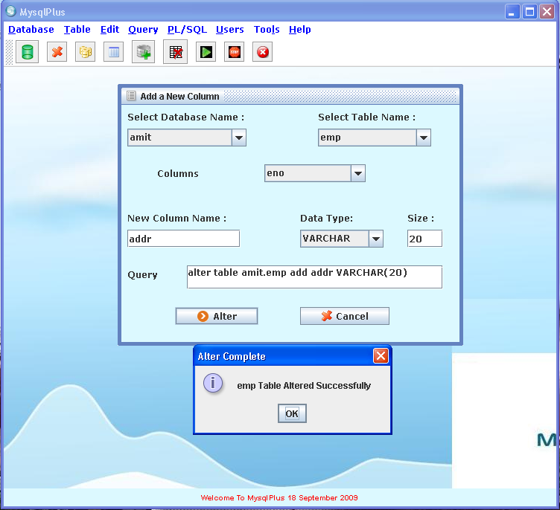
Add New Column
@mi$oft

Slide 18
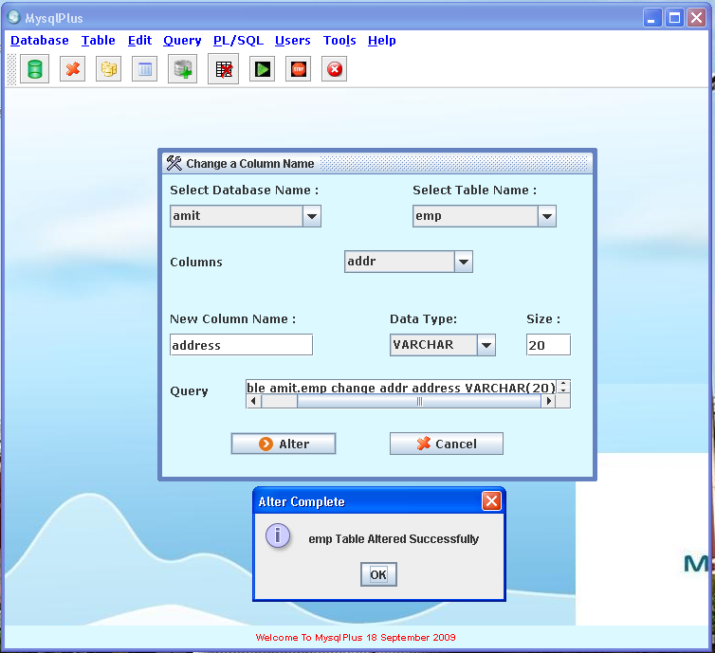
Change Column Name
@mi$oft

Slide 19
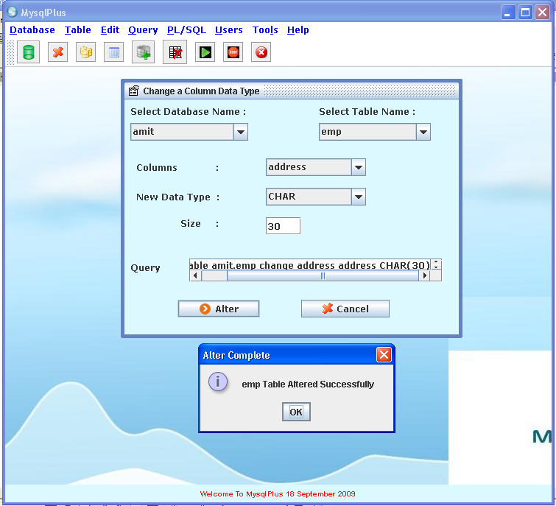
Change Column Type
@mi$oft

Slide 20
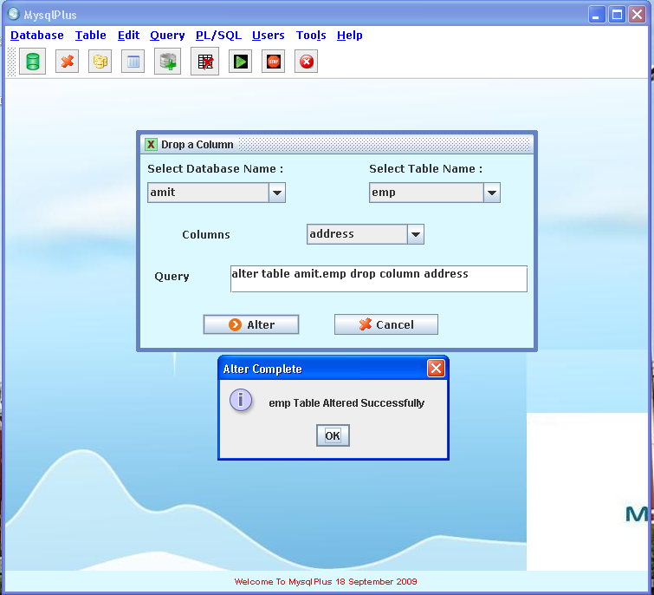
Drop Column
@mi$oft

Slide 21
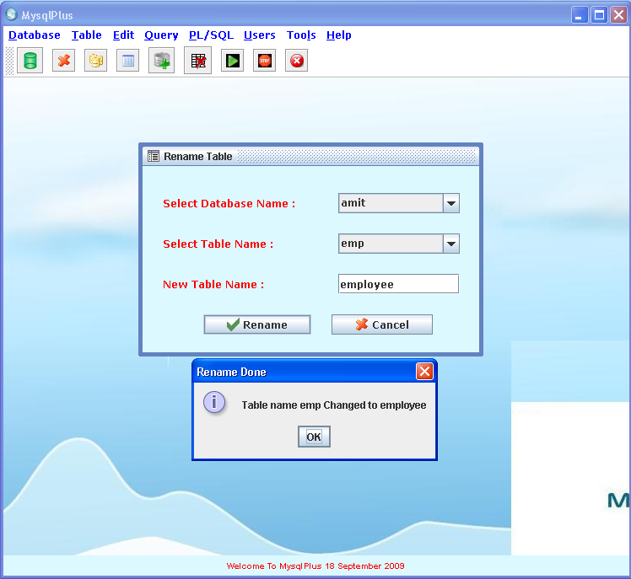
Rename Table
@mi$oft

Slide 22
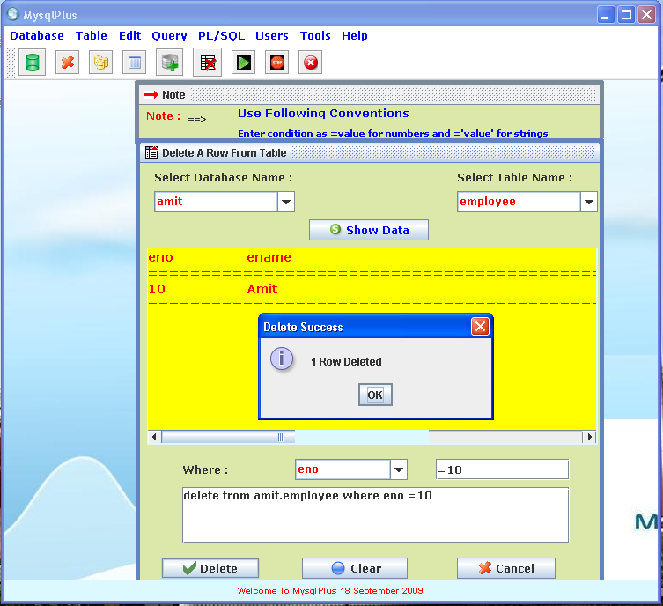
Delete Data From Table
@mi$oft

Slide 23
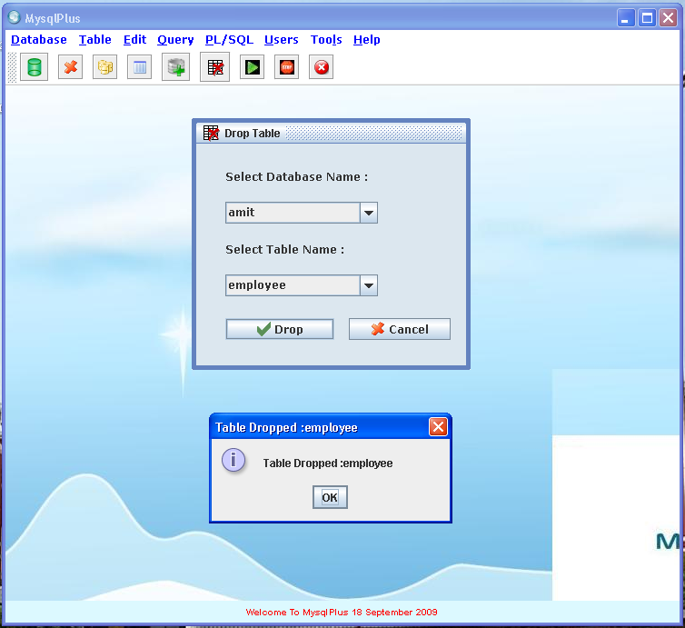
Drop Table
@mi$oft

Slide 24
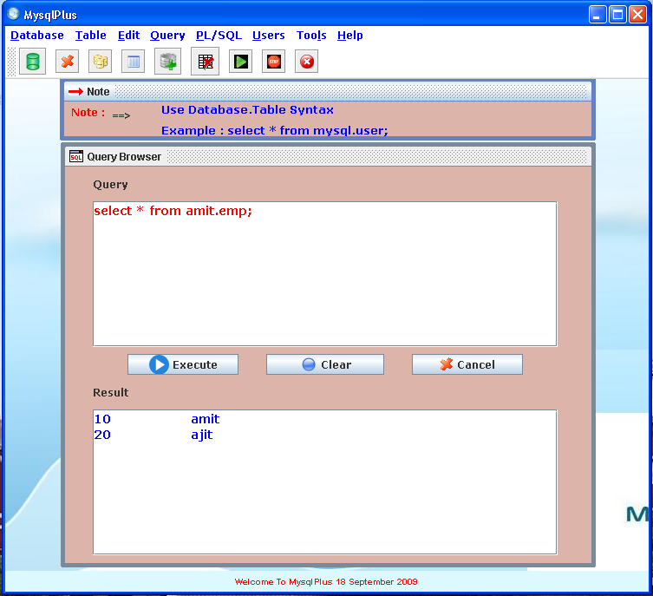
Custom Query Window
@mi$oft

Slide 25
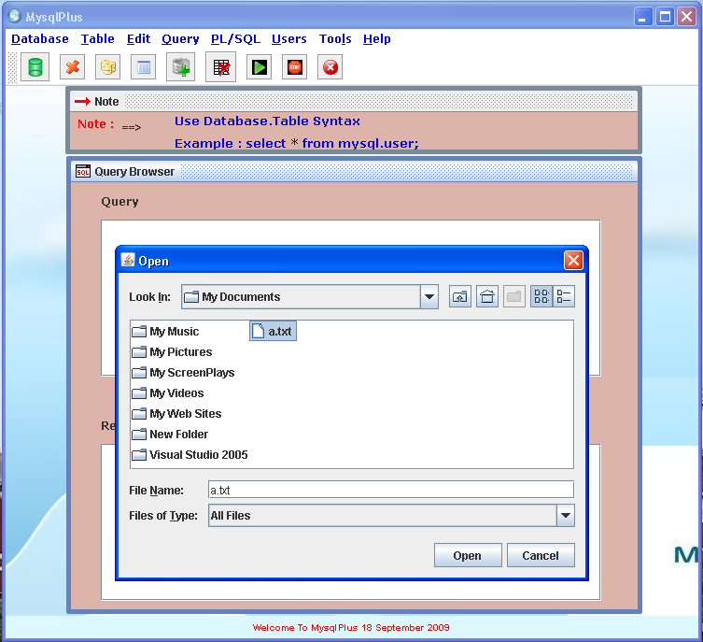
Load Query From File
@mi$oft

Slide 26
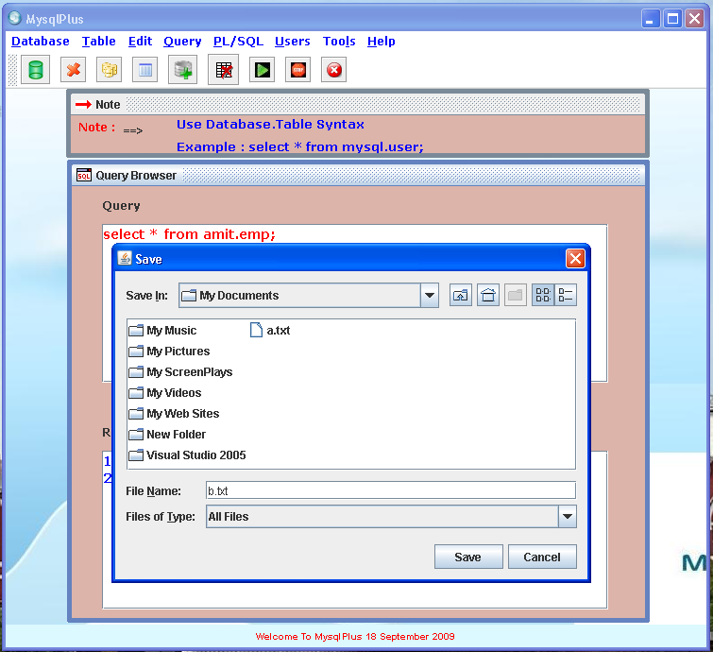
Save Query To File
@mi$oft

Slide 27
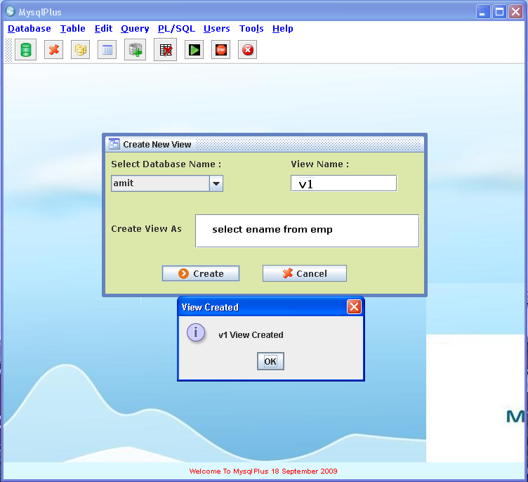
Creating Views
@mi$oft

Slide 28
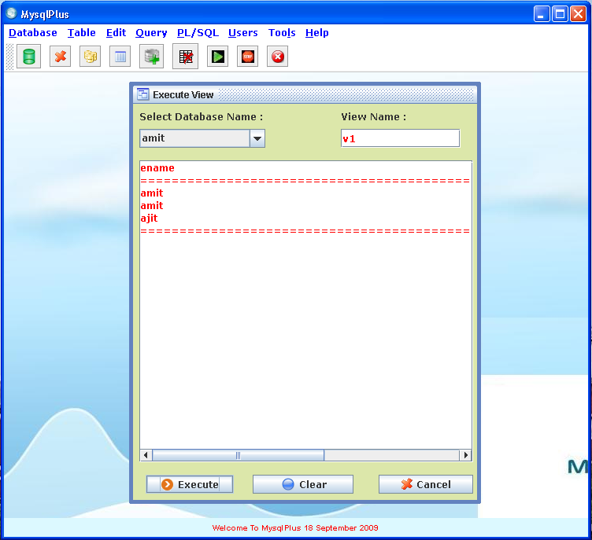
Executing Views
@mi$oft

Slide 29
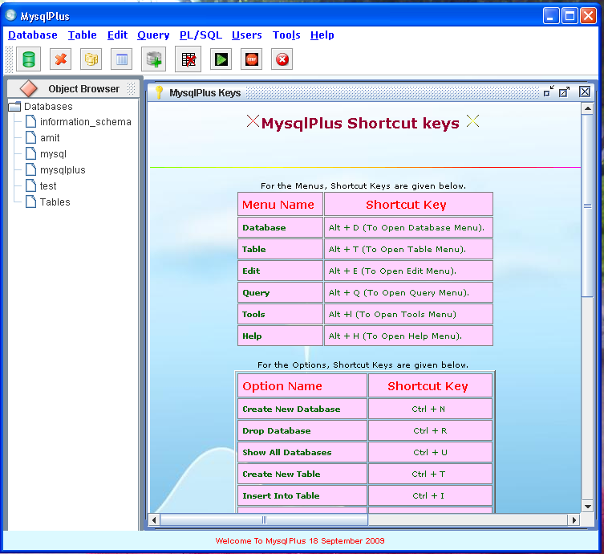
Help
@mi$oft

Slide 30

@mi$oft
Questions ?

Slide 31

@mi$oft

