Slide 1
INTRO TO PSYCHOLOGY
States of Consciousness

Slide 2
WHAT IS CONSCIOUSNESS?
A cognitive state in which you are aware of yourself and your situation
  Someone who is conscious is aware of the immediate environment
Also includes inner awareness, knowledge of our own thoughts feelings, and memories
The theater of our mind
How is consciousness studied?

Slide 3
Consciousness in history
Descartes – Dualism – The mind and body are completely separate things.
  Today, scientists do not believe this. The mind does not exist independent of the body
Materialism – mental life has a physiological basis rooted in the brain
Wundt has subjects report the contents of their consciousness while doing various activities
  Structuralists tried to uncover the structure of consciousness.

Slide 4
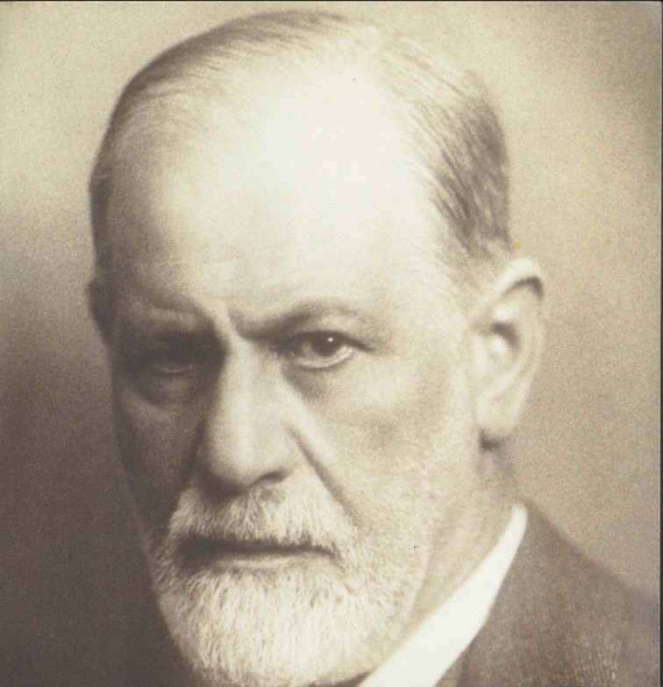

Slide 5
Freud believed that deep within consciousness contained needs, wishes, and desires that influence feelings and behavior – the unconscious
That is, Freud believed that people had different levels of consciousness

Slide 6
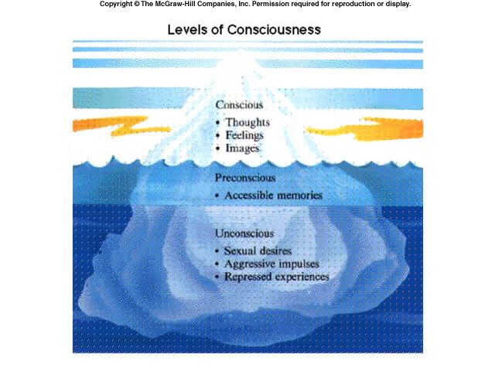
FREUD’S LEVELS OF CONSCIOUSNESS

Slide 7
Many people now believe that we have different levels of consciousness
  Ex. Automatic processing
  Ex. Being drunk (lower level of consciousness)

Slide 8
THEORIES OF CONSCIOUSNESS
Many theories, each somewhat different
Commonality is that they all arise by firing patterns of the brain
Neuroscience is revolutionizing the study of consciousness
  Ex. PET scans to look at visual perception
Some things we may never be able to study

Slide 9
THE EASY PROBLEM OF CONSCIOUSNESS
Those that can be studied by cognitive science
  the ability to discriminate, categorize, and react to environmental stimuli;
  What is the brain doing when someone is thinking?
  the difference between wakefulness and sleep.
The easy problem is actually very hard, but the hard problem is even harder!

Slide 10
THE HARD PROBLEM
problem of experience - Qualia
All experiences contain a subjective aspect
  the sound of music
  felt quality of redness
  the taste of meat/gulabjamun.
the felt quality of emotion, and the experience of a stream of conscious thought
Ex. Pain – we can study how it works in the brain, and the mental states involved, but:
  Why does it hurt?
  What is that feeling made of?

Slide 11
Consciousness is what makes us aware of ourselves
The prevailing view of consciousness is that various levels of it exist.
Sleep, dreams, hypnosis, meditation, drugs

Slide 12
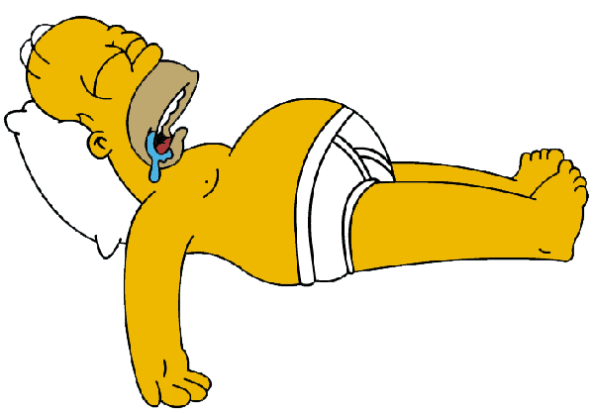
SLEEP

Slide 13
Why do we sleep?
Repair and restoration theory
  Sleep deprivation can deteriorate the body
  Repairing products are produced during sleep: protein production, growth hormone, etc.
  the more physical exercise an animal does, the more sleep an animal will have
Evolutionary or Energy conservation theory
Hedonistic theory – we sleep because we like it

Slide 14
WHEN DO WE SLEEP?
Circadian Rhythm - biological clock; controls the rise and fall of physiological responses such as temperature, and even sleep.
Rhythm is daily and regulated by the sun.
  Studies find that without external reminders of time, we prefer 25 hour cycles
Problems arise when our circadian rhythm is disrupted
  Jet lag
  Monday mornings

Slide 15
Environmental Arousal - When our body is in a state of high arousal, we cannot sleep.
  Stress, excitement, and drugs that increase arousal can interfere with the onset of sleep as well as staying a sleep.
  Lack of arousal can make you sleepy
Sleep Deprivation When we are deprived of one night's sleep, we go to sleep sooner and stay asleep longer

Slide 16
WHAT HAPPENS DURING SLEEP?
Is sleep like being unconscious? Not exactly.
We can continue to process the external world while asleep.
  Infants crying
  Environmental events can become incorporated into our dreams.
We can continue to process our internal world.
  We wake up when we have to use the restroom or get sick
  Events of the previous day become incorporated into our dreams.

Slide 17
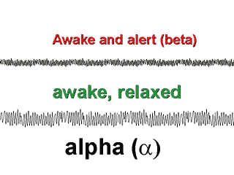
WHAT HAPPENS TO THE BRAIN AND BODY DURING SLEEP?
EEG: Electroencephalogram – measures overall activity patterns of neurons in the brain. Is used to tell how active as a whole a person’s brain is.

Slide 18
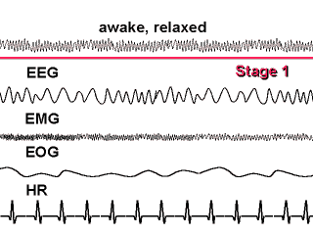
5 STAGES OF SLEEP: STAGE 1
EEG activity is of higher amplitude and lower frequency than during waking
People awaken from Stage 1 claim to have not been asleep

Slide 19
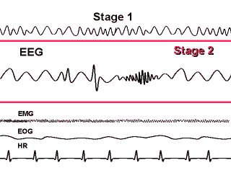
STAGE 2
The EEG is higher in amplitude and lower in frequency
Contains strange firing bursts
K-complexes
Sleep spindles

Slide 20
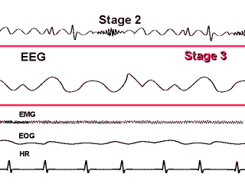
STAGE 3
Waves are slower and higher in amplitude, indicating greater cortical synchrony

Slide 21
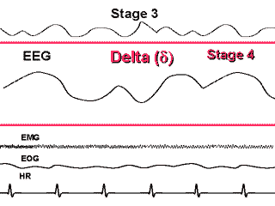
STAGE 4
EEG is higher in amplitude and lower in frequency than in any other stage
Stage 4 is the “restorative” stage

Slide 22
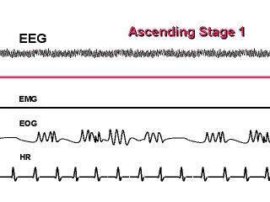
REM: RAPID EYE MOVEMENT SLEEP
The EEG is that of an awake individual
Muscle activity ceases completely
Heart rate returns to the level it had at the start of sleep
Eyes dart back and forth together underneath the closed lids

Slide 23
Interesting Aspects of Sleep
REM is when the majority of dreaming occurs
During REM, the brainstem actively shuts down muscles
Many see REM as being important for memory consolidation
Sleep occurs in cycles, generally progressing from 1 through 4 and REM and then starting over

Slide 24
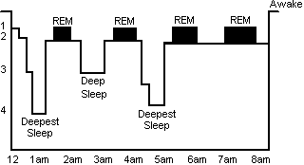

Slide 25
When people are deprived of REM sleep, REM rebound is often seen upon the next sleep period
Stage 4 - peak occurrence of many restorative hormones
  growth hormone
  adrenocorticotropic hormone
  prolactin
Implications of stage 4 involvement in growth
  Children sleep deprived will have stunted growth
  Many feel that people age because stage 4 sleep declines as we get older

Slide 26
EFFECTS OF PROLONGED SLEEP DEPRIVATION
Research shows that it is bad
After 90 hours awake, begin having perceptual distortions, hallucinations, and delusions.
Experiments with rats show that it can cause death
Deprivation of REM only – irritation, difficulty in concentration
Many drugs specifically prevent REM
  Alcohol
  Antihistamines

Slide 27
SLEEP DISTURBANCES
Sleep Walking: occurs in stage 4; person is not conscious
Generally happens in children and it dissipates with age.
Causes:
  Genetic
  Environmental: stress, drugs and alcohol
  Physiological – magnesium deficiency, pregnancy, and menstruation
  Psychiatric disorders – panic disorder, PTSD
The walker can traverse their environment well if they are very familiar with it.
Not dangerous to awaken a sleepwalker

Slide 28
Nightmares: Fear-inducing dreams during sleep
  Vivid and disturbing. Simply dreams with bad stuff in them.
Causes: our experience
  Watching horror movies can cause nightmares
  Stress
  More frequent when people are under emotional stress.
  Basically, anything aversive can cause nightmares
Drugs and alcohol

Slide 29
Narcolepsy: involves brain abnormalities. Person may suddenly fall into REM sleep without warning
  Lose consciousness and muscle tone
Snoring: occurs during obstructive hypopnea, which is continuous but slow and shallow breathing
Caused by blocked airways.
Snoring can occur in both nose- and mouth-breathers
Drugs and alcohol, lack of sleep can enhance snoring.

Slide 30
Sleep apnea: dangerous condition where the person stops breathing while asleep.
Causes: mechanical problems with the airways. It is an obstructive problem.
Treated with several types of devices that serve to keep the airway open
Can lead to SIDS in infants

Slide 31
Insomnia: impairment in functioning due to inability to sleep.
About 15-20% of adults suffer this.
Causes
  Anxiety
  Emotional problems
  Health
  Use of drugs
One major cause is worry about having insomnia.
Treatment:
  Drugs – sleeping pills like Unisom, Ambien, etc.
  Fix source of problem
  Conditioning procedures

Slide 32
Night Terrors: Sudden awakening from sleep, persistent fear or terror that occurs at night, screaming, sweating, confusion, and rapid heart rate
  Can involve violent movement.
  Usually no recall of "bad dreams" or nightmares, may have a vague sense of frightening images.,
  no memory of the event on awakening the next day.
Almost always occurs in children, and it goes away with age
Generally occurs during stage 4 sleep and not REM
  Not just a bad dream
Cause is physiological and not psychological.
Tends to run in families

Slide 33
Sleep paralysis – Upon waking, person has an inability to move
  Probably due to delayed offset of motor inhibition from REM
REM Behavior Disorder: act out dramatic and/or violent dreams during rapid eye movement (REM) stage sleep
  Problem with the normal inhibition of muscles that the pons usually carries out

Slide 34
DREAMING
Freud- Two functions of dreams:
1) Dreams prevent the sleeper from being awoken by minor environmental disturbances
2) Wish fulfillment- Unconscious impulses are responsible for dreams and the goal of dreams was to gratify some drive.
  Reflects sexual and aggressive instincts
  Distorted and symbolic version of the impulses that trigger it.
    Symbolic especially about sex.

Slide 35
According to Freud, dreams had two types of content
Manifest content – the overt story line, characters, and setting of the dream
Latent content – deeper meaning involving symbolism, hidden meaning, and repressed ideas or wishes
Common dreams?

Slide 36
Being chased or attacked
Being injured, ill or dying
  Freud: dreams of teeth falling out means fear of castration
Poor test scores
Falling or drowning
Being naked in public

Slide 37
Carl Jung- believed that dreams were prospective: they helped the dreamer prepare for events anticipated in the immediate future.
  Asserted that dreams give visual expression to instincts
  Claimed that all humans share a collective unconscious – a storehouse of primitive ideas and images inherited from one’s ancestors.

Slide 38
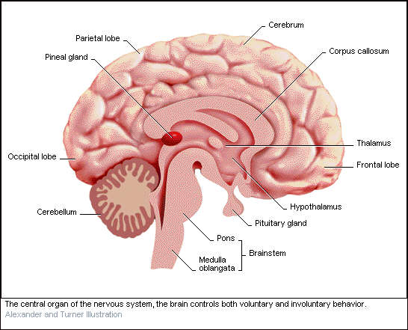
ACTIVATION – SYNTHESIS MODEL
During REM, the pons starts firing randomly in waves like pulses. These travel to the visual cortex. Called PGO waves.

Slide 39
Visual cortex is activated producing images
Frontal lobe of the brain tries to interpret these images
Overall result is a visual story albeit very strange at times
What visual images appear? What is interpreted?
Depends on previous experience of the day or things that are especially important
  Priming - Neurons that are active often become easier to activate.
Result: we dream about what we have recently seen or are very familiar with

Slide 40
Lucid dreaming - dreaming while knowing that you are dreaming
  Has advantages: fantasy, overcoming nightmares, practice
  Must first be able to remember your dreams
  Start writing down your dreams in detail immediately when you wake up
  Many techniques for recognizing when you are dreaming

Slide 41
HYPNOSIS
Stage hypnotists
Hypnotism – a state of mind characterized by a focused awareness on vivid, imagined experiences and decreased awareness of the external environment.
The state is brought on by hypnotic induction – a process in which the participant is encouraged to relax and focus
Trance state
  Generalized reality fading
  Trance logic

Slide 42
HYPNOTIC RESPONSIVENESS
Who can be hypnotized?
  Open to experience
  Vivid imagination
  Deeply absorbed in activities
  Able to sustain attention
  Able to filter distractions
  Need lack of skepticism

Slide 43
HYPNOSIS – WHAT CAN IT DO?
Hypnotized people subjectively experience actions to be involuntary
Hypnosis can affect physiological responses, but non hypnotized controls often develop the same responses
It can produce analgesia (absence of pain)
It can relieve anxiety
It can produce amnesia in some people

Slide 44
HYPNOSIS
Can hypnosis improve memory?
  Controlled experiments suggest the hypnosis does not improve eyewitness memory
  Some memories (pseudo memories) recalled under hypnosis may be created by leading suggestions or statements
  Increases number of memories reported, both true and false

Slide 45
THEORIES OF HYPNOSIS
Dissociation Theories (Trance theory)
  Hypnosis experiences two streams of consciousness that are cut off from each other
Social-Cognitive Theories
  Hypnotic experiences result from expectations of people who are motivated to take on the role of being “hypnotized”

Slide 46
MEDITATION
An altered state of consciousness characterized by a sense of deep relaxation and loss of self-awareness
  Contrast to hypnosis
  Similar to hypnotic induction
  Tends to focus on objects rather than someone else’s voice
  Mantra, mandala, rhythmic breathing

Slide 47

Mandala

Slide 48
Many types of meditation
  Prayer, yoga, etc.
Concentrative meditation – attention is restricted to one stimulus while disregarding everything else.
  Yoga, transcendental meditation
Opening-up meditation – Focus on one object and gradually increase the whole of the surroundings
Mindfulness meditation – combination of first two, except focus is on whatever comes to mind. Also called awareness meditation

Slide 49
EFFECTS OF MEDITATION
Relaxation, release of tension
Reduction of stress and anxiety
  Can have many, many effects
Decreases heart and respiration rate
Better overall health of the body

