Slide 1
SELF DEVELOPMENT
AND
GOAL SETTING

Slide 2
SELF DEVELOPMENT
Self awareness
Stress awareness
Strengths and weaknesses
Time Management

Slide 3
What?
Why?
Self Awareness
How?
Validity of Self awareness measures

Slide 4
SELF AWARENESS :-
“Ability to assess one’s personality, behaviors & skills accurately”.
Example :-
Student-teacher agreement on judgments of performance on presentations

Slide 5
WHY BECOME SELF AWARE?
To improve performance
To manage yourself
To understand differences between you and others
To accept your tendencies of behaving, thinking & feeling

Slide 6
HOW TO BECOME SELF AWARE
Use valid & reliable tests
Feedback from friends & family
Feedback from peers
Feedback from yourself
  In different kinds of situations
  In new situations

Slide 7
HOW TO BECOME SELF-AWARE:
SOME WAYS OF THINKING ABOUT YOURSELF
Personality
Specific Traits
Knowledge
Abilities
Skills
Learning Styles Preferences
Values
Goals
Motives

Slide 8
STRESS AWARENESS :-
WHAT IS STRESS?
A normal part of life
Has good and bad implications
Biological response to our environment
Flight or fight response
Physical and mental reactions

Slide 9

COMMON STRESSFUL EVENTS
moving
starting college
tests
changing jobs
births
deaths
breakups in relationships
financial hardships

Slide 10


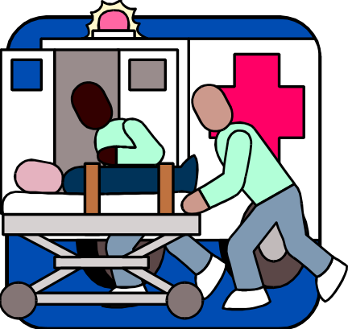
BUSY MODERN LIFE
Studying for exams
Handling emergencies
balance responsibilities

Slide 11
WHAT HAPPENS WHEN
WE ARE STRESSED
Releases chemicals into the blood , causing physical changes--faster heartbeat, increased muscle tension,
This gives us extra strength and energy
Helps us deal with stressful events such as:

Slide 12
SYMPTOMS OF TOO MUCH STRESS
Tiredness/exhaustion
Tight muscles
Nervousness
Stomach problems
Change in appetite
General body complaints: weakness, headache, back pain, etc.

Slide 13
STRATEGIES TO MANAGE STRESS IN YOUR LIFE
Simplify Your Life
Ask for help
Practice Time Management
Minimize Alcohol Use
Humor--Take Time to Play
Relaxation Techniques
Get Counseling If Needed

Slide 14
STRESS RELIEVING STRATEGIES
Assertiveness Training
Time Management
Problem Solving
Social Support
Exercise
Plenty of Sleep
Fun

Slide 15

TIME MANAGEMENT

Slide 16
BENEFITS OF TIME MANAGEMENT
Efficient
Successful
Healthy

Slide 17
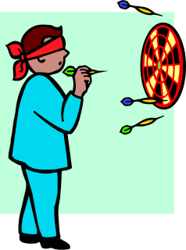
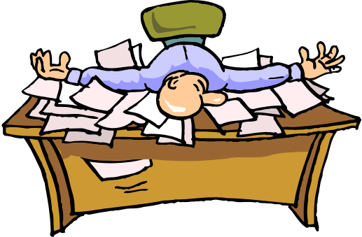

OBSTACLES TO EFFECTIVE TIME MANAGEMENT
Unclear objectives
Disorganization
Inability to say “no”

Slide 18



OBSTACLES TO EFFECTIVE TIME MANAGEMENT
Interruptions
More interruptions
Periods of inactivity

Slide 19



OBSTACLES TO EFFECTIVE TIME MANAGEMENT
Too many things at once
Stress and fatigue
All work and no play

Slide 20


WHAT CAN WE DO?
Recognize that obstacles exist
Identify them
Employ strategies to overcome

Slide 21

GOAL SETTING

Slide 22
SET GOALS
Specific
Measurable
Achievable
Realistic
Time-based

Slide 23
WHAT TO DO?

Slide 24
PRIORITIZE
Address the urgent
Accomplish what you can early
Attach deadlines to things you delay

Slide 25
LEARN WHEN TO SAY “NO”
You can’t do everything
Don’t undertake things you can’t complete
Remain consistent to your goals

Slide 26

USE YOUR WAITING TIME
On public transportation
At the doctor’s office
Waiting for someone
On hold
When you are early

Slide 27

CONCENTRATE ON THE TASK AT HAND
Focus on your goal
Tune out interruptions

Slide 28

CELEBRATE YOUR SUCCESS

Slide 29
REVIEW
  Set goals
  Prioritize
  Organize
  Learn when to say “NO”
  Use your waiting time
  Concentrate on the task at hand
  Celebrate success

Slide 30
SUBMITTED BY
Avinash Dhame
Govind Bakale
Abhijit Shinde
Yogesh Jagtap
Vishwas Talule

Slide 31
Thanking you!.

