Slide 1


e- Governance Projects :
Lessons Learned
( ELITEX 2005 )
The World Bank
by
Shashank Ojha
e- Government Practice
The World Bank

Slide 2

e- Governance :
World Bank’s Role

Slide 3

E- Governance - Bank Projects
World Bank – Global Experience
Ukraine – Govt MIS/ Document Mgt. Systems
Jordan – Public Sector Reforms
Thailand – Institutional Leadership for e- Government Project
Ghana - National Clearing House
Mexico – E- Business Systems
Bangladesh – Public Sector Modernization Project
Tanzania - ICT for District Governance
Kenya - Busting Corruption Using Internet
S. Africa - Government Portal
Uganda - Parliament Portal
Cuba - InfoMed Health System
Peru - Information System for Rural Development
Uganda - Elections Uganda
Sri Lanka - E- Sri Lanka
Ecuador – Public sector Financial Management Project
India …

Slide 4
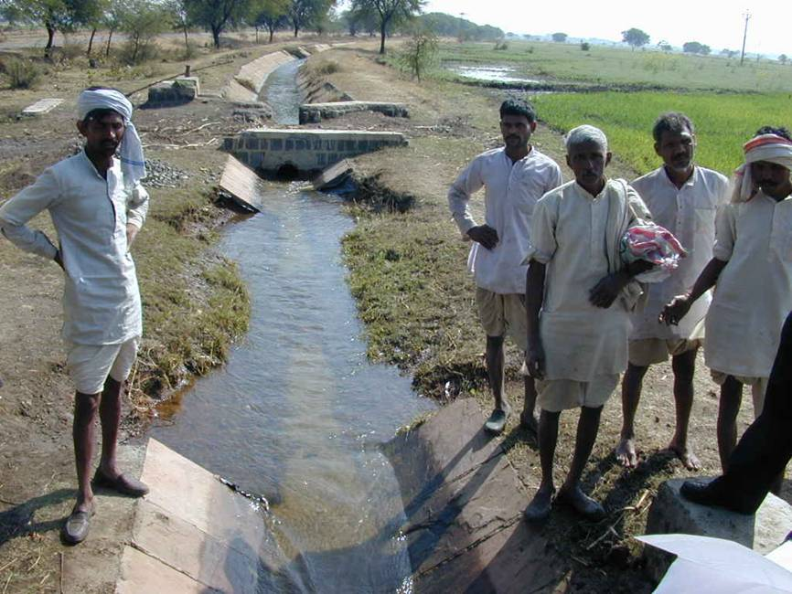
E- Governance in India- Bank Projects
Water Sector Projects
UP- WSRP
Rajastan -WSRP
MP - WSRP
Maharastra- WSRP

Slide 5

E- Governance in India- Bank Projects
Health Sector Projects
IDSP
Malaria Control
AIDS
State Health Systems Projects

Slide 6

E- Governance in India- Bank Projects
Infrastructure Projects
Power Sector Projects
TN Urban Devp. Project
NHAI
Gujarat Earthquake
Assam Roads
Delhi Jal Board

Slide 7
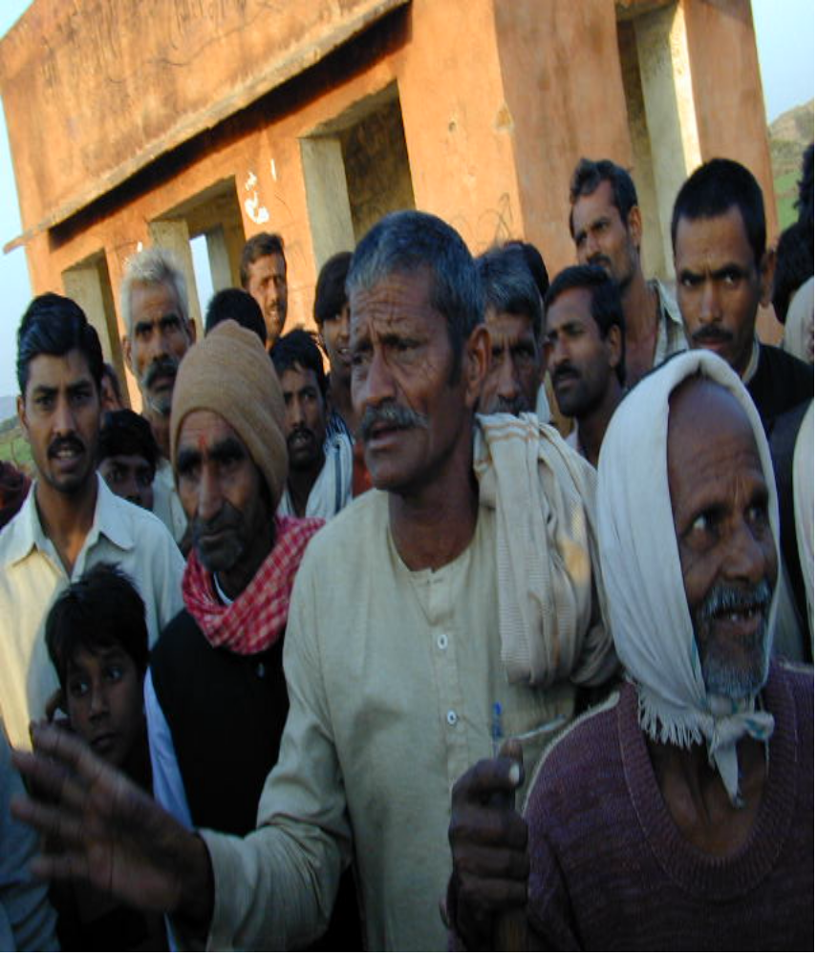
E- Governance in India- Bank Projects
Rural Devp. Projects
Sodic Lands Project
National Agriculture Technology Project
UP Forestry
ICT in Rural Districts of Pune

Slide 8

E- Governance in India- Bank Projects
Environment Sector Projects
Pollution Control Boards
Environment Mgt. Capacity Project

Slide 9
E- Governance in India- Bank Projects
STATEWIDE ROLLOUT
NATIONWIDE ROLLOUT
India – National E- Governance Action Plan
DGFT
Customs
Central Excise
Postal Department
Passports
DCA
Direct Taxes
E D I
Integrated citizen services
Payment Gateway
e-Biz
e-Procurement
Land Records
Registration
Treasuries
Transport
Police
Municipalities
Gram Panchayats
Commercial / Sales Tax
Agriculture
Courts etc.

Slide 10
e- Governance Projects
Critical Analysis

Slide 11
E- Governance
Critical Analysis
High Risk – High Returns projects !
Limited Human Resources in e-Governance
Project Management -Difficulties abound
  Delayed, limited functionality, budget over-runs
Financial Sustainabilty - Rarely achieved ?
Grassroots consultation
  Top down approach rarely works !
IT Policy & Law

Slide 12
E- Governance
Critical Analysis
Standardization / Policy Framework
  Standalone efforts, Islands !
Sector level Solutions !
Local language / Locally relevant content
  English content, illiteracy, target audience ?
Reinventing the Wheel !
  Duplicate efforts - wasted cost, time and funds
Wiring India – last mile solutions
  Need for low cost connectivity ?

Slide 13
e- Governance
Lessons Learned

Slide 14
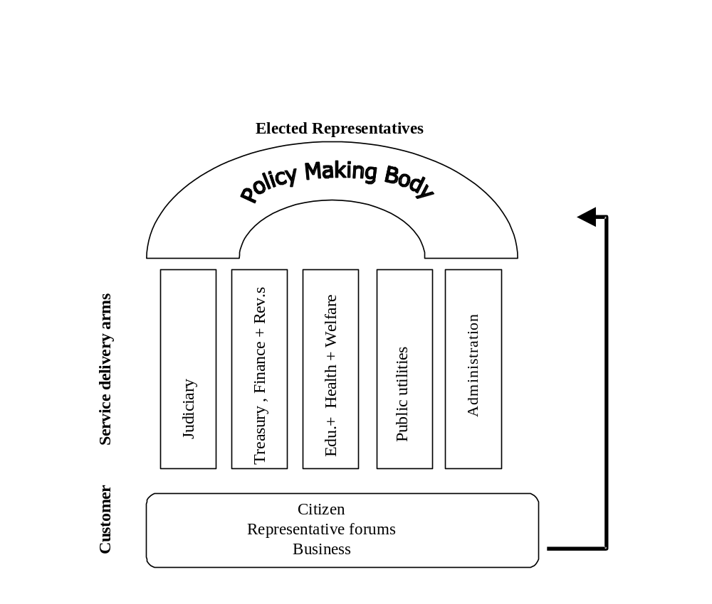
E- Governance - Lessons
1. Need for a Holistic Approach
Need for a Holistic Approach – the ‘ Big Picture ’.
Support at the ‘Highest levels ’.
Need for Policies, Standards & Legal Framework for e- Government
Partnerships – Private sector, Academics & NGOs.
‘Inclusive Approach’ - Social , Gender, Language etc

Slide 15
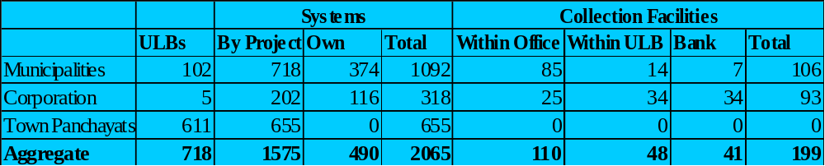
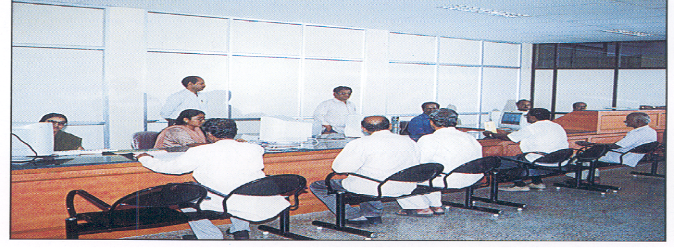
E- Governance - Lessons
Tamilnadu UDP II
Coimbatore

Slide 16
E- Governance - Lessons
Holistic Approach – Tamilnadu UDP II
Services
  Birth and Death registration
  Building Plan Registration/ Approval
  Dangerous and Offensive & PFA
Financial Management
  Financial Accounting System
  Inventory Control
  Movable Property
  Vehicle Inventory
  Immovable Property
Revenue Management
  Non-Tax
  Professional Tax
  Water Charges
  Property Tax
Others
  Census
  Personal Management System
  Electoral rolls
  Family Enumeration
  Solid Waste management
  Hospital Information

Slide 17
E- Governance - Lessons
Tamilnadu UDP II
Demand from staff and citizens - ULB’s on their own have invested in procurement of systems (1575 systems from the project, additional 490 by ULBs)
A 10-15% improvement in collections have been recorded as against manual systems. [Roughly an increase in revenue of about US $ 7-8 million.
An issue especially in terms of closure of subsidiary revenue registers has been of collection greater than demand… about 10 % of errors in demand registers to be rectified ] ,
Birth and death certificates issued in 15 minutes…
The impact, closure of cash book by 5.30-6 PM as against 8 PM before automation.

Slide 18
E- Governance - Lessons
2. Need to Develop HR Capability
Need for a CIOs in every
Government department
Need for more aware
Bureaucracy & Political
Leadership
Continued Training
Change Management
Department Head
CIO
Officers & Staff

Slide 19
E- Governance - Lessons
3. Need to Develop Organizations
Need to develop ‘appropriate organizational structures’ in states and centre
Building Ownership and ‘Buy-in’ at all levels
Need to accept Change and Flexibility – to address changing requirements
National
State
District
Block
Village

Slide 20
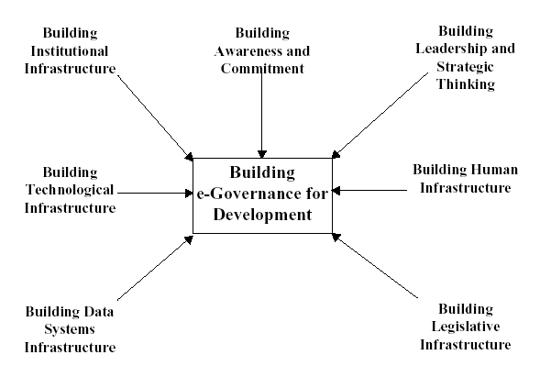
E- Governance - Lessons
4. Need to Develop Support Framework
Policies, Standards & Technical Framework for
e- Government
Coordinated approach – Communication Infrastructure, Data Centres, Security Systems, R&D support etc.

Slide 21
E- Governance - Lessons
5. Focus on Sustainability
Target Outcomes =
Cost Savings + Revenues + Efficiencies
Project Cost + Operations Cost + Risks
Coordinated long term view – ‘ Focus on Outcomes’
Develop innovative Financial & Business Models - PPP
Monitoring & Evaluation - for Target Outcomes !

Slide 22
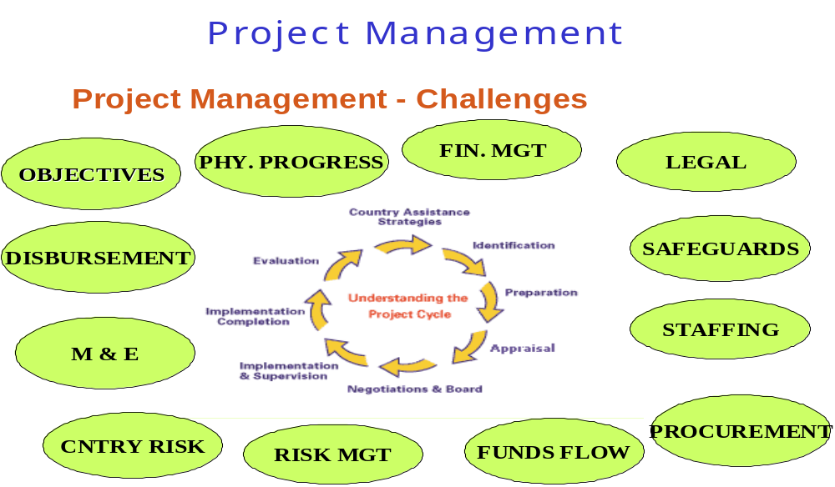
E- Governance - Lessons
6. Focus on Project Management

Slide 23
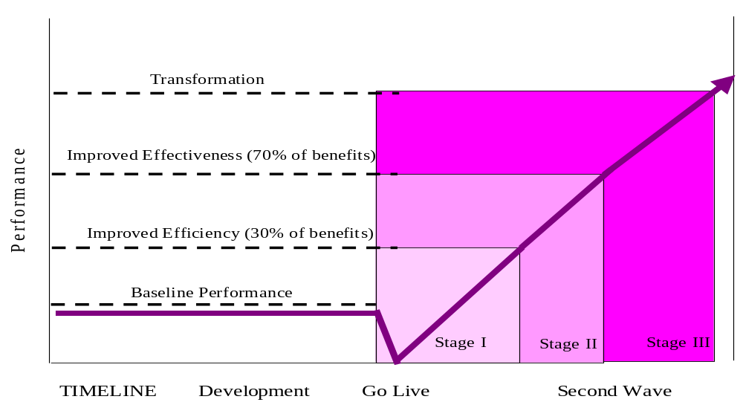
E- Governance - Lessons
7. Need for a ‘Big Push’
Performance
Project Costs

Slide 24
e- Governance :
Lessons Learned
Thank you
Shashank Ojha
e- Government Practice -ISG
The World Bank

