Slide 1

Dry Run – ITEE EDC ‘ROCCO’.
IT Emergency Exercise (ITEE) @ EDC – August 16th to 18th 2020
Change Request: CRQ000001423779
https://atc.bmwgroup.net/confluence/display/ITEEEDC/ITEE+Rocco+2020
Aug. 11th 2020

Slide 2
Agenda.
Purpose of dry run
Time line until exercise
Roles and People
Communication during ITEE: Channels
Communication rules
Back-up
Milestones
Start of Dry Run now!

Slide 3
Purpose.
Information about time line
clarification of role setting
information on working mode, collaboration and communication
common understanding of ITEE course
clarification of dependencies and time consumption within the activity plan
clarification of open questions

Slide 4
Time Line until ITEE.
Tue. Aug. 11th: Dry Run – TODAY
Tue. Aug. 11th: ITEE Mgt. Sounding Board
(no special event)
Fri. Aug.14th: Final Go/ NO-Go decision
Sun. Aug. 16th: Start ITEE at 6:00 a.m. CEST (day 1)
Mon. Aug. 17th: standard business day
Tue. Aug. 18th: Start ITEE at 4:00 a.m. CEST (day 2)
Wen. Aug. 19th: hyper care/ spare day to solve problems
Thu. Aug. 20th: wrap-up
all days until Fr.:
fine tuning of activity plan and alignment of open issues

Slide 5
Roles and People (1/3).
IT Escalation
Technologies
ITEE core team
Applications
Business
IT Management

Slide 6
Roles and People (2/3).
Technologies
Technologies can be taken from CRQ -> Checklist and Plan -> Tab ITEE Activity Plan
ITEE core team
ITEE Lead: Boris Staerk & Robert Gaiser
Evidence Mgr.: Karolina Matutyte
Protocol: Dan Amaritei (CGF) Communication Manager: Verena Tautz
Visual Tracking: Robert Gaiser
FG-3 Application Coordinator: Valentin Hilger FG-3-AL Application Coordinator: Christian Barkow
FG-84 Infrastructure Coordinator: Karl-Heinz Bauer
Bank Business Coordinator: Christina Knabel/ Ilinca Havrici
Web Linux Windows Data Base Oracle Data Base MS SQL Data Base Postgres SQL Tableau Server MQS Informatica SAN | NAS F5 Loadbalancer Connect direct Documentum EAI
All persons responsible for the applications and contact data can be taken from CRQ -> Checklist and Plan -> Tab “ITEE contacts”
Applications
The list of all applications involved can
be found here:
https://atc.bmwgroup.net/confluence/display/ITEEEDC/Applications+in+scope+Rocco

Slide 7
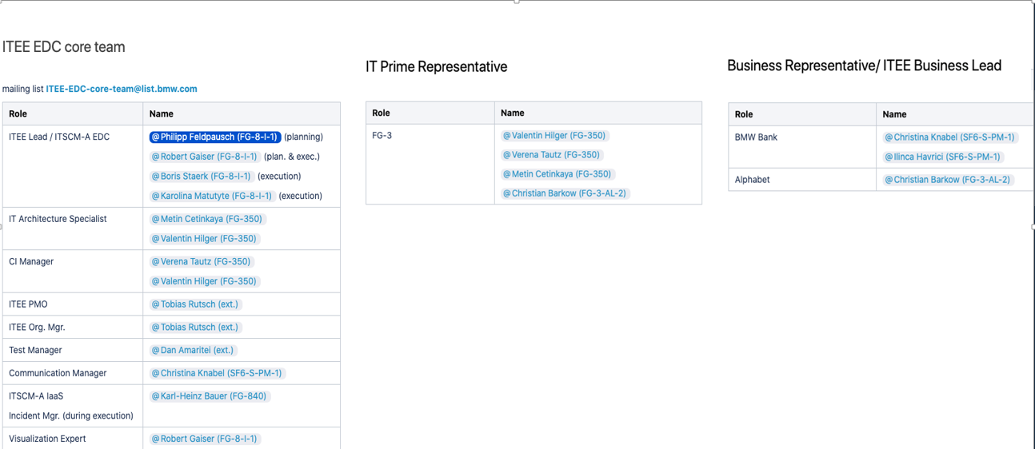
Roles and People (3/3).
https://atc.bmwgroup.net/confluence/display/ITEEEDC/Organization+Rocco

Slide 8
Agenda.
Purpose of dry run
Time line until exercise
Roles and People
Communication during ITEE: Channels
Communication rules
Back-up
Milestones
active DRY RUN now!

Slide 9
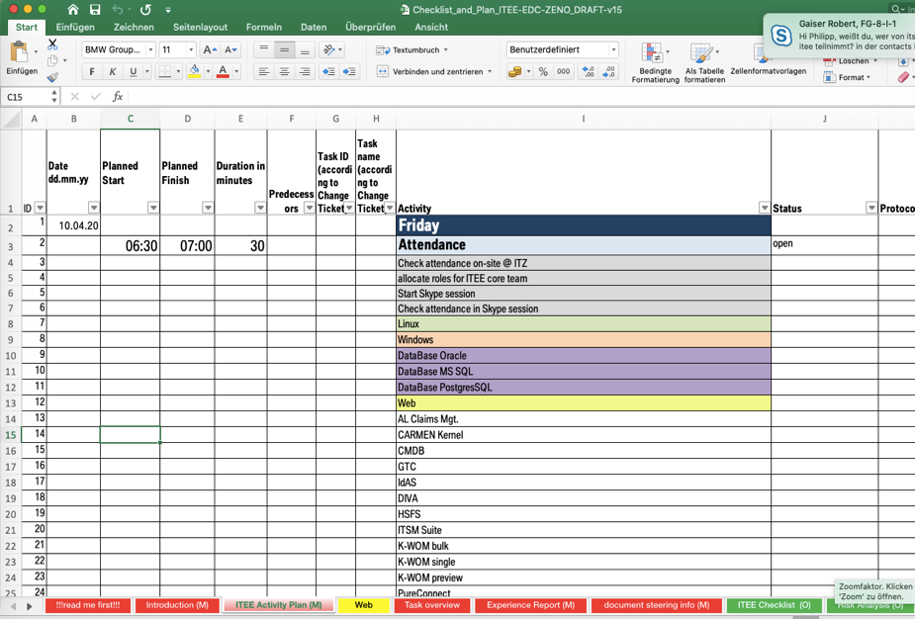

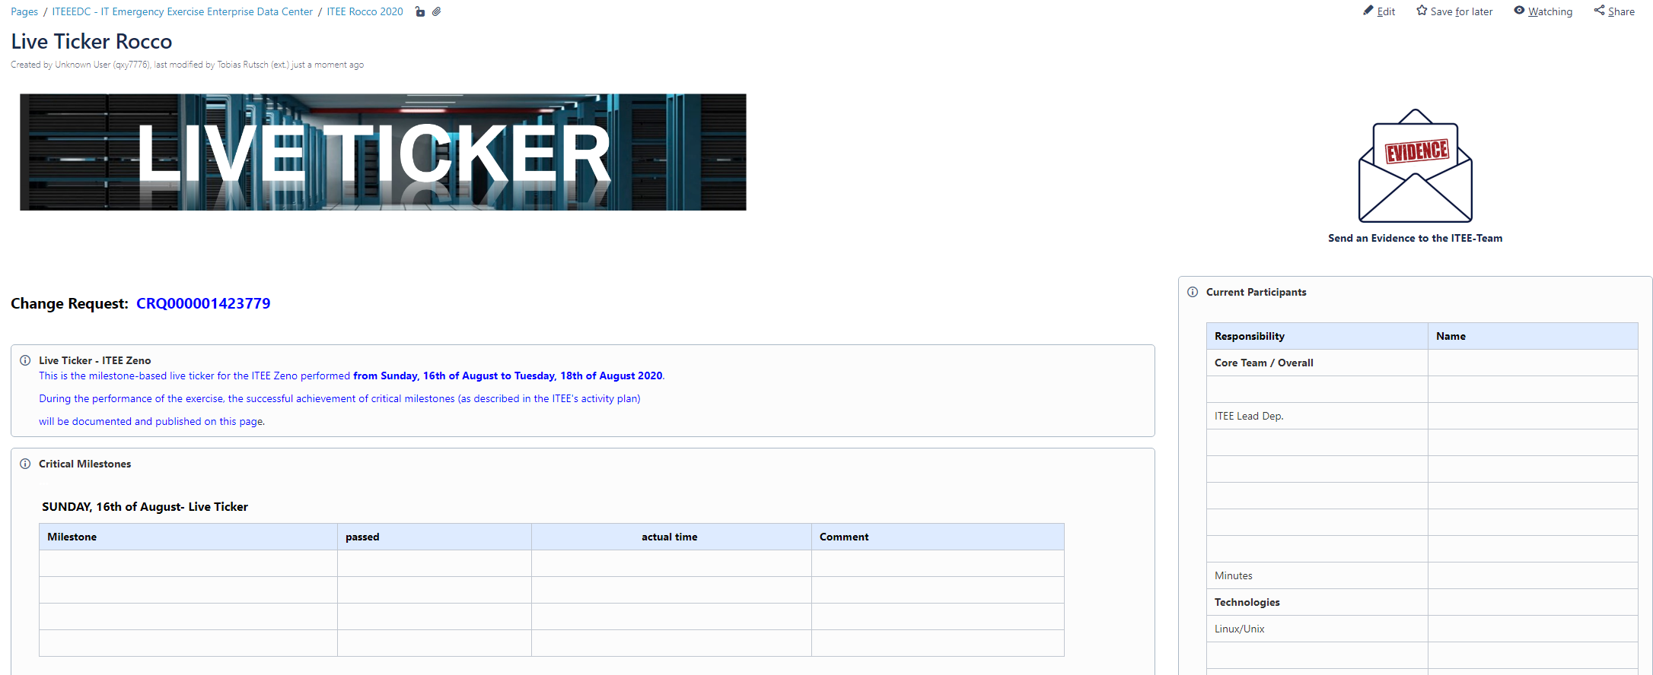
communication during ITEE: Channels.
IT Escalation
IT Info Mgr./ MIM /MoD
audio
chat
…
screen sharing
Technologies and Applications
ITEE core team
mail templ.
Business BMW Bank
IT Management + news letter mailing list
Business Alphabet
mile stones
participants

Slide 10
communication during ITEE: Channels.
Channel | What | To Whom | When | Responsible | Info Source | comments | Link
ITEE Lead Skype session | current activity plan step by screen sharing audio exchange between participants | all participants of operational teams and ITEE core team | continuous through the whole ITEE conduction | each ITEE participant, Ph. Feldpausch, FG-8-I-1 Andreas Neugebauer, CGF | current feedback given within the Skype session | back up in case of outage of Skype @BMW: Web Ex, dial-in data given at Outlook-entry and CRQ | see Outlook entry or CRQ000001423779
Confluence “Live Ticker” | current status on critical milestones | public for all interested stakeholder | update per milestone | Robert Gaiser, FG-8-I-1 | ITEE Lead Skype session | combined with current responsible (next line) | https://atc.bmwgroup.net/confluence/display/ITEEEDC/Live+Ticker+Rocco
Confluence “Live Ticker” | current list of responsible ITEE participants | public for all interested stakeholder | update on demand | Tobias Rutsch, CGI | ITEE Lead Skype session | combined with current ITEE participants (line above)
Evidence E-Mail | Evidence as log file, screen shot, console output, monitoring, etc. | ITEE_Team@bmw.de | according to activity plan | each ITEE participant, Karolina Matutyte, FG-8-I-1 | ITEE participants | use mail template and reference on ID according to activity plan column “A” | mail-to link
ITEE News Letter (IT) | current status update on milestones | all members of list, mainly IT Operations, IT Mgt. | update per milestone | Verena Tautz, FG-350 | ITEE Lead Skype session | predefined mail list | self subscription link to ITEE_Rocco_EDC@list.bmw.com
ITEE News Letter (business Bank) | Status on selected milestones | Stakeholders in affected BMW Bank business units | Update on selected milestones acc. to communication plan | Ilinca Havrici, SF6-S-PM-1 | ITEE Lead Skype session | predefined distribution list | n/a
ITEE News Letter (business Alphabet) | Status on selected milestones | Stakeholders in affected Alphabet business units AL-DE-S4 | Update on selected milestones acc. to communication plan | Christian Barkow, FG-3-AL | ITEE Lead Skype session | predefined distribution list | n/a

Slide 11
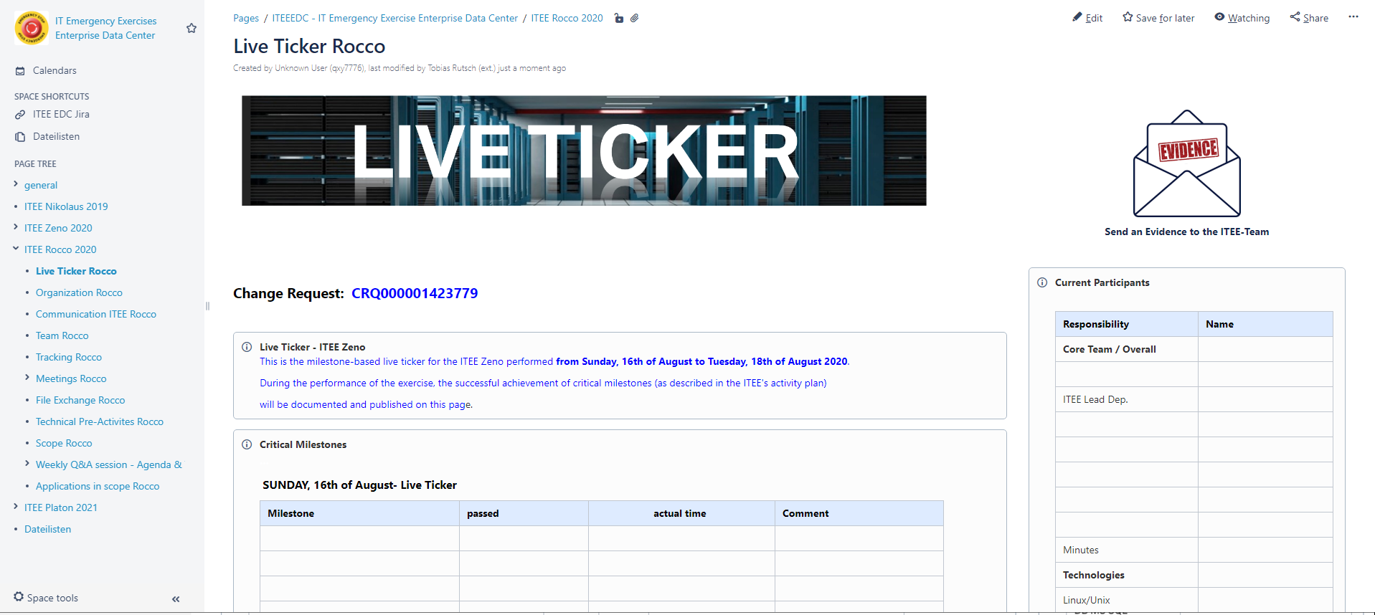
communication during ITEE: Channels LIVE Ticker.
LIVE TICKER at
https://atc.bmwgroup.net/confluence/display/ITEEEDC/Live+Ticker+Rocco

Slide 12
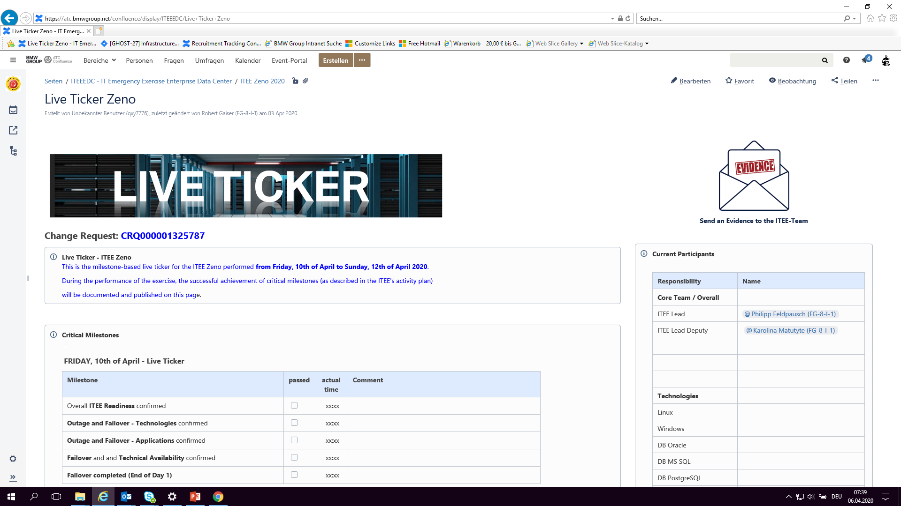
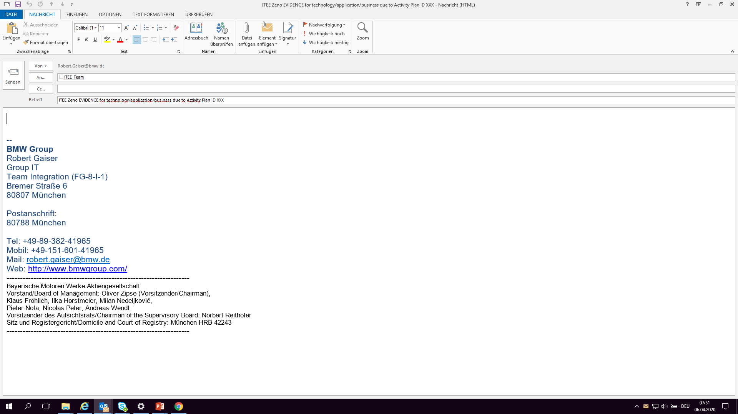
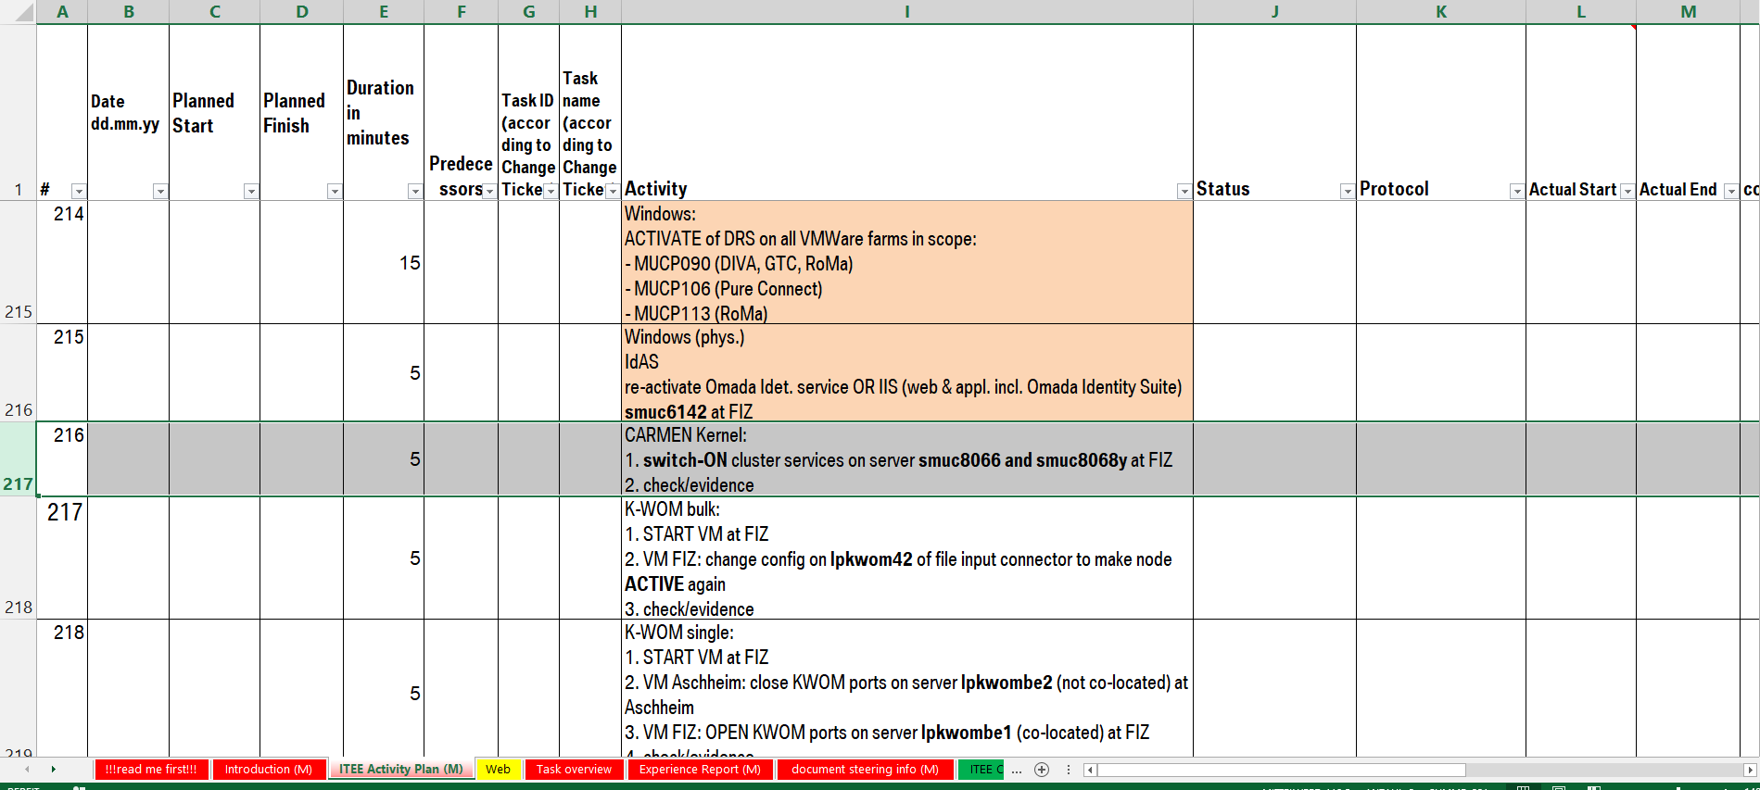
How to document an evidence.
https://atc.bmwgroup.net/confluence/display/ITEEEDC/Live+Ticker+Rocco
0 – Open Confluence „Live Ticker Zeno“
1 – Click on Evidence Icon (to send an email to ITEE_Team@bmw.de)
2 – Adapt eMail subject (technology/application/activity plan ID)
4 – Add evidence (screenshot, logfile, console output,…)
5 – Keep eMail signature in your mail
6 – Send eMail incl. evidence
ITEE Rocco EVIDENCE for technology/application/business due to Activity Plan ID XXX
ITEE Rocco EVIDENCE for CARMEN Kernel due to Activity Plan ID 216

Slide 13
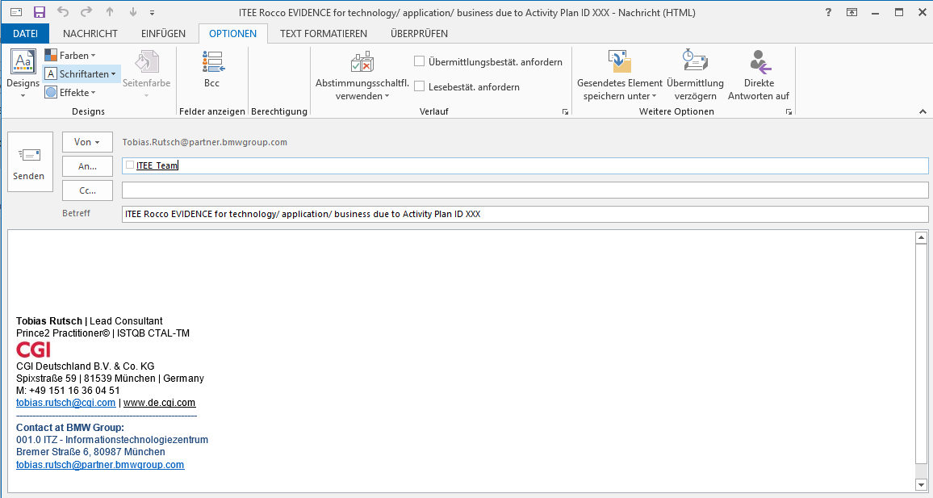
communication during ITEE: Channels Evidence E-Mail.
active presentation of how to create an EVIDENCE mail at https://atc.bmwgroup.net/confluence/display/ITEEEDC/Live+Ticker+Rocco
attach your evidence as file
your personal sender contact, no project mail box!
the address to sent,
don’t change!
give your personal signature incl. contact data
type in the technology (web, linux,..) or the applicatoin (IdAS, RoMa,..), give ID according to Activiy Plan ID column “A”

Slide 14
Agenda.
Purpose of dry run
Time line until exercise
Roles and People
Communication during ITEE: Channels
Communication rules
Back-up
Milestones
active DRY RUN now!

Slide 15
Communication Rules.
DOs
participate at ITEE Lead Skype Session
speak loud and clear English
give your name first, than speak
mute your microphone, if you do not speak
give server names, instances etc. to the ITEE lead chat in written form
last instance of decision is the ITEE LEAD - no independent decisions by participants!
send evidences to given mail box
ask if things unclear to you
if you leave the call, align this within the call and drop deputy's full name to the chat
DON’Ts
wait to be called or invited to the session
leave without assigned deputy
mumble unclear
speak without a name
cause back round noise
talk about unspecific labels like server names
decide on your own without ITEE lead alignment
drop evidences somewhere
→ We do have time to clarify open issues. No need to rush!

Slide 16
Communication Backup during dry run.
If your personal data connection (e. g. WiFi) is lost, you may check to switch to LAN cable or to attend via mobile data connection (personal hot-spot).
VPN: If you cannot access to VPN, try to use other VPN Gateways to select at Cisco Any Connect drop down menu.
VPN Authentication: Organize yourself an additional VPN Access/ Authentication, e.g. Mobile Push here https://strong.bmwgroup.net/
If you can’t dial into the running Skype session, try by phone, use common dial-in data.
If Skype is really down, dial into WebEx session. Details at CRQ and Outlook calendar entry.
In case of you are lost, dial +49-151-601-53044 (→ Karolina Matutyte)

Slide 17
Agenda.
Purpose of dry run
Time line until exercise
Roles and People
Communication during ITEE: Channels
Communication rules
Back-up
Milestones
Start of Dry Run now!

Slide 18
MileStones.
Sunday August 16th 2020
06:00 a.m. - start of exercise
08:00 - start of failover
14:00 - failover completed – end of day 1 (Applications with reduced redundancies)
Monday August 17th 2020
09:00 a.m. - Documentation business functionality (no activities by IT, just business)
Tuesday August 18th 2020
04:00 a.m. - start of exercise day 2
06:00 - start of failback
09:00 - downtime
10:00 - Applications with standard redundancies – end of ITEE

Slide 19
MileStones
Day 1
Overall ITEE Readiness confirmed
Outage and Failover - Technologies confirmed
Outage and Failover - Applications confirmed
Failover and Technical Availability confirmed
Failover completed (End of Day 1)
Day 2
Overall Failback Readiness confirmed
Failback/ Activation of Redundancies completed
IT Services available / redundancy confirmed
Business Validation on IT Service availability / Failback completed
End of Day 2

Slide 20
Planned course.
Sunday, August 16th |  |  |  |  |  |  |  |  |  |  | Monday, August 17th
6 | 7 | 8 | 9 | 10 | 11 | 12 | 13 | 14 | 15 | … | … | 6 | 7 | 8 | 9 | 10 | 11
Preparation
Applications without redundancies - Special Hypercare
Failover
Standard
Business
outage
IT-Tests
Business Tests
Monday, August 17th |  |  |  |  |  |  |  | Tuesday, August 18th
12 | 13 | 14 | 15 | 16 | 17 | 18 | … | … | 4 | 5 | 6 | 7 | 8 | 9 | 10 | 11 | …
Applications without redundancies - Special Hypercare
Preparation
Applications with standard redundancies
Standard
Business
Restore redundancies & IT-Tests
Standard
Business
Down
time

Slide 21
now the dry run starts!

Slide 22
Backup.

Slide 23


Objectives and approach.
Objectives
evidence redundancy capability of BMW Bank shared services within EDC according to BaFin requirements
evidence effectiveness of recovery procedures for time critical services
train involved staff on emergency situations
Approach
outage of key components essential for shared services at CoLo DC
scope: BMW Bank shared IT services
exercise scheduled for Sunday August 16th to Tuesday April 18st 2020

Slide 24
Planned course.
https://atc.bmwgroup.net/confluence/display/ITEEEDC/Live+Ticker+Rocco
Rocco 2020: Scheduled main activities and milestones
0
1
2
3
4
5
6
7
8
9
10
11
12
13
14
15
16
17
18
19
20
21
22
23
standard operations
infrastructure and appl. failover
smoke and shake down test
Sunday
August 16th
preparation
full IT service availability, reduced redundancy
Batch
failover
Batch
START of ITEE
OUTAGE
fail over
completed
confirmation of
IT service availability
Monday
August 17th
full IT service availability, reduced redundancy
Bank Business Hours (Dealers)
Batch
preparation
END of ITEE
Tuesday
August 18th
full IT service availability, reduced redundancy
standard operations
Batch
smoke and shake down test
Batch
fail back
Bank Business Hours (Dealers)
fail back
start
fail back
completed
confirmation of
business validation
Wednesday
August 19th
standard operations
back-up slot

