Slide 1
Clean Code: Chapter 2 Meaningful Names

Slide 2
Index
Why Are Good Names Important in Code?
Use Intention-Revealing Names.
Avoid Disinformation.
Make Meaningful Distinctions.
Use Searchable Names.
Avoid Encodings in Programming.
Avoid Mental Mapping.
Class Names.
Method Names.
Don’t Be Cute.
Pick One Word Per Concept.
Don’t Pun.
Use Solution Domain Names.
Use Problem Domain Names.
Add Meaningful Context.
Don’t Add Gratuitous Context.
Final Words.

Slide 3
Why Are Good Names Important in Code?

Slide 4
Good names are crucial in coding because they help:
Improve Code Readability.
Facilitate Easier Debugging.
Promote Consistency and Collaboration: In a team environment, consistent naming conventions ensure that everyone is on the same page.
Support Code Reusability.
"Think about a time when you misinterpreted a function's purpose because of a poorly named variable or function. How would you re-name it for better clarity?"

Slide 5
Use Intention-Revealing Names
Using Intention-Revealing Names means choosing clear, descriptive names for variables, methods, and classes that convey their purpose without needing additional explanation.
Why does this element exist?
What does it do?
How is it used?

Slide 6
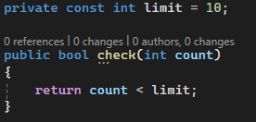
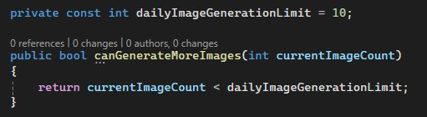
Bad Code
Good Code

Slide 7

Avoid Disinformation
Some words already have specific, well-known meanings in certain contexts. If we use these words as variable names in programming, it could confuse others.

Slide 8

Make Meaningful Distinctions
Noise words in programming are unnecessary or redundant words added to variable, method, or class names that do not contribute meaningful information and make the code harder to read.
Sometimes, programmers change names just to make the code pass a compiler, without thinking about what the names mean.

Slide 9
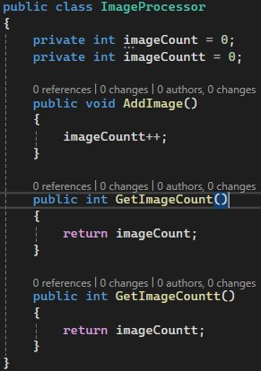
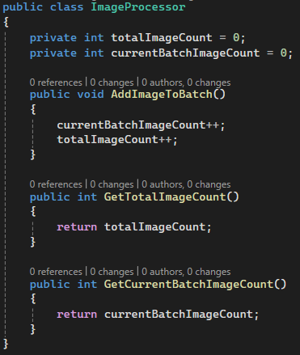

Slide 10
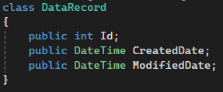
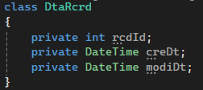
The Power of Pronounceable Words
If you have variable names that anyone can say without spelling them out, it becomes easier for us to discuss them.

Slide 11

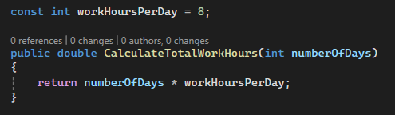
Use Searchable Names
Descriptive and Self-Explanatory
Full Words
Meaningful in Context
Consistency
Avoids Magic Numbers and Hardcoded Values

Slide 12

Avoid Encodings in Programming
Encodings in variable name refer to adding extra information to names that indicate the type or scope of a variable or function.
Hungarian notation

Slide 13
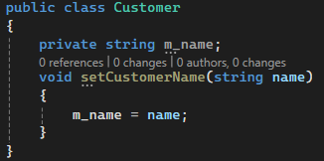
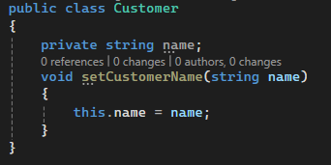
Avoid member Prefixes

Slide 14
Interfaces and implementations
In many coding practices, especially in languages like C# and Java, interfaces are often named with the prefix "I" to indicate that they are interfaces.
The purpose of an interface is to define a contract or a set of behaviors that classes can implement. The name of the interface should describe what it represents, not its technical nature (i.e., whether it's an interface or a concrete class).

Slide 15
Avoid Mental Mapping
Make variable names such that you don’t need to remember what they do.
Choosing clear and unambiguous names can help readers understand code more easily.
For example, instead of using “w” and “h” for variable names, use “width” and “height”.
This makes it clear what the variables represent, without requiring the reader to mentally map the names to their purpose.

Slide 16
Class Names
Classes names should be noun or noun phrases and specific.
Good Names Payment
Invoice UserRegistrationForm User
Bad Names PaymentProcessor
Data
Form Info
What is this class responsible for?
If the name reflects that single responsibility, it’s likely a good name.

Slide 17
Method Names
Method name should be verb or verb phrases and specific.
Good Names CalculateTotalPrice
SendEmailNotification ValidateUserInput ExportReportToCsv
Bad Names PriceCalculation
SendNotification
Validate ExportReport
What is this method responsible for?
If the name reflects that single responsibility, it’s likely a good name.

Slide 18
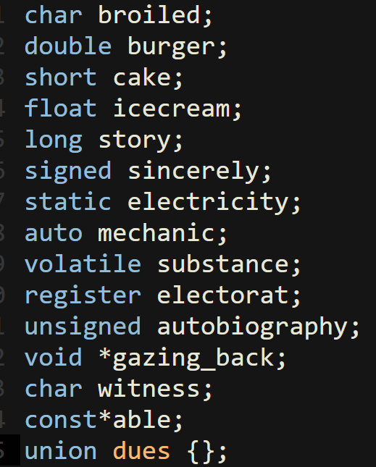

Don't Be Cute
Don’t make Joke names, It removes clarity and simplicity

Slide 19
Pick One Word Per Concept
You should not use two words for same concept.
Bad Code:
getRecords()
retrieveAccounts()
fetchUsers()
Good Code:
getRecords()
getAccounts()
getUsers()

Slide 20
Don’t Pun
You should not use one word for two different concepts.
Bad Code:
addRecords(pastRecords, newRecords)
addNewRecord(record)
Good Code:
combineRecords(pastRecords, newRecords)
insertRecord(record)

Slide 21
Let's go off topic (not really)
Let's assume you need to go from Jaipur to Bangalore. How would you do it?

Slide 22
Problem Domain: Getting the "What"
The problem domain defines the context, scope, and objectives of the issue the software seeks to address. It focuses on the real-world environment in which the software will operate.
Key Aspects:
Objectives: What must be achieved to solve the problem.
Stakeholders: The people involved, such as users, business owners, and regulators. (Who will surely be involved?)
Constraints: Business, regulatory, operational,(technological?) or environmental limitations that frame the solution.

Slide 23
Problem Domain: Getting the "What"
Techniques for Problem Analysis:
Requirement Gathering:
Methods: Interviews, workshops, surveys, observation, and prototyping.
Goal: Extract both explicit and implicit requirements from stakeholders.
Domain Modeling:
Tools: Use-case diagrams, process flowcharts, class diagrams, entity-relationship diagrams, and event storming.
Goal: Visualize the structure, processes, and relationships within the domain.
Shared Language:
Establishing a ubiquitous language that is consistent between business and technical teams to avoid misunderstandings.

Slide 24
Solution Domain: Getting the "How"
The solution domain is concerned with translating the problem into a technical implementation. It defines the tools, technologies, and architectural strategies to create the software.
Key Aspects:
Tools and Frameworks: Programming languages, libraries, cloud services, and infrastructure.
Architecture: High-level design choices such as microservices, serverless architecture, or monolithic systems.
Development Methodologies: The approach to software development heavily influences the solution domain. With various methodologies like best practices, low level design, data structures and algorithms.

Slide 25
Solution Domain: Getting the "How"
Techniques for Solution Design:
Prototyping and Proof of Concept:
Quickly validate technical feasibility and align solutions with requirements.
Architectural Design:
Tools: Architectural diagrams, system design blueprints, and deployment models.
Focus: Ensure scalability, reliability, and maintainability.
Development Processes:
Use modern methodologies like Agile or DevOps to streamline iterative feedback and continuous improvement.

Slide 26
Using Problem Domain Names
Let's assume the "What" to be "To make a Bank management system".
A function for making prediction of chance that the borrower will fail to repay loan. Is "calculateLoanFailureRiskPercentage()" a good name?
For a function getting Interest amount on some principal and rate. Is "calculateInterestAmount()" a suitable name?
Will a solution domain name be more eligible/suitable here? Why or why not?

Slide 27
Use Solution Domain Names
Let's assume the "How" to be "With a MERN stack web application".
For a function securing user password for storage. Is "hashPassword()" a good name?
For a user token used in authentication during api calls. Is "authToken" a suitable name?
Will a problem domain name be more eligible/suitable here? Why or why not?

Slide 28
Are you a "Smart" Coder?
Do you focus on: 1. Clever and concise solutions
2. Prioritizing speed over maintainability
3. Using shortcuts and minimal documentation
4. "Mental Mapping" because you are very "smart" and can remember every variable and its use in your head.

Slide 29
Are you a Professional Coder?
Do you focus on: 1. Quality over shortcuts 2. Clean, maintainable and scalable code 2. Using best practices and team collaboration 3. Well-documented and tested code

Slide 30
See the differences
Coder "Smart" v/s Professional
Focus: Quickness | Quality
Code Style: Clever and concise | Clear and modular
Documentation: Minimal | Detailed
Collaboration: Independent | Team-oriented Who would you want to work with?

Slide 31
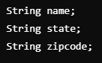
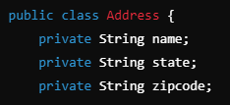

Add Meaningful Context
By adding context to your variable, class, or function names, you can make your code much easier to understand.
Bad Code: Good Code:

Slide 32
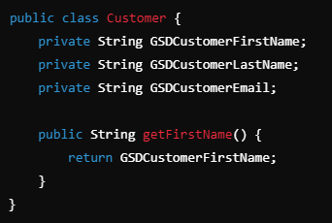
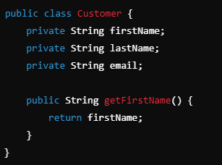
Don’t Add Gratuitous Context
In terms of adding context to variable and function names we should not overdo it by including redundant information that doesn’t add value.

Slide 33
Conclusion
In conclusion, meaningful names are critical for writing clean, understandable code.
They should clearly convey intent, avoid ambiguity, and maintain consistency throughout the codebase.
Thoughtful naming reduces the need for comments, improves maintainability, and facilitates effective collaboration among developers.

