Slide 1


OpenAI Functions: Empowering HR Onboarding
Welcome to the world of OpenAI functions and how they can be leveraged for HR Onboarding. Get ready to dive into the exciting possibilities.
by Amit Mishra, Amit Basnak

Slide 2

Overview of OpenAI Functions
1
AI algorithms 🤖
2
Machine learning 🔬
Learn how AI algorithms work and how they can be applied to automate various HR Onboarding activities, like screening resumes and scheduling interviews.
Understand how machine learning models can be developed, trained, and validated, and how they can be integrated with HRIS and other enterprise systems.
3
NLP and GPT-3 🗣
Learn about natural language processing and how GPT-3 can be used to generate chatbot responses, emails, and other HR-related communication with the employees.

Slide 3
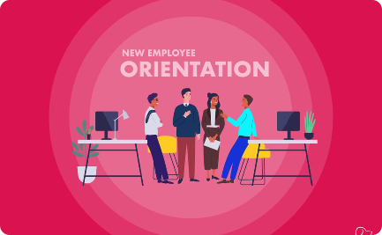
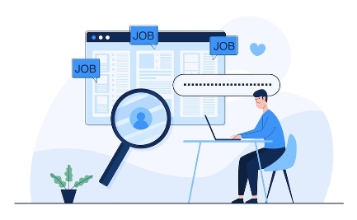
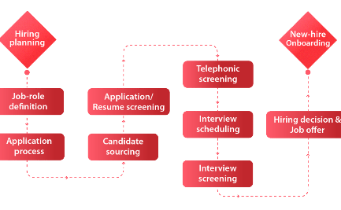
AI-Powered HR Onboarding
Employee Orientation
Resume Screening
Interview Scheduling
Explore how AI technologies can be used to provide on-demand, personalized, and interactive employee orientation programs, from virtual reality tours to digital handbooks.
Discover how AI and machine learning can speed up the resume screening process, eliminate bias, and ensure better matches between candidates and job requirements.
Find out how AI-powered chatbots can automate interview scheduling, reminders, and follow-ups, allowing HR managers to focus on higher-value tasks.

Slide 4
Language Processing with GPT-3
Sequence to Sequence Models
Text Generation
Chatbot Integration
Explore how language models like GPT-3 can be used to generate HR-related text, such as job descriptions, performance reviews, and employee feedback reports, with high accuracy and consistency.
Learn how chatbots are being integrated with language models to create conversational AI assistants that handle routine HR inquiries and streamline HR processes.
Discover how sequence to sequence models are being used to process large amounts of HR data, detect patterns, and generate insights that can inform strategic decisions.

Slide 5
Future of MVP Developed Using OpenAI Functions for HR Onboarding
Phase 2: GPT-3 Implementation
Implement GPT-3 for HR-related text generation and chatbot development, enabling the creation of human-like, context-aware, and language-capable HR assistants.
1
2
3
Phase 1: AI and ML Integration
Phase 3: Advanced Applications
Integrate AI and ML models with HR workflows, data sources, and platforms to enable end-to-end automation and optimization of HR Onboarding processes.
Explore advanced applications of OpenAI functions and other emerging technologies, such as computer vision, speech recognition, and emotion detection, to enhance and personalize the HR Onboarding experience.

Slide 6
Optimizing HR Onboarding with OpenAI Functions
Benefits 🎉
Challenges 🤔
Opportunities 🚀
Reduce time-to-hire, improve candidate experience, increase employee satisfaction, and enhance HR productivity and agility.
Overcome data privacy and security concerns, manage AI bias and ethical issues, and align AI strategies with HR and business goals.
Seize new opportunities for innovation, differentiation, and competitive advantage through AI-powered HR Onboarding that delivers superior employee experiences and business outcomes.

Slide 7

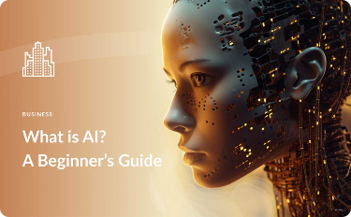
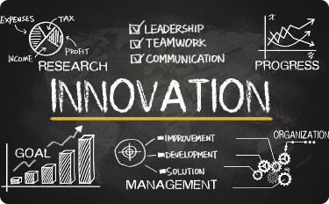
OpenAI Functions and HR Onboarding: A Look Ahead
Collaboration and Integration
AI Ethics and Governance
Continuous Innovation and Improvement
Learn how AI ethics and governance principles and practices are evolving in the HR domain, and how they can be leveraged to ensure responsible and sustainable use of OpenAI functions.
Discover how OpenAI functions can be combined with other HR technologies, such as blockchain, IoT, and cloud, to create an integrated HR ecosystem that leverages the best of each technology.
Explore how AI-powered HR Onboarding can spark a virtuous cycle of continuous innovation and improvement, where employees, HR managers, and business leaders collaborate to create and enhance new value propositions.

