Slide 1

OpenAI Functions & LLM: Facilitate Employee Onboarding
Welcome to the world of OpenAI functions and how they can be leveraged for Employee Onboarding. Get ready to dive into the exciting possibilities.
By Amit Mishra, Amit Basnak, Himani Singh
Github Link: amitmishra0404/BuddyEmployee (github.com)

Slide 2
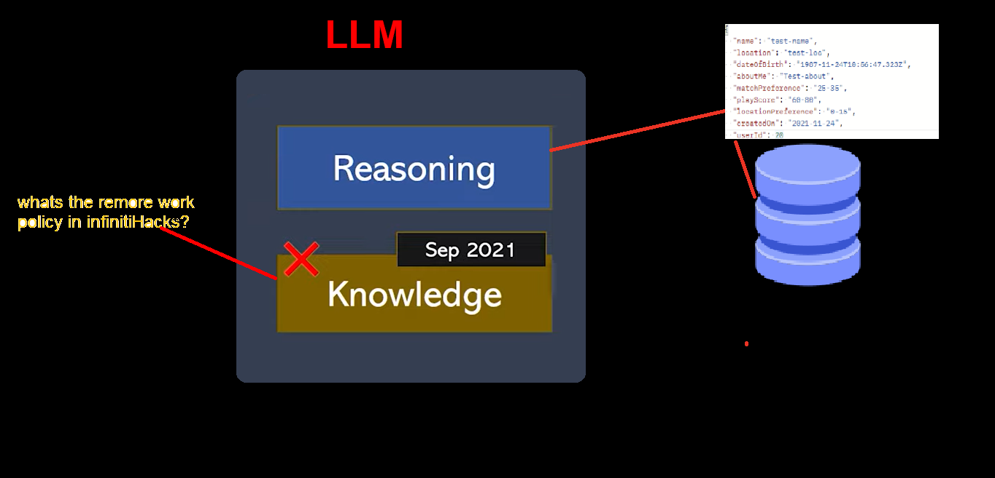
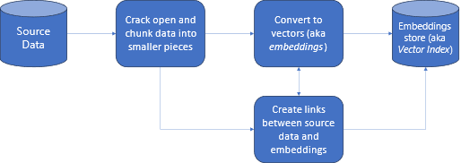
SOLUTION OVERVIEW
What is the workflow Infinity Hacks Bot ?
LLM
Tech Stack for Solution -
OpenAI Function Calling (LLM)
GPT-3.5 turbo – (ChatGpt Model)
MySql – (Backend)
Streamlit – (user interface)

Slide 3
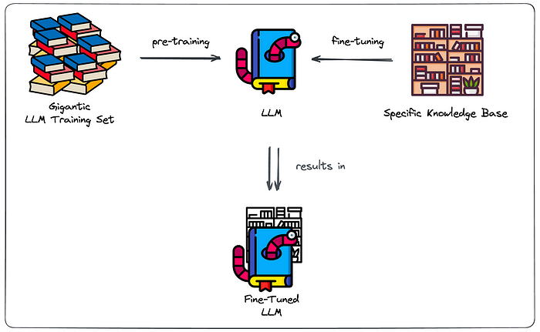
Why fine-tuning won’t always cut it?
Major challenges due to their pre-trained nature:
Struggle to provide coherent and accurate responses on topics they have not been trained on, especially content that is not publicly available.
Producing unreliable responses, often referred to as “hallucinations,” where they generate confidently incorrect information.
Crucial Problems
No source clarity: no clear distinction between “general” and “specific” knowledge.
No access restriction : can’t choose to leave out knowledge at inference time.
Hosting an LLM is costly : Costs to keep it up and running
Fine-tuning repetitions : retraining is required when you want the model to reflect changes to the knowledge base.

Slide 4
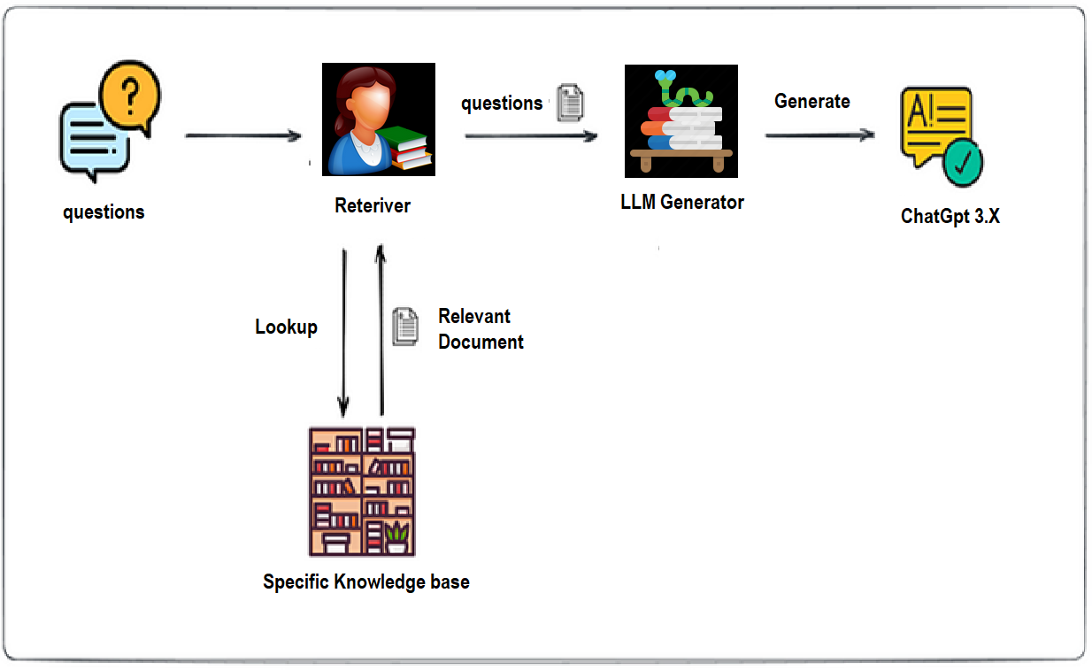
Future of MVP Developed Using LLM/RAG
Retrieval-Augmented Generation (RAG) :
Extract the information in our knowledge base.
comprehensively index the information of our knowledge base
Semantic Search (smart retrieval)
Benefits RAG-based setup
Clear indication of the source : Allowing to validate the source which the answer was based.
No or Less hallucinate : restricting generator component to our knowledge base, it will admit it can’t formulate a response when no relevant sources were found by the retriever.
Maintainable Search Index : With Changes to KB, we can adapt our Search Index to reflect those changes.

Slide 5
Shortcomings
Data privacy and security concerns,
Expansion
Prompt engineering as a way to steer generation toward success.
Plugin Integration (Grammarly, Other Data Sources)
Growth Possibilities
Integration with Different Data Sources – (Data Sources of different Dept) with LangChain.
For better performance use latest version of Generative AI models
Trade-off to be made in restriction to stick to info in knowledge base.
dependency on the performance of the Smart Retriever.
Difficulty in Assessment Challenges – to check the performance of RAG (Ongoing Research for automating assessment)
Categorial Conversational Open AI for different departmental integration.
Improving Data Governance by ChatGpt 4.0 enterprise.
We can extend functionality for multiple projects.

Slide 6
DEMO

Slide 7
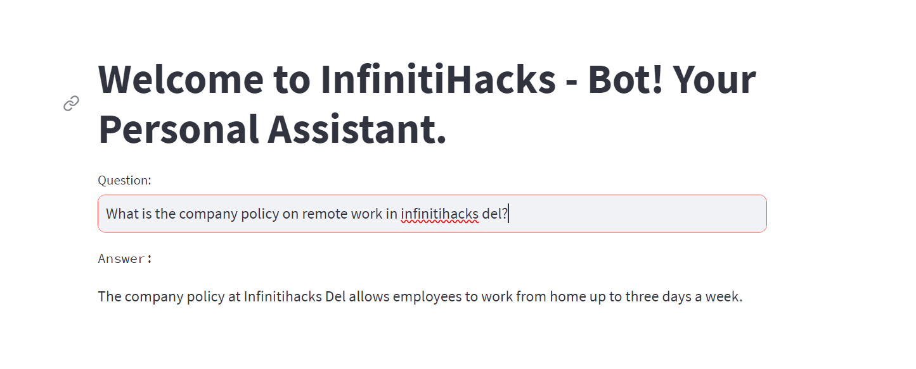

Slide 8
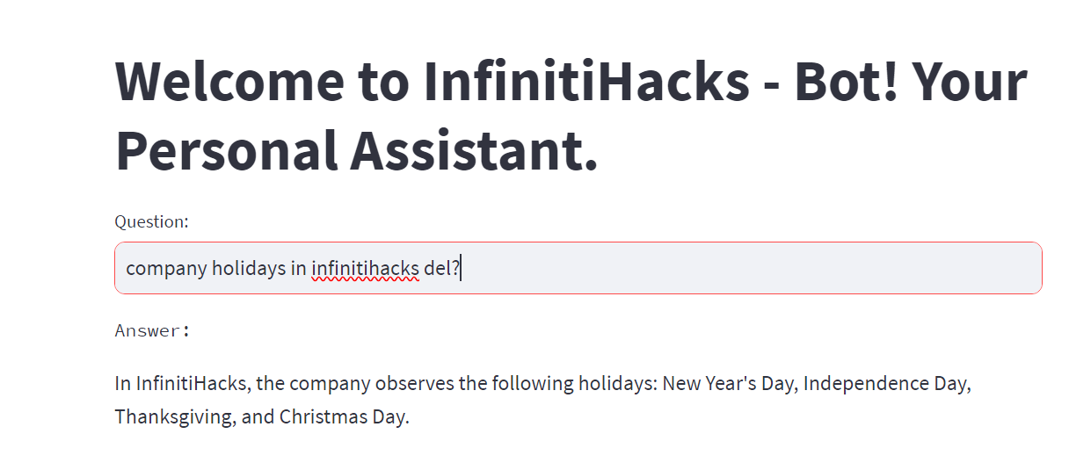

Slide 9
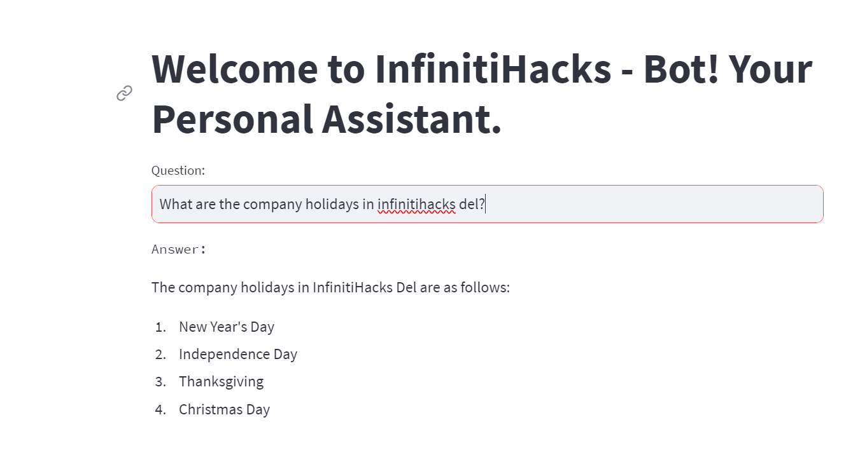

Slide 10
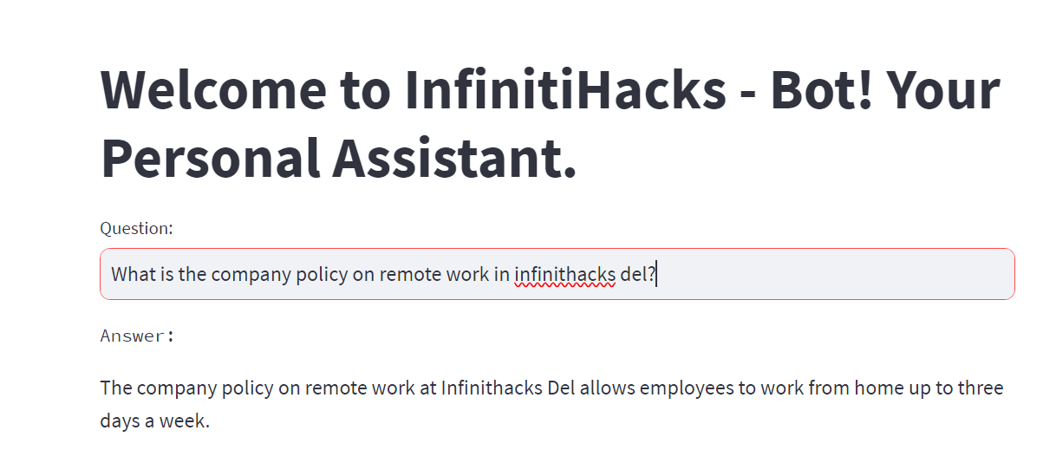

Slide 11

Thank you !

