Slide 1
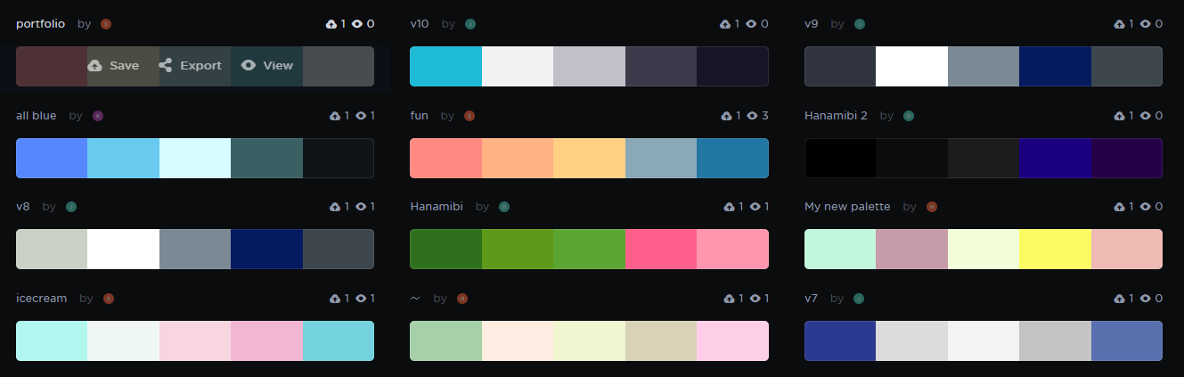

Slide 2
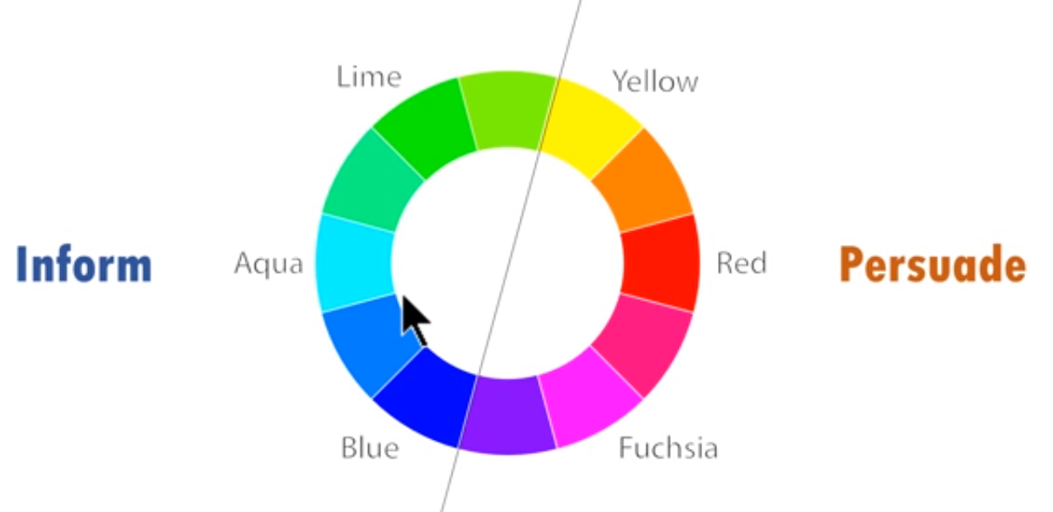


Slide 3
Edit points
Top one : smooth point
Bottom two: Drag it to top right corner of 2nd box where line meets

Slide 5


Slide 15
Big one convert into secondary axis

