Slide 2
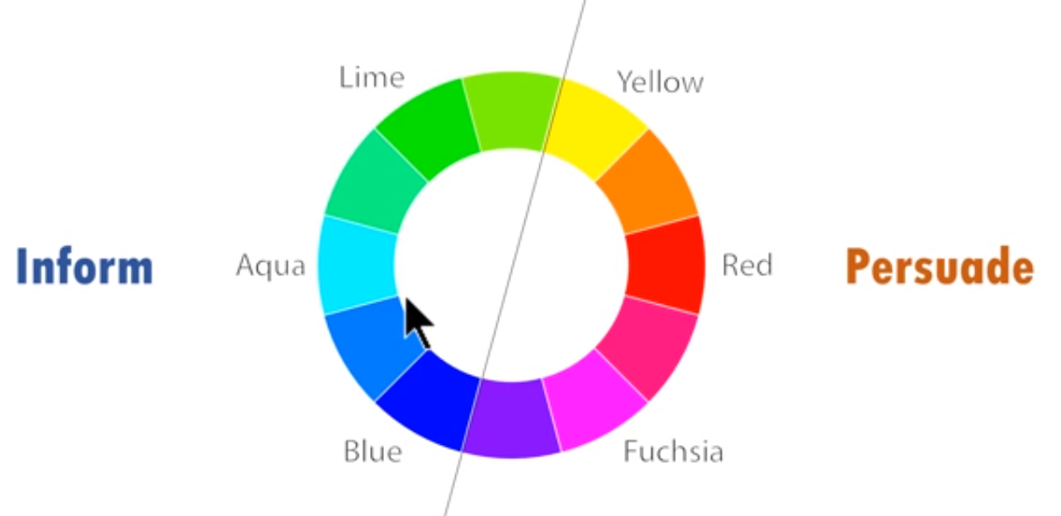


Slide 5


Slide 14
Big one convert into secondary axis

