Slide 1
Evaluation of Boolean/Ranked/Okapi BM25 retrieval models Team Members Amit Nanda Saurabh Rai

Slide 2
Contents
Information retrieval models
Web interface
Query Output
ZipFileReader
Boolean Retrieval model
Ranked Retrieval model
Okapi BM25
Evaluation strategy
Elements for evaluation strategy
Results of Retrieval models
Comparison of Retrieval models

Slide 3
Technologies Used
Apache Hadoop , Apache Tomcat
Java,SSH2
JSP ,Jquery (Javascript Library) ,Spring (MVC Framework)
Hadoop Configuration:
8 nodes
16 CPUs
And

Slide 4
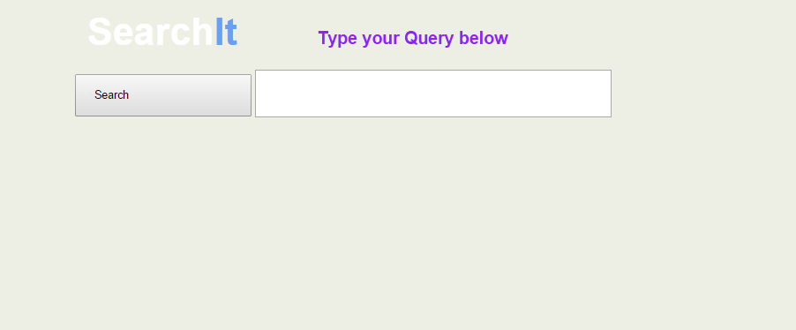
Web Interface

Slide 5
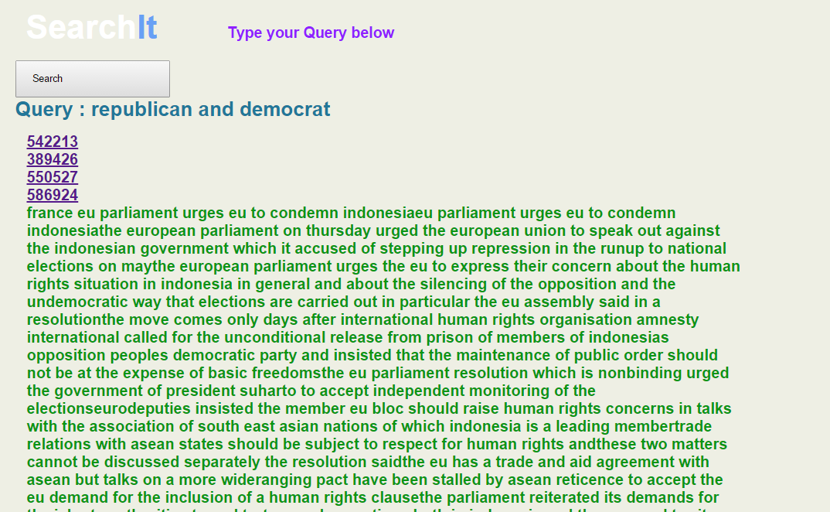
Query Output

Slide 6
ZipFileReader
Extracted Text Files as input
Initially We did the Boolean on extracted data from the zip files where our mappers had to parse the files one by one .
This method proved to be very-very slow as there was On disk IO per file read from the disk hence it was infeasible to use this method to compute the index on entire data set.
Zip File as Input using the ZipFileReader
. In this method we pass the entire zip file to the mapper and then the mapper would explode the zip file and in main memory and extract the data from it. Since here there were far less Disk IO’s compared to the previous method and accessing data in main memory is very fast we were able to compute indexes in a matter of minutes then hours as in previous case.

Slide 7
Boolean retrieval Model
UniWord Index
One Mapper → output {word,docId}
One Reducer → word , docId1,docId2,docId3 ……..
Biword index →
One Mapper → output { word1 word 2, docId}
One Reducer → output { word1 word2 , docId1,docId2,docId3 ……….}

Slide 8
Ranked Retrieval Model
Mappers - Three
Combiner – One Used only in phase 1 of generating the index.
Reducer - Three

Slide 9
Phase 1
Mapper | Reducer
{docId=>[words]} → Output {[word,docId]=>1} → to Combiner {[word,docId]=>[1,1,1,1,1} → to Reducer {[word,docId]=>[5} | {[word,docId]=>[5} → Output{[word,docId],wordCount]}
Phase 2
Mapper | Reducer
Output → {[word,docId],wordCount]} | {[word,docId]=>[wordcount,wordsPerDoc]}
Phase 3
Mapper | Reducer
{[word,docId]=>[wordcount,wordsPerDoc]} Output → { word=>[docId,wordCount,wordsPerDoc] } | {word=>[doc1,wc1,wpd1], [doc1,wc1,wpd1]……..} → intermediate Results : {[word,docId] => [wordCount,wordsPerDoc,docsPerWord]} (Stored in a temporary map) → Final Calculation : {[word,docId]=>tfidf }

Slide 10
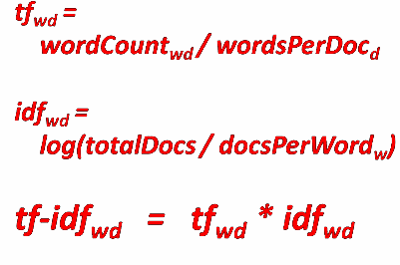
Final Index file format
word@docId, [d/D, n/N, TF-IDF]

Slide 11
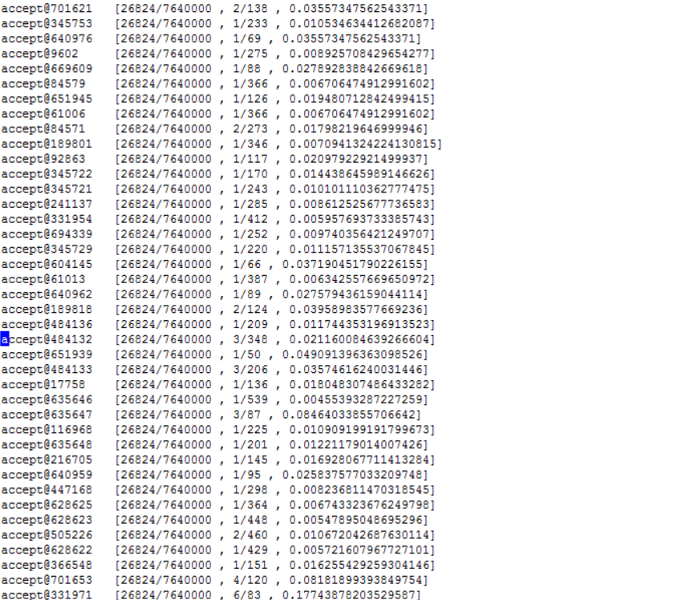

Slide 12
Distributed Search using TfIdf
Mapper → For every word which is in the query the index file is scanned and if a matching entry is found the in file we output the word and the corresponding the tfidf and tf value to the reducer
Reducer → using the output from the Mapper we create an intermediate Map of the following form to help create the document vector.
<word1,<docID1,tfIdf>, <docID2,tfIdf>, <docID3,tfIdf>, <docID4,tfIdf>…………………….>>,
<word2,<docID1,tfIdf>, <docID2,tfIdf>, <docID3,tfIdf>, <docID4,tfIdf>…………………….>>,
<word3,<docID1,tfIdf>, <docID2,tfIdf>, <docID3,tfIdf>, <docID4,tfIdf>…………………….>>,
<word4,<docID1,tfIdf>, <docID2,tfIdf>, <docID3,tfIdf>, <docID4,tfIdf>…………………….>>,
..
..
..
..
Finally we create the query vector and then find the cosine similarity and output the result.

Slide 13
Okapi BM25 Retrieval Model
Okapi BM25 is a probabilistic approach to information retrieval
In an information retrieval model, the way the model infers the user’s query may or may not be in sync with user’s information need. There is an uncertainty in retrieval model. This is solved by probabilistic retrieval model.
BM25 is derived from probabilistic model BIM which does not consider the term or document frequency
Okapi BM25 takes in to consideration the term frequency and document frequency in ranking documents. It does not take into consideration the proximity of query terms

Slide 14


Okapi BM25 Retrieval Model
Simplified assumption formula of BIM is
Now factor above equation with term frequency and document length
N is the number of documents in collection
dft is document frequency
Ld is length of the document
Lave is average length of document
k is constant varying between 1.2 and 2.0, tunes based on term frequency
b is a constant of value 0.75, tunes based on document length

Slide 15
Okapi BM25 Retrieval Model
Map reduce in Okapi BM25
Mapper:
Input – tfidf index file executed on the whole reuters data
Output - <query> <docid, query word, termfreq, numberoftermsindocument,numberofdocsincollection>
Reducer
Input – Output from reducer.
Process – calculates score of each document and sorts in order
Output – Writes sorted document on score to output

Slide 16
Size of Index
Boolean System (Uniword, Biword) | Ranked Retrieval | BM 25
614 MB, 1.1 GB | 2.4 GB | 2.4 GB
Boolean System is more space efficient

Slide 17
Average Time Efficiency for Search Queries
Boolean Retrieval | Ranked Retrieval | BM25
23 s | 51 s | 83 s
Boolean Retrieval is most efficient in terms of time

Slide 18
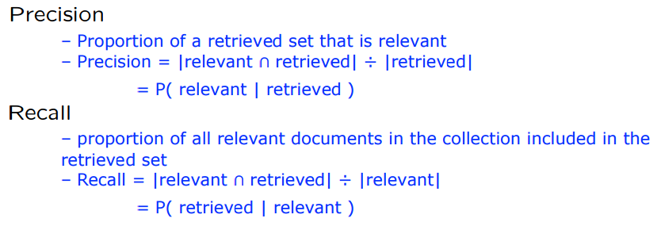


Precision, Recall and F-Measure
with β = 1 or α = 0.5
This is the harmonic mean of P and R:

Slide 19
Precision -
- No of Documents Retrieved - 25
Query | Ranked Retrieval | BM25
Clinton | 0.68 | 0.76
Ronald Reagan | 0.76 | 0.84
Los Angeles | 0.72 | 0.84
World Cup | 0.52 | 0.68
World Mafia | 0.64 | 0.72

Slide 20
Recall
Calculated on small subset of Data
Inserted terms in the dataset
Boolean System | Ranked Retrieval | BM 25
0.85 | 0.6 | 0.65

Slide 21
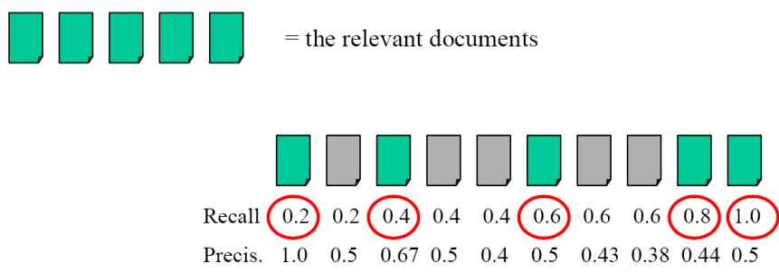
Precision- Recall Curve

Slide 22
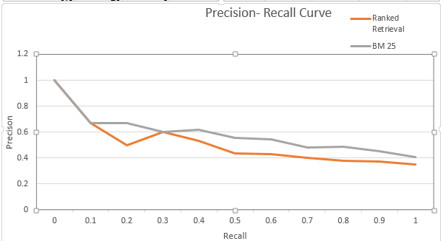
Precision – Recall Curve
 | Ranked Retrieval | BM 25
11-point Average | 0.515 | 0.588
Break Even Point | 0.45 | 0.55
F-measure | 0.45 | 0.55

Slide 23
R-Precison
The precision of the top Rel documents returned
Top 20 Results in :
Ranked retrieval - YNYNNYNYYYNNYNYNNYNN
BM25 retrieval - YNYNYYNNYYNYYNNYNYYNN
 | Ranked Retrieval | BM-25
Precision@20 | 9/20 = 0.45 | 11/20 = 0.55

Slide 24
Conclusion
BM25 is the more accurate and slower
Ranked Retrieval is less accurate and faster
Boolean is space efficient

