Slide 1
Decentralised Land Records Storage System
Group 6
Akash Bhale – 2021A3PS0854H
Anamay Trivedi- 2021AAPS2217H
Sriharsha Tippavajhala- 2021AAPS0717H
Pranay G- 2021A3PS2725H
Amit Narayan Satpathy – 2021AAPS2127H

Slide 2
Introduction
Background
Blockchain Emergence: With the rise of Bitcoin, blockchain technology gained attention for its decentralized and secure nature.
Beyond Cryptocurrencies: Blockchain offers versatile applications beyond digital currencies, including secure transaction management.
Importance of Decentralization: Traditional centralized systems are prone to single points of failure and security vulnerabilities.
Project Objective
Familiarization with Blockchain: The project aims to provide hands-on experience in blockchain development.
Real-World Problem Solving: Addressing a tangible issue - secure land records storage - utilizing blockchain technology.
Secure Transaction Management: Implementing blockchain fundamentals to ensure the integrity and security of transactions.

Slide 3
Blockchain Fundamentals
Definition
Digital Ledger: Blockchain serves as a digital and distributed ledger, recording transactions across a network of nodes.
Peer-to-Peer Trustless Mechanism: Transactions are validated through consensus, eliminating the need for centralized authorities.
Key Concepts
Transaction Validation: Consensus mechanisms ensure the validity of transactions before they are added to the blockchain.
Cryptographic Hashing: Each block contains a hash of the previous block, ensuring the integrity of the entire chain.
Proof of Work: Miners solve complex computational puzzles to add new blocks to the chain, ensuring security and immutability.
Relevance to the Project
Secure Transaction Storage: Blockchain's decentralized and immutable nature provides a secure platform for storing land transaction records.
Elimination of Intermediaries: By removing centralized authorities, blockchain reduces the risk of fraud and tampering in land transactions.

Slide 4
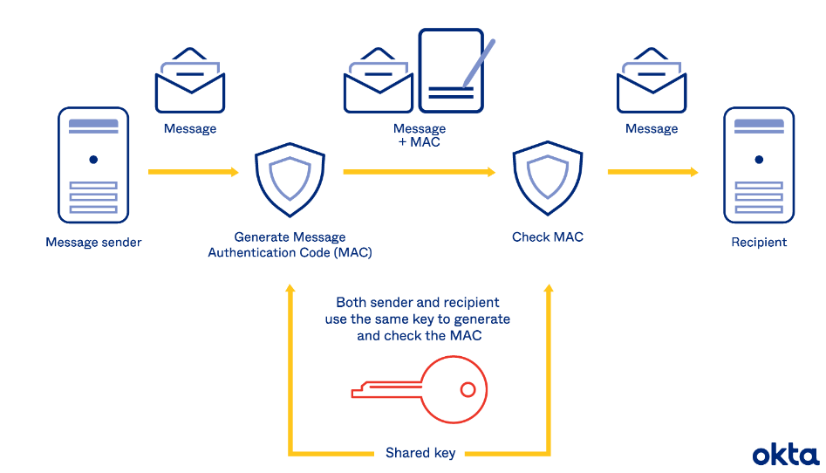
Quick Introduction to HMAC
Challenge-Response Authentication
HMAC Mechanism: Utilizing Hash-based Message Authentication Code for secure key verification.
Confidentiality and Integrity: Allows users to prove knowledge of a secret key without revealing the key itself.
Scenario
Secure Messaging System: Alice and Bob's communication scenario demonstrates HMAC-based authentication.
Confidentiality Assurance: HMAC ensures that Alice can authenticate herself to Bob without exposing her secret key.
Implementation in the Project
Secure User Authentication: HMAC is incorporated into the blockchain application to verify the authenticity of transactions without revealing sensitive information.
Enhanced Security: Challenge-response mechanism adds an additional layer of security, safeguarding transactions against unauthorized access and tampering.

Slide 5
Implementation Details
Blockchain Components
Block: Data structure containing transaction details and cryptographic hash.
Transaction: Record of land transactions including buyer, seller, amount, and land details.
Blockchain: Chain of blocks, decentralized ledger ensuring transaction integrity.
Methods
createBlock(): Generates a new block in the blockchain with validated transactions.
verifyTransaction(): Verifies the authenticity of transactions using HMAC authentication.

Slide 6
Implementation Details
mineBlock(): Utilizes proof-of-work to securely add blocks to the blockchain.
viewUser(): Provides users with visibility into their transaction history within the blockchain.
Code Overview
Utilization of Libraries: Hashlib, time, json, hmac, random, and Flask for web interface development.
Class Structure: Block, Transaction, and Blockchain classes facilitating blockchain management.
Helper Functions: Continuous mining thread and HMAC challenge-response authentication.

Slide 7
Project Demonstration
User Interface
Adding Transactions: Users can input transaction details, which are securely stored in the blockchain.
Mining Blocks: Mining process verifies transactions and adds them to the blockchain, ensuring security and immutability.
Viewing User Transactions: Users can access their transaction history, enhancing transparency and accountability.
Code Execution
Flask Application: The Flask web framework facilitates user interaction with the blockchain application.
Blockchain Interaction: Users can interact with the blockchain through the web interface, ensuring seamless integration and usability.

Slide 8
Results and Future Work
Achievements
Successful Implementation: The project demonstrates a functional blockchain application for secure transaction management.
Integration of Security Measures: HMAC-based authentication enhances the security of transactions, ensuring confidentiality and integrity.
Challenges
Scalability and Performance: Addressing scalability issues and optimizing performance for larger datasets and networks.
Security Vulnerabilities: Continuously monitoring and mitigating potential security risks and vulnerabilities.
Future Directions
Enhanced User Experience: Improving the user interface and experience to streamline interaction with the blockchain application.
Additional Blockchain Features: Implementing advanced blockchain features such as smart contracts and decentralized governance.
Scalability Solutions: Exploring solutions for scalability challenges to accommodate growing transaction volumes and network size.

Slide 9
Conclusion
Key Takeaways
Understanding Blockchain Fundamentals: We gained a comprehensive understanding of blockchain technology and its applications.
Real-World Problem Solving: The project addresses a tangible issue in land transaction management, showcasing the practical utility of blockchain.
Emphasis on Security: By integrating HMAC-based authentication, the project emphasizes the importance of security in transaction management.
Acknowledgments:
We would like to thank each other for the collaborative effort put in and ma’am too for letting us do an interesting and relevant project.

