Slide 1
Date:23/11/2024
Hardware Implementation of Hash Module for Kyber
NAME(ID): Sriharsha Tippavajhala (2021AAPS0717H),
Dhananjay Rao T S (2021AAPS0321H),
Amit Narayan Satpathy(2021AAPS2127H)
Mentor: Dr. Subhendu Kumar Sahoo
Course: ECE/EEE F366
Notes:
Good Morning Everyone!
My topic for my Seminar is Methods for finding Polynomial Multiplication on Friendly rings

Slide 2
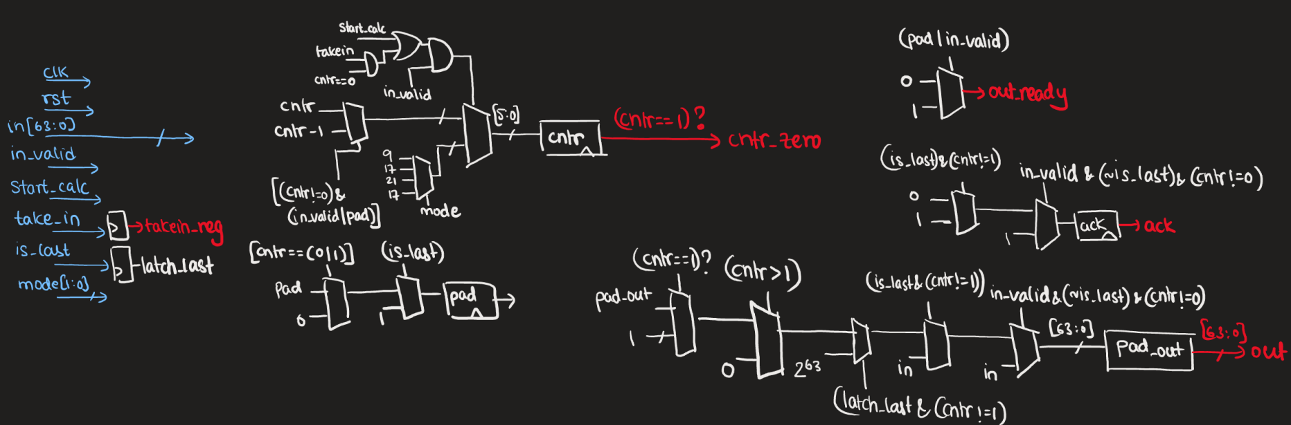
Padder
Notes:
This is the Equation for finding Nega-Cyclic NTT
These are Viable Techniques which can be used for finding Nega-Cyclic NTT

Slide 3
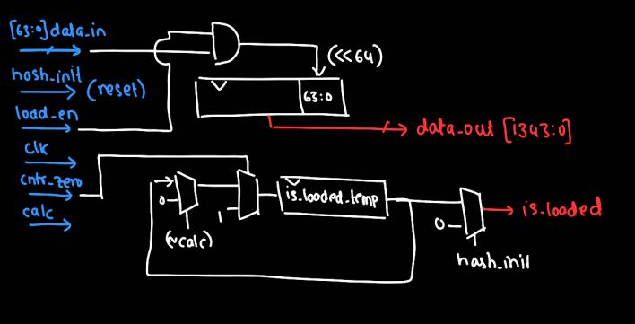
Serial In and Parallel Out Register

Slide 4
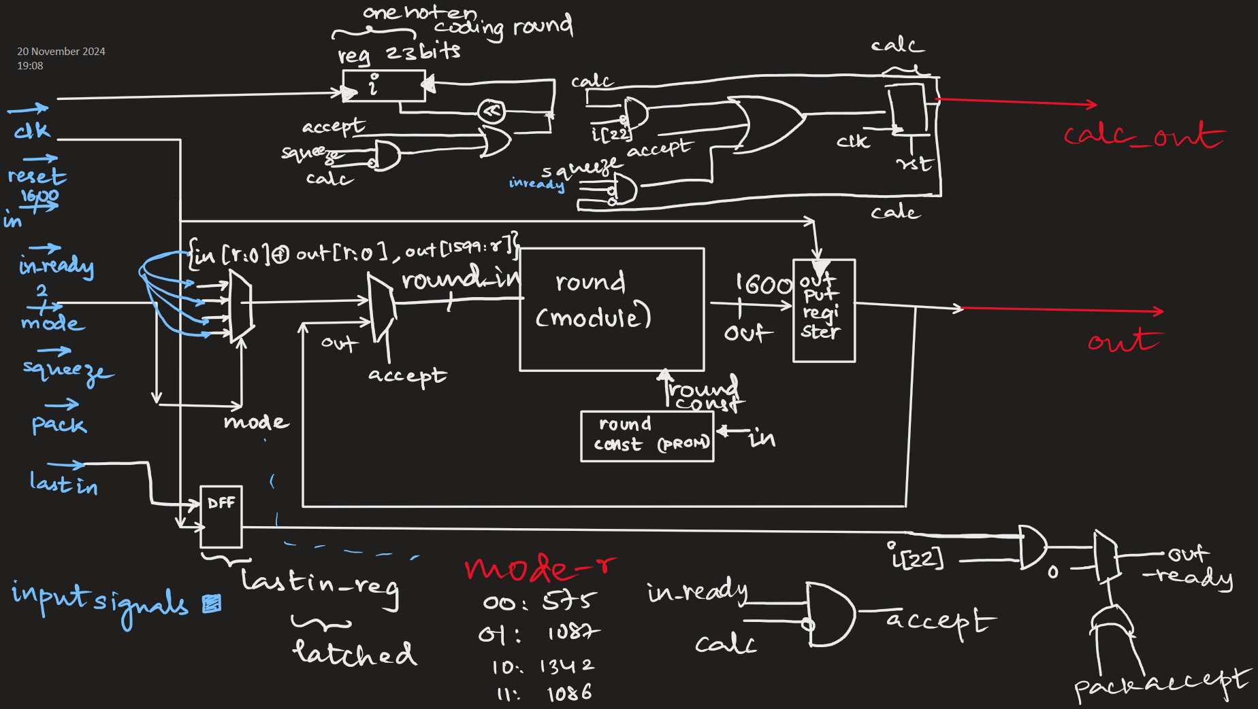
F Permutation
Notes:
This is the Equation for finding Nega-Cyclic NTT
These are Viable Techniques which can be used for finding Nega-Cyclic NTT

Slide 5
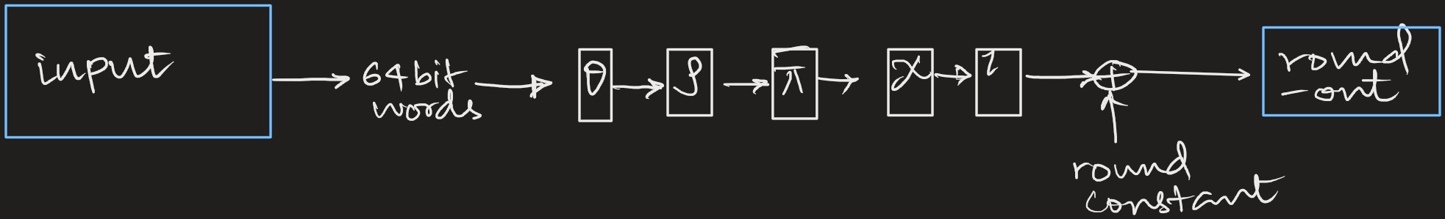
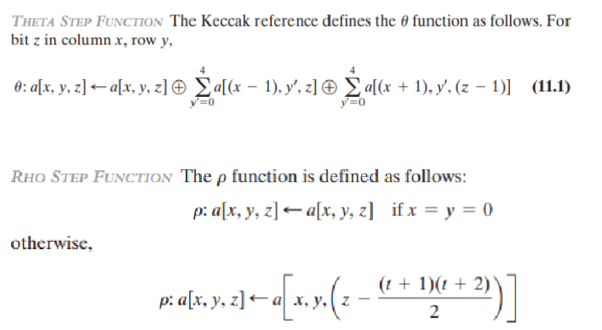
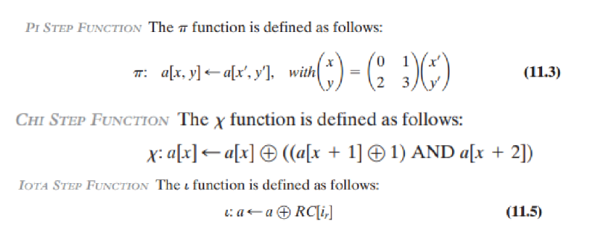
Round
Notes:
This Algorithm was taken from A.C.Mert’s Thesis and His Paper CoHa NTT and This was first published for FFT as Twisted FFT in “Tangent FFT”

Slide 6
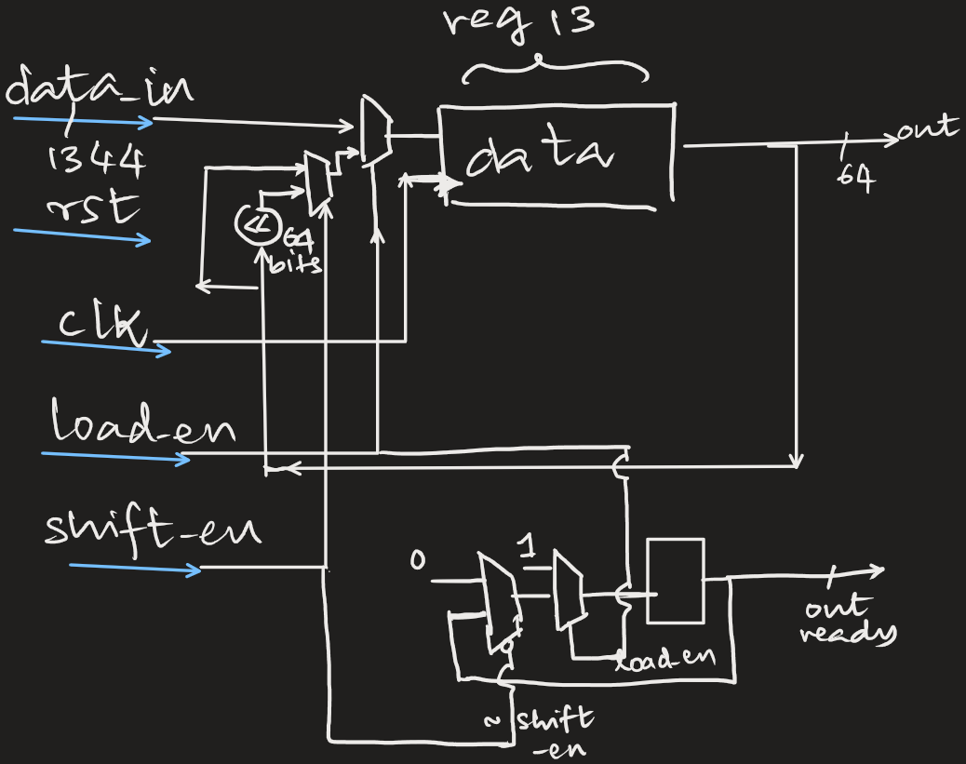
Parallel In Serial Out
Notes:
Placement Cordinator

Slide 7
References
  1. Bisheh-Niasar, Mojtaba, Reza Azarderakhsh, and Mehran Mozaffari-Kermani. "Instruction-set accelerated implementation of CRYSTALS-Kyber." IEEE Transactions on Circuits and Systems I: Regular Papers 68.11 (2021): 4648-4659.
  2 Mestiri, Hassen, et al. "High throughput pipelined hardware implementation of the KECCAK hash function." 2016 International Symposium on Signal, Image, Video and Communications (ISIVC). IEEE, 2016.
  3 Maache, Ahmed, and Abdesattar Kalache. "FPGA-based tunable Keccak core." 2023 International Conference on Smart Applications, Communications and Networking (SmartNets). IEEE, 2023.
  4 Assad, F., et al. "An optimal hardware implementation of the KECCAK hash function on virtex-5 FPGA." 2019 International Conference on Systems of Collaboration Big Data, Internet of Things & Security (SysCoBIoTS). IEEE, 2019.
  5 Dworkin, Morris J. "SHA-3 standard: Permutation-based hash and extendable-output functions." (2015).
  6 Guo, Wenbo & Li, Shuguo & Kong, Liang. (2021). An Efficient Implementation of KYBER. IEEE Transactions on Circuits and Systems II: Express Briefs. PP. 1-1. 10.1109/TCSII.2021.3103184
  7.Cryptogra-phy, Elliptic Curve. "William Stallings. Cryptography and Network Security Principles and Practices." PGM334401. htm.

Slide 8
Thank You

