Slide 1

AMAZON PRODUCT FEATURE EXTRACTION, SCORING & SUMMARIZATION
ISM 6930 – Text Analytics
Amitoj Singh Lotey
Durga Prasad Somarouthu
Sahil Shah

Slide 2

CONTEXT – Online reviews
Online shopping surged 43% during the COVID-19 Pandemic from $571.2 billion in 2019 to $815.4 billion in 2020 (www.census.gov) ​
82% of users confirmed that reviews directly influence buying decision, and 69% shared the reviews with others including: family, friends, and co-workers​
However, online reviews and ratings are often biased and tend to over- represent the most extreme views (Harvard Business Review, 2018). ​
Volume of reviews for popular products makes understanding and acting upon reviews a challenge for both customers and sellers

Slide 3
PROBLEM STATEMENT – Gaps​ in Online Reviews
Amazon's current product feature rating system requires manual input from the customer, but does not necessarily capture what customers care about most​
Features available to rate are the same for all products in a category – some of which do not correspond to actual product features
Numeric (star) rating of a product is often an inaccurate reflection of actual reviewer sentiment​
Amazon's “most useful” positive and negative reviews for a product do not provide a holistic summary of all reviews submitted. ​

Slide 4

OBJECTIVE ​
WHAT: Promote customer decision making and seller insight generation by resolving discrepancies in online reviews/ratings.
HOW: Utilize sentiment analysis and next generation transformer models to capture the following from online product reviews:
Features
Extract and score meaningful product features based on text reviews​
Summary
Provide a compact, holistic summary of reviews​ based on features

Slide 5
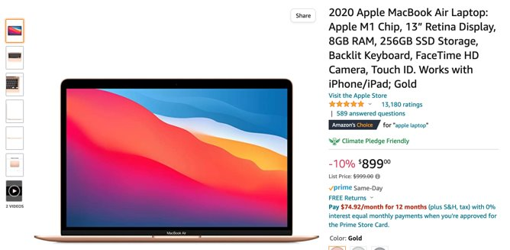
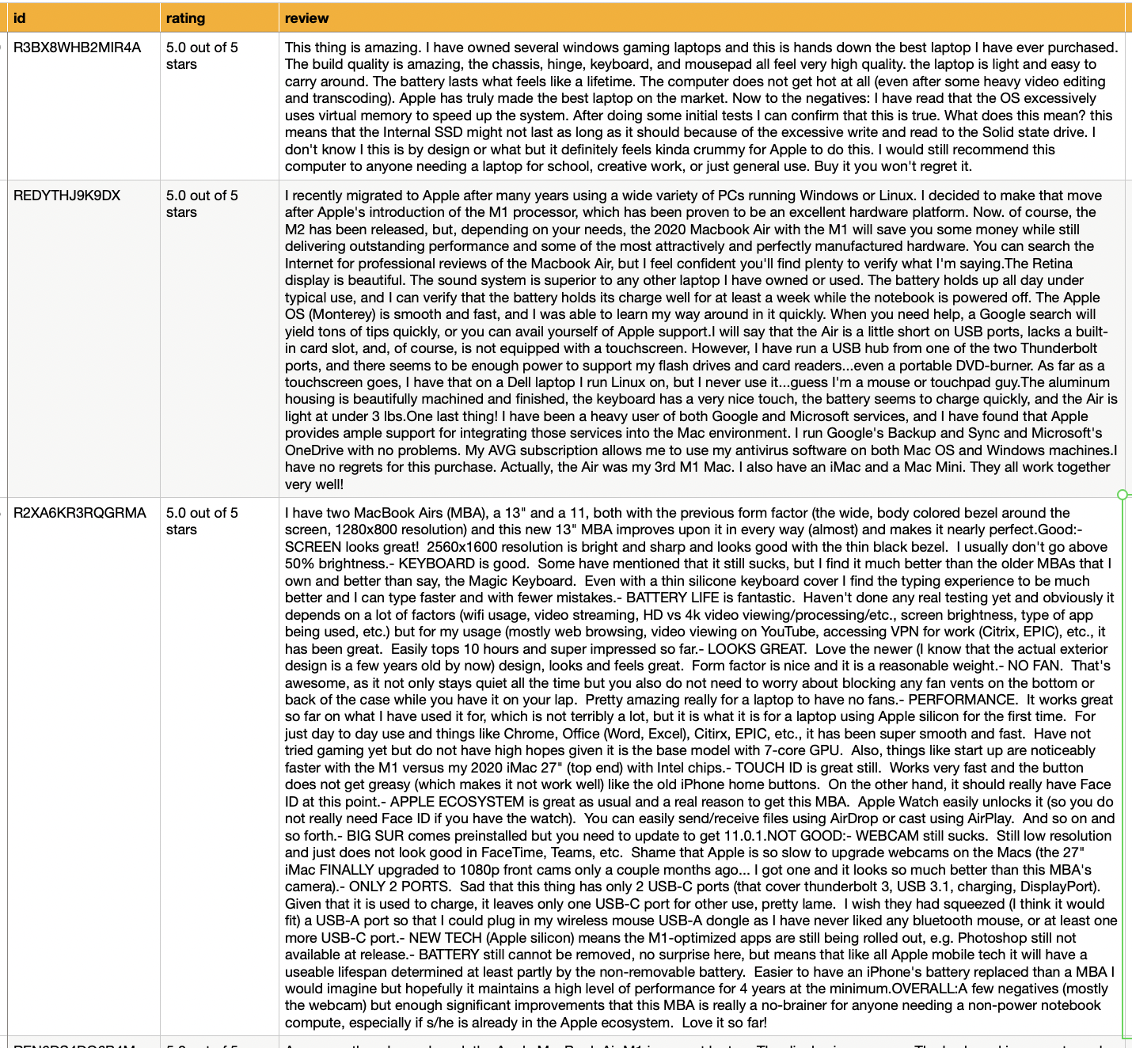
DATA SOURCE
450+ Amazon reviews of 2020 Apple MacBook Air sourced via web scraping​

Slide 6
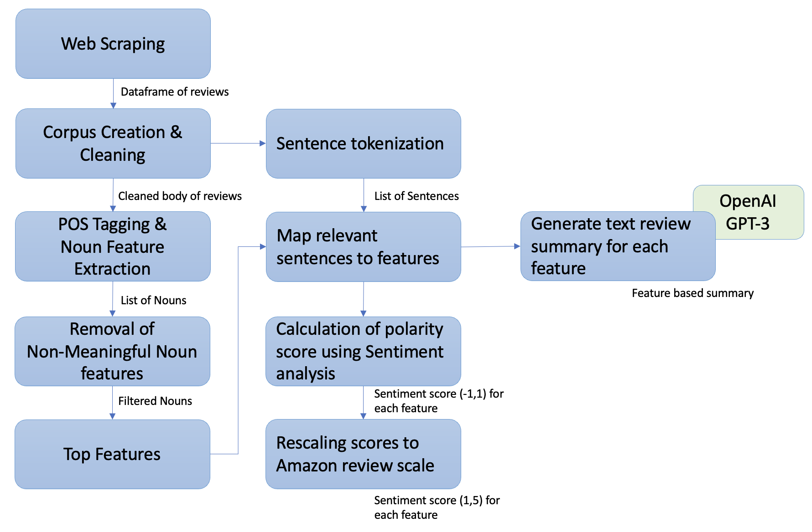
METHODOLOGY

Slide 7
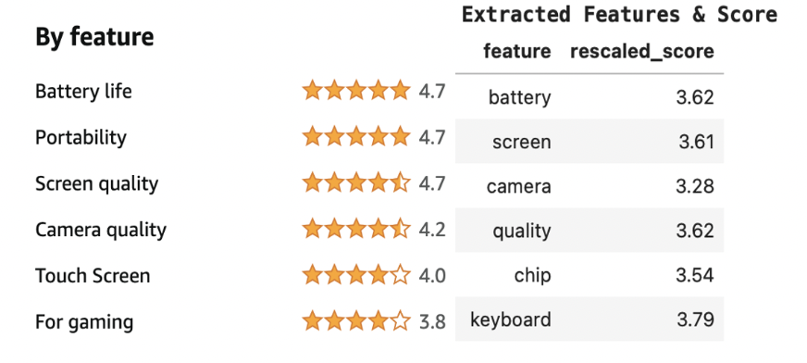
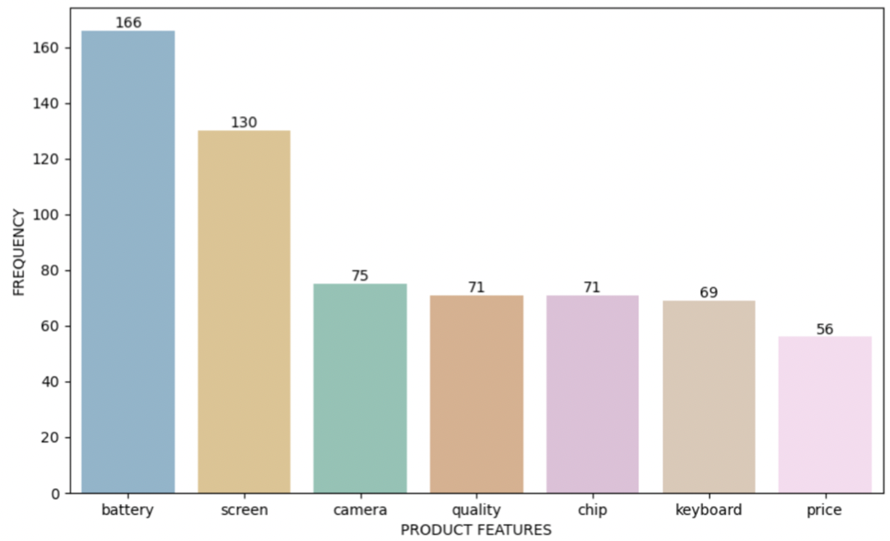
RESULTS (A) - Feature Extraction and Scoring
Amazon Features vs Extracted Features
Frequency of Extracted Features

Slide 8
RESULTS (B) – Review Summary By Feature
Feature | Generated Summary
Battery | The MacBook Air's battery life is much less than advertised. The battery life of the Surface is better. I am mulling over upgrading to the MacBook Pro 13 because of its bigger battery, but do not know if I want to spend the extra money.
Screen | The Apple MacBook Air is a beautifully designed and well-crafted laptop with a great screen and amazing battery life. However, it is not without its flaws. One of the most common complaints is that the screen is susceptible to cracking, even with normal use.
Camera | The only thing is that the camera could be better.
Quality | The build quality on the 2020 MacBook Air is amazing--chassis, hinge, keyboard, and mousepad all feel very high quality. The screen quality is great, the touch screen is easy to use, and the webcam quality is crystal clear.
Chip | The MacBook Air is a beautifully designed laptop with a great keyboard, trackpad, and screen. I think the new keyboard is great. I love the haptic feedback on the trackpad, it feels very natural.
Keyboard | The new Apple M1 chip is extremely powerful and efficient, running cool and silent. So far it has been able to handle everything I have thrown at it with ease. Some apps are not yet available or compatible with the new chip, but running through.
Price | The M1 MacBook Air is a great laptop for the price. It is thin, light, and has a great retina display. The battery life is incredible and the performance is great for the price.

Slide 9
IMPLICATIONS
FEATURE EXTRACTION & SCORING:
Customers:
Reduce manual input
Provide scoring for most relevant features
Feature scores are more accurate
Sellers:
Identify features to highlight/improve/include
SUMMARY:
Customers:
Provide holistic summary that is feature focused
Provide compact, consumable summary of reviews
Sellers:
Provide explanation of sentiment-based ratings

Slide 10
FUTURE SCOPE
Extending to multiple products on multiple platforms
Extracting and scoring secondary level product features
Exploring effectiveness of other pretrained text models for tasks including
Summarization
Query Response
Translation
Creating an interactive dashboard for customers/sellers

Slide 11
Thank you for your time!

