Slide 1
Ansible
Ow

Slide 2
Config management
Configuration management is a way of handling changes in a system using a defined method so that the system maintains its integrity over time.
A log is kept of every change made to a system along with documentation about who made the change, when the change was made, and why it was made.
This allows us to know the exact state of a system at any moment in time

Slide 3
Key goals
Consistency: Maintain uniformity in system configurations across environments (development, testing, staging, production).
Traceability: Track changes to identify who made the change, when, and why.
Version Control: Manage different versions of configurations and ensure only approved changes are deployed.
Automation: Use tools to automate repetitive configuration tasks, reducing errors and saving time.
Compliance: Ensure systems meet regulatory and security standards.

Slide 4
Issues:Inconsistency
Problem: Different servers may have varying configurations due to manual changes or lack of standardization.
Impact:
Difficulties in debugging and troubleshooting.
Increased risk of deployment failures or unexpected behavior in production.
Example: A configuration file updated on one server but not on others leads to application crashes in some environments.

Slide 5
Lack of Version Control
Problem: Changes to configurations are not tracked systematically.
Impact:
Difficulty in identifying who made a change and why.
Inability to roll back to a stable configuration after a failure.
Example: A critical configuration is overwritten accidentally, causing downtime, and there’s no record of the previous state.

Slide 6
Manual Processes
Problem: Configuration changes made manually are prone to human error and are time-consuming.
Impact:
Inconsistent setups across servers.
Difficulty in scaling operations.
Example: A system administrator forgets to update a critical dependency on some servers during an upgrade.

Slide 7
Environment Drift
Problem: Over time, servers in different environments (e.g., development, testing, production) diverge in configuration.
Impact:
Code that works in one environment might fail in another.
Delayed releases due to additional debugging.
Example: A missing library in the production server causes an application crash despite successful testing.

Slide 8
Solution: Configuration Management Tools
Solution: Implement tools like Ansible, Puppet, Chef, or SaltStack to automate and standardize server configurations.
How It Helps:
Automates repetitive tasks (e.g., software installation, user management).
Ensures uniform configurations across servers.
Simplifies scaling by applying configurations to new servers effortlessly.
Example: Using Ansible playbooks to manage configurations across 100+ servers.

Slide 9
vErsion control
Git and github

Slide 10
Ansible intro
Ansible provides open-source automation that reduces complexity and runs everywhere. Using Ansible lets you automate virtually any task. Here are some common use cases for Ansible:
Eliminate repetition and simplify workflows
Manage and maintain system configuration
Continuously deploy complex software
Perform zero-downtime rolling updates

Slide 11
..
Agent-less architecture : Low maintenance overhead by avoiding the installation of additional software across IT infrastructure.
Simplicity: Automation playbooks use straightforward YAML syntax for code that reads like documentation. Ansible is also decentralized, using SSH with existing OS credentials to access to remote machines.
Scalability and flexibility :Easily and quickly scale the systems you automate through a modular design that supports a large range of operating systems, cloud platforms, and network devices.
Idempotence and predictability :When the system is in the state your playbook describes Ansible does not change anything, even if the playbook runs multiple times.

Slide 12
Control node
The machine from which you run the Ansible CLI tools (ansible-playbook , ansible, ansible-vault and others).
You can use any computer that meets the software requirements as a control node - laptops, shared desktops, and servers can all run Ansible.
You can also run Ansible in containers known as Execution Environments.

Slide 13
Managed nodes
Also referred to as ‘hosts’, these are the target devices (servers, network appliances or any computer) you aim to manage with Ansible.
Inventory
A list of managed nodes provided by one or more ‘inventory sources’. Your inventory can specify information specific to each node, like IP address. It is also used for assigning groups, that both allow for node selection in the Play and bulk variable assignment.

Slide 14
What is playbook?
Playbooks: This is the yaml file where we define what to perform on inventory list
From the control node you will be running the playbook on set of inventory .
It contains the plays
Each play will have name, name of host group or all.
Any specific user to access [optional field]
Tasks list what to peform

Slide 15
Plays
Plays is the main stuff in playbook
It is a list Means one playbook can have one or more play
Play will have one or more tasks defined
name: <name of the play>
hosts: all/or name of the group where to run
tasks
- name: name of task

Slide 16
terminology
name
Hosts
Tasks
Become
Become_user
Vars
Handlers

Slide 17
..
Role
A modular and reusable way to organize playbooks, tasks, and variables.
Roles are stored in a specific directory structure
Inventory
A file or dynamic source defining the systems (hosts) on which Ansible operates.
Module
A reusable unit of code used by Ansible to perform specific tasks like managing packages, files, or services. Examples include copy, yum, and service.

Slide 18
What is YAML?
Introduction to YAML
What is YAML? YAML is a human-readable data serialization standard commonly used for configuration files and data exchange between applications. It emphasizes simplicity and readability, making it easier for both humans and machines to understand.
Why Use YAML?
Readability: Clean and minimalistic syntax, resembling natural language.
Flexibility: Supports various data types like scalars (strings, numbers), sequences (lists), and mappings (dictionaries).
Widely Used: Common in DevOps tools (Kubernetes, Ansible, Docker Compose) and APIs.

Slide 19
..
Indentation: Indentation defines structure. Use spaces, not tabs.
Extension file : .yaml, .yml
We need standardization when we submit or declare our request
Declaration must be in standard format. Vendor provide syntax for the same

Slide 20
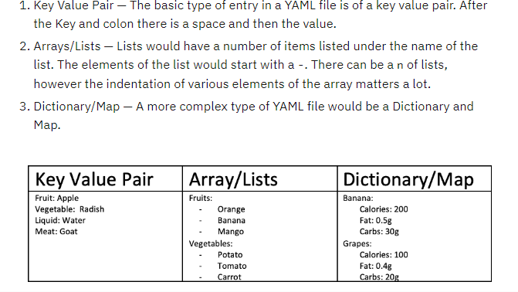
Yaml example

Slide 21
Lab
ansible setup on control node

Slide 22
cmds
ansible : Executes ad-hoc commands on managed nodes.
ansible all -m ping
ansible-playbook: Runs Ansible playbooks to automate tasks.
ansible-inventory: Manages and inspects inventory files.
ansible-inventory –list
ansible-doc : Provides documentation for Ansible modules.

Slide 23
..
ansible-vault : Manages encrypted files and secrets.
ansible-galaxy :Manages roles and collections from Ansible Galaxy.

Slide 24
Inventory file
ow

Slide 25
Inventory file
ansible_host The name of the host to connect to, if different from the alias you wish to give to it. Never set it to depend on inventory_hostname if you use delegation.
ansible_port The connection port number, if not the default (22 for ssh
ansible_user The username to use when connecting to the host
ansible_password The password to use to authenticate to the host (never store this variable in plain text; always use a vault. See Keep vaulted variables safely visible)
Specific to the SSH connection:
ansible_ssh_private_key_file Private key file used by SSH. Useful if using multiple keys and you do not want to use SSH agent.

Slide 26
Overview
Ansible automates tasks on managed nodes or “hosts” in your infrastructure, using a list or group of lists known as inventory.
You can pass host names at the command line, but most Ansible users create inventory files.
Your inventory defines the managed nodes you automate, with groups so you can run automation tasks on multiple hosts at the same time. Once your inventory is defined, you use patterns to select the hosts or groups you want Ansible to run against.

Slide 27
..
You can create your inventory file in one of many formats, depending on the inventory plugins you have. The most common formats are INI and YAML
An inventory group is a logical collection of hosts that share a common purpose or role. It allows you to target multiple hosts at once in your playbooks or ad-hoc commands.
[webservers]
foo.example.com
bar.example.com
[dbservers]
one.example.com
two.example.com
three.example.com

Slide 28
Default group
Even if you do not define any groups in your inventory file, Ansible creates two default groups: all and ungrouped.
The all group contains every host. The ungrouped group contains all hosts that don’t have another group aside from all.
Every host will always belong to at least 2 groups (all and ungrouped or all and some other group).

Slide 29
Hosts in multiple groups
You can put each host in more than one group. For example, a production web server in a data center in Atlanta might be included in groups called [prod] and [atlanta] and [webservers]. You can create groups that track:
What - An application, stack or microservice (for example, database servers, web servers, and so on).
Where - A datacenter or region, to talk to local DNS, storage, and so on (for example, east, west).
When - The development stage, to avoid testing on production resources (for example, prod, test).

Slide 30
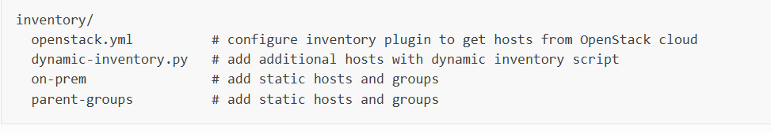
Organizing inventory in a directory
You can consolidate multiple inventory sources in a single directory. The simplest version of this is a directory with multiple files instead of a single inventory file.
A single file gets difficult to maintain when it gets too long. If you have multiple teams and multiple automation projects, having one inventory file per team or project lets everyone easily find the hosts and groups that matter to them.

Slide 31
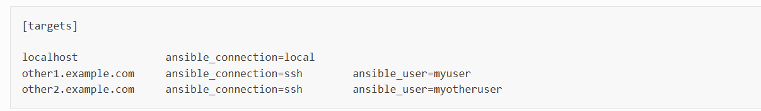
Assigning a variable

Slide 32
Lab create with localhost
[local]
localhost ansible_connection=local
Create inventory.ini
ansible -i inventory.ini all -m ping

Slide 33
authentication
In Ansible, authentication and authorization are essential to communicate and execute tasks on managed nodes.
The tool primarily uses SSH (Secure Shell) for secure communication, and there are multiple ways to configure it based on the authentication methods available

Slide 34
SSH with Password
This is the simplest form of SSH authentication, where the Ansible control node uses a username and password to log in to managed nodes.
Configuration :Ensure password-based SSH login is enabled on the target node (/etc/ssh/sshd_config).
Provide the username and password in your inventory file or a vars file.
[webservers]
192.168.1.10 ansible_user=amit ansible_password=yourpassword

Slide 35
SSH with Key
This method uses SSH key pairs for authentication, a more secure and preferred approach.
Steps to Set Up: Generate an SSH key pair on the control node
ssh-keygen -t rsa -b 2048
Copy the public key to the target node
ssh-copy-id amit@192.168.1.10

Slide 36
SSH with Another User and Password/Key
Ansible allows running tasks as another user by escalating privileges or logging in as a different user.
[webservers]
192.168.1.10 ansible_user=admin ansible_password=adminpassword ansible_become=true ansible_become_user=amit

Slide 37
privilege escalation: become
Why Use It? To perform actions that require higher privileges or access as a different user.
How Does It Work? By specifying the privilege escalation method (like sudo) and target user.
Configuration in Playbooks: You can use it globally in a playbook or per task.

Slide 38
playbook
Playbooks are automation blueprints, in YAML format, that Ansible uses to deploy and configure managed nodes.
Playbook
A list of plays that define the order in which Ansible performs operations, from top to bottom, to achieve an overall goal.
Play
An ordered list of tasks that maps to managed nodes in an inventory.
Task
A reference to a single module that defines the operations that Ansible performs.
Module
A unit of code or binary that Ansible runs on managed nodes. Ansible modules are grouped in collections with a Fully Qualified Collection Name (FQCN) for each module.

Slide 39
Writing playbook
List of plays, each play we need to provide the name, it can be userdefined, you can provide any name
Each play contain tasks list, you can decide which tasks has to executed.
Check built-in module name for ping and print
https://docs.ansible.com/ansible/latest/collections/ansible/builtin/debug_module.html#ansible-collections-ansible-builtin-debug-module

Slide 40
..
- name: My first play
hosts: myhosts
tasks:
- name: Ping my hosts
ansible.builtin.ping:
- name: Print message
ansible.builtin.debug:
msg: Hello world

Slide 41
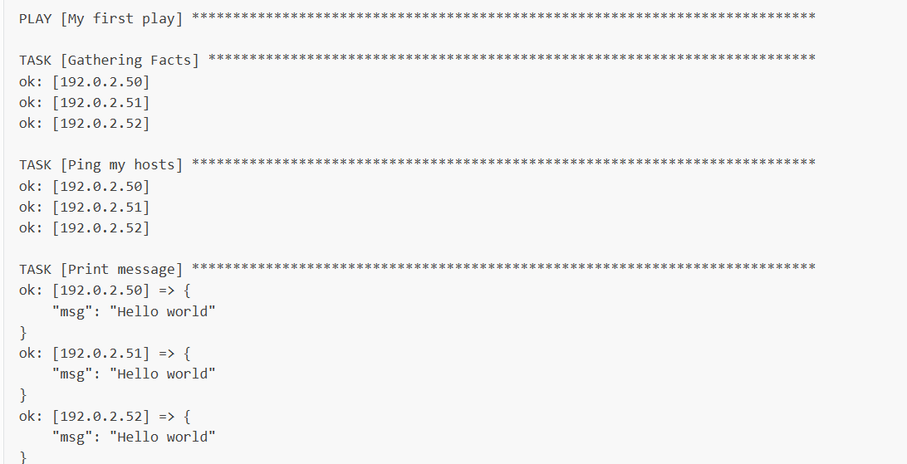
..
ansible-playbook -i inventory.ini playbook.yaml

Slide 42
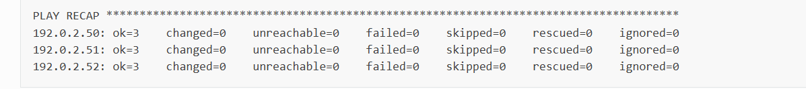
..
The names that you give the play and each task. You should always use descriptive names that make it easy to verify and troubleshoot playbooks.
The “Gathering Facts” task runs implicitly. By default, Ansible gathers information about your inventory that it can use in the playbook.
The status of each task. Each task has a status of ok which means it ran successfully.
The play recap that summarizes results of all tasks in the playbook per host. In this example, there are three tasks so ok=3 indicates that each task ran successfully.

Slide 43
..
Become
Description: Activates privilege escalation for tasks. When set to true, Ansible will use a privilege escalation mechanism to execute tasks with elevated privileges.
Default: false
Usage: Typically set at the playbook level, task level, or in the inventory file.

Slide 44
Become_user
Description: Specifies the user you want to "become" during privilege escalation. This is the target user with the necessary permissions to perform the task (e.g., root, admin, or any specific user).
It does not automatically enable privilege escalation (become: true must be explicitly set). For example, if you log in as deploy_user but need to execute commands as root, you set become_user: root.
Default: root Usage: Can be set at the playbook level, task level, or in the inventory.

Slide 45
Built in module apt
- name: Install apache httpd (state=present is optional)
ansible.builtin.apt:
name: apache2
state: present

