Slide 1
tags
ow

Slide 2
defination
If you have a large playbook, it may be useful to run only specific parts of it instead of running the entire playbook. You can do this with Ansible tags. Using tags to execute or skip selected tasks is a two-step process:
Add tags to your tasks, either individually or with tag inheritance from a block, play, role, or import.
Select or skip tags when you run your playbook.

Slide 3
..
---
- name: Install Apache
hosts: webservers
tasks:
- name: Install Apache
apt:
name: apache2
state: present
tags: apache_install

Slide 4
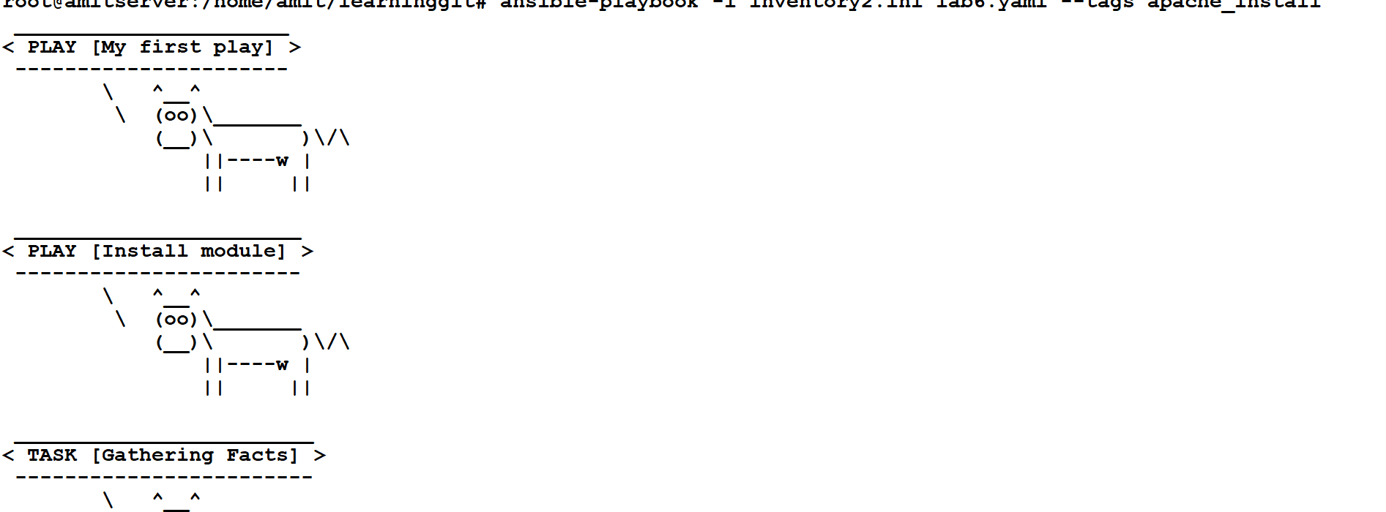
..
ansible-playbook example-playbook.yml --tags apache_install

Slide 5
lab6

