Slide 1
Hooks
OW

Slide 2
Hooks
Helm hooks and ArgoCD hooks are both mechanisms used in Kubernetes-based environments to execute custom logic during specific lifecycle events
However, they serve different purposes and are integrated differently within their respective deployment and management tools.

Slide 3
Helm Hooks Types
Pre-install and Pre-upgrade Hooks:Executed before any resources are created or modified during installation or upgrade.Useful for tasks like provisioning infrastructure or setting up prerequisites.
Post-install and Post-upgrade Hooks:Executed after resources are successfully created or modified during installation or upgrade.Useful for tasks like initializing applications or performing cleanup.
Pre-delete Hooks:Executed before resources are deleted during uninstallation.Useful for tasks like exporting data or performing final cleanup actions.

Slide 4
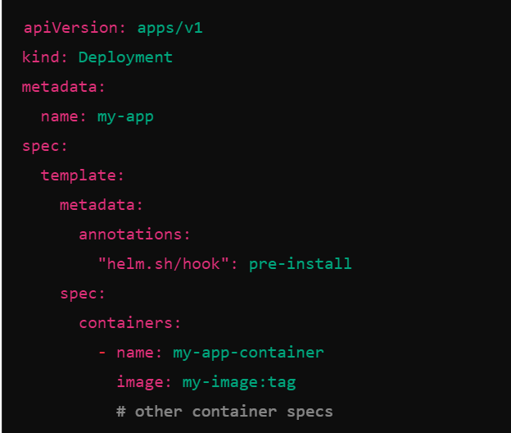
..

Slide 5
Argo CD Hooks
PreSync Hook: Executed before synchronization (deployment) of resources to the Kubernetes cluster.Useful for tasks like environment-specific configuration adjustments or validation checks.
PostSync Hook: Executed after synchronization is complete.Useful for tasks like notifications, logging, or triggering downstream processes.

Slide 6



