Slide 1
ec2
ow

Slide 2
instance
An instance is a virtual server for running applications on Amazon’s EC2.
It can also be understood like a tiny part of a larger computer, a tiny part which has its own Hard drive, network connection, OS etc. But it is actually all virtual.
You can have multiple “tiny” computers on a single physical machine, and all these tiny machines are called Instances.

Slide 3
General instance
For applications that require a balance of performance and cost.
E.g email responding systems, where you need a prompt response as well as it should be cost-effective since it doesn’t require much processing.
t2
m4
m3

Slide 4
Compute Instances
For applications that require a lot of processing from the CPU.
E.g analysis of data from a stream of data, like a Twitter stream
c4
c3

Slide 5
Memory Instances
For applications that are heavy in nature, therefore, require a lot of RAM.
E.g when your system needs a lot of applications running in the background i.e multitasking.
r3
x1

Slide 6
Storage Instances
For applications that are huge in size or have a data set that occupies a lot of space.
E.g When your application is of huge size.
i2
d2

Slide 7
Gpu instance
For applications that require some heavy graphics rendering.
E.g 3D modeling etc.
g2

Slide 8
pricing
In this AWS EC2 Tutorial, let’s start with the free things first!
AWS EC2 free tier allows 750 hrs of t2.micro instance usage per month!
The free tier for EC2 is valid for 1 year from SignUp of your AWS account.

Slide 9
Some terms
Spot Instances is a pricing option which enables you to bid on unused EC2 instances. The hourly price for a Spot Instance is set by AWS EC2, and it fluctuates according to the availability of the instances in a specific Availability Zone.
On-Demand Instances are used when you want to pay for the hour, with no long-term commitments and upfront payments. They are useful for applications that may have unpredictable workloads or for test applications that are being deployed for the first time.

Slide 10
..
Reserved Instances provide you with significant discounts as compared to On-Demand Instances. With Reserved Instances you reserve instances for a specific period of time with three payment options:
No Upfront
Partial Upfront
Full Upfront

Slide 11
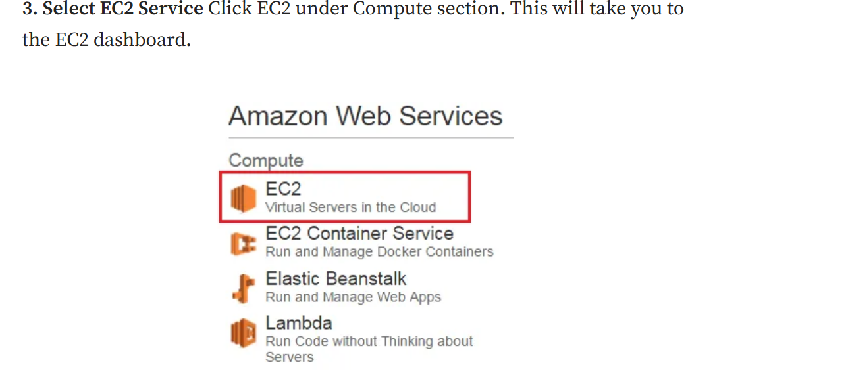
ec2 dashboard

Slide 12
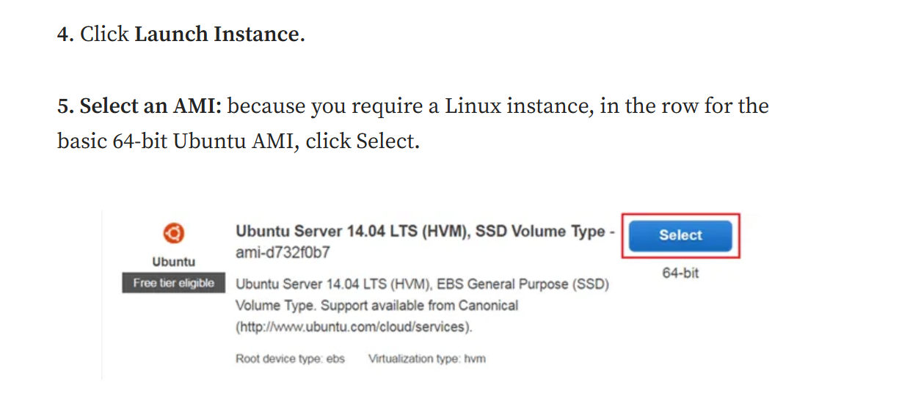
..

Slide 13
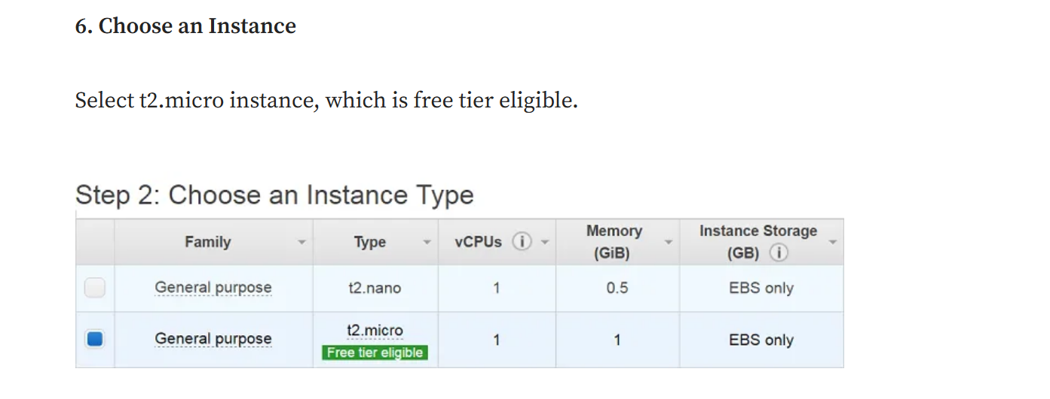
..

Slide 14
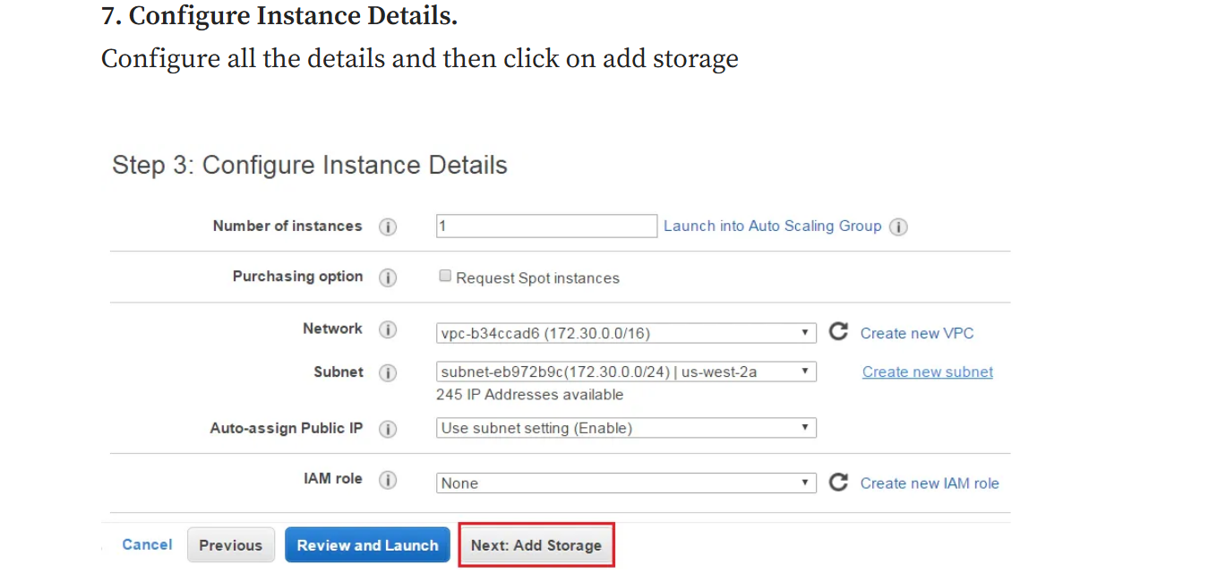
..

Slide 15
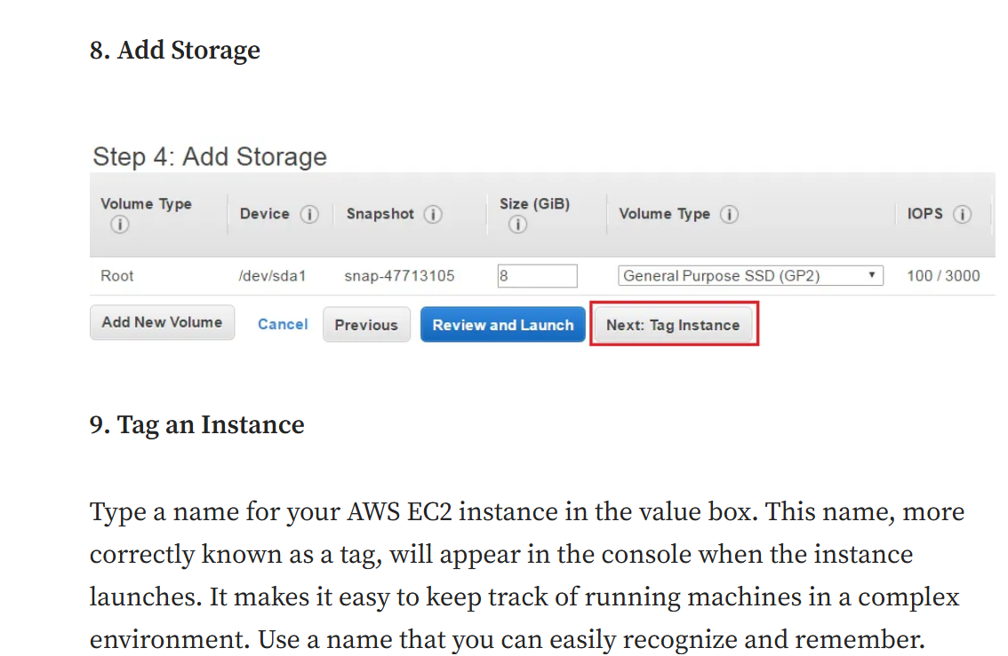
..

Slide 16
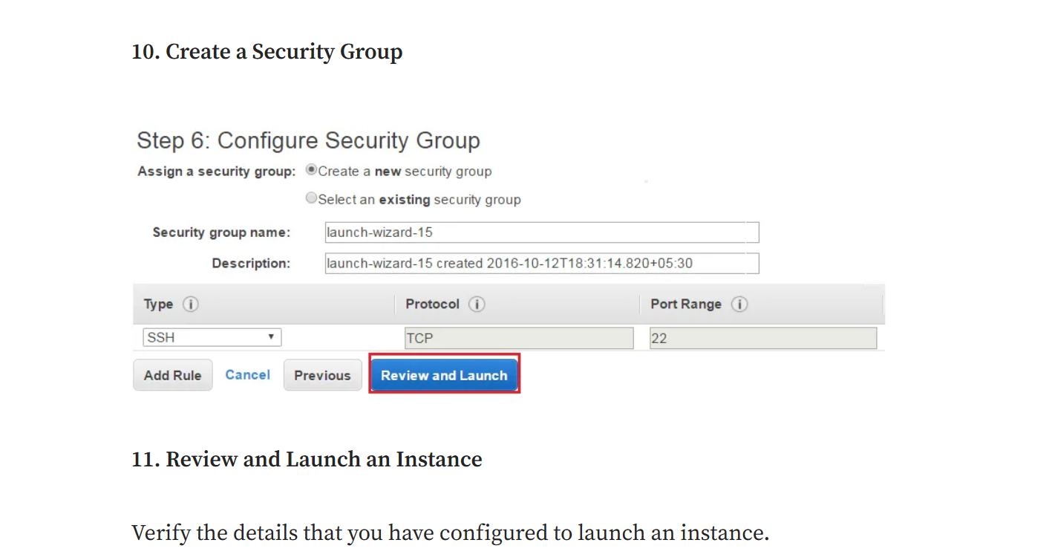
..

Slide 17
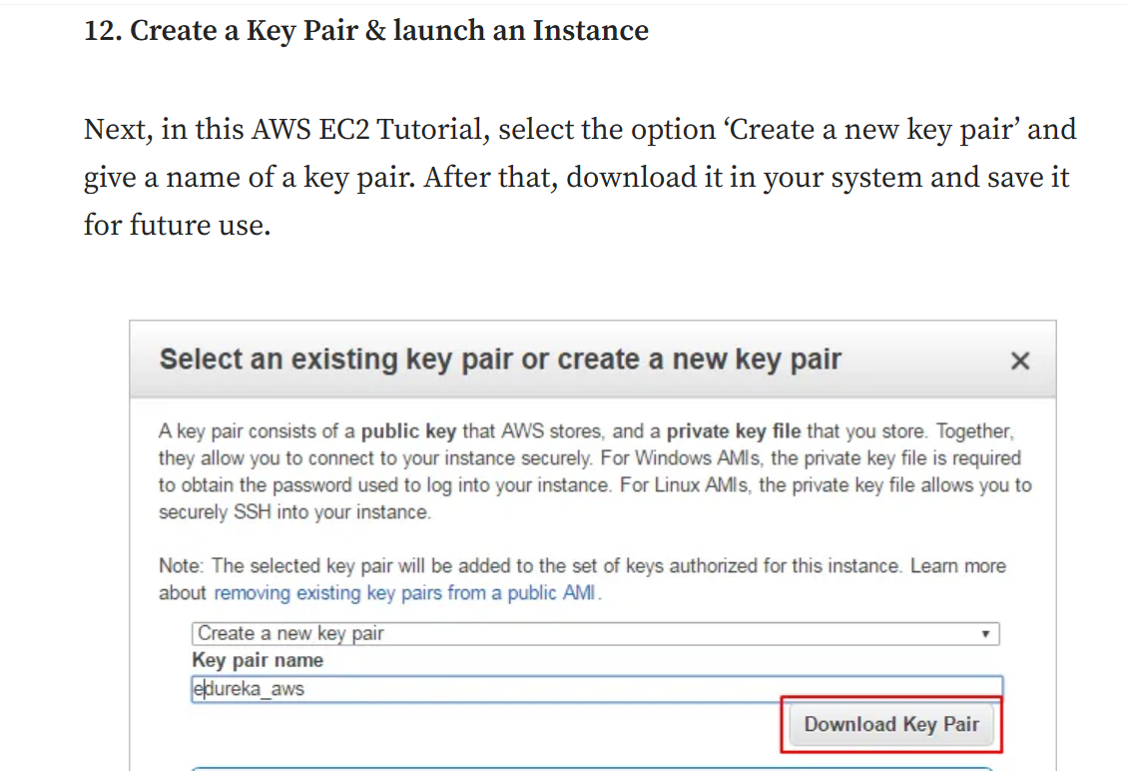
..

Slide 18
lab
explain

