Slide 1
crossplane
ow

Slide 2
intro
Crossplane helps you manage things outside of Kubernetes (like cloud services: databases, networks, or virtual machines) from inside your Kubernetes cluster.
It does two big things:
Makes external stuff look like Kubernetes objects:
It turns cloud resources (like an AWS RDS database or GCP bucket) into Kubernetes-like objects. So, you can create them with normal Kubernetes commands like kubectl apply.
Keeps everything in sync:
If someone changes or deletes those cloud resources outside Kubernetes (like through a cloud dashboard), Crossplane notices and fixes it automatically by restoring or recreating the resource to match your desired state

Slide 3
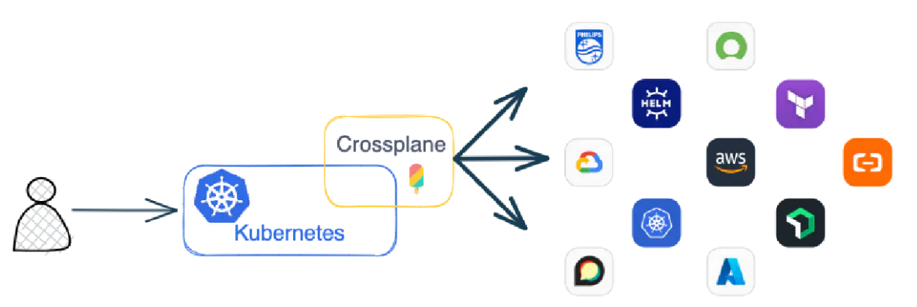
..
Crossplane also acts as a Kubernetes Controller to watch the state of the external resources and provide state enforcement. If something modifies or deletes a resource outside of Kubernetes, Crossplane reverses the change or recreates the deleted resource.

Slide 4
..
With Crossplane installed in a Kubernetes cluster, users only communicate with Kubernetes. Crossplane manages the communication to external resources like AWS, Azure or Google Cloud.
Crossplane also allows the creation of custom Kubernetes APIs. Platform teams can combine external resources and simplify or customize the APIs presented to the platform consumers.

Slide 5
Setup of kubernetes
Using kind we will setup

Slide 6
CRD
A CRD is like a blueprint that tells Kubernetes about a new type of object it doesn't know by default.
By default, Kubernetes understands objects like:
Pod
Service
Deployment
But if you want Kubernetes to manage something new (like an EC2 instance or a database), you need to define it first. That's where a CRD comes in.

Slide 7
..
A CRD is like creating a new "form" in Kubernetes.
Once that form exists, you can fill it out — just like you create pods, you can now create custom objects.

Slide 8
cRossplane setup
When you install Crossplane into your Kubernetes cluster, it creates some CRDs (Custom Resource Definitions).
These are special objects that extend Kubernetes, so you can define things like:
cloud databases
virtual machines (like EC2)
networks, storage, etc.
provider configs (like AWS, GCP, Azure settings)
These CRDs let Kubernetes understand and manage non-Kubernetes resources — like AWS or GCP — as if they were native Kubernetes objects.

Slide 9
Prereq
Prerequisites
This quickstart requires:
a Kubernetes cluster with at least 2 GB of RAM
permissions to create pods and secrets in the Kubernetes cluster
Helm version v3.2.0 or later
an AWS account with permissions to create an S3 storage bucket
AWS access keys

Slide 10
Setup lab

Slide 11
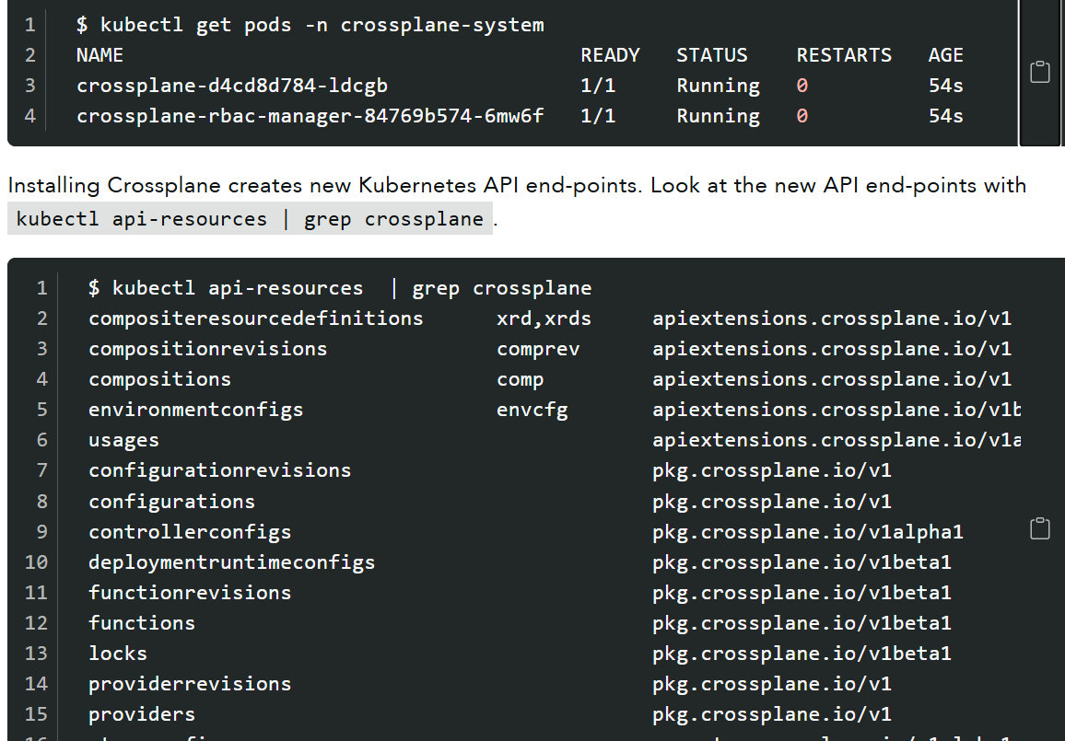
..

Slide 12
Crossplane pod:brain of Crossplane
Role:
This is the main Crossplane controller. It’s the core engine that:
Watches for custom Kubernetes resources like RDSInstance, Bucket, EC2Instance, etc.
Talks to external systems (like AWS, GCP, Azure) and provisions resources.
Continuously monitors the desired vs. actual state of those resources.
Reconciles any drift (e.g., recreates a resource if it’s deleted outside of Kubernetes).

Slide 13
crossplane-rbac-manager Pod
Role:
This pod manages Roles and RoleBindings required by Crossplane and its child controllers.
It ensures:
All Crossplane controllers have the right RBAC (Role-Based Access Control) permissions.
Any new CRDs or controllers created later also get the permissions they need.
💡 Think of it as the security manager, keeping access and permissions in order.

Slide 14
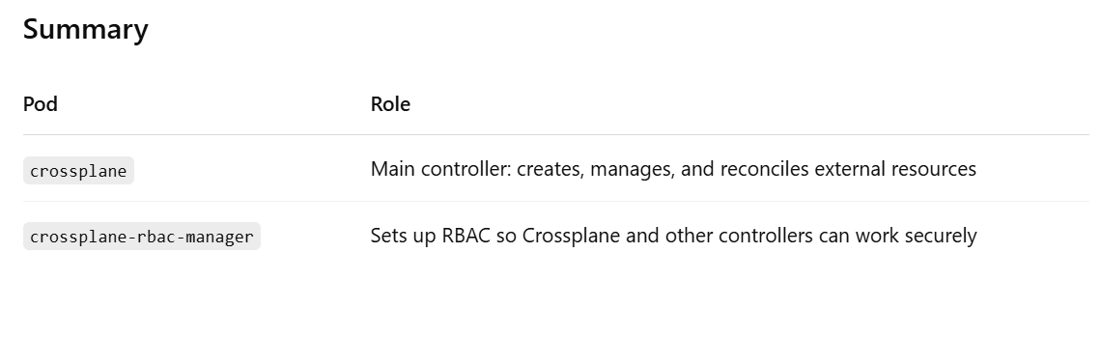

Slide 15
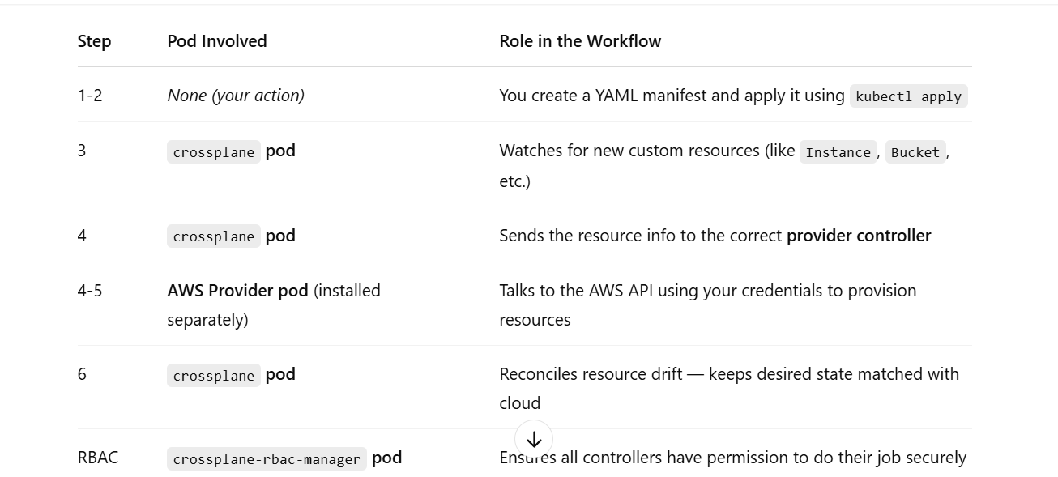
workflow

Slide 16
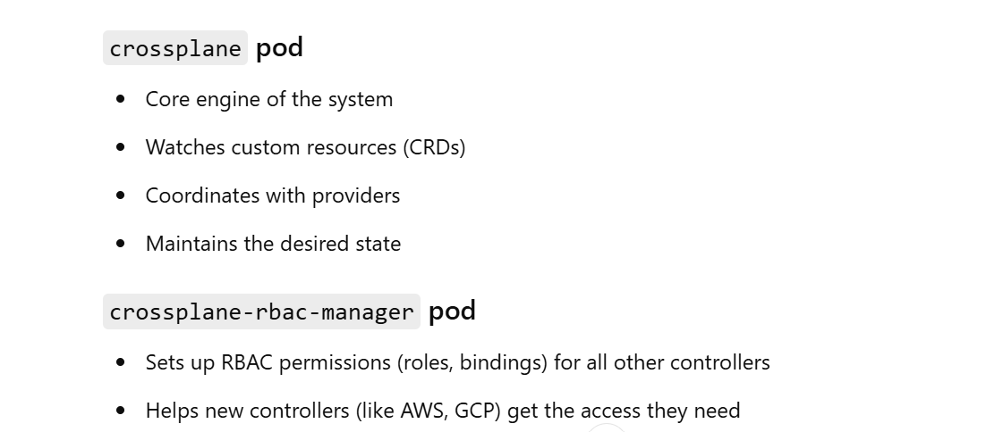
..

Slide 17
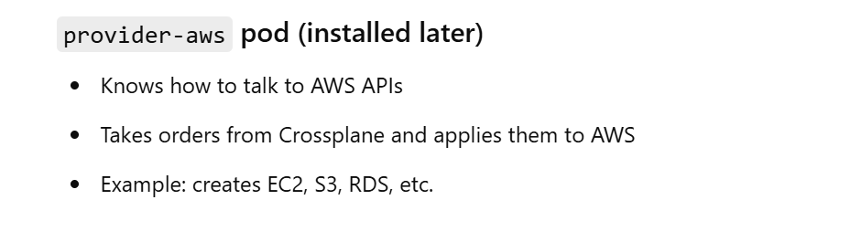
..

Slide 18
Lab setup

Slide 19
provider
This is an API resource managed by Crossplane, used for installing and managing provider package
Resource: Provider
API Group: pkg.crossplane.io
API Version: v1
Kind: Provider

Slide 20
The Provider resource tells Crossplane to install a provider package (like AWS, GCP, Azure, etc.) from a container registry.
Crossplane then manages the lifecycle (install, upgrade, garbage collection) of the provider.
The Provider resource tells Crossplane to install a provider package (like AWS, GCP, Azure, etc.) from a container registry.
Crossplane then manages the lifecycle (install, upgrade, garbage collection) of the provider.

Slide 21
..
This installs two things:
1. S3 Provider (provider-aws-s3)
Handles S3-specific resources like buckets, bucket policies, etc.
2. Family Provider (provider-family-aws)
Shared by all AWS modular providers (e.g., S3, IAM, EKS).
Manages:
AWS credentials
Common configuration
ProviderConfig and ProviderConfigUsage

Slide 22
Lab 2

Slide 23
Aws auth
Using access key and secret key
Create a text file containing the AWS account aws_access_key_id and aws_secret_access_key
[default]
aws_access_key_id =
aws_secret_access_key =
Save this text file as aws-credentials.txt
Create a Kubernetes secret with the AWS credentials A Kubernetes generic secret has a name and contents. Use kubectl create secret to generate the secret object named aws-secret in the crossplane-system namespace.

Slide 24
Lab 3

Slide 25
Providerconfig
What is ProviderConfig?
In Crossplane, ProviderConfig is how you tell a provider (like AWS, GCP, Azure, etc.) how to authenticate and which credentials to use.
It’s kind of like giving the provider a key to access the cloud.
Even after you install a provider (like provider-aws-s3), it won’t work until you tell it how to connect to AWS.
That's what ProviderConfig does — it points to your AWS credentials stored in a Kubernetes Secret.

Slide 26
..
apiVersion: aws.crossplane.io/v1beta1
kind: ProviderConfig
metadata:
name: default
spec:
credentials:
source: Secret
secretRef:
namespace: crossplane-system
name: aws-secret
key: creds

Slide 27
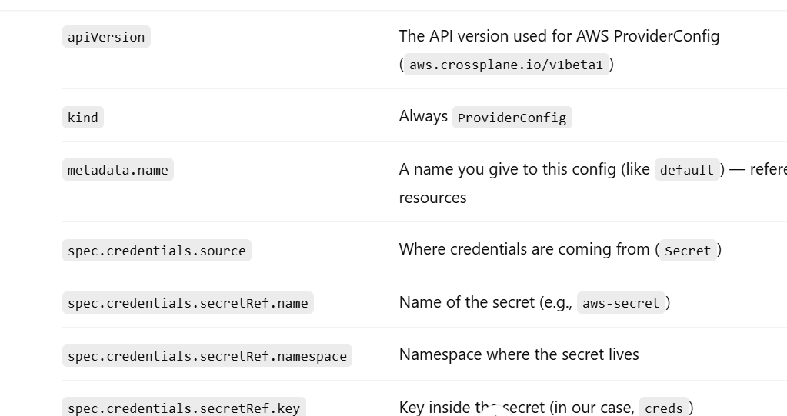
..

Slide 28
..
ProviderConfig is how you set up cloud access in Crossplane.
It references a Kubernetes Secret that contains your cloud credentials.
Your Crossplane resources (like Bucket, VPC, etc.) must point to it to work.

Slide 29
Lab 4
Setup providerconfig

Slide 30
Crossplane cli
The Crossplane CLI helps simplify some development and administration aspects of Crossplane.
The Crossplane CLI includes:
tools to build, install, update and push Crossplane Packages
standalone Composition Function testing and rendering without the need to access a Kubernetes cluster running Crossplane
troubleshoot Crossplane Compositions, Composite Resources and Managed Resources

Slide 31
Lab 5
curl -sL "https://raw.githubusercontent.com/crossplane/crossplane/main/install.sh" | sh
https://docs.crossplane.io/latest/cli/

Slide 32
What is a Managed Resource?
A Managed Resource is a resource provisioned outside the Kubernetes cluster, like:
An S3 bucket in AWS
A database in Azure
A VPC in GCP
Crossplane takes full responsibility for creating, updating, deleting, and syncing the external (cloud) resource.

Slide 33
..
apiVersion: s3.aws.upbound.io/v1beta1
kind: Bucket
metadata:
generateName: crossplane-bucket-
spec:
forProvider:
region: us-east-2
providerConfigRef:
name: default

Slide 34
Lab 6
The apiVersion and kind are from the provider’s CRDs.
The metadata.generateName value is the name of the created S3 bucket in AWS.
This example uses the generated name crossplane-bucket-<hash> in the $bucket variable.
The spec.forProvider.region tells AWS which AWS region to use when deploying resources.
The region can be any AWS Regional endpoint code.
Use kubectl get buckets to verify Crossplane created the bucket.

Slide 35
Provider for kubernetes
provider-kubernetes is a Crossplane provider that allows you to manage Kubernetes-native resources (like Deployments, Services, ConfigMaps, etc.) using Crossplane's infrastructure-as-code model.
Instead of provisioning cloud resources (like an RDS or S3 bucket), this provider creates and manages Kubernetes resources in any Kubernetes cluster — local or remote.

Slide 36
..
apiVersion: pkg.crossplane.io/v1
kind: Provider
metadata:
name: provider-kubernetes
spec:
package: xpkg.upbound.io/upbound/provider-kubernetes:v0.16.0

Slide 37
Secrets
Discuss about admin.conf file
How kubectl connects to admin.conf file
Modify the config file
Create generic type secret using cli

Slide 38
Lab 7 and lab 8
Setup provider and secret

Slide 39
Setup providerconfig
apiVersion: kubernetes.crossplane.io/v1alpha1
kind: ProviderConfig
metadata:
name: kind-provider1
spec:
credentials:
source: Secret
secretRef:
namespace: crossplane-system
name: gke-provider-secret
key: kubeconfig

Slide 40
Lab 9

Slide 41
Test our setup: Object resource
What is Object in this context?
In provider-kubernetes, the Object kind is a generic wrapper that allows Crossplane to create or manage any Kubernetes resource.
Think of it like a "universal adapter" for any Kubernetes manifest.

Slide 42
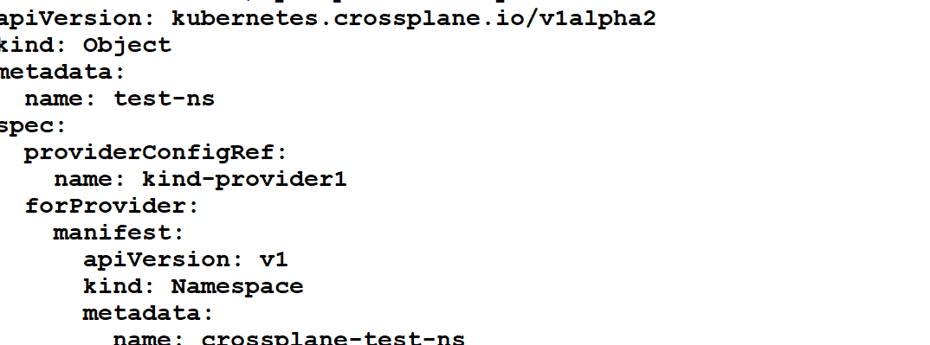
Create a ns

Slide 43
LAB 10

Slide 44
What is a CompositeResourceDefinition (XRD)
A CompositeResourceDefinition (XRD) is a way to define your own custom API type in Kubernetes using Crossplane.
It lets you build abstractions that hide cloud provider complexity behind simple, user-friendly YAML.
"I want to allow my team to request cloud resources like databases, buckets, VPCs, etc., but I don’t want them to worry about provider details (AWS, GCP, Azure). I’ll define a custom resource like MyDatabase or MyBucket and Crossplane will take care of the rest."

Slide 45
..
Composite resource definitions (XRDs) define the schema for a custom API.
Users create composite resources (XRs) and Claims (XCs) using the API schema defined by an XRD.
Composite resource definitions (XRDs) create new API endpoints inside a Kubernetes cluster.
Creating a new API requires defining an API group, name and version.

Slide 46
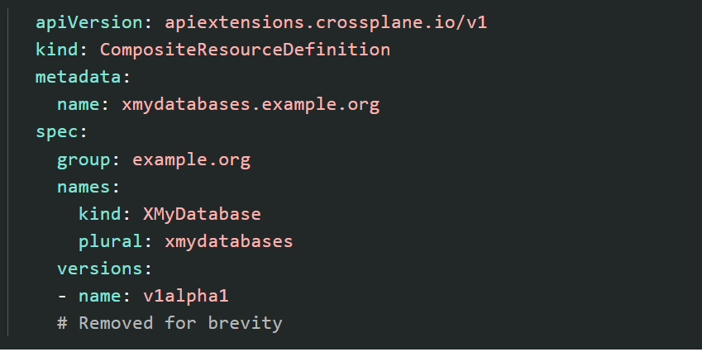
..

Slide 47
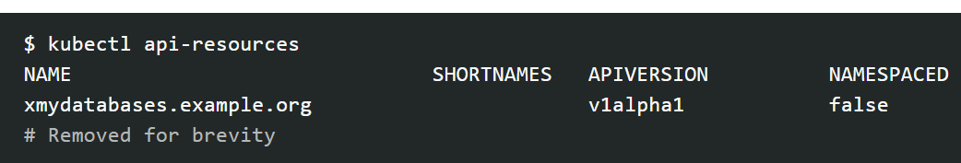
..
After applying an XRD, Crossplane creates a new Kubernetes custom resource definition matching the defined API.
For example, the XRD xmydatabases.example.org creates a custom resource definition xmydatabases.example.org.

Slide 48
Xrd groups
Groups define a collection of related API endpoints. The group can be any value, but common convention is to map to a fully qualified domain name.
Many XRDs may use the same group to create a logical collection of APIs.
For example a database group may have a relational and nosql kinds.
Group names are cluster scoped. Choose group names that don’t conflict with Providers. Avoid Provider names in the group.

Slide 49
Xrd names
The names field tells Kubernetes how to refer to your custom resource in the API. It includes two important parts:
kind: This is the name used in your YAML files when creating the resource. It should be in UpperCamelCase (e.g., XMyResource). Crossplane suggests starting it with "X" to show it's a Crossplane-defined custom resource.
plural: This is the lowercase, plural version of the resource name used in the API URL (e.g., xmyresources).

Slide 50
names:
kind: XMyResource
plural: xmyresources
So when you create a resource of this kind, you'd use:
apiVersion: mygroup.example.org/v1alpha1
kind: XMyResource
to list them with kubectl
kubectl get xmyresources

Slide 51
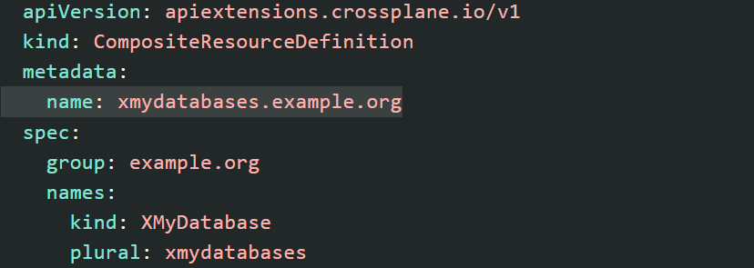
..

Slide 52
Xrd version
The version in an XRD works like Kubernetes API versions. It tells you how stable the API is and changes when the API is updated.
Here’s what the versions mean:
v1alpha1 – New and still changing. Can break or change often.
v1beta1 – More stable, but still might change. Breaking changes are not recommended.
v1 – Fully stable. No breaking changes allowed.
Crossplane doesn’t force you to use a certain version name, but it's a good idea to follow Kubernetes’ versioning style.

Slide 53
Define the schema
The schema tells Kubernetes what the custom resource should look like. It defines:
The names of the parameters
The types of the values (like string, number, etc.)
Which ones are required and which are optional
It uses the Kubernetes OpenAPIv3 schema format.
Each version of your API can have its own schema.
The schema checks that your custom resource is valid.

Slide 54
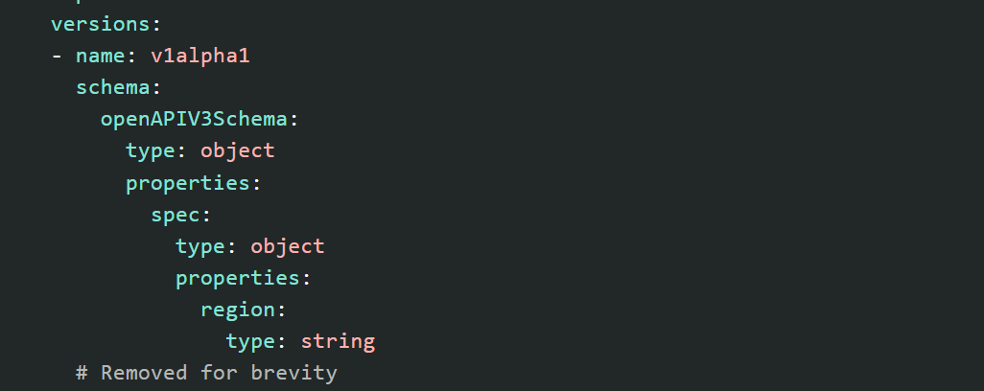
..

Slide 55
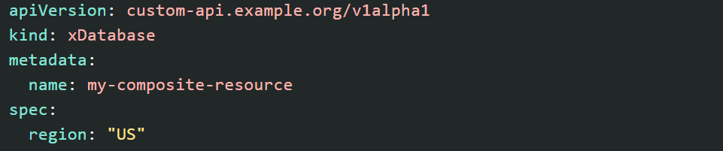
..

Slide 56
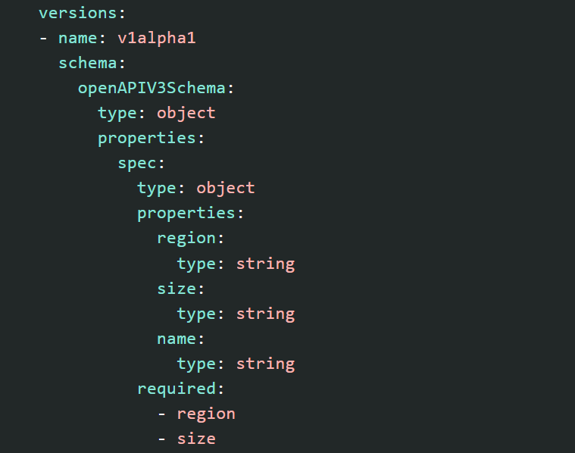
Required fields
By default all fields in a schema are optional. Define a parameter as required with the required attribute.
In this example the XRD requires region and size but name is optional.

Slide 57
lab
Create schema

Slide 58
Composite resource
A composite resource is like a bundle of cloud resources (like databases, networks, or VMs) grouped into one Kubernetes object.
Crossplane creates composite resources when you use a custom API defined by a CompositeResourceDefinition (XRD).
So instead of managing many cloud resources separately, you manage one composite resource, and Crossplane handles the rest for you behind the scenes.

Slide 59
composition
To create composite resources in Crossplane, you need two things:
CompositeResourceDefinition (XRD) – This defines the custom API that users will use (like kind: XNetwork).
Composition – This defines what resources should be created (like a VPC, subnets, etc.) when someone uses that custom API.
Think of it like this:
XRD = "Here's the type of thing you can create."
Composition = "Here's what that thing includes behind the scenes."
So when a user creates a custom resource, Crossplane uses the Composition to build the actual cloud resources.

Slide 60
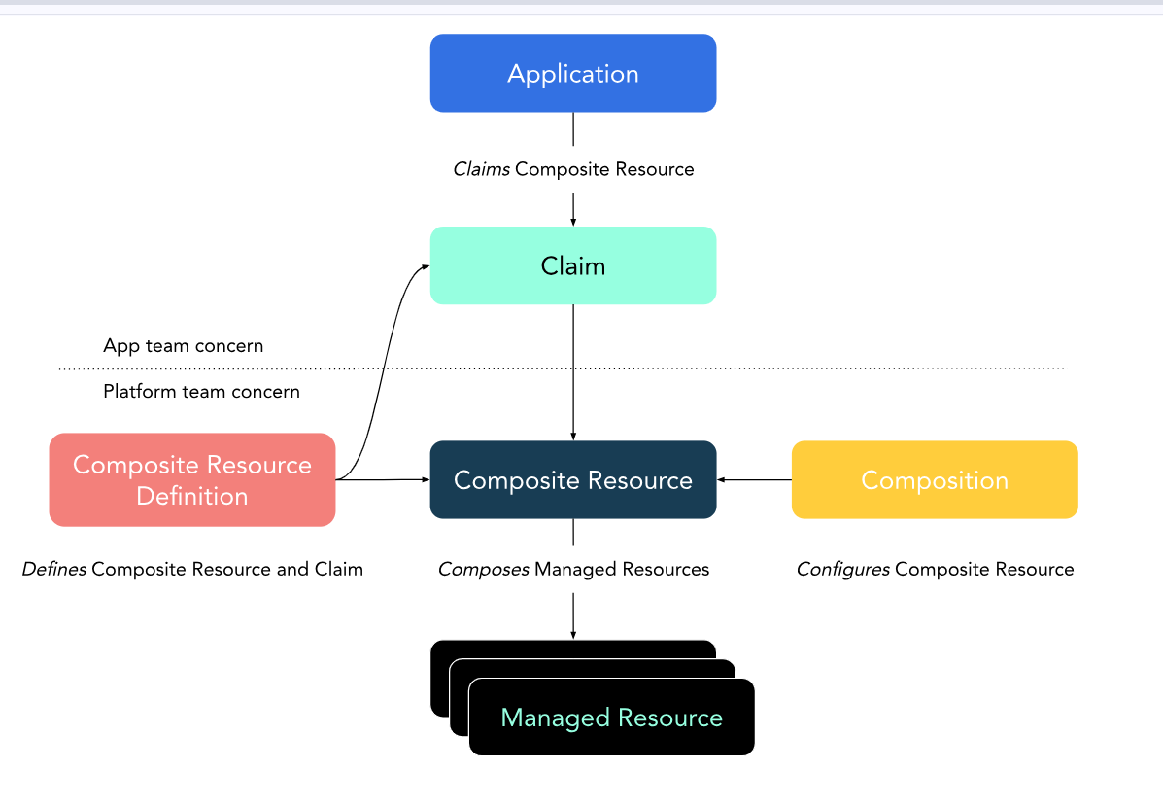
..

Slide 61
..
Composite Resource
Based on the claim and the XRD, Crossplane creates a Composite Resource, which is like a blueprint or template of what resources are needed.
Composition
The Composition defines the actual cloud infrastructure (like VPC, subnet, DB) that should be created for this composite resource.
Managed Resources
Crossplane uses the composition to create and manage the real infrastructure resources in the cloud (called Managed Resources).

Slide 62
..
App → makes a Claim
Claim → triggers creation of a Composite Resource
Composite Resource → is based on XRD and configured by a Composition
Composition → results in real Managed Resources

Slide 63
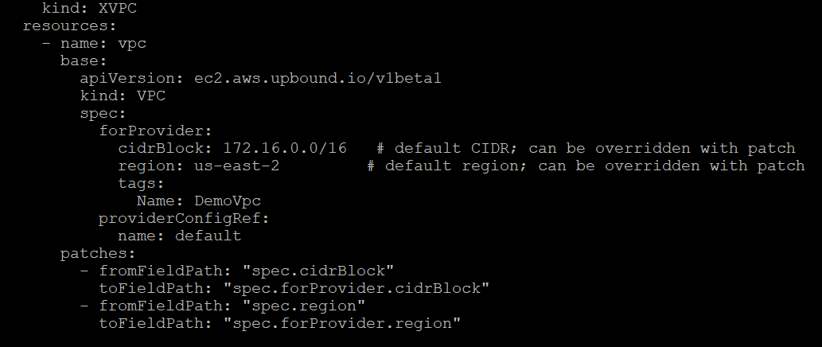
.

Slide 64
lab

Slide 65
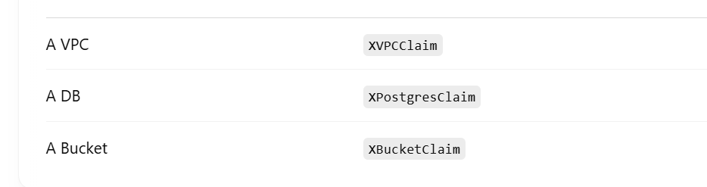
claim
A Claim is a namespaced Kubernetes resource that allows end users to request infrastructure without worrying about the low-level details (like exact cloud provider API resources). It abstracts the underlying CompositeResource (XR).
Define

Slide 66
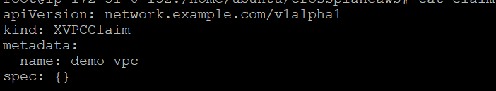
..

Slide 67
lab

Slide 68
Learn about managed resource
Kubernetes
Mongodb atlas

Slide 69
Crossplane Composition Mode: Patch and Transform
Patch and Transform in Composition Mode is about manipulating resources within a specific composition, adapting and updating resources to fit the desired state.
It’s a way to configure and customize cloud resources in an automated way, typically through the Composite Resource and the definitions of the Managed Resources.

Slide 70
.
Patching in Crossplane refers to modifying or updating the properties of a Managed Resource within a Composition. This is usually done using patches to apply changes to the configuration of resources as part of the composition.
Example: If a composition defines a cloud database, and you want to patch the storage size, you would use Crossplane’s patching mechanism to update that specific property of the underlying database resource.
Use Case: This is helpful when you need to modify specific attributes of the resources that are part of a Composition, like scaling a resource or updating its configuration.

Slide 71
.
Transforming in Crossplane, on the other hand, refers to the ability to manipulate the data between the Composite Resource and the underlying Managed Resources. It allows you to modify the way resource fields are passed or mapped from one resource to another, often based on input from the user.
Example: If a composite resource takes in an input for a database type (e.g., Postgres), and the underlying resources require specific field names like dbType or dbVersion, transformation can be used to map those fields appropriately.
Use Case: Transformations are often used when you need to adapt resource attributes or parameters to fit specific requirements, such as formatting or merging different types of input data.

Slide 72
..
PatchSets: Crossplane provides the ability to define patch sets that specify how to update the composition’s resources, either via manual updates or automatic reconciliation.
Transforms: These allow the user to define how inputs are mapped to the underlying cloud provider resources, ensuring correct behavior and configuration.
Consider a DatabaseCluster composite resource that defines a PostgreSQL database and an S3 bucket. When users create a composite resource, Crossplane can patch the database storage size, transform the database type into a field format accepted by the cloud provider, and automatically provision the underlying resources (Postgres database and S3 storage).

Slide 73
Pipeline Mode
A Pipeline in general terms refers to a sequence of stages through which data or resources pass, often transforming or modifying them at each step.
In the context of Crossplane, a Pipeline Mode would focus on the orchestration of operations across multiple stages, potentially involving patching and transforming of resources, but with a focus on sequencing and dependency management.

Slide 74
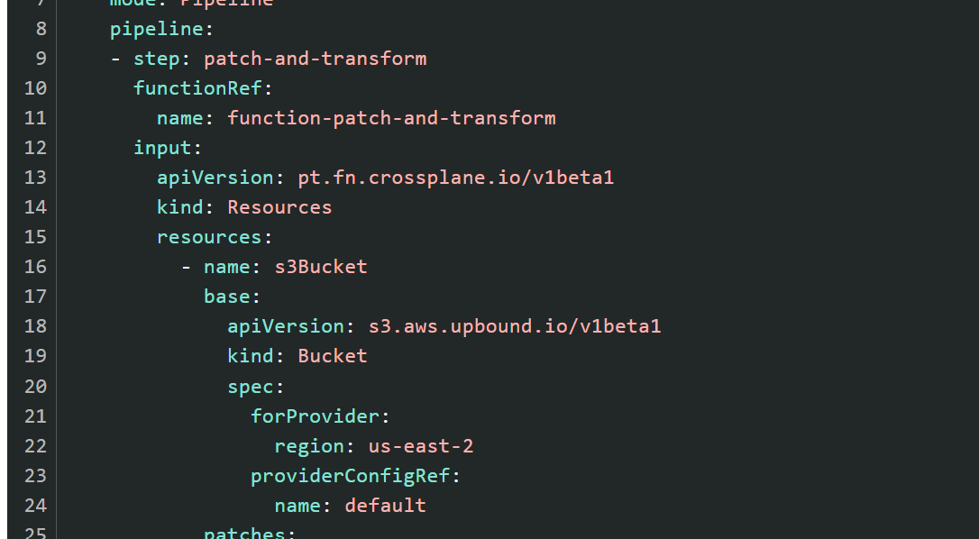
..

Slide 75
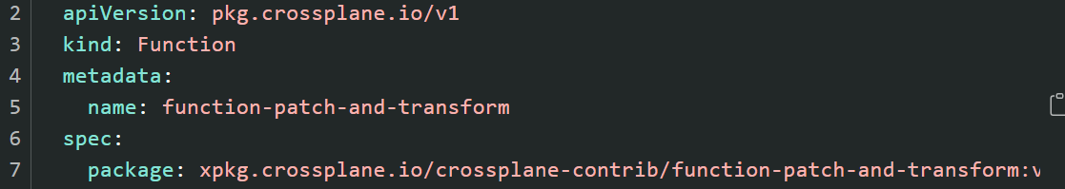
..

Slide 76
A Composition uses a pipeline of composition functions to define the cloud resources to deploy."
This means:
In Pipeline mode, Crossplane doesn't just statically define resources in YAML.
Instead, it runs through a pipeline of functions — each of which can mutate, transform, filter, or create resources dynamically.
Think of it like a CI/CD pipeline — each step does something to the data before the next step takes over.

Slide 77
lab

Slide 78
..
A pipeline in Crossplane might involve:
Create Database (e.g., RDS or PostgreSQL instance).
Apply Transformations (e.g., transforming input values into cloud-specific formats).
Provision Backup Resources (e.g., S3 bucket for backups).
Apply Patch (e.g., increasing storage size for the database).

