Slide 1
Dockerfile
OW

Slide 2
Dockerfile
Docker can build images automatically by reading the instructions from a Dockerfile.
A Dockerfile is a text document that contains all the commands a user could call on the command line to assemble an image.
Using docker build users can create an automated build that executes several command-line instructions in succession.

Slide 3
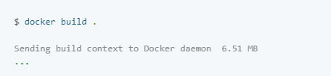
Docker build
The docker build command builds an image from a Dockerfile and a context. The build’s context is the set of files at a specified location PATH or URL. The PATH is a directory on your local filesystem. The URL is a Git repository location.

Slide 4


..
use the -f flag with docker build to point to a Dockerfile anywhere in your file system.
specify a repository and tag at which to save the new image if the build succeeds:

Slide 5

Dockerfile format
The instruction is not case-sensitive. However, convention is for them to be UPPERCASE to distinguish them from arguments more easily.
A dockerfile must begin with a FROM instruction. The FROM instructions specifies the Parent image from which we are building
Docker treats lines begins with # as a comment

Slide 6
RUN
RUN has 2 forms:
RUN <command> (shell form, the command is run in a shell, which by default is /bin/sh -c on Linux or cmd /S /C on Windows)
RUN ["executable", "param1", "param2"] (exec form)
The RUN instruction will execute any commands in a new layer on top of the current image and commit the results. The resulting committed image will be used for the next step in the Dockerfile.
The exec form makes it possible to avoid shell string munging, and to RUN commands using a base image that does not contain the specified shell executable.

Slide 7
CMD
The CMD instruction has three forms:
CMD ["executable","param1","param2"] (exec form, this is the preferred form)
CMD ["param1","param2"] (as default parameters to ENTRYPOINT)
CMD command param1 param2 (shell form)
There can only be one CMD instruction in a Dockerfile. If you list more than one CMD then only the last CMD will take effect.

Slide 8
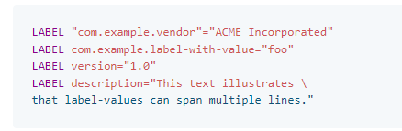
LABEL
LABEL <key>=<value> <key>=<value> <key>=<value> ...
The LABEL instruction adds metadata to an image. A LABEL is a key-value pair. To include spaces within a LABEL value, use quotes and backslashes as you would in command-line parsing.

Slide 9

EXPOSE
The EXPOSE instruction informs Docker that the container listens on the specified network ports at runtime. You can specify whether the port listens on TCP or UDP, and the default is TCP if the protocol is not specified.

Slide 10


ADD and COPY
The ADD instruction copies new files, directories or remote file URLs from <src> and adds them to the filesystem of the image at the path <dest>.
The COPY instruction copies new files or directories from <src> and adds them to the filesystem of the container at the path <dest>.

Slide 11


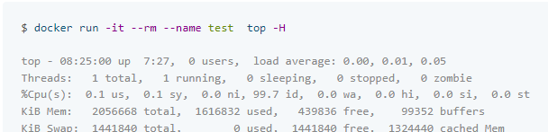
ENTRYPOINT
An ENTRYPOINT allows you to configure a container that will run as an executable.

Slide 12
Understand how CMD and ENTRYPOINT interact
Both CMD and ENTRYPOINT instructions define what command gets executed when running a container. There are few rules that describe their co-operation.
Dockerfile should specify at least one of CMD or ENTRYPOINT commands.
ENTRYPOINT should be defined when using the container as an executable.
CMD should be used as a way of defining default arguments for an ENTRYPOINT command or for executing an ad-hoc command in a container.

Slide 13
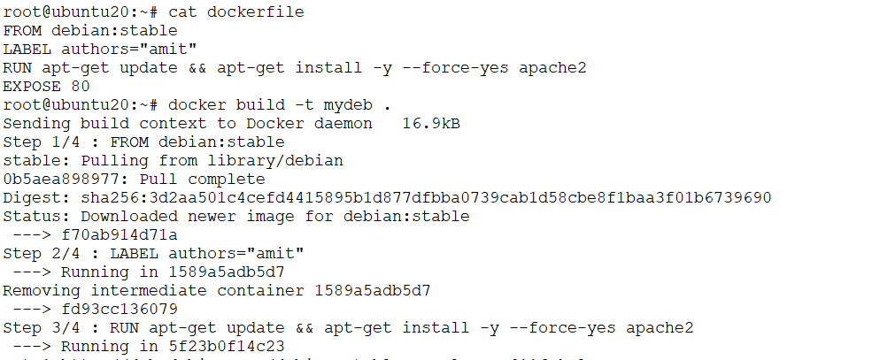
Examples

Slide 14
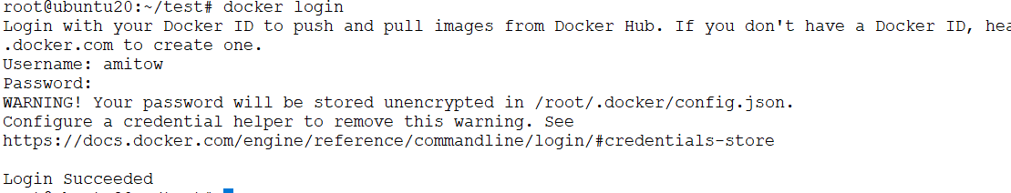
Docker hubs
Signup to docker hubs
docker login

Slide 15
Push image to docker hub
Tag the image with the host name or IP address, and the port of the registry
docker image tag myimage amitow/myimage
Push the image
docker image push amitow/myimage

Slide 16



