Slide 1
Docker

Slide 2
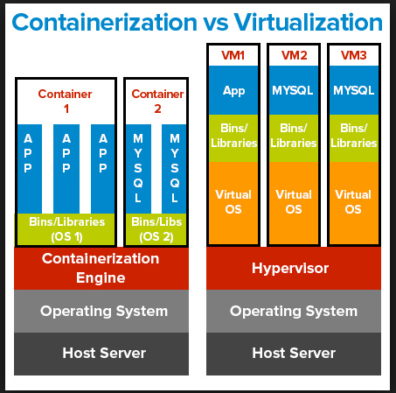
Containerization vs Virtualization

Slide 3
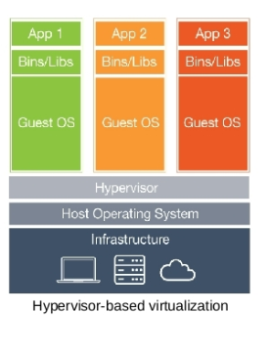

Slide 4
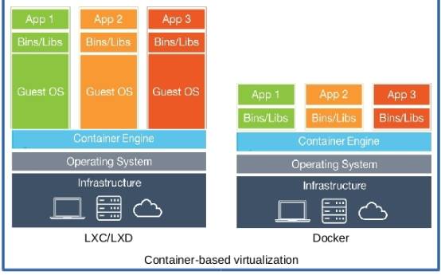

Slide 5
Docker
Docker is an open platform for developing, shipping and running applications
Enable separate application for delivering software quickly
Provide quick mechanism for shipping, testing and deploying code quickly
Docker provides the ability to package and run an application in an isolation environment called container
Isolation and security allow to run multiple container on the same host.

Slide 6
Lifecycle of container
Docker provides tooling and a platform to manage the lifecycle of container
Develop application and supporting components using container
Container become unit for distributing and testing application
Container image becomes the unit
It can be pushed and pulled from repo [Will be discussed in details]

Slide 7
Docker Engine
Docker engine is a client-server application with following components:
A server which is running daemon process [the dockerd command]
A rest api which specifies interfaces that program can use to talk to daemon and instruct what to do
A command line interface [CLI] client [the docker command]

Slide 8
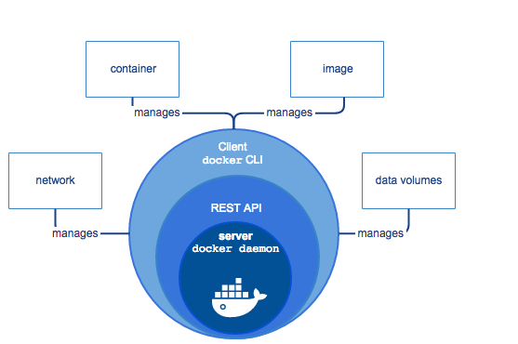
…

Slide 9
Docker Architecture
Docker uses client server architecture
The docker client talks to the docker daemon, which does the heavy lifting of building,running and distributing Docker container
Docker client and docker daemon can run on the same system as well or you can connect from remote as well
Client and daemon communicate using rest api over unix sockets or network interface

Slide 10
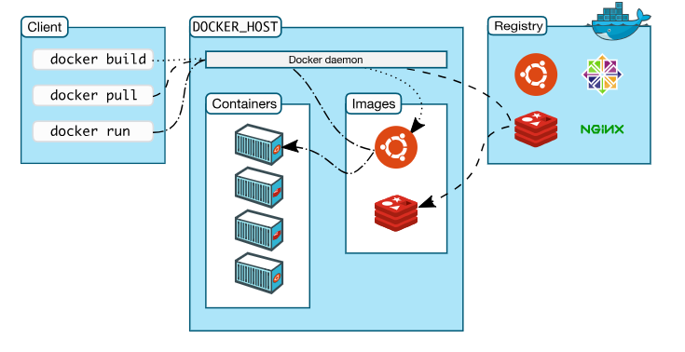

Slide 11
The docker daemon
The docker daemon (dockerd) listens for Docker API requests and manages Docker objects such as images,containers,network and volumes.
A daemon can also communicate with other daemons to manage Docker Services

Slide 12
The Docker Client
The docker client (docker) is the primary way to communicate with daemon
When we run docker run command what exactly happens??
These request to be sent to dockerd, which carries out
The docker command uses the Docker Api
Client can communicate more than one daemon

Slide 13
Docker registry
A docker registry stores docker images
Docker hub and docker cloud are public registries
By default docker has been configured to look for images on Docker hub
Private registry can be also mapped.
When we run “docker run” or “docker pull” command, images will be pulled from the configure registry
“docker push” command push the image to the configured registry

Slide 14
Docker Objects
When we use Docker, following are some of the objects:
Images
Container
Services

Slide 15
Images
An image is a read-only template with instruction for creating a Docker container
Often, an image is based on another image, with some additional customization
For example, which is based on ‘centos’ image, but install the apache web server and application, as well as configuration details needed to make application run.
To build own image, create a Dockerfile with a simple syntax for defining the steps needed to create the image and run it.
Each instruction in a Dockerfile creates a layer in the image.
When changes are made to the dockerfile and rebuild the image, only those layers which have changed are rebuilt.

Slide 16
Containers
A container is a runnable instance of an image
You can create,start,stop,move or delete a container using the docker api or cli
A container is defined by its image as well any configuration options provides during the creation or starting of container
What happen when we run following command
“docker run -i –t ubuntu /bin/bash
If you don’t have the image locally, docker pulls from the registry , which can be done manually as well
Its creates a container and run /bin/bash
-i option is for interactive mode and –t for terminal mode

Slide 17
Services
Services allow to scale container across multiple docker daemon.
It can run in a clustering form such as docker swarm
Docker swarm case all the worker and master node docker daemon runs
This docker daemon communicates to each other using api
This provides load balancing, replicas kind of features

Slide 18
The underline technology
Docker is written in go lang and takes advantage of several features of linux kernel to deliver the functionality
When we create container, Docker creates a set of namespace for the container
The namespace provides a layer of isolation. Each aspect of a container runs in a separate namespace and its access is limited to that namespace.

Slide 19
…
Docker engine uses namespace such as
The pid namespace: Process isolation(PID:process id)
The net namespace: Managing network namespace(NET:networking)
The ipc namespace: Managing access to ipc resources
The mnt namespace: Managing filesystem mount point
The uts namespace: Isolation kernel and version identifier

Slide 20
Control groups [cgroup]
A cgroup limits an application to a specific set of resources
Control groups allow Docker Engine to share available hardware resources to containers and optionally enforce limits and constraints.
For example, you can limit the memory available to a specific container

Slide 21
Union File systems [UnionFS]
UnionFS are file systems that operate by creating layers, making them very lightweight and fast
Docker engine uses UnionFS to provide the building blocks for container
UnionFS variants : AUFS,brts,vfs and device manager

Slide 22
Container format
Docker engine combines the namespaces, control groups and UnionFS into a wrapper called container format
The default container format is libcontainer

Slide 23
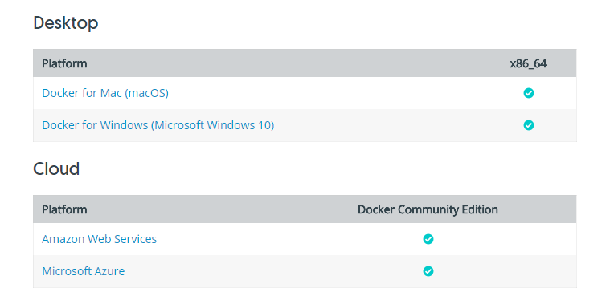
Docker CE [customer edition]
Docker CE is ideal for developers and smb
Docker CE has two update channels
Stable: reliable, get updates every quarter
Edge: New features every month

Slide 24
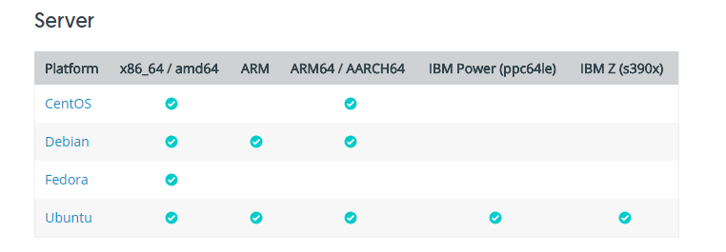
…

Slide 25
Define a container with dockerfile
Dockerfile defines what goes on in the environment inside container
What need to be copied during container build
Network interfaces and disk drives is virtualized in the environment, which is isolated from the rest of the system, need to map the ports to the outside world, and be specific about what files you want to “copy in” to that environment

Slide 26
Dockerfile
Create an empty directory
Change directory (cd) into new directory
Copy and paste the content into that file
Docker file Syntax
#Use an official python runtime as parent image
From python:2.7-slim
#Set the working directory to /app
WORKDIR /app

Slide 27
…
#Copy the current directory contents into the container at /app
ADD . /app
#install any needed package specified in requirement.txt
RUN pip install –trusted-host pypi.python.org –r requirements.txt
#Make port 80 available to the outside world
EXPOSE 80
#Define environment variable
ENV NAME WORLD
# Run app.py when the container launches
CMD [“python”, “app.py

Slide 28
Dockerfile refers couple of file, haven’t created yet app.py and requirements.txt. Lets create that one.
Requirements.txt
Flask
Redis
Pip install –r requirements.txt, installs the Flask and Redis library for python

Slide 29
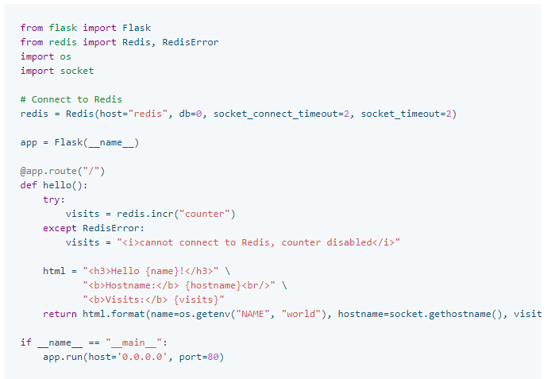
…
App.py

Slide 30

…
ls command output of app dir
Now run the build command. This will create docker image, with –t option it provides option user friendly
Dokcer build –t hello
Docker images ls

Slide 31
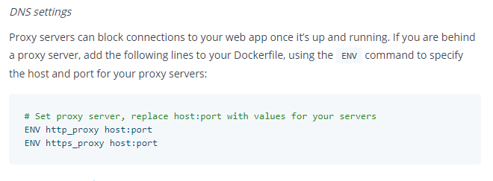
Troubleshooting

Slide 32
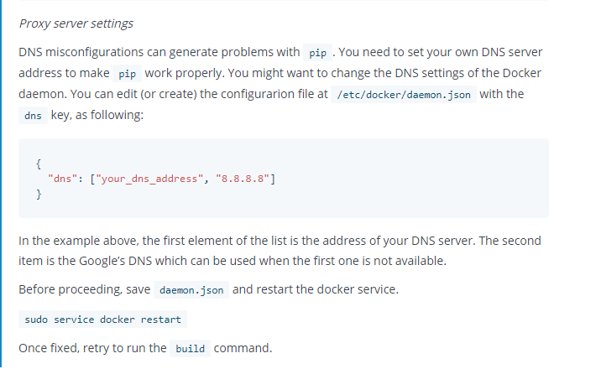
…

Slide 33
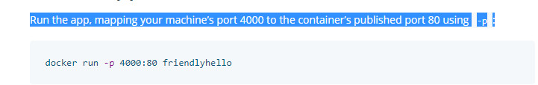
Port mapping with host system

Slide 34
Run in background [detach mode]
Docker run –d –p 4000:80 hello
Docker container ls
Docker container stop <container id>

Slide 35
Share image to public registry
If want to share the image,push it to registry. This is kind of repo.
Default registry is “hub.docker.com”
Sign-up and create an account on that
Login using command line
Docker login
Tag the image, associating a local image with a repository on a registry is
Username/repository:tag
Note: Tag is always optional part,but recommended

Slide 36
…
Publish the image
Docker push username/repository:tag
Pull image
Docker run –p 4000:80 username:/repository:tag

Slide 37
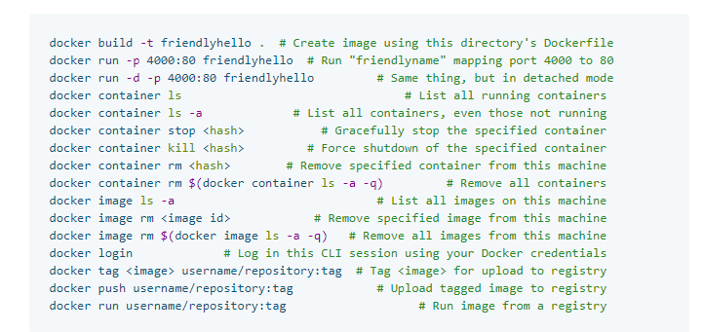
Commands

Slide 38
Services:
Now wants to scale our application and enable load balancing. To do this, we must go one level up in the hierarchy of distributed application: service
In a distributed application , different pieces of the app are called “services”
Example:
Imagine a video sharing site, it includes service for storing application data in a database, a service for video transcoding in the background, a service for front end.
Services are just “containers in production
Services run container image, provide option for which port,how many replicas, resource requirement etc..

Slide 39
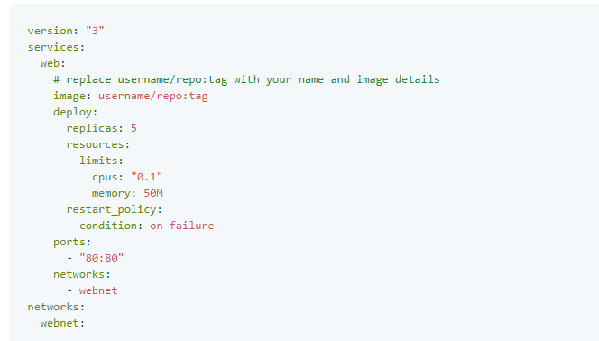
Docker-compose.yml
Docker-compose.yml file is a yaml file, how docker containers should behave in production

Slide 40
Compose file instruct following steps
Pull image using docker registry
Running 5 replicas and each one using 10% of cpu core and 50 MB memory [resource restriction]
Policy to “restart-immediately” in case of failure
Map port 80 to host port 80
Instruct container to share port 80 via load-balanced network called webnet
Define the webnet network with the default settings.

Slide 41
Swarm
Dockerized cluster called swarm
A swarm is a group of machines that running Docker and joined into cluster
In case of cluster environment when we execute docker commands, they will be executed on cluster by docker swarm
Docker swarm hosts refer as nodes
Swarm manager are the only machine in a swarm that executes command or authorize to tell other nodes what can do or cannot
Workers are just to provide capacity , no authority

Slide 42
Network Drivers
Docker networking subsystem is pluggable, using drivers. Some of the drivers are:
Bridge: Default driver, if don’t specify anything. Bridge network specifcally

