Slide 1
CICD
OW

Slide 2
Explain about project
Python project
Dockerfile
Registry
CICD flow

Slide 3
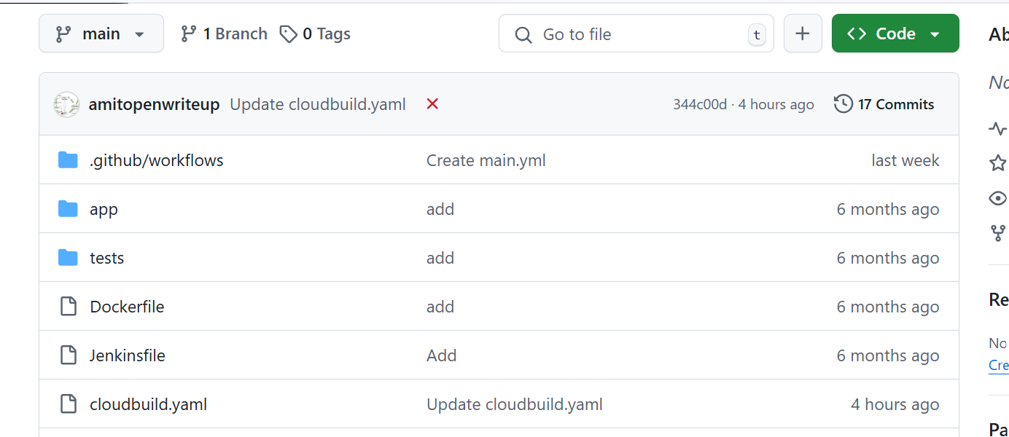
..

Slide 4
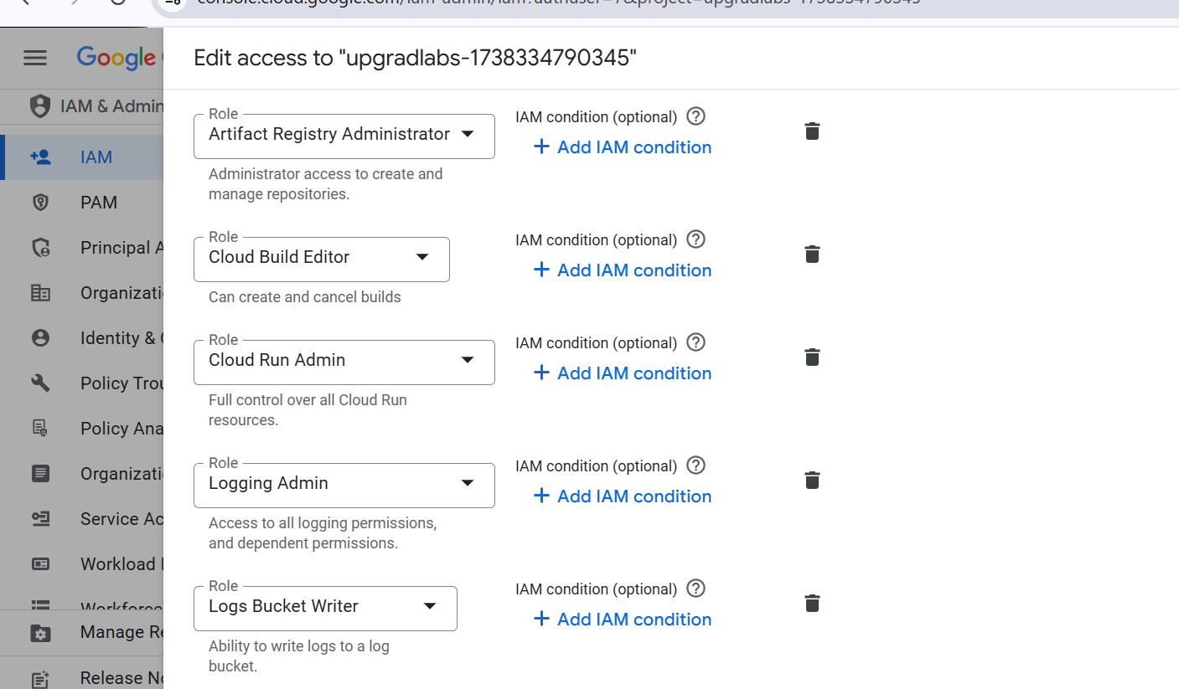
Service account permissions

Slide 5
Cloud build
Install package for app
Run test
Build Docker image
Push to docker registry
Deploy to cloudrun

Slide 6
.
- name: 'python:3.9'
entrypoint: 'sh'
args:
- '-c'
- |
python -m venv venv && \
. venv/bin/activate && \
pip install --upgrade pip && \
pip install -r requirements.txt

Slide 7
It uses the Python 3.9 base image.
Runs the script inside a shell (sh).
Creates a virtual environment (venv).
Activates the virtual environment.
Upgrades pip to the latest version.
Installs all dependencies from requirements.txt.

Slide 8
Step2
- name: 'python:3.9'
entrypoint: 'sh'
args:
- '-c'
- |
. venv/bin/activate && \
python -m unittest discover tests

Slide 9
..
Uses the same Python 3.9 base image.
Activates the virtual environment (venv).
Runs the unit tests using unittest discover inside the tests/ directory.

Slide 10
step3
- name: 'gcr.io/cloud-builders/docker'
args:
- 'build'
- '-t'
- 'us-east1-docker.pkg.dev/upgradlabs-1738334790345/mydockerrgisty/myapp:$BUILD_ID'
- '.'

Slide 11
..
Uses Google Cloud Build’s Docker image (gcr.io/cloud-builders/docker).
Runs docker build to create a container image.
Tags the image using us-east1-docker.pkg.dev/.../myapp:$BUILD_ID.
$BUILD_ID is a unique ID assigned by Google Cloud Build to each build.

Slide 12
step4
- name: 'gcr.io/cloud-builders/docker'
args:
- 'push'
- 'us-east1-docker.pkg.dev/upgradlabs-1738334790345/mydockerrgisty/myapp:$BUILD_ID'

Slide 13
.
Uses Google Cloud Build’s Docker image.
Pushes the built Docker image to Google Artifact Registry (us-east1-docker.pkg.dev).

Slide 14
..
- name: 'gcr.io/cloud-builders/gcloud'
args:
- 'run'
- 'deploy'
- 'myapp'
- '--image'
- 'us-east1-docker.pkg.dev/upgradlabs-1738334790345/mydockerrgisty/myapp:$BUILD_ID'
- '--platform'
- 'managed'
- '--region'
- 'us-east1'
- '--allow-unauthenticated'

Slide 15
…
Uses the Google Cloud SDK (gcloud).
Deploys the container image to Cloud Run as a new revision.
Specifies:
--image: The built Docker image (myapp:$BUILD_ID).
--platform managed: Uses fully managed Cloud Run.
--region us-east1: Deploys in us-east1 region.
--allow-unauthenticated: Allows public access to the service.

