Slide 1
Ci/cd
ow

Slide 2
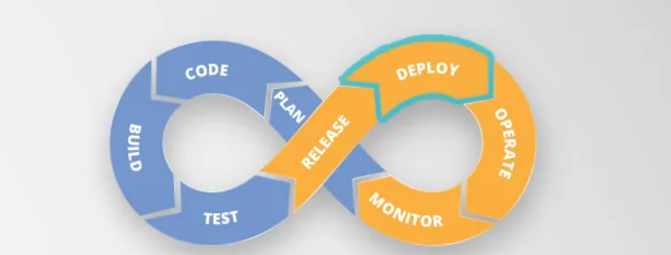
..

Slide 3
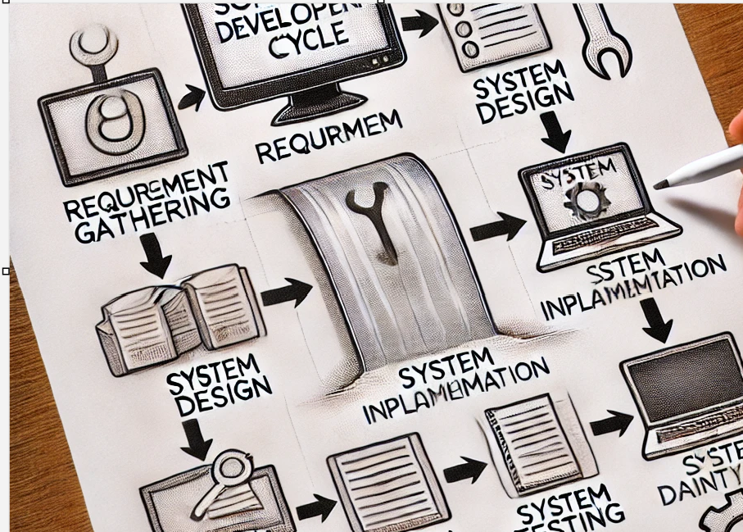
Waterfall model

Slide 4
Phases of waterfall model
­In phase 1- Complete Requirement is gathered and SRS is developed
In phase 2 - This System is Planned and Designed using the SRS
In phase 3 - Implementation of the System takes place
In phase 4 - System is tested and its quality is assured
In phase 5 - System is deployed to the end users
In phase 6 - Regular Maintenance of the system is done

Slide 5
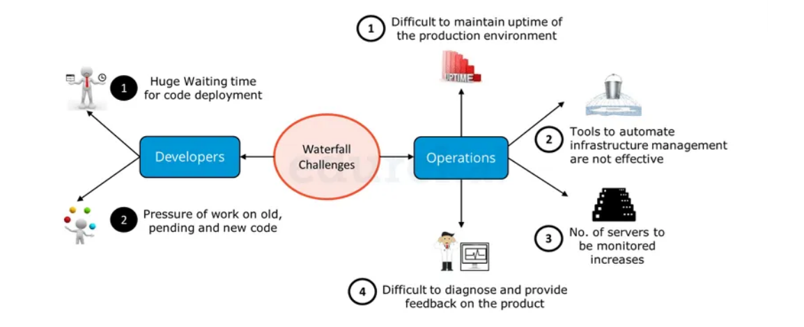
challenges

Slide 6
Solution
From the Developers point of view:
A system which enables code deployment without any delay or wait time.
2. A system where work happens on the current code itself i.e. development sprints are short and well planned.
From Operations point of view:
1.System should have at-least 99% uptime.
2. Tools & systems are there in place for easy administration.
3. Effective monitoring and feedbacks system should be there.
4. Better Collaboration between Development & Operations and is common requirement for Developers and Operations team.

Slide 7
Devops
DevOps is a set of practices that combines software development (Dev) and IT operations (Ops) with the aim of shortening the development lifecycle and delivering high-quality software continuously.
It emphasizes collaboration, automation, continuous integration, continuous delivery (CI/CD), and a culture of continuous improvement.
Dev and Ops : Where a code changes start from Devops side and end up with product release/Deployment, this whole process comes under devops

Slide 8
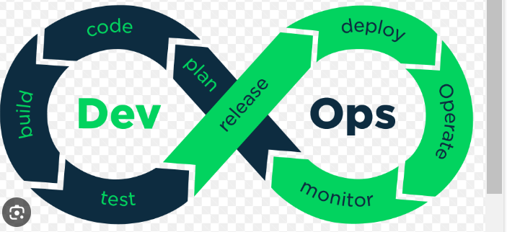
Introduction to DevOps
DevOps is a software development methodology that emphasizes collaboration, communication, and integration between software developers and IT operations professionals.
The goal of DevOps is to increase the speed and efficiency of software delivery while maintaining high levels of quality and reliability.

Slide 9
dev
Developers | challenges | solution
 | Waiting time for code deployment | CI (Continuous Integration) ensures quick deployment of code, faster testing and shared feedback
 | Pressure of work on old, pending and new code | Since wait time has reduced developer can focus more on current code

Slide 10
Ops
OPS | Challenges | solution
 | Difficult to maintain uptime | Virtualization and containerization helps, run app in form of containers
, | Tools to automate management part | Config management , CD tools and iac tools
 | monitoring | Continuous monitoring

Slide 11
What is ci/cd?
CI/CD practices are crucial to keeping the software release process agile, reliable, and fast. Continuous Integration (CI) focuses on regularly integrating code changes into a shared repository, allowing developers to identify bugs early in the development process.
Continuous Deployment (CD) extends this by automating the deployment of code changes, helping get tested code into production or staging environments more quickly and reliably.

Slide 12
Why we need ci/cd
A CI/CD platform is essential for modern software development teams. It accelerates the release cycle, reduces errors, and promotes collaboration.
By automating repetitive tasks, development teams can focus on writing quality code, ultimately enabling quicker, more consistent delivery of features, bug fixes, and updates. Without a CI/CD platform, managing and deploying code changes at the pace of modern development would be challenging and prone to errors.

Slide 13
Tools
Code management: git
Build: maven, docker
Cicd: gitlab,jenkins,azure devops
Monitoring:nagios
Config management: ansible
Deploy: terraform
Notification: slack,mail

Slide 14
CICD
Continuous Integration (CI)
Definition: Developers frequently integrate code into a shared repository,
often multiple times a day.
Goal: Detect integration errors as early as possible.
Tools: Jenkins, GitLab CI, Travis CI, CircleCI.
Continuous Delivery (CD)
Definition: Code changes are automatically built, tested, and prepared for release
to production.
Goal: Ensure that the software can be released reliably at any time.
Tools: Jenkins, GitLab CI/CD, Spinnaker, Argo CD.

Slide 15
Approach
The DevOps approach involves automating as much of the software development and deployment process as possible, using tools like continuous integration and continuous delivery (CI/CD) pipelines.
By automating routine tasks, DevOps teams can focus on more strategic activities, such as improving code quality and enhancing customer experiences.
Tools we use:
Git,Github,aws code commit
Jenkins, Github actions, Gitlabs,aws pipeline

Slide 16
Benefits of DevOps
One of the key benefits of DevOps is faster time-to-market for software products.
By automating the development and deployment process, DevOps teams can release new features and updates more frequently, which allows them to respond quickly to changing market conditions and customer needs.
Finding the Bugs in early stage.
Integration is quite easier, as platforms are compatible

Slide 17
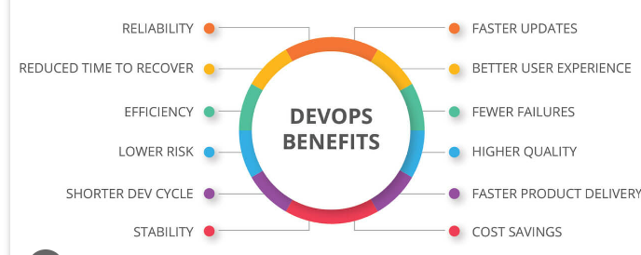
..
Another benefit of DevOps is improved collaboration between development and operations teams.
By breaking down silos and encouraging cross-functional teams, DevOps fosters a culture of collaboration and communication that leads to better outcomes for everyone involved.

Slide 18
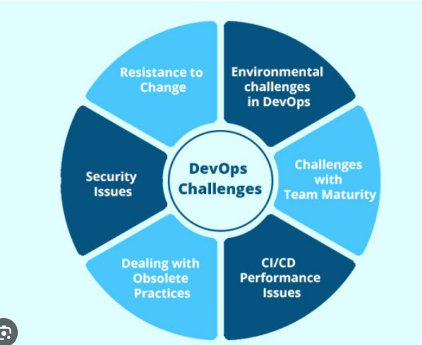
Challenges of DevOps
While DevOps offers many benefits, there are also some challenges associated with this approach. One of the biggest challenges is cultural resistance to change.

Slide 19
..
DevOps requires a shift in mindset and a willingness to embrace new ways of working, which can be difficult for some teams to accept.
Shifting from Traditional approach to Microservice Approach
Tools knowledge (Lot of integration are supported), which itself become a challenges

Slide 20
Implementing DevOps
To successfully implement DevOps, organizations must first assess their current processes and identify areas for improvement.
This may involve conducting a gap analysis or performing a maturity assessment to determine where the organization stands in terms of DevOps readiness.
Once the organization has identified areas for improvement, it can begin implementing DevOps practices and tools.
This may involve adopting new technologies, such as CI/CD pipelines, or reorganizing teams to promote cross-functional collaboration and communication.

Slide 21
DevOps Best Practices
There are several best practices that organizations can follow to ensure successful DevOps implementation. These include automating routine tasks wherever possible, using version control to manage code changes, and monitoring performance and user feedback to identify areas for improvement.
Other best practices include fostering a culture of collaboration and continuous learning, promoting transparency and accountability, and prioritizing security and compliance throughout the development and deployment process.

Slide 22
GitLab CI/CD as a CI/CD Platform
GitLab CI/CD is one of the most comprehensive CI/CD platforms available, providing an integrated environment that manages everything from code creation to deployment.
Unlike many other CI/CD tools, GitLab goes beyond simply automating the integration and deployment steps by integrating with GitLab’s robust source code management system.

Slide 23
Source Code Management
GitLab offers a seamless solution for hosting your application’s code with Git-based repositories, allowing for version control and tracking of all changes. This is essential for collaborative development as it enables teams to track, merge, and revert changes effortlessly.
GitLab’s source code management also supports collaboration with features like code reviews and merge requests. These features allow teams to review, comment on, and refine code before merging it into the main branch, ensuring the highest quality of code with every release.

Slide 24
Basic lab for git
Git basic command
Git init
Git config
Git add
Git commit

Slide 25
GitLab CI/CD
In a GitLab repository, you can set up CI/CD pipelines that automate testing, building, and deploying applications. GitLab CI/CD integrates a wide range of tools, covering every phase of the software development and release cycle.
This integration makes the entire process smoother by reducing the need for separate tools or plugins for testing, building, and deploying, and enabling a consistent, automated workflow.

Slide 26
..
GitLab, in contrast, offers a complete CI/CD platform with built-in source code management, continuous integration, and continuous deployment features, requiring no additional plugins for these core functions.
GitLab is designed with modern workflows in mind, supporting containerization and Kubernetes out of the box. GitLab CI/CD can be cloud-hosted or installed on-premises, providing flexibility for different deployment needs.
Notable features of GitLab include a built-in Container Registry, straightforward integrations with Kubernetes, and Auto DevOps, which automatically configures pipelines for applications, making setup easier and faster.

Slide 27
Jenkins
Jenkins is an open-source, industry-leading CI/CD tool with a large community and an extensive library of plugins. It’s powerful and highly customizable, but it’s also an older tool that wasn’t initially designed for containerized applications, which are now widely used.
As a result, Jenkins often requires additional plugins to support newer workflows. Furthermore, Jenkins only offers a self-hosted solution, meaning teams must install, configure, and maintain their Jenkins instance and any required plugins, adding to the overall complexity.

Slide 28
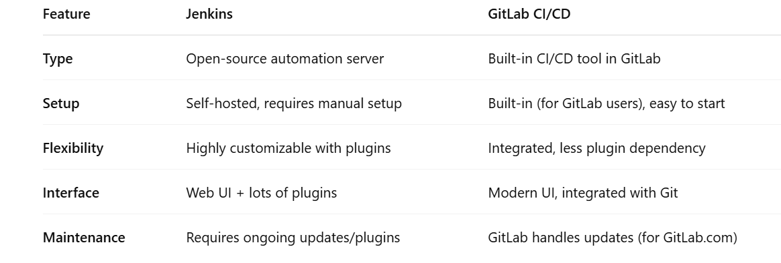
Jenkins vs gitlab

Slide 29
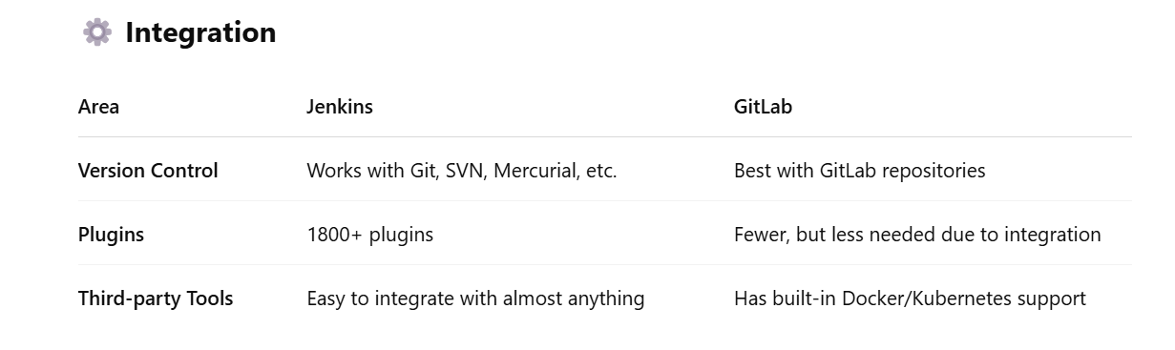
..

Slide 30
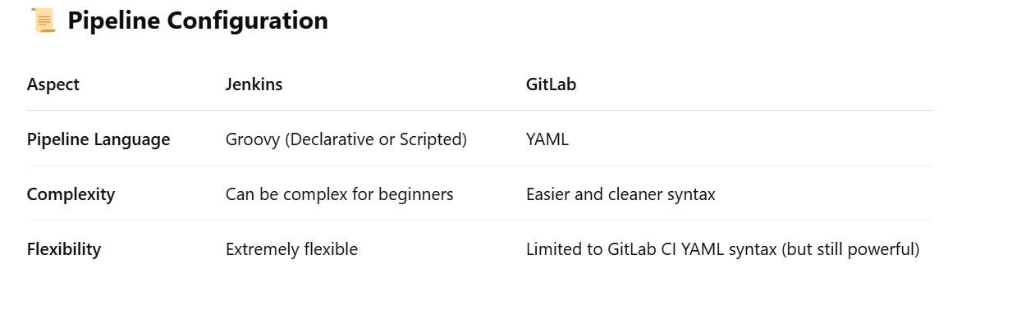
..

Slide 31
Lab 2
Create account on gitlab.com
Setup ssh authentication in your dev account vs gitlab
Perform the git push activity
Git branch basics

Slide 32
Basic of git branch
Concepts explain
Add and commit on the clone repo
Lab 3: branch lab

Slide 33
Gitlab server
A GitLab server is a system that runs the GitLab application, which provides a complete DevOps platform for managing source code, running CI/CD pipelines, tracking issues, and collaborating on software development projects.
Selfhosted
SAAS

Slide 34
Self hosted
Pros:
Full control over infrastructure, security, and customization.
Can integrate deeply with private tools or on-prem services.
Useful for air-gapped environments or where data privacy is critical.
Can fine-tune performance, backups, and upgrades on your schedule.
Cons:
You manage everything: setup, updates, monitoring, scaling, security.
Requires infrastructure and DevOps effort.
Downtime and performance issues are your responsibility.

Slide 35
saas
GitLab manages everything. You just create an account and use it via web.
Pros:
Zero maintenance – GitLab handles upgrades, backups, performance.
Fast to start – great for individuals, startups, or small teams.
Built-in scalability and reliability.
Access from anywhere, just like other cloud apps.
Cons:
Less control over environment and configurations.
Data is hosted by GitLab (might be an issue for compliance-heavy orgs).
Some premium features may be limited or costly.

Slide 36
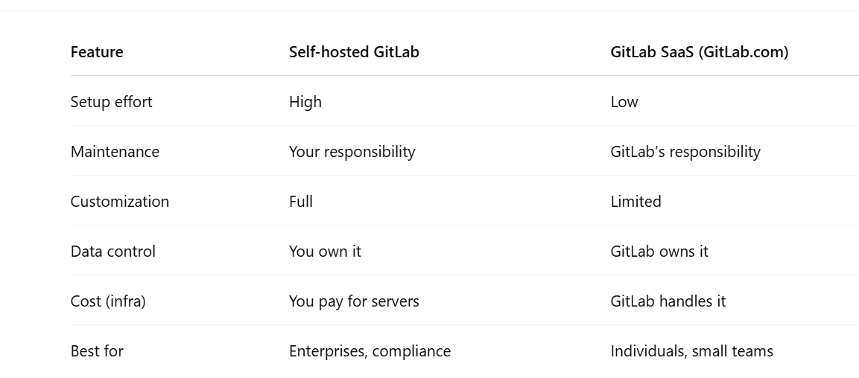
..

Slide 37
lab
Setup self hosted : Lab 4

Slide 38
Key components
What are the key components of GitLab CI/CD?
The key components include:
gitlab-ci.yml file: Defines the pipeline configuration.
Runners: Execute jobs.
Jobs and Stages: Define tasks and group them.
Pipelines: Automate workflows from code to deployment.

Slide 39
The Architecture of GitLab CI/CD
GitLab Server
Like every online platform, GitLab works on a server.
The GitLab server is accountable for hosting all your Git repositories. It helps you keep your data on the server for your client and team.
The GitLab server hosts your applications and configures the pipeline. It also manages the pipeline execution and assigns jobs to the runners available.
GitLab.com is run by a GitLab instance that further comprises an application server, database, file storage, background workers, etc.

Slide 40
..
Runners
Runners are applications that run CI/CD pipelines. GitLab has several runners configured. Every user can access these runners on gitlab.com. Users are allowed to set up their own GitLab runners.
Jobs
Jobs are tasks performed by the GitLab pipeline. Each job has a unique name and script. Each script gets finished one after the other. A user moves on to the next one only when the previous one is complete.

Slide 41
..
Stages
Stages are referred to the differences between jobs. They ensure the completion of jobs in the pipeline. For instance, testing, building, and deploying.
Pipeline
The pipeline is a complete set of stages. Every stage comprises single or multiple jobs.
You can find various types of pipelines in GitLab. These types include basic pipelines, multi-branch pipelines, merge request pipelines, parent-child pipelines, scheduled pipelines, multi-job pipelines, etc.

Slide 42
Commit
Commit is a record of changes made in the code or files. It is similar to what we see in a GitHub repository.
So this is an architecture of GitLab CI/CD. Let us learn how to build a simple CI/CD pipeline with GitLab.

Slide 43
Explain about
What is yaml
Key-value
List/array
dictionary/map

Slide 44
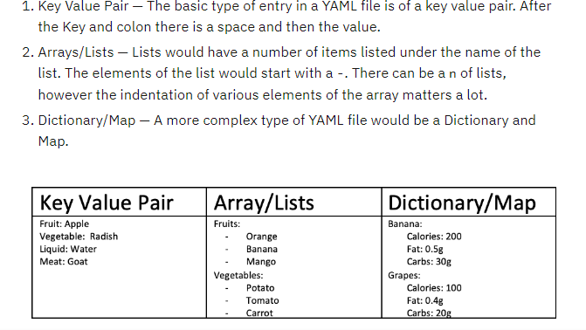
Yaml example

Slide 45
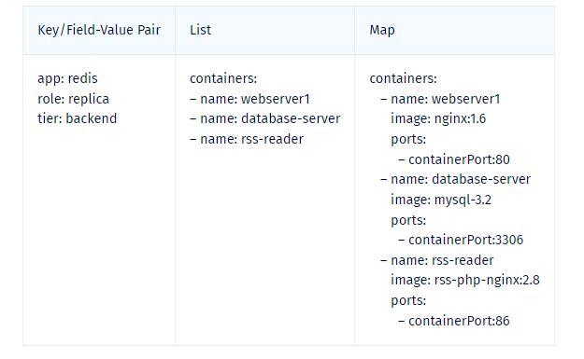
Yaml in k8s

Slide 46
.gitlab-ci.yml
It's a YAML file that lives in the root directory of your GitLab repo. It defines the CI/CD pipeline — how and when your code should be built, tested, and deployed.
job1:
script:
- echo "Hello from GitLab CI"

Slide 47
Lab 5
Try and observe.

Slide 48
Runner
A GitLab Runner is a lightweight agent (like a worker or helper) that runs your CI/CD jobs — the steps you define in .gitlab-ci.yml.
When you push code, GitLab looks at that file and sends the job instructions to a runner, which then executes the scripts.
There Are Two Main Types of Runners:
Shared Runners : Provided by GitLab. Automatically available for your jobs (especially for public repos).
Specific/Custom Runners: You install and manage them yourself. Useful if you want more control or need to run on private machines (e.g., behind a firewall, with special tools).

Slide 49
Lab 5 output
You pushed code
You triggered the pipeline by committing and pushing code to GitLab.
GitLab picked a runner
GitLab automatically chose one of its own shared runners to run your job.
Runner used Docker
It used Docker to create a temporary container (environment) using the ruby:3.1 image.
Your code was downloaded
The runner cloned your Git repository into the container.

Slide 50
..
Job script was run
Your job script was just:
echo "Hello from GitLab CI"
So it printed:
Hello from GitLab CI
Cleanup
The container was destroyed, and everything was cleaned up.
Job passed — success!

Slide 51
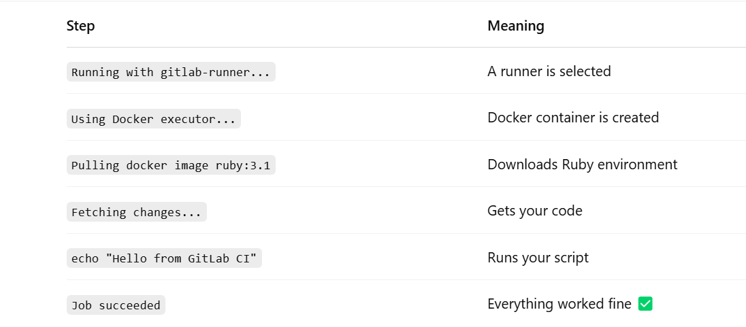
..

Slide 52
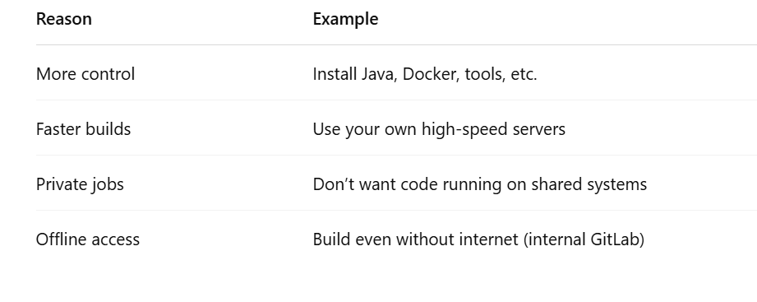
Custom runner
A custom runner is:
A runner you install yourself, on your own machine, VM, or cloud server.
You use it when you want more control — like special software, more resources, or privacy.
Instead of using GitLab's shared runners, you run jobs on your own system.

Slide 53
Lab 6
Custom runner
Run job and explain the output

Slide 54
jobs
Job is the smallest unit to run in GitLab CI/CD. It is often called a “build step”. It can be a build or compilation task; it can be running unit tests; it can be code quality check(s) like linting or code coverage thresholds checks; it can be a deployment task.
A single job can contain multiple commands (scripts) to run. The following is an example:
Unit tests:
script:
- npm install
- npm run test

Slide 55
stages
Each job belongs to a single stage. Stage can contain zero, one or more jobs to execute. All jobs in a single stage run in parallel. The next stage is executed only if all jobs from previous stage complete successfully — or they are marked as allowed to fail.
GitLab out-of-the-box has defined the following three stages:
stages: - build - test - deploy

Slide 56
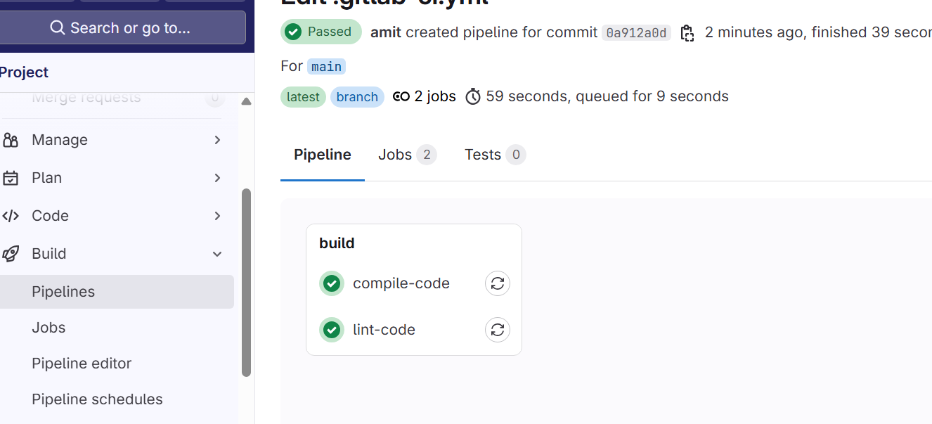
Lab 7
Lab file

Slide 57
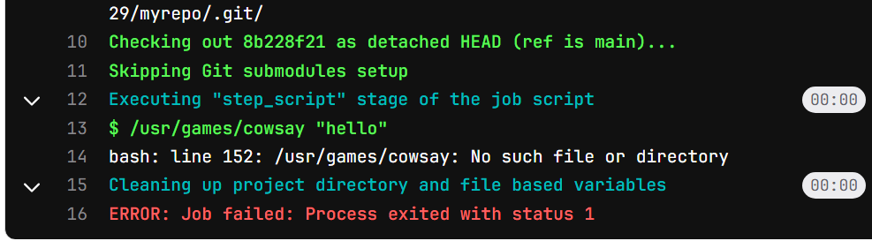
Env in runner
Suppose we want to use specific utility in runner, how can we do it..
We are using a utility in our code for testing
Cowsay

Slide 58
Lab 8 – part 1

Slide 59
before_script
In a .gitlab-ci.yml file, before_script is a set of commands that run before the main script block in a job.
You can define it:
Globally (for all jobs)
Individually (per job)

Slide 60
..
say-hello:
stage: hello
tags:
- myrunner
image: debian:bullseye # Use a base image that supports apt
before_script:
- apt-get update -y
- apt-get in stall -y cowsay

Slide 61
Lab 8 –Part 2

Slide 62
After_script
What is after_script?
after_script is a special section in a GitLab CI job that runs after the main script, no matter if the job succeeds or fails.
You use after_script for cleanup or post-processing tasks. For example:
Deleting temp files
Logging some final message
Sending notifications
Uninstalling packages you installed in before_script

Slide 63
..
before_script:
- apt-get update -y
- apt-get install -y cowsay
script:
- /usr/games/cowsay "hello from GitLab CI"
after_script:
- echo "Cleaning up after job..."
- apt-get remove -y cowsay

Slide 64
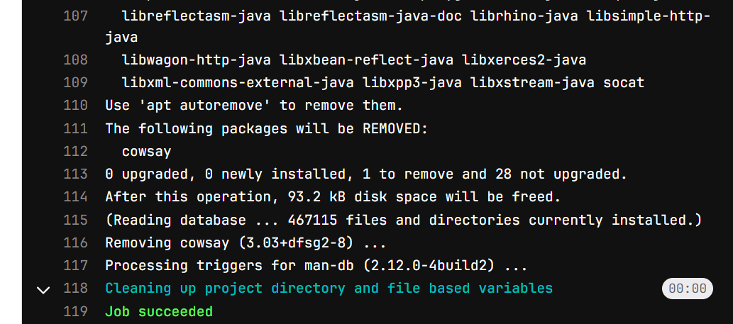
Lab 9

Slide 65
Artifacts
artifacts are files or directories created by a job that you want to save and share between stages or download later from the GitLab web UI.
artifacts:
paths:
- path/to/file-or-folder
expire_in: 1 hour # Optional: how long to keep artifacts
when: always # Optional: when to upload artifacts (default: on_success)
reports: # Optional: for test, code quality, etc.
junit: test-results.xml

Slide 66
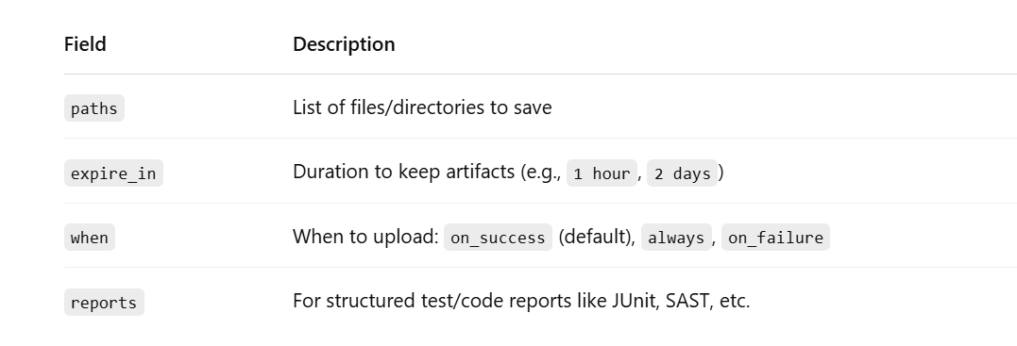
..

Slide 67
..
build:
script:
- make build
artifacts:
paths:
- build/output/
expire_in: 2 days

Slide 68
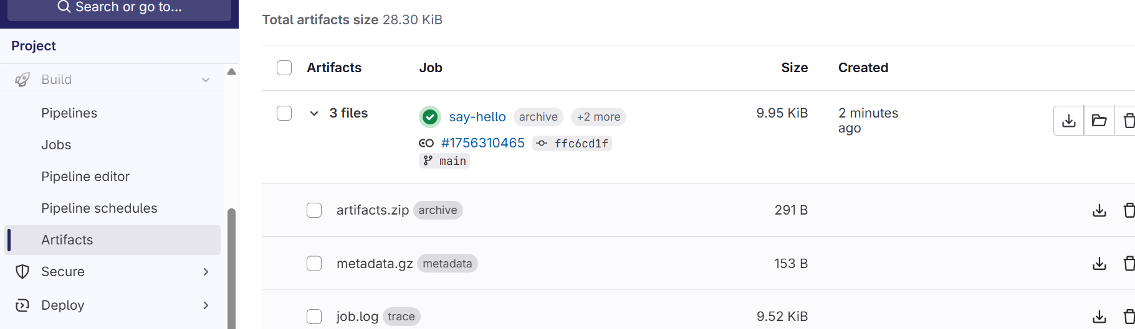
Lab 10

Slide 69
What is except?
The except rule tells GitLab CI when not to run a job.
It's like saying:
“Run this job unless the pipeline matches these conditions.”
job-name:
script:
- echo "Hello!"
except:
- main

Slide 70
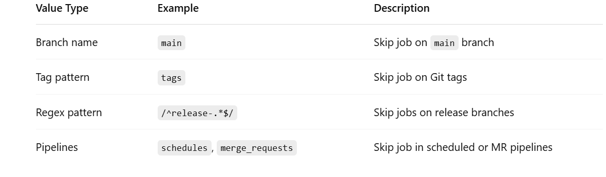
..

Slide 71
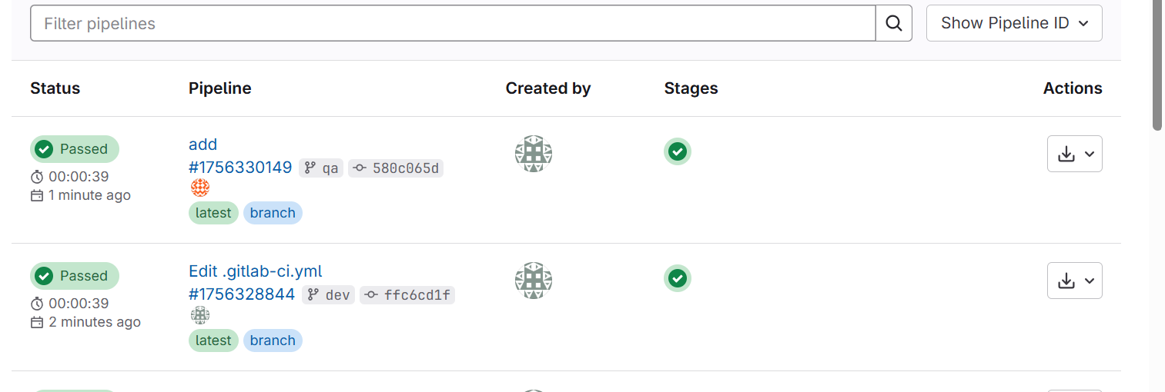
Lab 11

Slide 72
variables
What are GitLab CI/CD Variables?
GitLab variables let you store reusable values like:
Secrets (API keys, passwords)
Config values (environment names, paths, flags)
Dynamic data (branch name, commit ID, etc.)
You can use them in your .gitlab-ci.yml and your shell scripts.

Slide 73
Lab 12
Simple variables

Slide 74
Build tools
Maven
Msbuilder
Docker build
npm

Slide 75
Maven
OW

Slide 76
What is Apache maven?
Apache Maven is a Software project management and comprehension tool.
Based on the concept of a project object model(POM), Maven can manage a project’s build, reporting, and documentation from a central piece of information.
This is a project management tool with a project object model.
Which has a set of standards.
Which has a project life cycle.
A dependency management system.

Slide 77
How it Helps?
when you build a traditional Java application, you include the dependencies by downloading them directly and including them in the project structure.
If you have already done this you know how much of a laborious work that is. In addition, to download those dependencies you have to keep a track of their versions for your project to work

Slide 78
Understanding Maven — POM
POM stands for Project Object Model. This model has a set of standards, a project life cycle, a dependency management system, and a logic for executing plugin goals at defined phases in a lifecycle.
Projects are set up with default behaviors.
Source code must be in the src/main folder.
Resources necessary for the project are in another folder.
Test cases are in a specifically named folder.
The target folder is used for the final JAR file.

Slide 79
Understanding Maven — Maven Life Cycle
There are nine important phases in the Maven Life Cycle.
clean — clear the target directory into which Maven normally builds your project
validate — validate the project is correct
compile — compile the source code of the project
test — test the compiled source code using a unit testing framework
package — package the compiled code
verify — run any checks to verify the package is valid
install — install the package into the local repository
deploy — copies the final package to a remote repository
integration-test(not in this project) — deploy the package into an environment where integration tests can be run

Slide 80
Understanding Maven — Maven Repositories
When it comes to Maven there are two repositories, The Maven Central Repository, and the local .m2 repository.
Looking at the Maven Central Repository, you can visit the site by using search.maven.org It is the one having all the dependencies that you have mentioned in the pom.xml file.

Slide 81
Understanding Pom.xml
<project>
<groupId>com.example</groupId>
<artifactId>demo</artifactId>
<version>1.0</version>
</project>
The <groupId></groupId> , <artifactId></artifactId> and, <version></version> make up the project. Therefore they are essential when you are creating a Maven project.

Slide 82
..
<dependencies>
<dependency>
<groupId>log4j</groupId>
<artifactId>log4j</artifactId>
<version>1.2.14</version>
</dependency>
<dependency>
<groupId>jaxen</groupId>
<artifactId>jaxen</artifactId>
<version>1.1.1</version>
</dependency>
</dependencies>

Slide 83
scope
When using dependencies you can use <scope></scope> tag to define the scope you want that dependency to run on. For example, JUnit dependency can have <scope>test</scope> since it can be used for the test phase. There are other scopes like compile, provided, runtime and, system.
compile — default scope
provided — when JDK is expected to provide them
runtime — for executing and testing, not compiling
test — when testing, not required during normal operation
system — similar to “provided”, but must specify the explicit path to the JAR on a local file system

Slide 84
Import repo
Import using GitLab UI
Log in to GitLab
Go to your GitLab account.
Click ➡️ + → New Project
Choose “Import project” ➡️ Select “GitHub”
Authorize GitLab to access your GitHub account (if not done already)
Select the repository you want to import from GitHub.
Click “Import”

Slide 85
Lab 13
Assignment
Create .gitlab-ci.yml in java repo
Setup mvn
Command to use
apt-get install maven

Slide 86
Why runner stuck?
Go and map the runner
Register the project with runner
Start it

Slide 87
Maven project
before_script:
- apt-get update -y
- apt-get install -y maven
script:
- mvn clean package
artifacts:
paths:
- target/*.jar

Slide 88
Lab 15

