Slide 1
Kubernetes Intro

Slide 2
Docker limitation
Docker run single instance on the single host.
Scaling, load balancing and clustering is not available
Container across cluster limitation
Multiple solution available such as Mesosphere,Docker Swarn and Kubernetes.

Slide 3
Need of Container Orchestration Engine
Why we need Orchestration Engine
What is kubernetes
Comparison with similar product

Slide 4
Why we need??
Docker is limited to one single host.
When we need to deploy on large scale
When we think about high availability, replication
Docker as a production ready solution
When we talk about application stack, micro services docker compose is the solution, but this is also limited to one single host
Only solution: Container orchestration, what are the solution

Slide 5
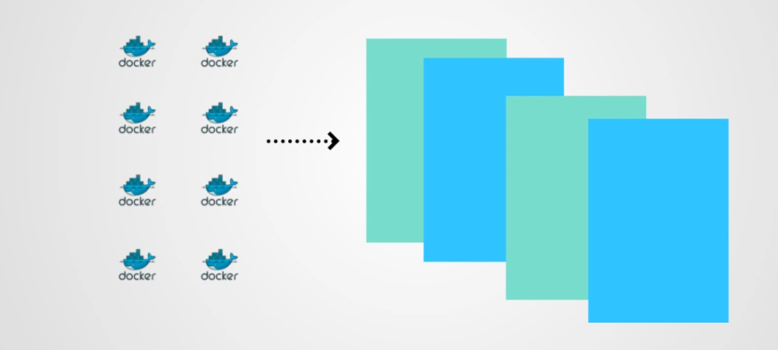
Kubernetes

Slide 6
We have pool of servers, where we need to run dockers.
If we don’t have orchestration engine, it would be difficult, where to schedule?
How to do load balancing. Manually tracking everything ☹
Without any kind of solution, if we plan to use docker we need to perform scheduling ,management manually…

Slide 7
..
Rather then sending the request to each node, we are submitting our request to container orchestrator engine.
This engine will take care scheduling the resource, will take care of resource utilization..
Take a pool of server, create an logical entity, container orchestrator engine take care of logical entity.

Slide 8
Comparison of COEs
Kubernetes: Robust, most features, its by google.
Docker swarm :Provided by Docker. Easy to deploy. Seamless with docker cli.
Mesos: Apace project, Mesos is not purely COEs, this is orchestrator. It has concept of datacenter os, so it again create a pool server.
Hadoop job
Batch job
Docker job
Everything require a framework. For docker this require marathon

Slide 9
Key features of COE
Clustering
Scheduling
Container as service such as cloud providers gives IAAS
Dynamic provision, horizontal scaling
Load balancing option
Fault tolerance
Release statergy, rolling update..

Slide 10
Why kubernetes
Created by google, based on their leaning
Its based on Borg
Google now given to Open source ,community based.
Lot of learning from Google.
Amount of features
It can use for Runc ,rocket
Redhat OSE completely based on kubernetes.

Slide 11
Kubernetes history
This is developed by Google
Borg was the product name, developed by Google internally
Used across multiple product solution.
Borg which was developed at Google to manage both long running processes and batch jobs, which was earlier handled by separate systems.
Google opensource kubernetes for community. Now this is maintain by opensource communities.

Slide 12
What is Kubernetes??
Kubernetes is opensource container management tool.
Kubernetes has the capability of automating deployment, scaling of the application and operations of application containers across cluster
Capable of creating container centric infrastructure
Kubernetes can run application on clusters of physical and virtual machine.
It helps in moving from host-centric infrastructure to container centric infrastructure.
Kubernetes is an orchestration framework, which deploy container in unit call pods

Slide 13
Kubernetes architecture
Kubernetes has a cluster architecture
It has client-server [master-node] architecture
Master would be on one linux vm with following components
Etcd
Api Server
Scheduler
Controller Manager

Slide 14
…
Node would be running on another linux vm
Kubernetes can have multiple node
Following are the node components:
Kubelet service
Docker/Container run time
Kubernetes proxy

Slide 15
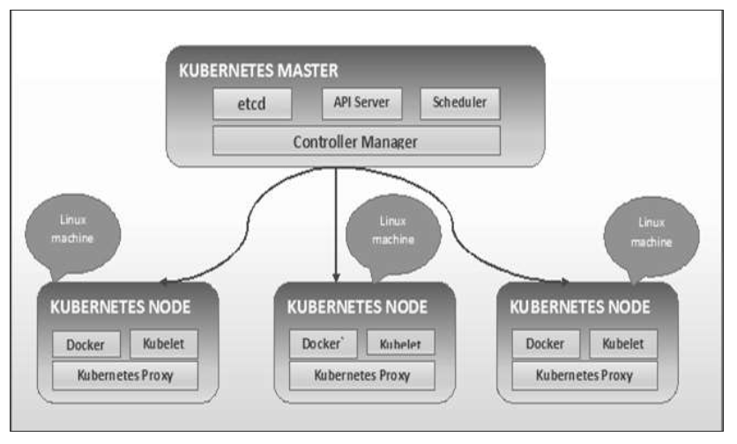
Kubernetes Architecture

Slide 16
What next?
Lets understand each component in details

Slide 17
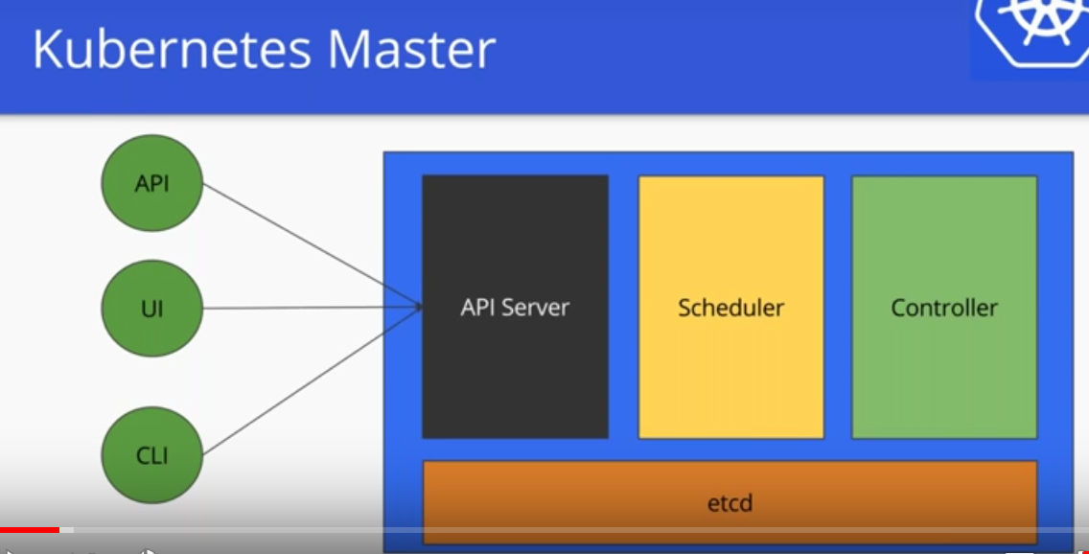
Master components

Slide 18
Kube api-server
The Kubernetes API server validates and configures data for the api objects which include pods, services, replicationcontrollers, and others.
The API Server services REST operations and provides the frontend to the cluster's shared state through which all other components interact.
The API server is a component of the Kubernetes control plane that exposes the Kubernetes API. The API server is the front end for the Kubernetes control plane.
It can scale horizontally

Slide 19
Master Component: etcd
Etcd originated from two ideas Etcd= etc+d
etc directory in linux stores the configuration file
D stands for distributed system.
Hence a “d”stributed “etc” is “etcd”
Stores metadata in a consistent and fault-tolerant way.

Slide 20
…
Kubernetes stores configuration data into etcd
This used for service discovery and cluster management
Kubernetes persist cluster state into etcd.
Master always keep monitoring the etcd and roll out critical configuration changes.

Slide 21
Other solution
Zookeeper
Zookeeper solves the same problem as etcd distributed system coordination and metadata storage.
Zookeeper has its own custom jute RPC protocol.
Consul
Consul bills itself an end-to-end service discovery framework.
For compete service discovery Consul is the best solution with kubernetes.

Slide 22
kube-scheduler
Control plane component that watches for newly created Pods with no assigned node, and selects a node for them to run on.
Factors taken into account for scheduling decisions include: individual and collective resource requirements, hardware/software/policy constraints, affinity and anti-affinity specifications, data locality, inter-workload interference, and deadlines

Slide 23
kube-controller-manager
Control plane component that runs controller processes.
Logically, each controller is a separate process, but to reduce complexity, they are all compiled into a single binary and run in a single process.
Some types of these controllers are:
Node controller: Responsible for noticing and responding when nodes go down.
Job controller: Watches for Job objects that represent one-off tasks, then creates Pods to run those tasks to completion.
Endpoints controller: Populates the Endpoints object (that is, joins Services & Pods).
Service Account & Token controllers: Create default accounts and API access tokens for new namespaces

Slide 24
kubelet
An agent that runs on each node in the cluster. It makes sure that containers are running in a Pod.
The kubelet takes a set of PodSpecs that are provided through various mechanisms and ensures that the containers described in those PodSpecs are running and healthy. The kubelet doesn't manage containers which were not created by Kubernetes

Slide 25
Kube-proxy
kube-proxy is a network proxy that runs on each node in your cluster, implementing part of the Kubernetes Service concept.
kube-proxy maintains network rules on nodes. These network rules allow network communication to your Pods from network sessions inside or outside of your cluster.

Slide 26
…
Kubernetes we use kubectl as cli
Kubernetes bit complex, lot of features.
- Lot of objects
- API format
Understand the api stack
Understand object stack
AKMS format

Slide 27
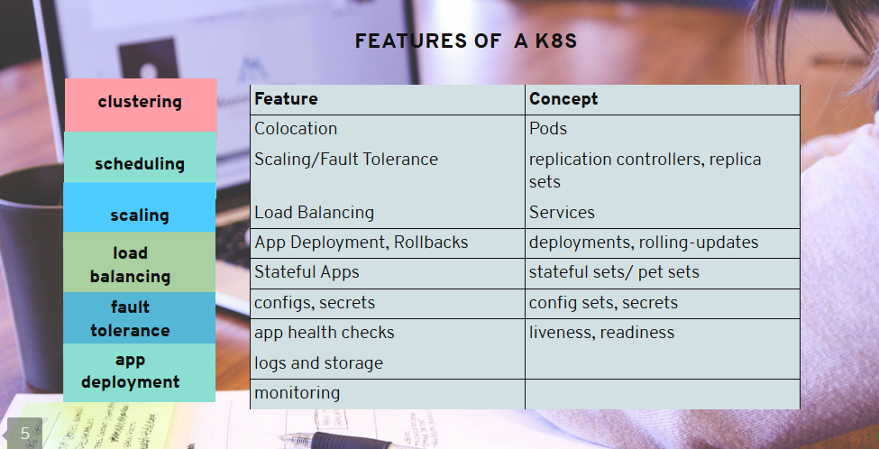
Key features of k8s

Slide 28
Setting up Kubernetes using kubeadm
kubeadm: the command to bootstrap the cluster.
kubelet: the component that runs on all of the machines in your cluster and does things like starting pods and containers.
kubectl: the command line util to talk to your cluster.

Slide 29
Setting up k8s cluster using kubeadm
Kubeadm init <args>
kubeadm init first runs a series of prechecks to ensure that the machine is ready to run Kubernetes. These prechecks expose warnings and exit on errors. kubeadm init then downloads and installs the cluster control plane components
Choose a Pod network add-on, and verify whether it requires any arguments to be passed to kubeadm init. Depending on which third-party provider you choose, you might need to set the --pod-network-cidr to a provider-specific value

Slide 30
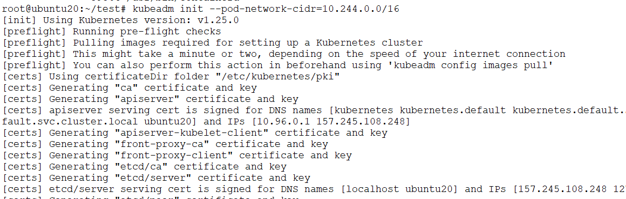
..

Slide 31
..
To start using your cluster, you need to run the following as a regular user:
mkdir -p $HOME/.kube
sudo cp -i /etc/kubernetes/admin.conf $HOME/.kube/config
sudo chown $(id -u):$(id -g) $HOME/.kube/config

Slide 32

Check the nodes status

Slide 33
Setup network
You must deploy a Container Network Interface (CNI) based Pod network add-on so that your Pods can communicate with each other.
Cluster DNS (CoreDNS) will not start up before a network is installed.
Flannel or calico can be used for the same
kubectl apply -f https://raw.githubusercontent.com/coreos/flannel/master/Documentation/kube-flannel.yml

Slide 34
