Slide 1
Taint

Slide 2
Taint
Taints are - they allow a node to repel a set of pods.
Currently master node taint value in “NoSchedule”
For training purpose we will untainted that node
kubectl taint nodes ubuntu20 node-role.kubernetes.io/control-plane:NoSchedule-
node/ubuntu20 untainted

Slide 3
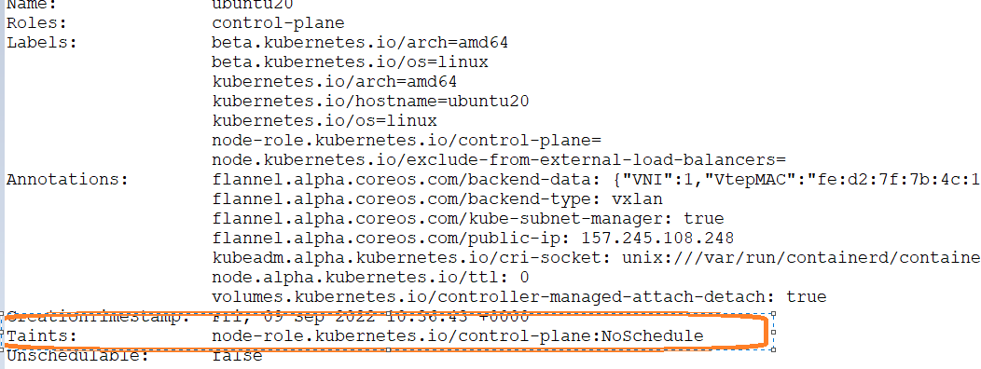
Can master schedule any pods by default

