Slide 1

Dockerfile
Ow

Slide 2

What is dockerfile??
A Dockerfile is a text document that contains all the commands a user could call on the command line to assemble an image.
Docker can build images automatically by reading the instructions from a Dockerfile.

Slide 3
Format
Here is the format of the Dockerfile:
# Comment
INSTRUCTION arguments
The instruction is not case-sensitive. However, convention is for them to be UPPERCASE to distinguish them from arguments more easily.
Docker runs instructions in a Dockerfile in order. A Dockerfile must begin with a FROM instruction.

Slide 4
FROM instruction
A Dockerfile must begin with a FROM instruction
The FROM instruction specifies the Parent Image
All subsequent commands are based on this parent image.
A Dockerfile with the FROM scratch directive uses no parent image, and creates a base image.

Slide 5
comments
Docker treats lines that begin with # as a comment
For backward compatibility, leading whitespace before comments (#) and instructions (such as RUN) are ignored, but discouraged

Slide 6
FROM [--platform=<platform>] <image>[:<tag>]
ARG is the only instruction that may precede FROM in the Dockerfile
The tag or digest values are optional. If you omit either of them, the builder assumes a latest tag by default. The builder returns an error if it cannot find the tag value.
The optional --platform flag can be used to specify the platform of the image in case FROM references a multi-platform image. For example, linux/amd64, linux/arm64, or windows/amd64. By default, the target platform of the build request is used.

Slide 7
RUN
The RUN instruction will execute any commands in a new layer on top of the current image and commit the results. The resulting committed image will be used for the next step in the Dockerfile.
RUN has 2 forms:
RUN <command> (shell form, the command is run in a shell, which by default is /bin/sh -c on Linux or cmd /S /C on Windows)
RUN ["executable", "param1", "param2"] (exec form)

Slide 8
example
RUN /bin/bash -c 'source $HOME/.bashrc && echo $HOME’
To use a different shell, other than '/bin/sh', use the exec form passing in the desired shell.
RUN ["/bin/bash", "-c", "echo hello"]
exec form does not invoke a command shell. This means that normal shell processing does not happen. For example, RUN [ "echo", "$HOME" ]

Slide 9
lab

Slide 10
CMD
The CMD instruction has three forms:
CMD ["executable","param1","param2"] (exec form, this is the preferred form)
CMD ["param1","param2"] (as default parameters to ENTRYPOINT)
CMD command param1 param2 (shell form)
The main purpose of a CMD is to provide defaults for an executing container.

Slide 11
Shell and exec form
The RUN, CMD, and ENTRYPOINT instructions all have two possible forms:
INSTRUCTION ["executable","param1","param2"] (exec form)
INSTRUCTION command param1 param2 (shell form)
The exec form makes it possible to avoid shell string munging, and to invoke commands using a specific command shell, or any other executable. It uses a JSON array syntax, where each element in the array is a command, flag, or argument.

Slide 12
..
The exec form is parsed as a JSON array, which means that you must use double-quotes (") around words, not single-quotes (‘).
Unlike the exec form, instructions using the shell form always use a command shell. The shell form doesn't use the JSON array format, instead it's a regular string.
The shell form string lets you escape newlines using the escape character (backslash by default) to continue a single instruction onto the next line.

Slide 13
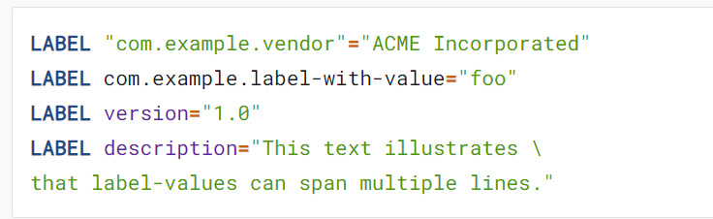
LABEL
LABEL <key>=<value> <key>=<value> <key>=<value> ...
The LABEL instruction adds metadata to an image. A LABEL is a key-value pair. To include spaces within a LABEL value, use quotes and backslashes as you would in command-line parsing

Slide 14

EXPOSE:EXPOSE 80/udp
EXPOSE <port> [<port>/<protocol>...]
The EXPOSE instruction informs Docker that the container listens on the specified network ports at runtime. You can specify whether the port listens on TCP or UDP, and the default is TCP if the protocol is not specified.
The EXPOSE instruction does not actually publish the port. It functions as a type of documentation between the person who builds the image and the person who runs the container, about which ports are intended to be published. To actually publish the port when running the container, use the -p flag on docker run to publish and map one or more ports, or the -P flag to publish all exposed ports and map them to high-order ports

Slide 15
ENV:ENV <key>=<value> ...
The ENV instruction sets the environment variable <key> to the value <value>. This value will be in the environment for all subsequent instructions in the build stage and can be replaced inline in many as well

Slide 16
ADD: exm: ADD hom* /mydir/
The ADD instruction copies new files, directories or remote file URLs from <src> and adds them to the filesystem of the image at the path <dest>.
Multiple <src> resources may be specified but if they are files or directories, their paths are interpreted as relative to the source of the context of the build.
Each <src> may contain wildcards and matching will be done using Go's filepath.Matchopen_in_new

Slide 17
COPY
The COPY instruction copies new files or directories from <src> and adds them to the filesystem of the container at the path <dest>.
Multiple <src> resources may be specified but the paths of files and directories will be interpreted as relative to the source of the context of the build.

Slide 18
lab

Slide 19
ENTRYPOINT
Command line arguments to docker run <image> will be appended after all elements in an exec form ENTRYPOINT, and will override all elements specified using CMD. This allows arguments to be passed to the entry point, i.e., docker run <image> -d will pass the -d argument to the entry point. You can override the ENTRYPOINT instruction using the docker run --entrypoint flag.

Slide 20
Understand how CMD and ENTRYPOINT interact
Both CMD and ENTRYPOINT instructions define what command gets executed when running a container. There are few rules that describe their co-operation.
Dockerfile should specify at least one of CMD or ENTRYPOINT commands.
ENTRYPOINT should be defined when using the container as an executable.
CMD should be used as a way of defining default arguments for an ENTRYPOINT command or for executing an ad-hoc command in a container.

Slide 21
lab

Slide 22
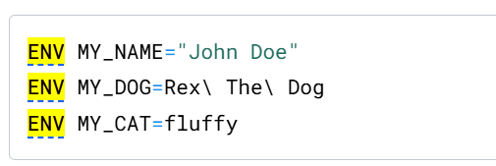
ENV
ENV <key>=<value> [<key>=<value>...]
The ENV instruction sets the environment variable <key> to the value <value>.
This value will be in the environment for all subsequent instructions in the build stage and can be replaced inline in many as well.

Slide 23
volume
VOLUME ["/data"]
The VOLUME instruction creates a mount point with the specified name and marks it as holding externally mounted volumes from native host or other containers.
The value can be a JSON array, VOLUME ["/var/log/"], or a plain string with multiple arguments, such as VOLUME /var/log or VOLUME /var/log /var/db.

Slide 24
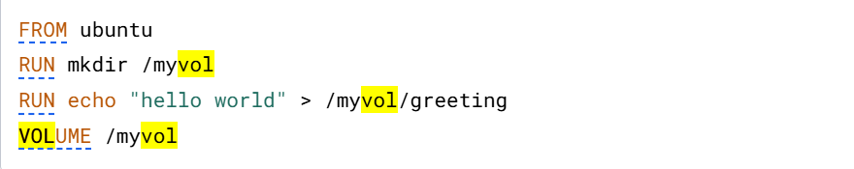
..
This Dockerfile results in an image that causes docker run to create a new mount point at /myvol and copy the greeting file into the newly created volume.

Slide 25
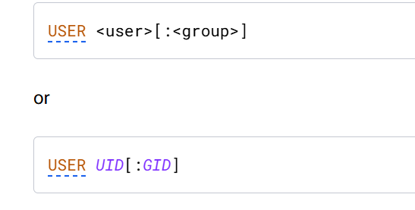
USER
The USER instruction sets the user name (or UID) and optionally the user group (or GID) to use as the default user and group for the remainder of the current stage.

Slide 26
WORKDIR
WORKDIR /path/to/workdir
The WORKDIR instruction sets the working directory for any RUN, CMD, ENTRYPOINT, COPY and ADD instructions that follow it in the Dockerfile.
If the WORKDIR doesn't exist, it will be created even if it's not used in any subsequent Dockerfile instruction.

Slide 27
ARG
You can use an ARG or an ENV instruction to specify variables that are available to the RUN instruction.
Environment variables defined using the ENV instruction always override an ARG instruction of the same name. Consider this Dockerfile with an ENV and ARG instruction.
FROM ubuntu
ARG CONT_IMG_VER
ENV CONT_IMG_VER=v1.0.0
RUN echo $CONT_IMG_VER

Slide 28
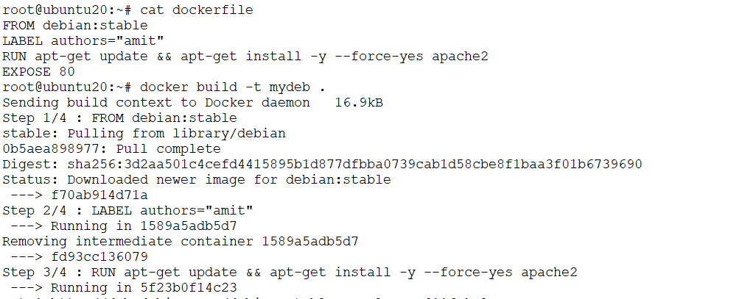
Examples

Slide 29
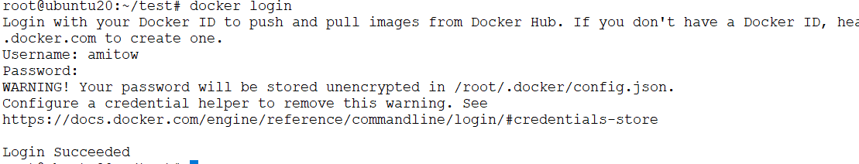
Docker hubs
Signup to docker hubs
docker login

Slide 30
Example
Uses Python 3.9 as the base image.
Defines a build-time argument for the repository URL.
Sets /app as the working directory.
Installs Git and updates packages.
Clones the GitHub repository into /tmp/repo.
Copies only the necessary files (app folder and requirements.txt).
Deletes the temporary cloned repository to save space.
Installs Python dependencies from requirements.txt.
Exposes port 5000 for the application.
Ensures unbuffered output for better logging.
Starts the application using python app/app.py.

Slide 31
..
1. Use an official Python runtime as a parent image
FROM python:3.9
•This sets up the base image for the container.
•It uses Python 3.9 from the official Python Docker images.
•The base image includes Python and pip pre-installed.
________________________________________
2. Set a build-time argument for the Git repository
ARG REPO_URL=https://github.com/amitopenwriteup/cicdproject.git
•Defines a build-time argument REPO_URL that specifies the Git repository URL.
•The value of this argument can be changed during the build process using the --build-arg option.

Slide 32
..
3. Set an environment variable for the working directory
ENV WORKDIR=/app
•Defines an environment variable WORKDIR with the value /app.
•This ensures consistency when referring to the working directory.
________________________________________
4. Set the working directory inside the container
WORKDIR $WORKDIR
•Changes the working directory inside the container to /app.
•Any subsequent commands will be executed from this directory.

Slide 33
..
5. Install Git and other necessary packages
RUN apt-get update && apt-get install -y git && rm -rf /var/lib/apt/lists/*
•Updates the package list to ensure the latest package versions.
•Installs git, which is needed to clone the repository.
•Removes unnecessary cached package files to reduce the image size.
________________________________________
6. Clone the Git repository
RUN git clone --depth=1 $REPO_URL /tmp/repo
•Clones the repository specified by REPO_URL into /tmp/repo.
•Uses --depth=1 to perform a shallow clone, downloading only the latest commit to reduce the size.

Slide 34
..
. Copy only the 'app' folder and 'requirements.txt'
RUN cp -r /tmp/repo/app $WORKDIR
RUN cp /tmp/repo/requirements.txt $WORKDIR/requirements.txt
•Moves only the app directory from the cloned repository to the working directory (/app).
•Copies the requirements.txt file, which contains dependencies.
________________________________________
8. Remove the cloned repository to free up space
RUN rm -rf /tmp/repo
•Deletes the cloned repository to reduce the container image size.

Slide 35
..
10. Expose the application's port
EXPOSE 5000
•Informs Docker that the application will listen on port 5000.
•This does not automatically publish the port; it must be mapped when running the container (-p 5000:5000).
________________________________________
11. Set an environment variable to improve Python performance
ENV PYTHONUNBUFFERED=1
•Disables Python output buffering, ensuring real-time logging in the container.
________________________________________
12. Define the command to run the application
CMD ["python", "app/app.py"]

Slide 36
lab

Slide 37
Push image to docker hub
Tag the image with the host name or IP address, and the port of the registry
docker image tag myimage amitow/myimage
Push the image
docker image push amitow/myimage

Slide 38



