Slide 1
architecture
ow

Slide 2
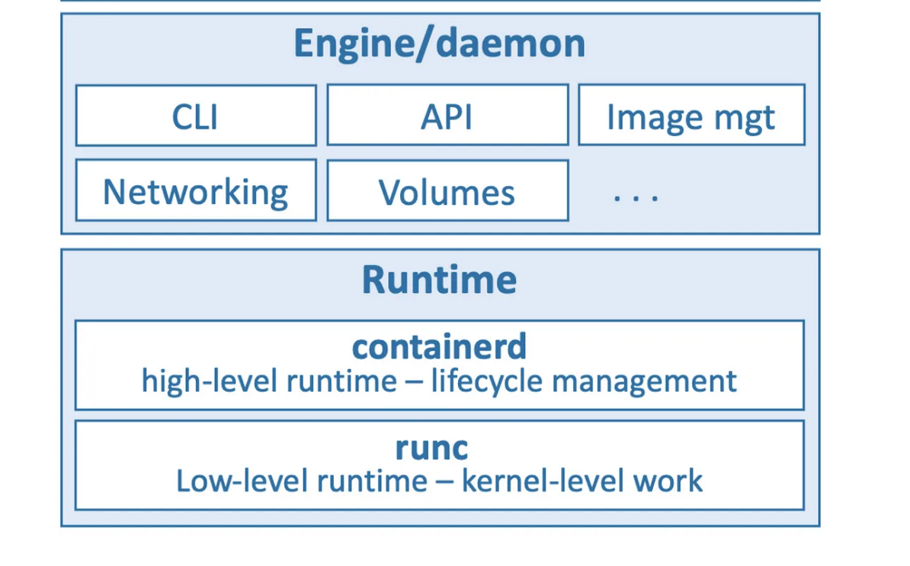
overview

Slide 3
definition
A container is a standard unit of software that packages up code and all its dependencies, so the application runs quickly and reliably from one computing environment to another.
A major difference with VMs is that containers do not require their own full-blown OS. In fact, all containers on a single host share the host’s OS. This frees up huge amounts of system resources such as CPU, RAM, and storage.

Slide 4
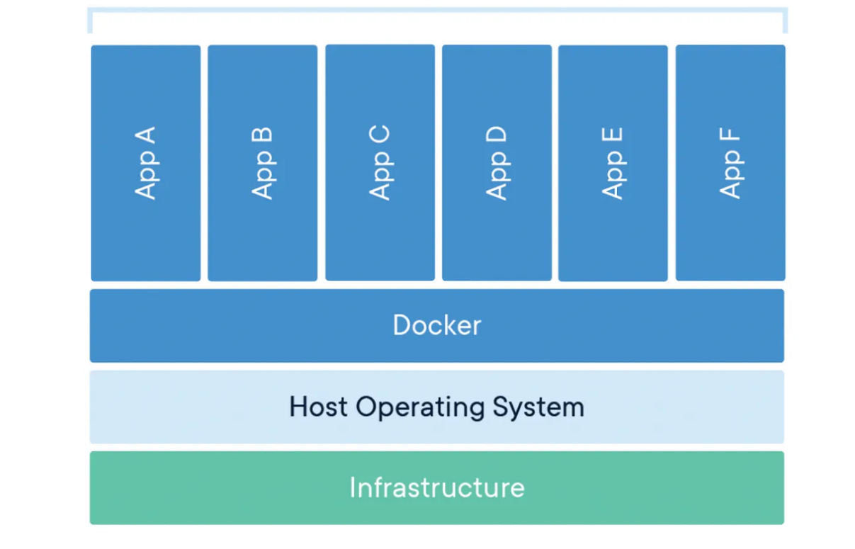
..

Slide 5
..
The runtime operates at the lowest level and is responsible for starting and stopping containers (this includes building all of the OS constructs such as namespaces and cgroups).
The low-level runtime is called runc and is the reference implementation of Open Containers Initiative (OCI) runtime-spec. Its job is to interface with the underlying OS and start and stop containers. Every container on a Docker node was created and started by an instance of runc.
The higher-level runtime is called containerd. This manages the entire container lifecycle including pulling images and managing runc instances.

Slide 6
..
A typical Docker installation has a single long-running containerd process instructing runc to start and stop containers. runc is never a long-running process and exits as soon as a container is started.
The Docker daemon (dockerd) sits above containerd and performs higher-level tasks such as exposing the Docker API, managing images, managing volumes, managing networks, and more… A major job of the Docker daemon is to provide an easy-to-use standard interface that abstracts the lower levels.

Slide 7
What happens when you run Docker CLI commands
When you install Docker, you get two major components:
The Docker client
The Docker engine (sometimes called the “Docker daemon”)
The engine implements the runtime, API and everything else required to run containers. In a default Linux installation, the client talks to the daemon via a local IPC/Unix socket at /var/run/docker.sock.

Slide 8
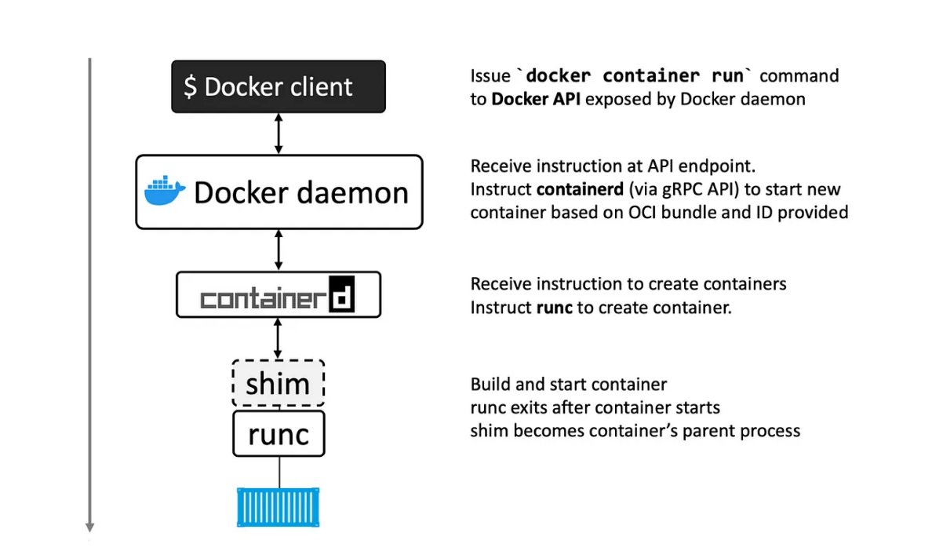
..

Slide 9
..
The Docker client converts them into the appropriate API payload and POSTs them to the API endpoint exposed by the Docker daemon. The API is implemented in the daemon and can be exposed over a local socket (which is mentioned above for both Linux and Windows)or the network.
Once the daemon receives the command to create a new container, it makes a call to containerd. Remember that the daemon no-longer contains any code to create containers! The daemon communicates with containerd via a CRUD-style API over gRPC.

Slide 10
Despite its name, containerd cannot actually create containers. It uses runc to do that. It converts the required Docker image into an OCI bundle and tells runs to use this to create a new container.
runc interfaces with the OS kernel to pull together all of the constructs necessary to create a container (namespaces, cgroups etc.). The container process is started as a child-process of runc, and as soon as it starts, runc will exit.

Slide 11
shim
The shim acts as a middle layer between the container and containerd. It keeps the container running even after runc exits. This allows containerd to manage containers without being tightly coupled to them, enabling features like:
Daemonless containers: Containers keep running even if containerd crashes or restarts.
Efficient resource usage: We don’t need hundreds of runc processes running for each container.
Better lifecycle management: The shim helps with logging, reattaching to running containers, and cleaning up when a container stops.
In short, the shim ensures that once a container is started, it keeps running smoothly without depending on runc or containerd staying active.

